Slide 1
Sloan Digital Sky Survey & Pan-STARRS
--- Examples of Big Data
Wen-Ping Chen
Institute of Astronomy
National Central University
TAIWAN
2015 Big Data Astronomy and Application Summer Boot Camp 7 to 9 September 2015 @ NCU/IA

Slide 2
Big Data
“Big data is like teenage sex: everyone talks about it, nobody really knows how to do it, everyone thinks everyone else is doing it, so everyone claims they are doing it.”
--- Dan Ariely
"Big data” is a broad term for data sets so large or complex that traditional data processing applications are inadequate.
--- Wikipedia “big data”

Slide 6
Astronomical Sky Surveys
Survey = No specific target = Numerous targets for different scientific purposes
Photometry, imaging, spectroscopy, polarimetry, (temporal)
A survey often leads to the production of catalogs (stars, galaxies, emission nebulae), sometimes of special interests (binaries, variables, merging galaxies)
A survey leads to discovery of new kinds of phenomena or objects, with which follow-up studies by sophisticated instruments are justified.

Slide 7
Decadal Surveys in the USA
To prioritize projects in the astronomy community
1970s (1972): VLA, (HST)
1980s (1982): VLBA
1990s (1991): Great Observatories
2000s (2001): JWST, ALMA
2010s (Astro2010): Time domain phenomena (LSST), WFIRST, gravitational waves …

Slide 8
Palomar Observatory Sky Survey (POSS)
From 1949, Palomar Observatory 48 inch Schimidt Telescope
→ mapping of the entire visible sky
Funded by National Geographic Society and Caltech
Using 14 inch glass plates, each of 6 deg on a side on the sky; every patch of sky taken by blue (Kodak 103a-O) and red (Kodak 103a-E) sensitive emulsion
1958 completed covering north of −30 deg latitude; limiting 22 mag
Followed by survey in the south; second generation
All plates digitized by various institutes, e.g., Digitized Sky Survey (DSS)

Slide 9
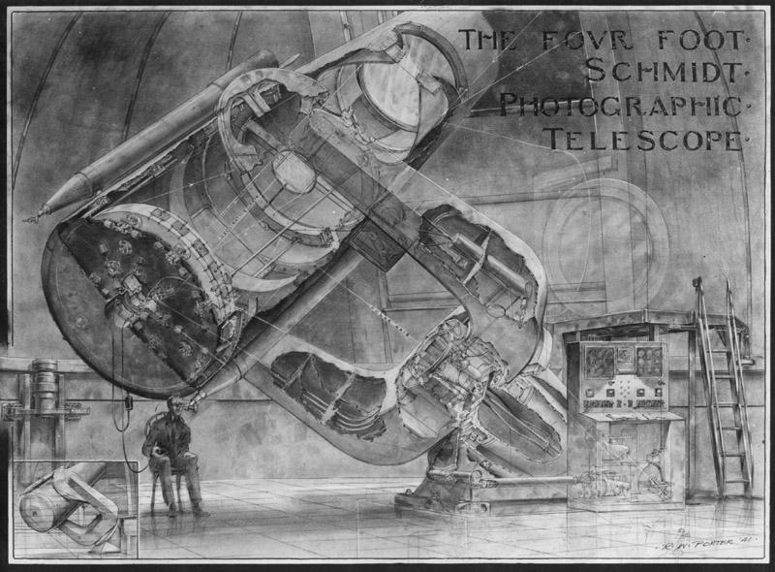

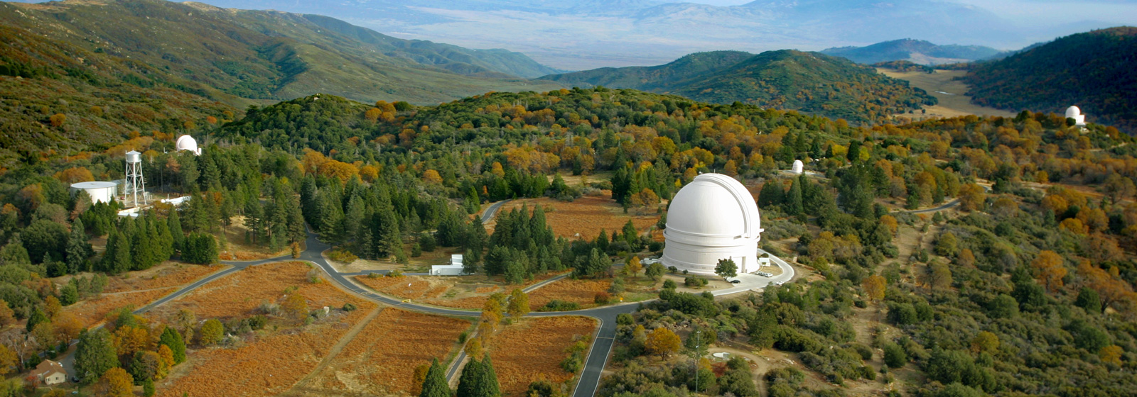

Slide 10
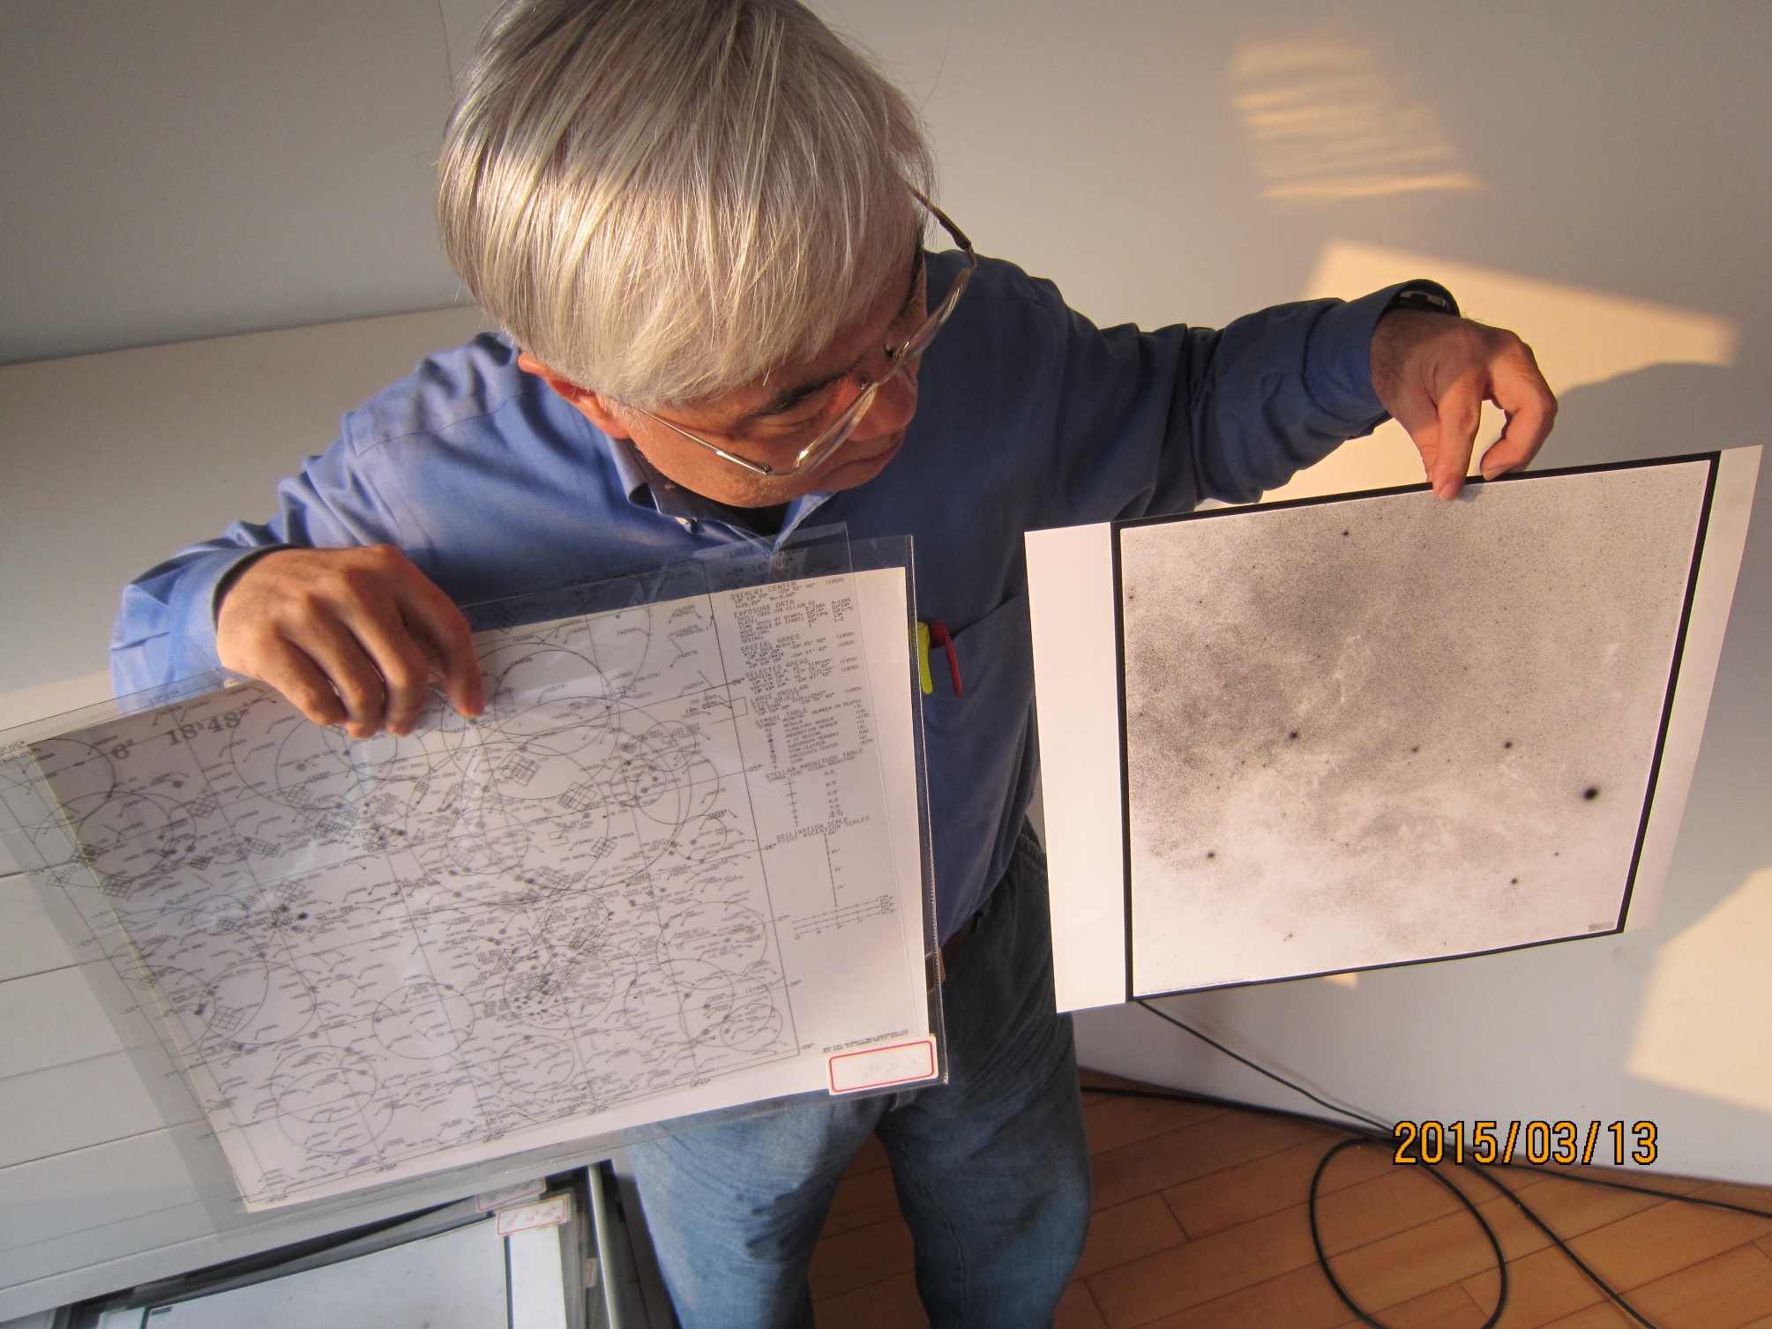

Slide 11
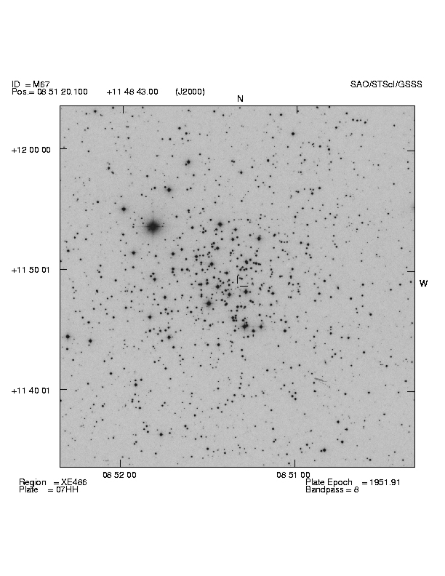
Plate image with overlaid information.
Here M67 is shown with the image taken from the POSS, FOV=30’.

Slide 12
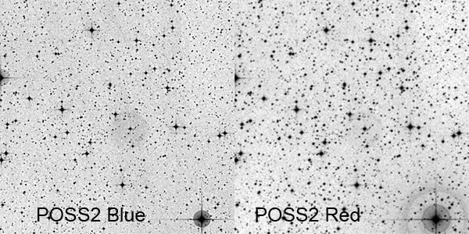
http://www.astrodonimaging.com/gallery/display.cfm?imgID=279

Slide 13
https://archive.stsci.edu/cgi-bin/dss_form

Slide 14
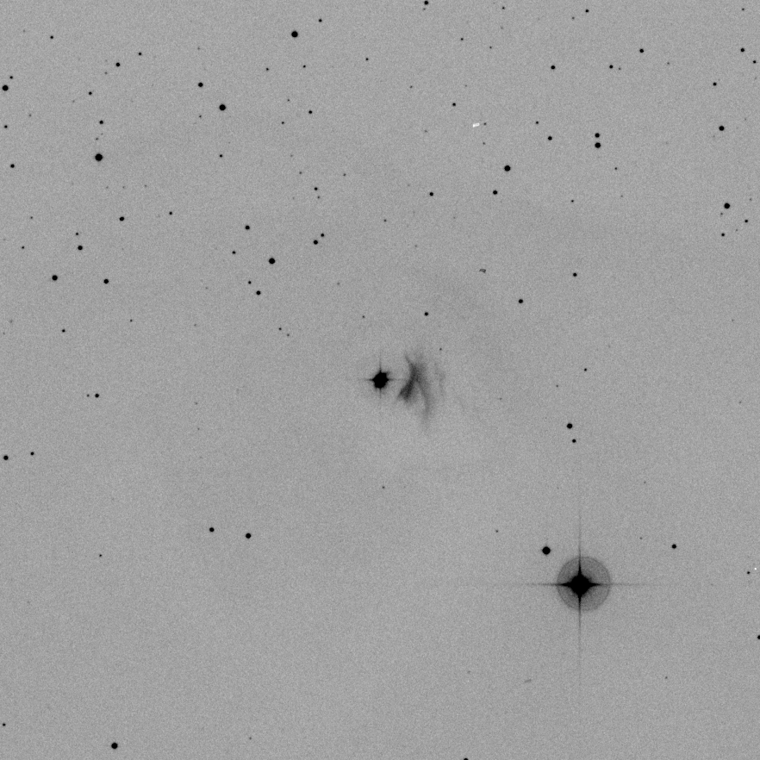
T Tauri
(coordinates resolved by Simbad by MAST)
POSS 2 blue
FOV 30’
FITS
ds9 → png image
What is Simbad?
What information can be found for T Tau?

Slide 15
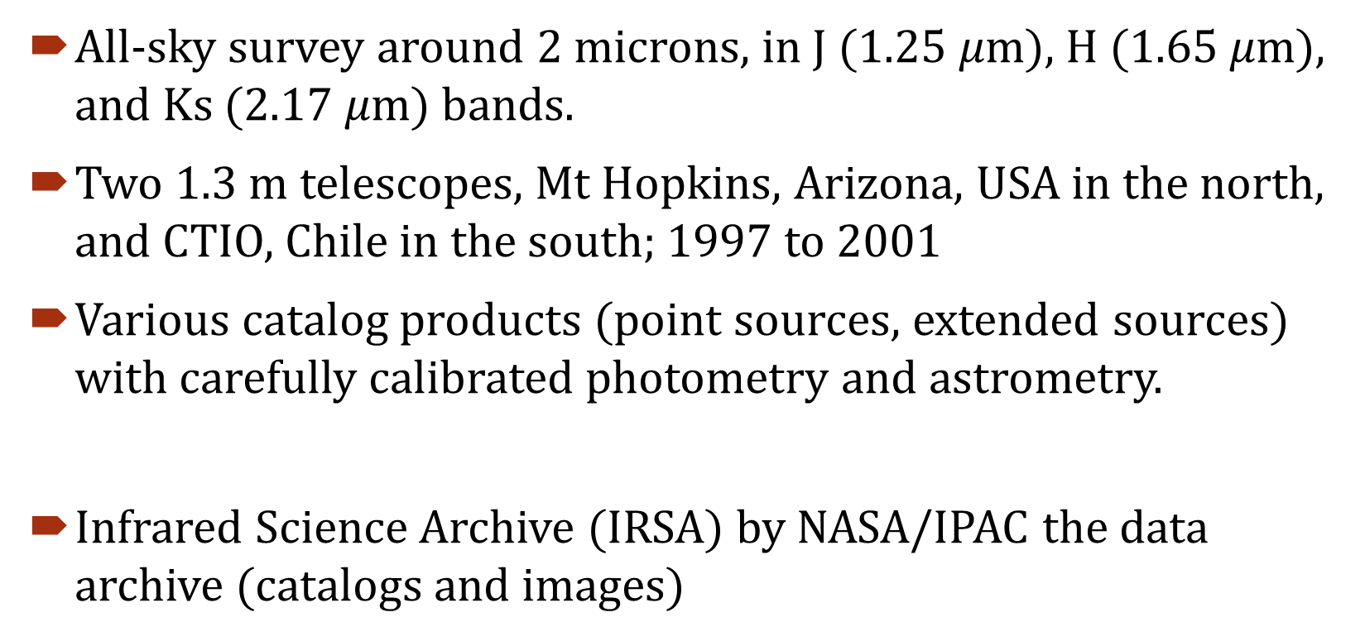
Two Micron All Sky Survey (2MASS)
All-sky survey around 2 microns, in J (1.25 $μm$), H (1.65 $μm$), and Ks (2.17 $μm$) bands.
Two 1.3 m telescopes, Mt Hopkins, Arizona, USA in the north, and CTIO, Chile in the south; 1997 to 2001
Various catalog products (point sources, extended sources) with carefully calibrated photometry and astrometry.
Infrared Science Archive (IRSA) by NASA/IPAC the data archive (catalogs and images)
http://www.ipac.caltech.edu/2mass /

Slide 17

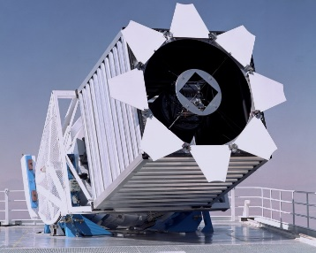
Sloan Digital Sky Survey (SDSS)
Multi-color imaging and spectroscopic redshift survey
Apache Point Observatory 2.5 m telescope in New Mexico, USA; named after Alfred P. Sloan Foundation.
SDSS I (2000-2005)
SDSS II (2005-2008)
  Sloan Legacy Survey
  Sloan Extension for Galactic Understanding and Exploration (SEGUE)
  Sloan Supernova Survey
http://www.sdss.org/

Slide 18
SDSS III (2008-2014)
  APO Galactic Evolution Experiment (APOGEE)
  Baryon Oscillation Spectroscopic Survey (BOSS)
  Multi-object APO Radial Velocity Exoplanet Large-area Survey (MARVELS)
  SEGUE-2
DR12 (2014 July) (images, O/IR spectra, catalog data)
latest

Slide 19
SDSS IV (2014-2020)
APO Galactic Evolution Experiment (APOGEE-2)
extended Baryon Oscillation Spectroscopic Survey (eBOSS)
Mapping Nearby Galaxies at APO (MaNGA)
ongoing

Slide 20
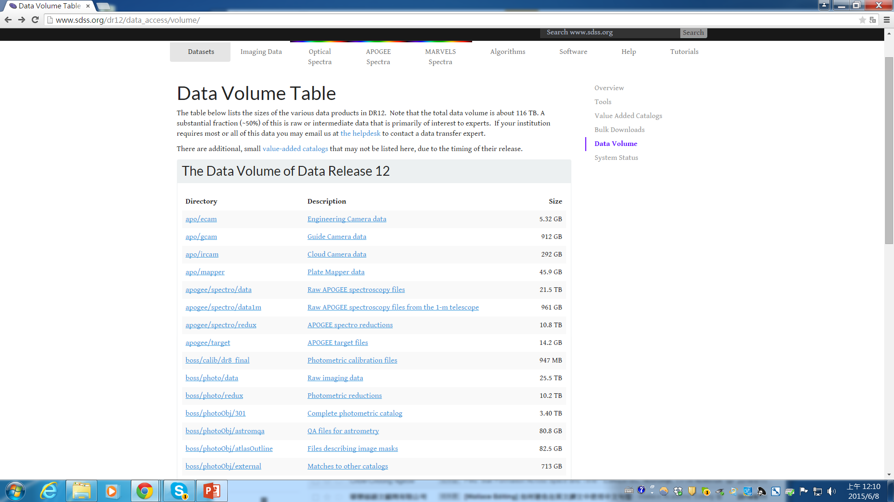
Total data volume = 116 TB, with 50% being raw and intermediate data

Slide 21
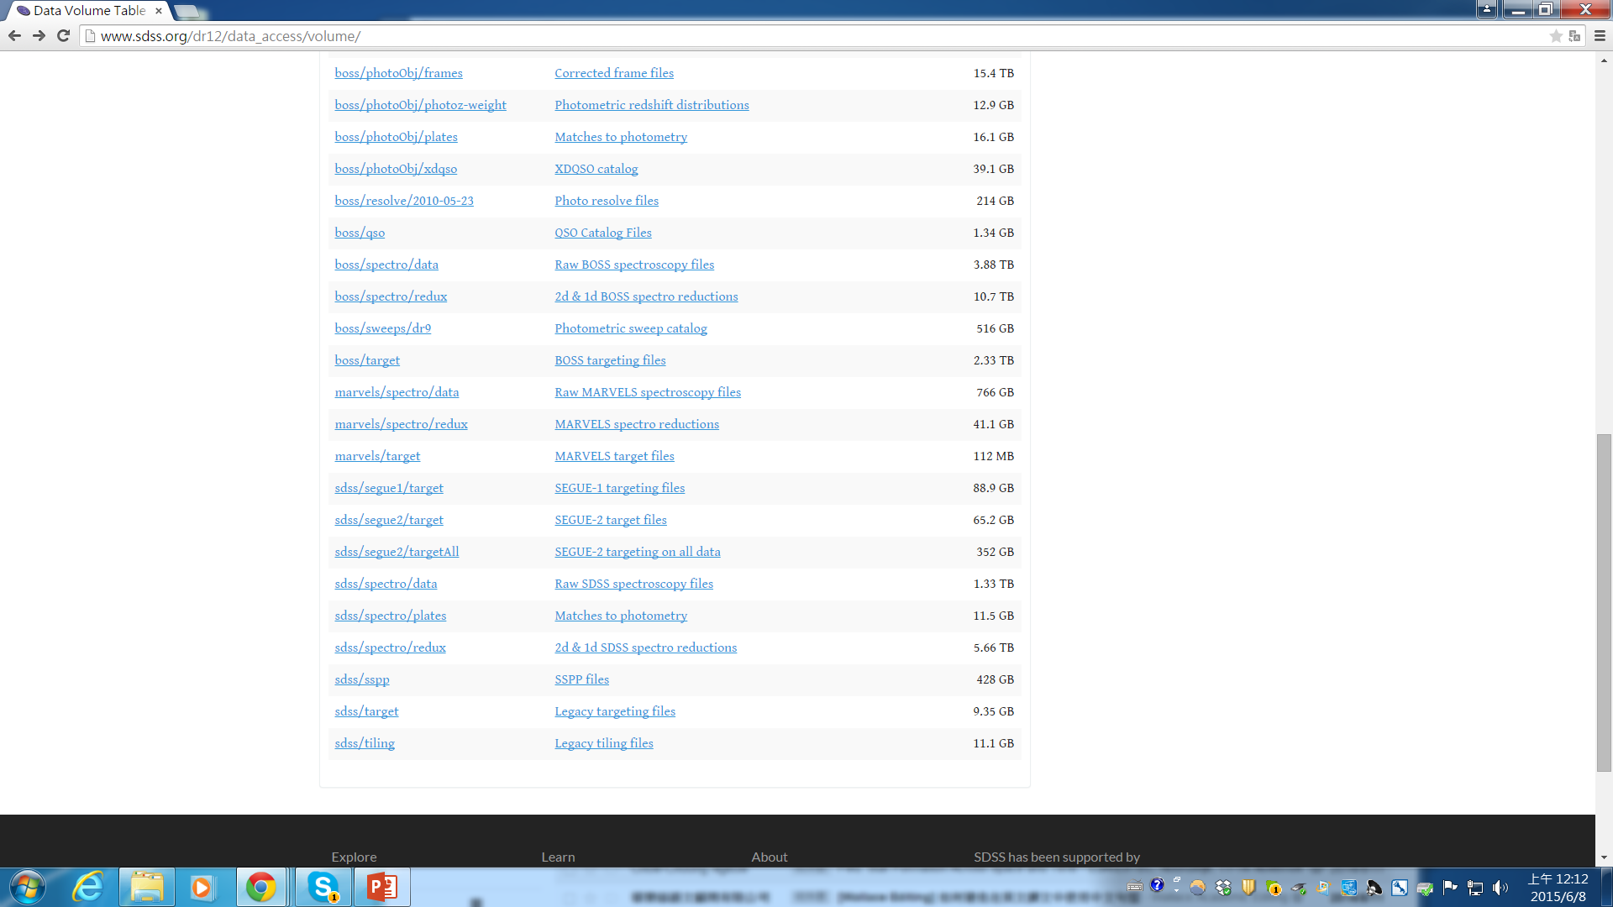

Slide 22
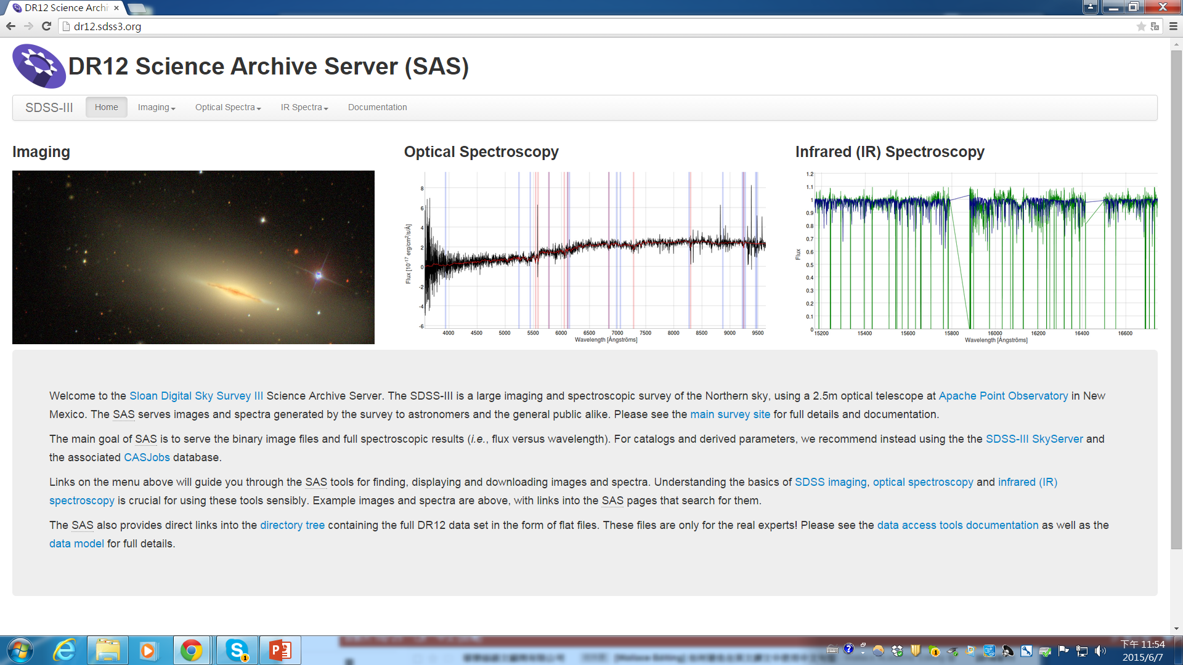

Slide 23
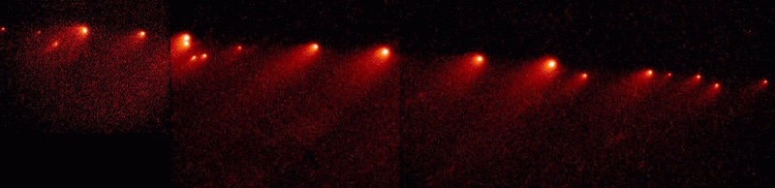
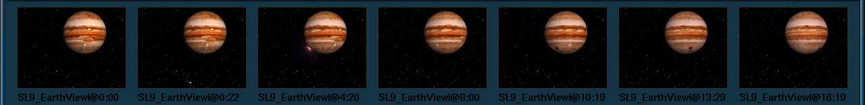
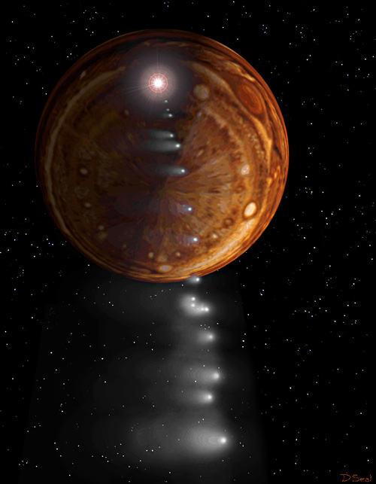
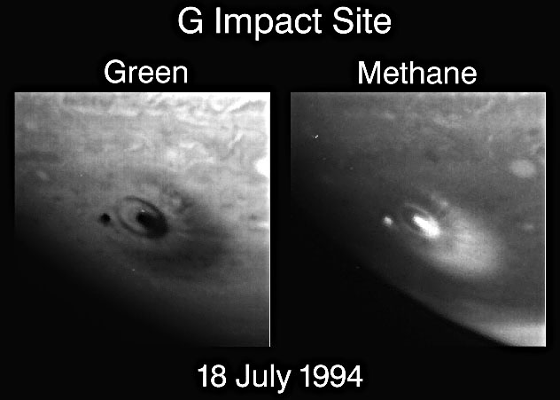
1994年夏天
彗星撞木星

Slide 24
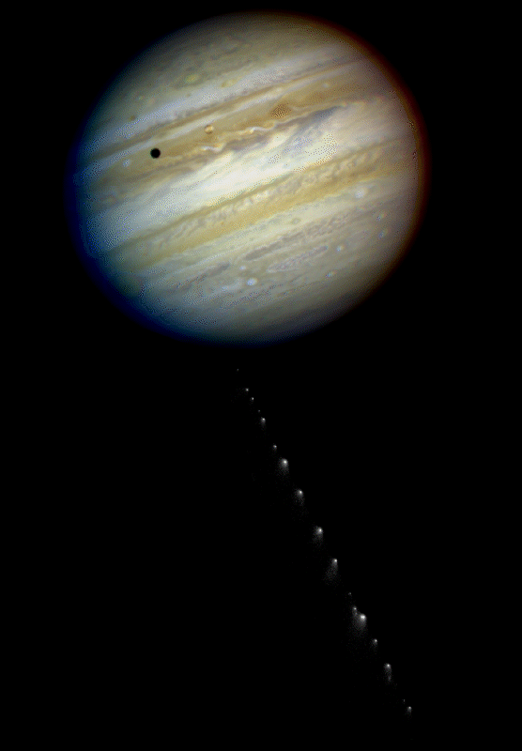
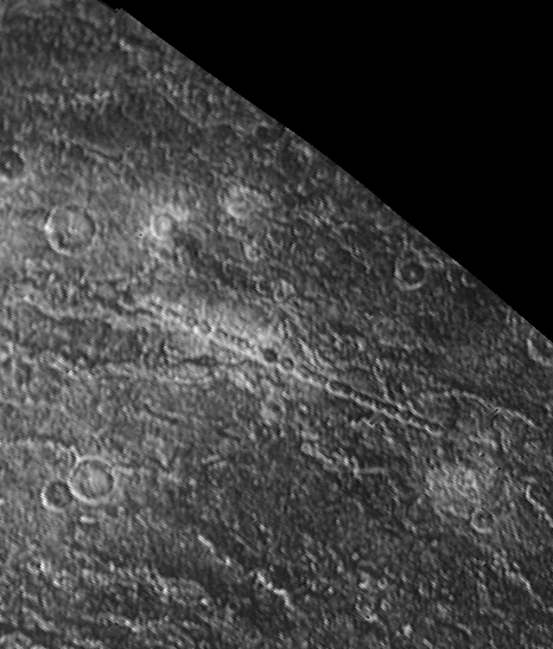
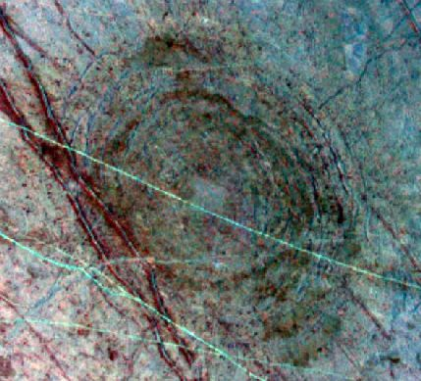
木星衛星 Callisto 表面的串狀隕石坑
木星衛星 Europa
表面的
隕石坑

Slide 25
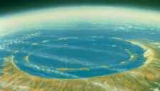
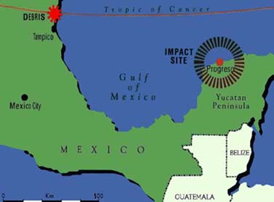
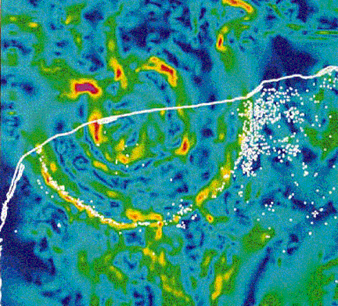

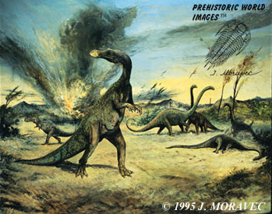
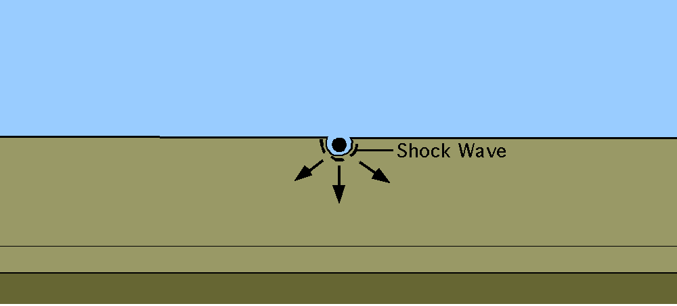
6500萬年前的天體撞擊
Chicxulub Crator
D> 180 km
Bolide D~10 km

Slide 26
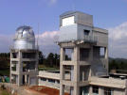

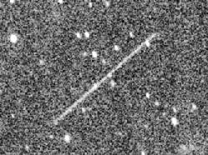
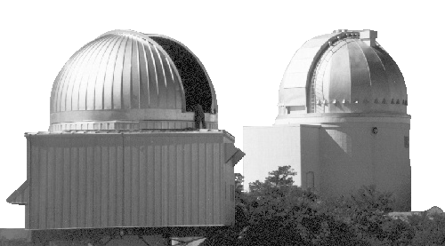
日本 Space Guard 計畫
美國 Space Watch 計畫

Slide 27


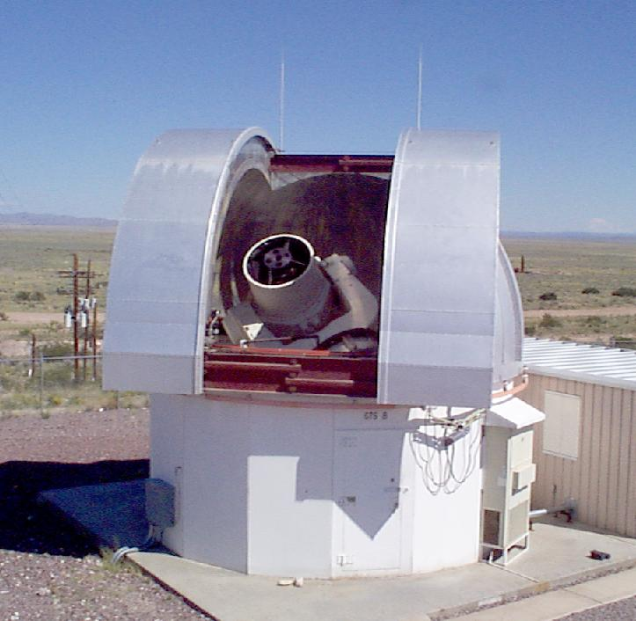


Near –Earth Asteroid Tracking (NEAT)
兩座1.2公尺口徑望遠鏡搜尋「近地小行星」
Lincoln Near Earth Asteroid Research (LINEAR)

Slide 28
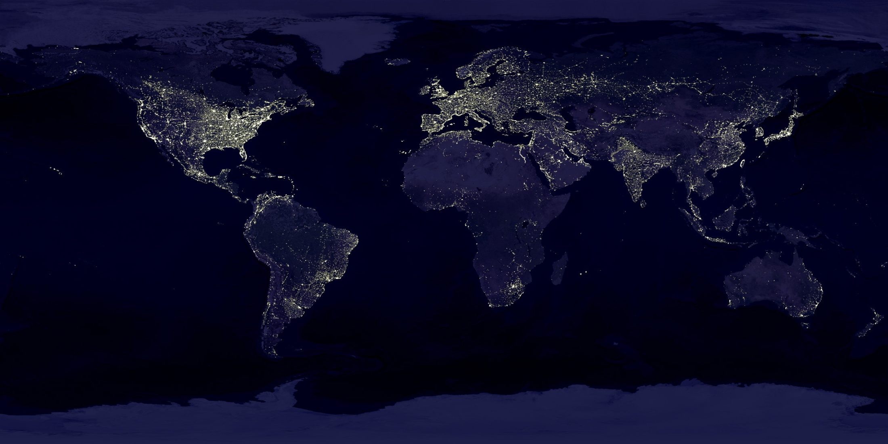

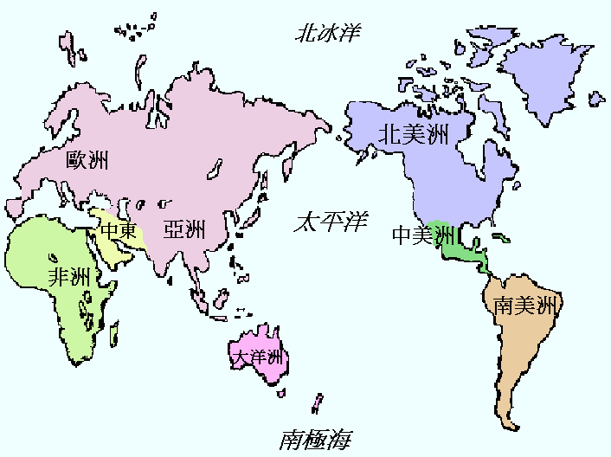
我國參與的相關研究
台灣的地理特性
西太平洋
低緯度
高山多
適合研究時變現象

Slide 29
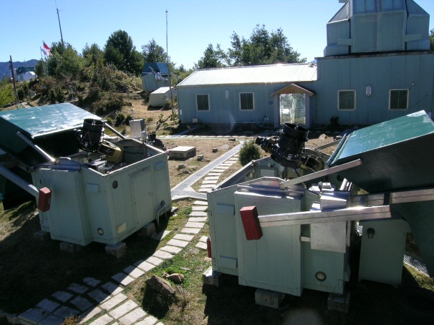
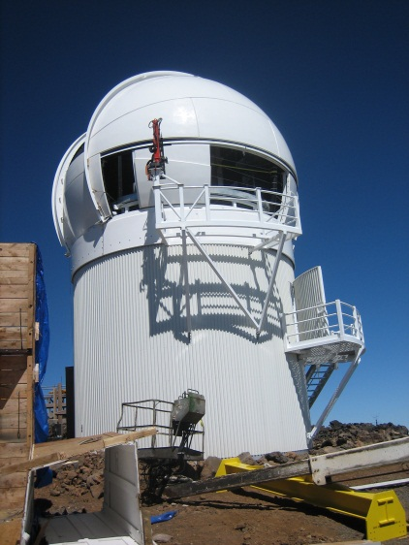
位於台灣
進行中
TAOS 中美掩星計畫
Taiwanese-American Occultation Survey
Pan-STARRS 泛星計畫
Panoramic Survey Telescope
And
Rapid Response System
位於夏威夷

Slide 30

LULIN OBSERVATORY
鹿林天文台
海拔 2862m; 在大氣逆溫層以上
從玉山 (～4000 m) 眺望鹿林山

Slide 31
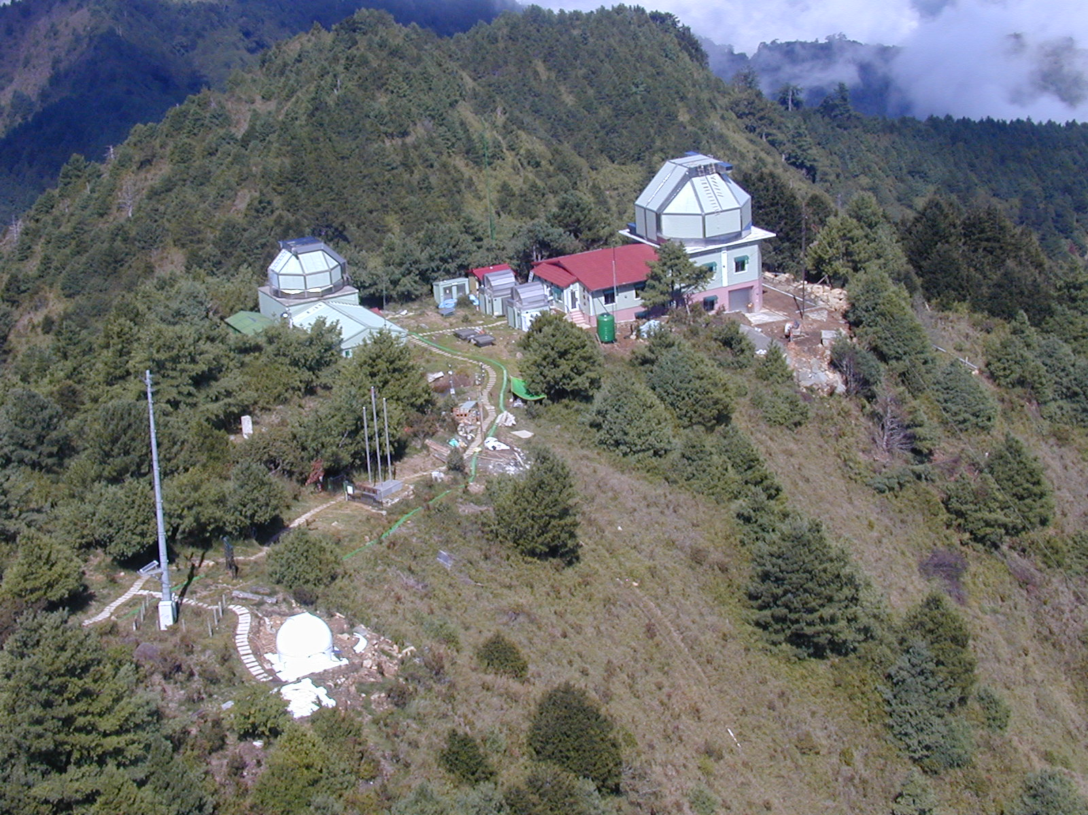
鹿林天文台

Slide 32
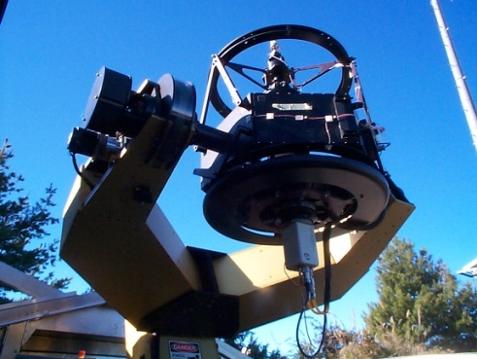
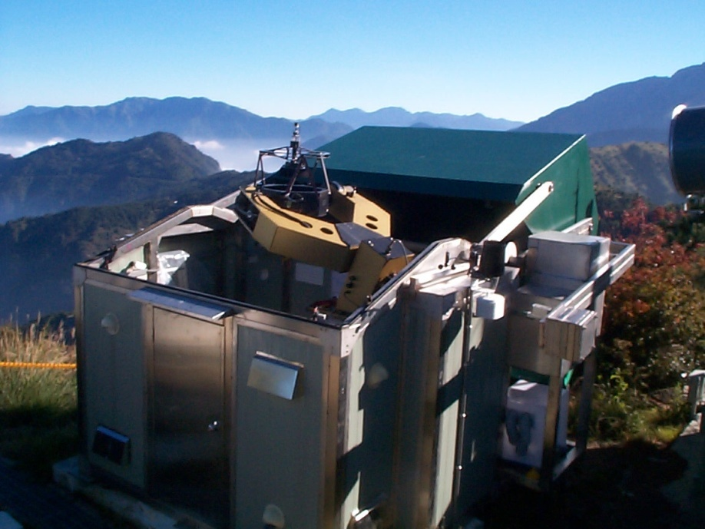
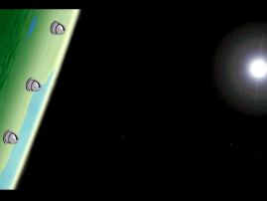
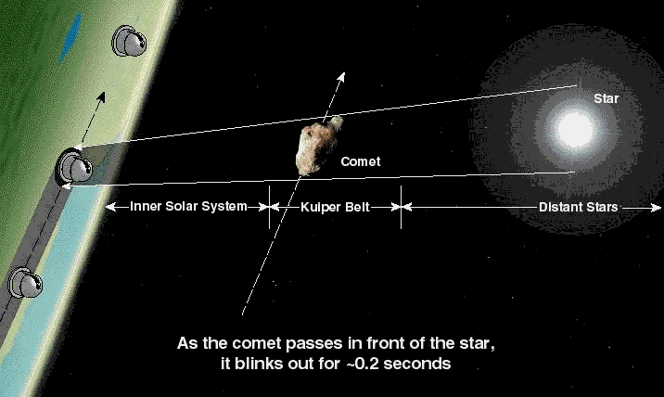
中美掩星計畫 TAOS (Taiwanese-American Occultation Survey) 由我國、美國與韓國合作，利用太陽系小天體遮掩背影恆星的技術，統計「看不見」的小天體數量。從2005年起觀測，至今已經收集超過數十億筆光度資料，計畫極受國際學界矚目。
遙遠彗星核反射陽光微弱，能藉由「掩星」技術偵測它們的存在
鹿林山
中美掩星計畫

Slide 33
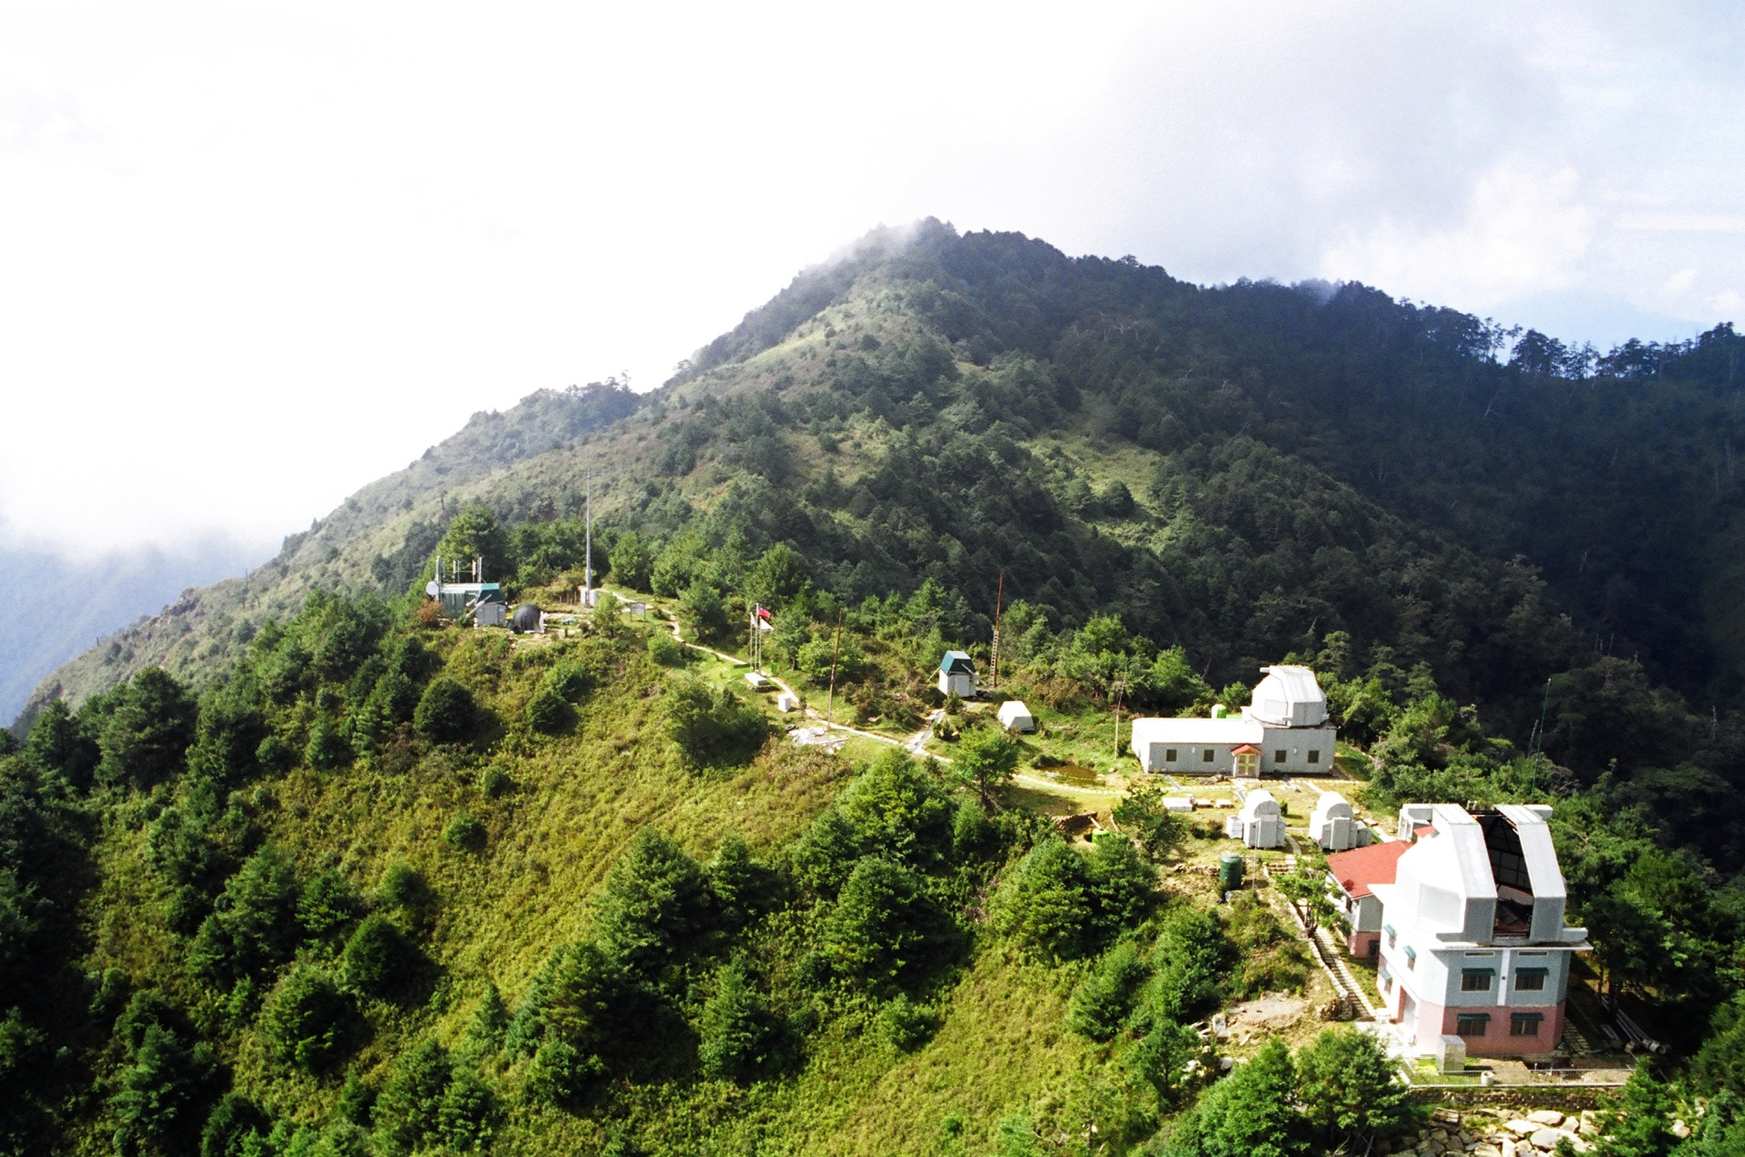


TAOS 望遠鏡陣列
鹿林天文台2862 m
TAOS 是目前世界上唯一系統性清點太陽系外圍 直徑 1-2 公里天體的計畫
以獨特相機讀取技術測量恆星快速 (5 Hz) 亮度變化
C
B
D
A
每晚資料量～100 GB

Slide 34
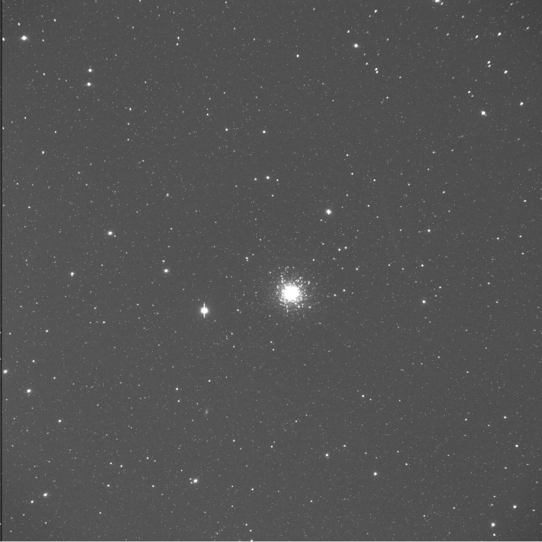
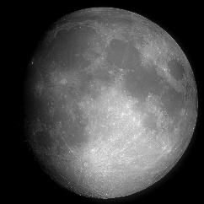

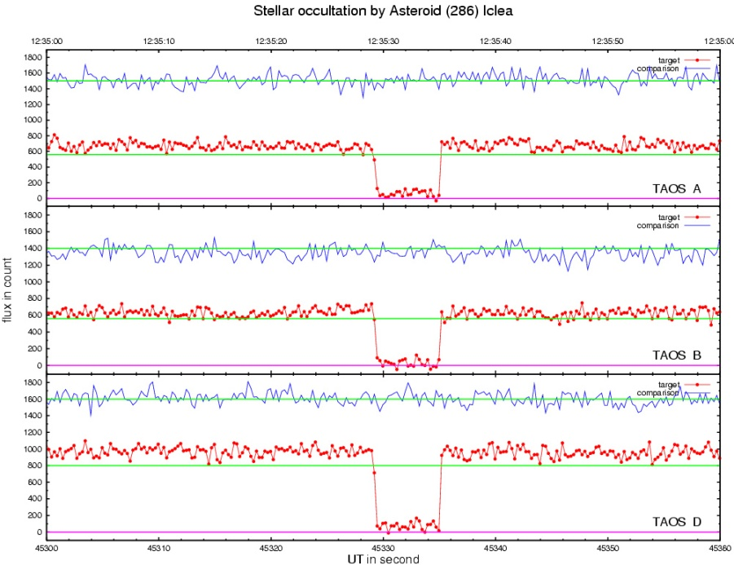


TAOS 超廣角望遠鏡
0.5º
2006 Feb 06 三座 TAOS 望遠鏡觀測到預測會發生的小行星 (286) Iclea (m_{V} ~ 14.0 mag, D~ 97 km) 掩星TYC 076200961 (m_{V} ~ 11.83) 事件
1.7º
到目前為止沒有偵測到任何掩星事件，表示太陽系外圍小天體數量不如某些理論所主張那麼多

Slide 35


George E. Brown, Jr. Near-Earth Object Survey Act (2005 由美國布希總統簽署) ──
NASA 在生效日一年內提出
（1） 分析清點 NEOs 的方法；
（2）建議方案並估計預算；
（3）改道（減少損失）方案
目標：在 15 年內對於直徑大於140公尺（可造成區域性災難），而近日點小於1.3 AU 的 NEOs，予以偵測 (detect)、追蹤 (track)、建檔 (catalog)，與述性 (characterization)，達90％完整
美國加州民主黨
眾議員 (1920-
1999)，畢生致力
推廣科學與科學政策擬定，身後仍有多項實驗室、圖書館及法案以其名之

Slide 36

Panoramic Survey Telescope
And
Rapid Response System
泛星
To patrol the entire observable sky (3π) several times a month
PS1 system: in Haleakala, Hawaii, D=1.8 m, 1.4 Gpix camera with OTA CCD detectors (= 40 cm square focal plane) ➔ 0.26”/pix, 7 deg² FOV
Detection of moving, transient, and variable celestial objects
down to very faint limits; very deep cumulative sky images
PS1 surveys from 2010 May to 2014 March
Fully calibrated data released in 2015 via STScI server
Now PS1 + PS2 funded by NASA as an NEO machine
A forerunner of time-domain astronomy; preluding LSST

Slide 37
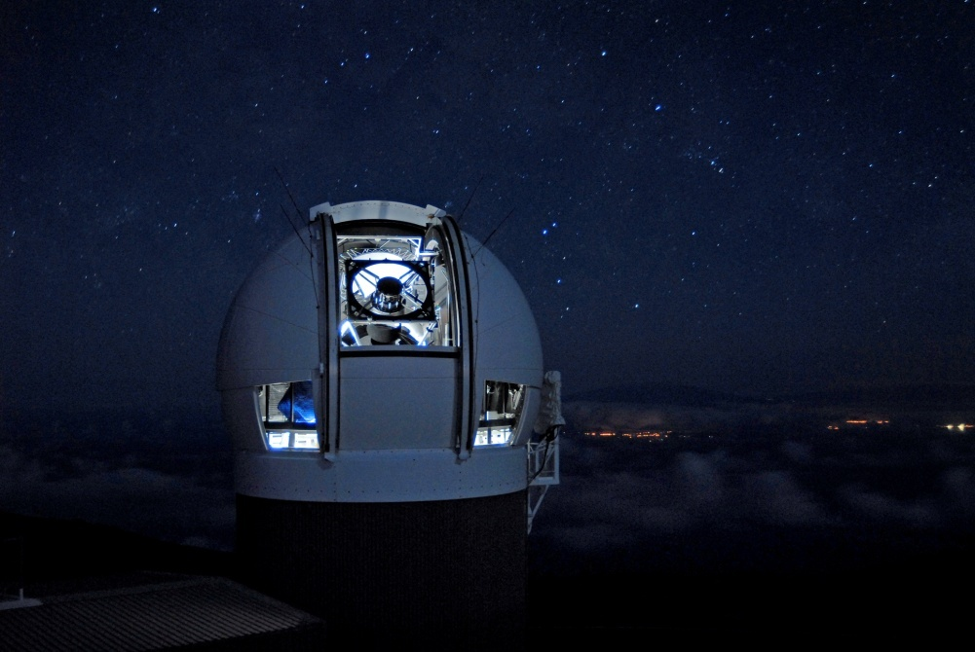
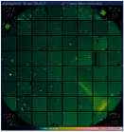
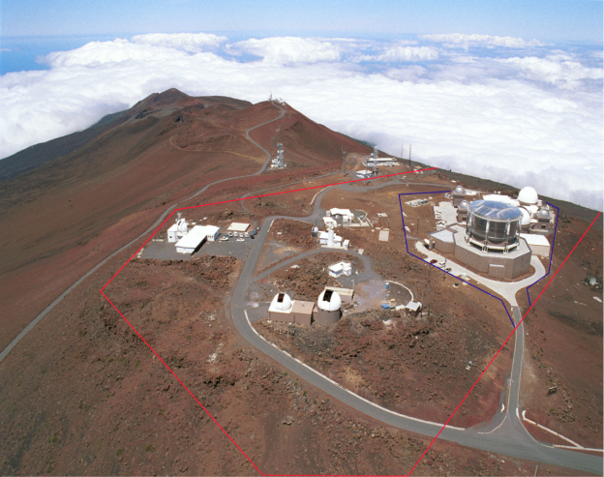
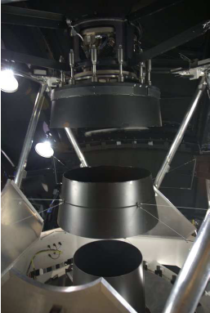
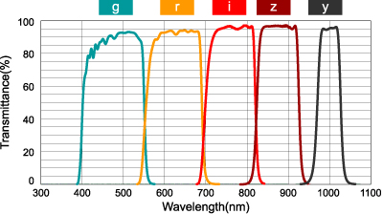
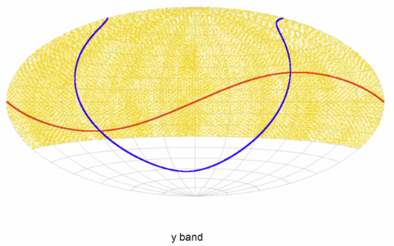
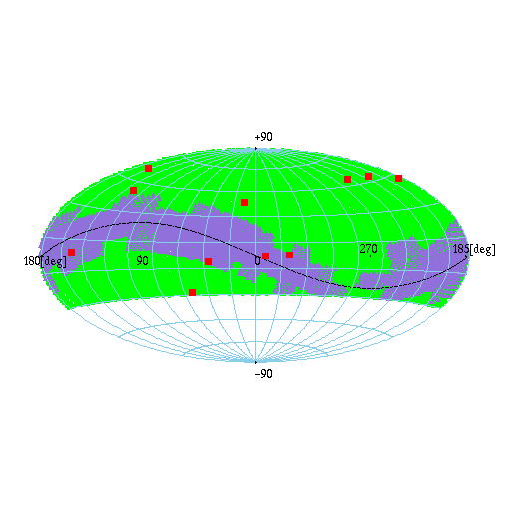
PS1– Haleakala, Maui
High-angular resolution and wide-field imaging + high cadence

Slide 38
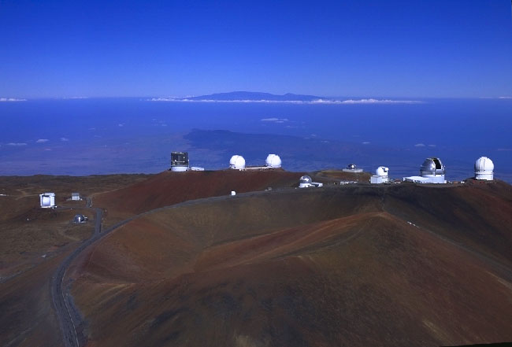

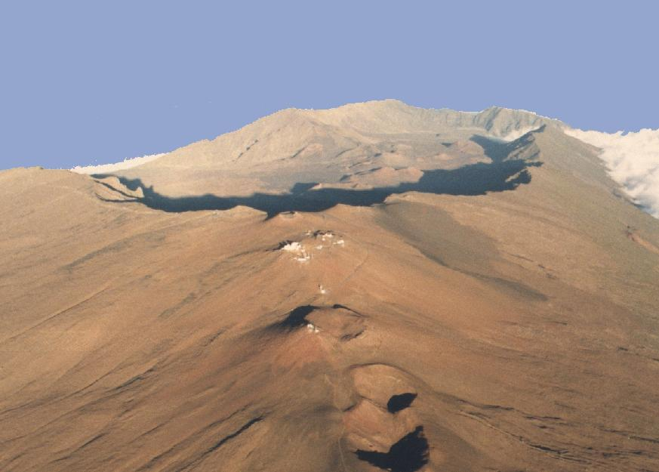

PS4– Mauna Kea, Hawaii
Hawaii, USA
PS1– Haleakala, Maui

Slide 39
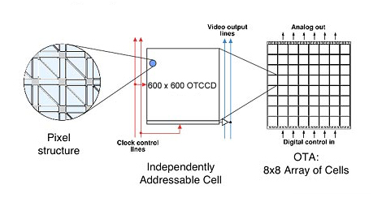






Detector Technology
Independently addressable orthogonal transfer CCDs (cells)
Reducing cost by increasing yield
Fast readout: Gigapixels in 2 s
On-Chip guiding
Minimizing effects of bright stars
Compensating for image motion
1.4 giga pixels
Several TBs/night

Slide 40

鹿林兩米望遠鏡
泛星計畫將發現極多可疑事件，
鹿林望遠鏡將在第一時間進行
追蹤觀測 to secure the discoveries
配備最先進且具特色的偵測儀器，
成為國際上極具競爭力的望遠鏡
望遠鏡已完成
建築已經通過環境評估
預算已編列
建築執照申請中
2010/03

Slide 41






PS1 Key Projects
Inner solar system
Outer solar system
Low-mass stars, brown dwarfs and young stars
Exoplanets by stellar transit surveys
Milky Way structure and Local Group
M31
Massive stars and supernova progenitors
Cosmology with variable stars and explosive transients
Galaxies
AGNs and high redshift quasars
Cosmological lensing
Large scale structure

Slide 42

http://upload.wikimedia.org/wikipedia/commons/c/c5/Comparison_optical_telescope_primary_mirrors.svg

Slide 43


Power of a Sky Survey
$AΩ$“étendue “ (a measure of the efficiency of a sky survey telescope system)
$A$: effective collection area of
the survey telescope
$Ω$: field of view (solid angle) of
the camera
Telescope | Diameter [m] | Ω [deg²] | A’Ω [m² deg²]
CFHT/MegaCam | 3.6 | 1 | 8.0
Pan-STARRS 1 | 1.8 | 7.0 | 12.0
SDSS | 2.5 | 7.0 | 20.9
Blanco/DECam | 4.0 | 3.0 | 28.5
SUBARU/HSC | 8.2 | 1.8 | 84.4
LSST | 8.4/6.68 | 9.6 | 319
x 4 for PS4
etendue per unit cost?

Slide 44

泛星計畫產生大量極有價值的天文資料（尤其是太陽系的研究），對於「時域宇宙」將有革命性貢獻

Slide 45


革命性天文計畫
幫宇宙拍攝10年電影，研究動態天文現象
World’s largest digital camera (1.4 Gpix)
目前為止世界上最成功搜尋近地小行星的儀器
美國夏威夷島
2010/05~2014/02
PS1 多波段重複巡天
Now PS2
PS1– Haleakala, Maui
PS4– Mauna Kea, Hawaii

Slide 46


Slide 47
PS1 data release to be served (expected December 2015) by the STScI Multimission/Mikulski Archive for Space Telescopes (MAST) in Baltimore, USA
(in honor of US Congresswoman Barbara Mikulski)
Catalogs
  Simple form-feed interface
  Web services (VO-compatible interfaces) with SQL queries
Images
  Whole images or cutouts, either at FITS files or JPEG previews
  Interactive display

Slide 48


Slide 49
MAST heavily used, with > 5000 users, 1 million searches/mo, and 18 TB download/mo; currently holding ~300 TB
But PS1 data large, ~2000 TB
Images: Coadded stacks and single-epoch warps
  3-pi (30,000 square deg north of declination -30)
  Medium Deep Surveys (10 fields, 7 square deg each)
  Celestial North Pole; Ecliptic Plane; M31
  Total data volume without difference images ~1.8 PB
  Intermediate data; metadata …

Slide 50


PS1 Data on MAST
Catalogs: stack detections, single-epoch detections,
forced photometry and objects; multi-epoch detections
    total data volume ~100 TB
Current database for single epochs
For 3-Pi
  $29.4×{10}^{9}$ detections
  $5.9×{10}^{9}$ objects
  $1.4×{10}^{9}$ objects with nDetection > 1
For comparison, SDSS a few ${10}^{8}$ objects (14,000 sq deg)

Slide 51
Green … 3-pi
Red …... MD
Indigo … Sweet spots
Black: Ecliptic
Sky Coverage of all PS1 Data

Slide 52


Compare to SDSS --- sky coverage
Imaging
Spectroscopy

Slide 53

PS1/Medium Deep 1.5 years
NTNU/ASIAA Stacking
SDSS
PS1/MD
r ~ 23.0
r ~ 24.7
z ~ 21.0
z ~ 24.0

Slide 54
http://archive.stsci.edu/mug/mug_2014/mug2014_PanSTARRS.pdf

Slide 55
http://archive.stsci.edu/mug/mug_2014/mug2014_PanSTARRS.pdf

Slide 59
At MAST, PS1 will use the Hubble Source Catalog portal interface
  Multi-epoch; multi-filter data; integrated with image database
  Cutout images; interactive display
A stepping stone to the future …
  JWST (4 PT)
  WFIRST-AFTA (Astrophysics Focused Telescope Assets
  (9 PB)
  Large Synoptic Survey Telescope (LSST, 3.2 Gpix camera; 400 PT)

Slide 60




Large Synoptic Survey Telescope (LSST)
D=8.4 m atop El Pa$\tilde{n}\acute{o}$n, Chile
3.2 Gpix camera (0.2”/pix); in 6 bands (ugrizy)
FOV = 3.5 deg (Wide)
Entire sky (18,000 sq deg) every 3 days (Fast)
To start in 2022 (?) for 10 years
5 Mn images; 7 Tn sources
5 Bn galaxies (Deep)
10 x Bn time-domain events
15 TB/night (Final disk 400 PB)
http://www.lsst.org/lsst/

Slide 61
http://www.eso.org/sci/meetings/2015/eso-2020/LSST_Antilogus.pdf

Slide 63
Summary
Larger-format detectors and efficient (cyclic) observing
→ data in quantity and complexity
The “big data“ era the norm in astronomy.
A 10-m telescope not just a bigger 1-m telescope
→ A completely different set of scientific questions
to address
A PB dataset not just a scaled up TB dataset
→ IT challenges
Data mining and efficient algorithm a must.

