Slide 1
Astronomical Journal Writing
Wen Ping CHEN

Slide 5
In this course, we will learn how …
To Read
(astronomy) journal papers, news, …, anything
To Present
how to deliver (what you want to show) a talk? A poster?
To Listen
how to be an audience
To Write
a term paper, a conference proceedings paper, a journal paper

Slide 6
This is a workshop course in which you will learn about presenting your research results in a poster, a seminar, or in a journal paper.
We will review the journals in astronomy and astrophysics, and discuss the practicality of submitting a paper to these journals, first by reading some of the papers already published (the good and the bad), then by writing a short one of your own.
You will be exposed to a variety of tools to help compose an assay, and develop the skills to come up with a writing plan, starting from the paper “skeleton” and branching out to sections, subsections, paragraphs, to sentences.
This is not a language course, therefore a good command of language (English) is a prerequisite. I will lecture. But you should do much of the work by excessive reading and writing.

Slide 7
There is no point sitting in the class. You do not learn (much) by listening.
You improve by doing, that is, by writing.
Scientific writing is English writing.
If you cannot write well in your own language, you most likely cannot write well in English.
(Try to compose an email to inform others about this class.)
Nothing trumps good scientific results to write about.
Scientific writing is easier, because of the often restrict format (and language). Easier than what?
Grammatical and spelling errors, stylish glitches, vs styles (author, nationality/culture, publisher … Be a seasoned writer

Slide 8
- How to be an effective reader and an audience
- Good practices to make a presentation
- Journals in astronomy and astrophysics
- Paper structure: the writing plan
  + Title and abstract
  + Section and subsection headings
  + Introduction
  + Figures and tables
  + Conclusions

Slide 9


Available NCU/LIB eBook

Slide 11


Slide 12
The Introduction section is often difficult to write.

Slide 13
Tools of the Trade
SIMBAD (what does this word mean?)
--- http://simbad.u-strasbg.fr/simbad/
information regarding a celestial object: observations, literature
VizieR (what does this word mean?)
--- https://vizier.u-strasbg.fr/viz-bin/VizieR
published astronomical catalogues and data
ADS Abstract service
--- https://ui.adsabs.harvard.edu/
online astronomy and physics literature

Slide 17
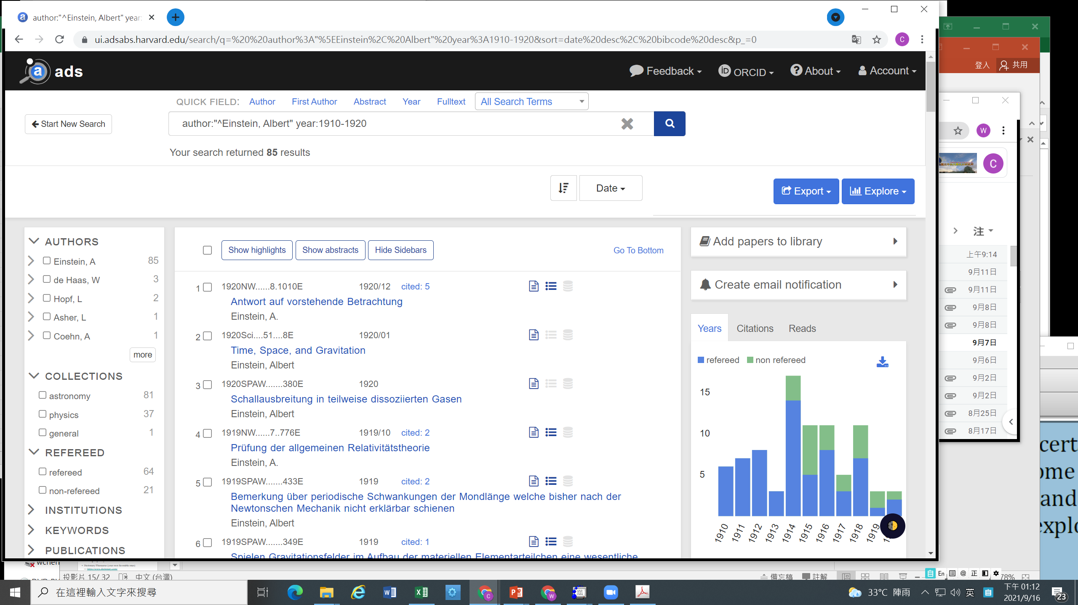

Slide 18
Tools of the Trade (cont.)
DSS (THE digitized sky survey)
--- at ESO
--- at STScI/MAST
--- at IRSA
--- at CADC
image depository
Dictionary/Thesaurus (your own favorable ones)
--- https://www.dictionary.com/
--- https://www.thesaurus.com/

Slide 19
Palomar Observatory Sky Survey (POSS)
From 1949, Palomar Observatory 48 inch Schimidt Telescope → mapping of the entire visible sky
Funded by National Geographic Society and Caltech
Using 14 inch glass plates, each of 6 deg on a side on the sky; every patch of sky taken by blue (Kodak 103a-O) and red (Kodak 103a-E) sensitive emulsion
1958 completed north of −30 deg latitude; limiting 22 mag
Followed by survey in the south; second generation
All plates digitized by various institutes, e.g., Digitized Sky Survey (DSS)

Slide 20
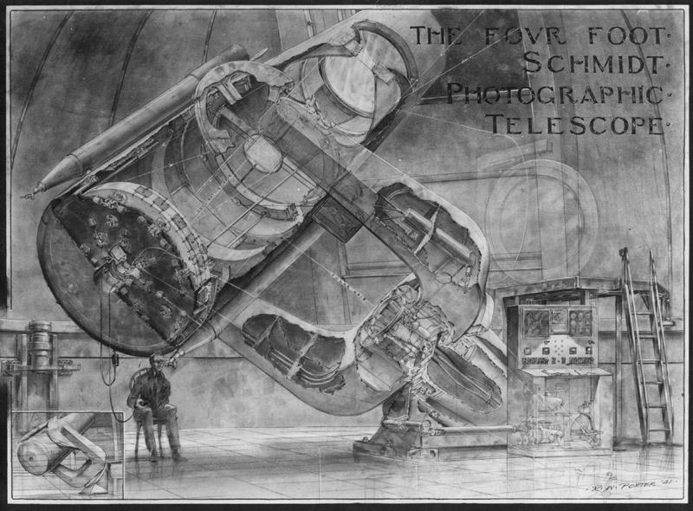

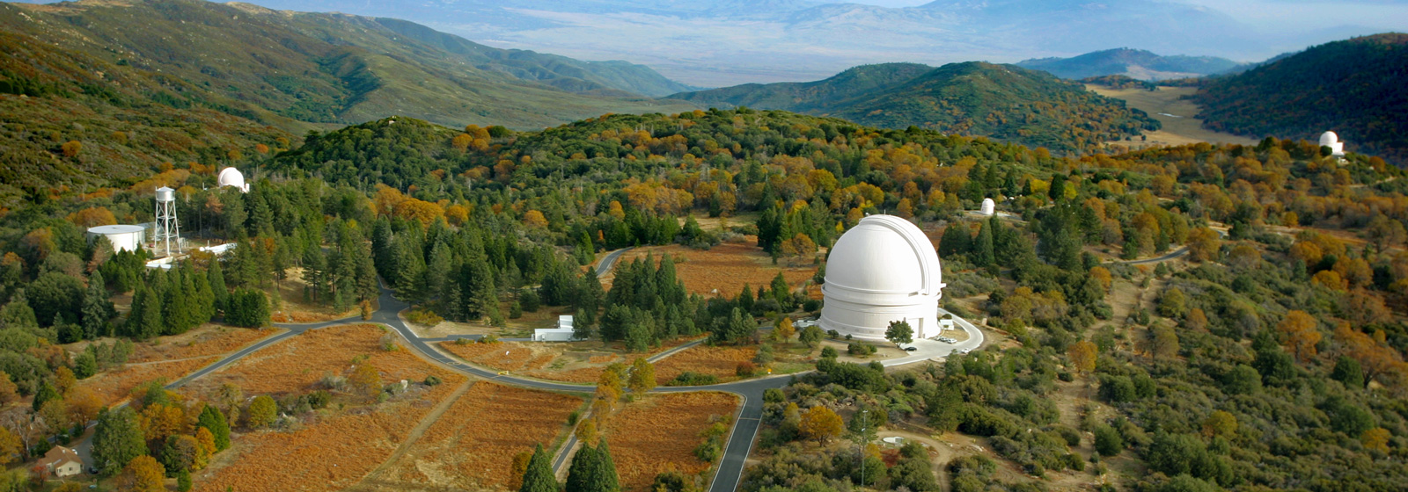

Slide 21
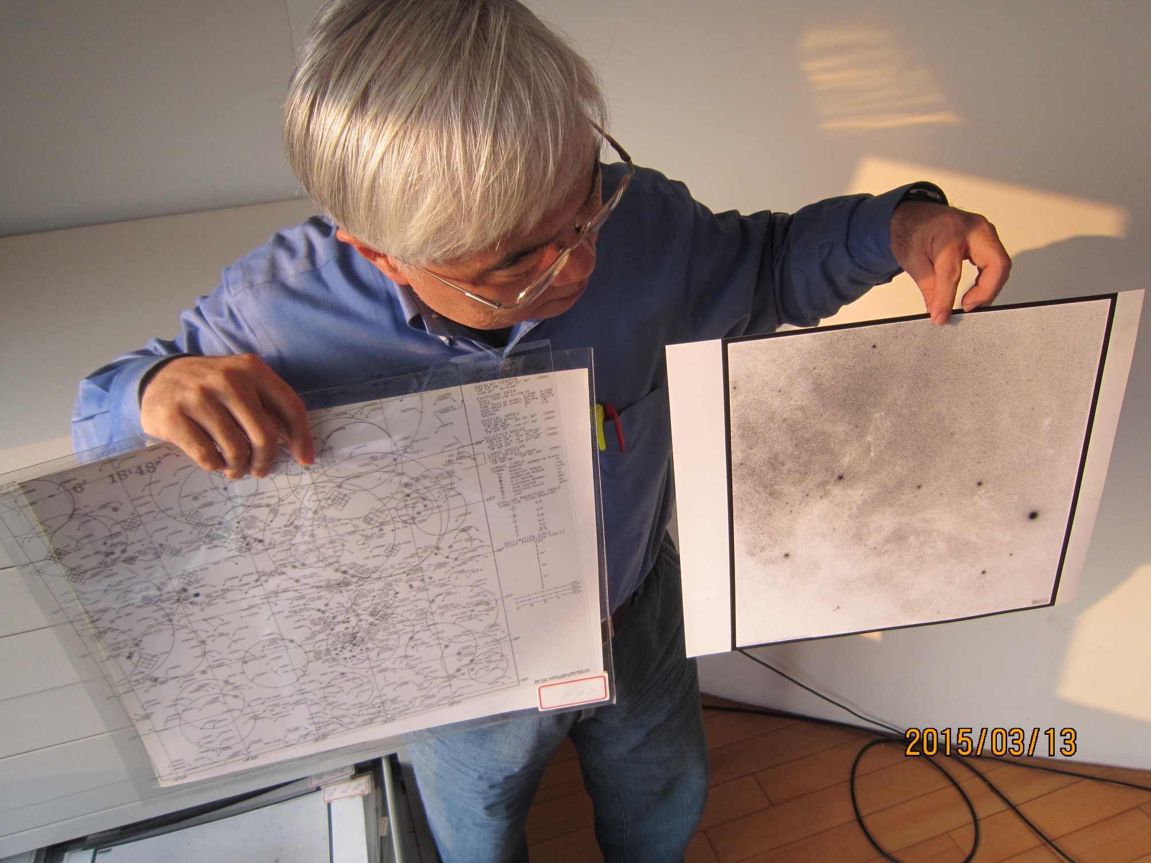

Slide 22
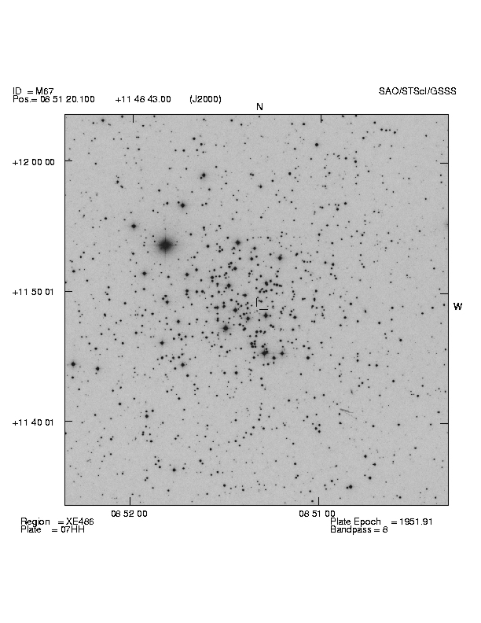
Plate image with overlaid information.
Here M67 is shown with the image taken from the POSS, FOV=30’.

Slide 23
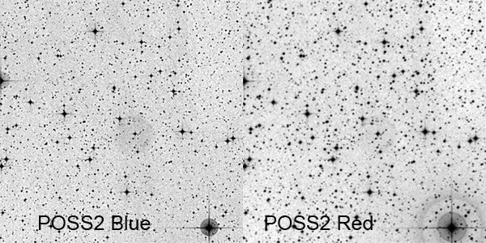
http://www.astrodonimaging.com/gallery/display.cfm?imgID=279

Slide 24
https://archive.stsci.edu/cgi-bin/dss_form

Slide 25
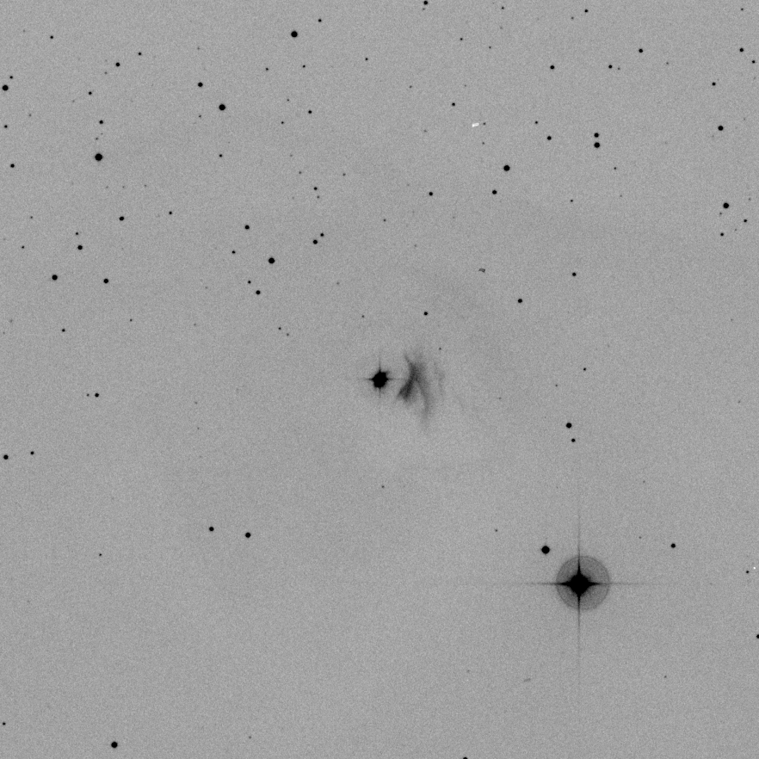
T Tauri
(coordinates resolved by Simbad by MAST)
POSS 2 blue
FOV 30’
FITS
ds9 → png image
What is SIMBAD?
What information can be found for T Tau?

Slide 26

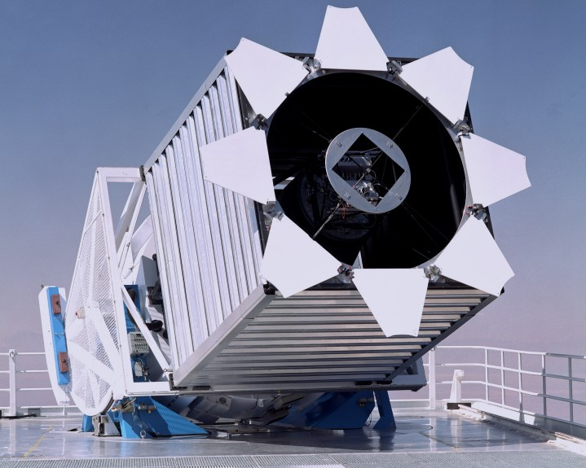
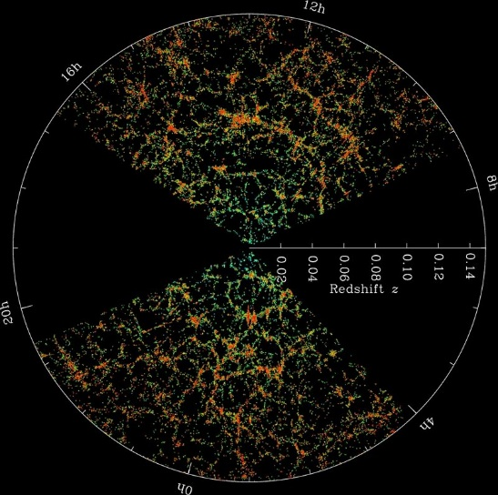
Sloan Digital Sky Survey (SDSS)
Multi-color imaging and spectroscopic redshift survey
Apache Point Observatory 2.5 m telescope in New Mexico, USA; named after Alfred P. Sloan Foundation.
SDSS I (2000-2005); II (2005-2008); III (2008-2014)
DR12 (2014 July) (images, O/IR spectra, catalog data)
SDSS IV (2014-2010)
http://www.sdss.org/

Slide 27
Elsevier: Author guideline
https://www.elsevier.com/connect/author-guidelines-and-submission-process
AAS journals: Author guide
https://journals.aas.org/author-resources/
Writing tips
Show, don’t just tell.
Use action verbs; go easy on the adjectives
Choose active voice
Quotes should sound human
Avoid clichés
Say it simply
Define technical terms
Eliminate words that do not add meaning

Slide 28
Steps to organizing your manuscript
Prepare the figures and tables.
Write the Methods.
Write up the Results.
Write the Discussion.
    Finalize the Results and Discussion before writing the introduction. This is because, if the discussion is insufficient, how can you objectively demonstrate the scientific significance of your work in the introduction?
Write a clear Conclusion.
Write a compelling Introduction.
Write the Abstract.
Compose a concise and descriptive Title.
Select Keywords for indexing.
Write the Acknowledgements.
Write up the References.
https://www.elsevier.com/connect/11-steps-to-structuring-a-science-paper-editors-will-take-seriously

Slide 29
Exercise
Write one paragraph to report the following hypothetical situation.
Who: FU Orionis (position, any other information?)
What: Brighter than the nominal literature value by 1.2 mag in V, and 0.8 mag in B; remained the same state during the rest of the observing session
When: observed September 17, 2021, UTC16:31 to 19:45, then clouded out for the night
Where: LOT, (detector?)
(No need to interpret the result.)

Slide 31
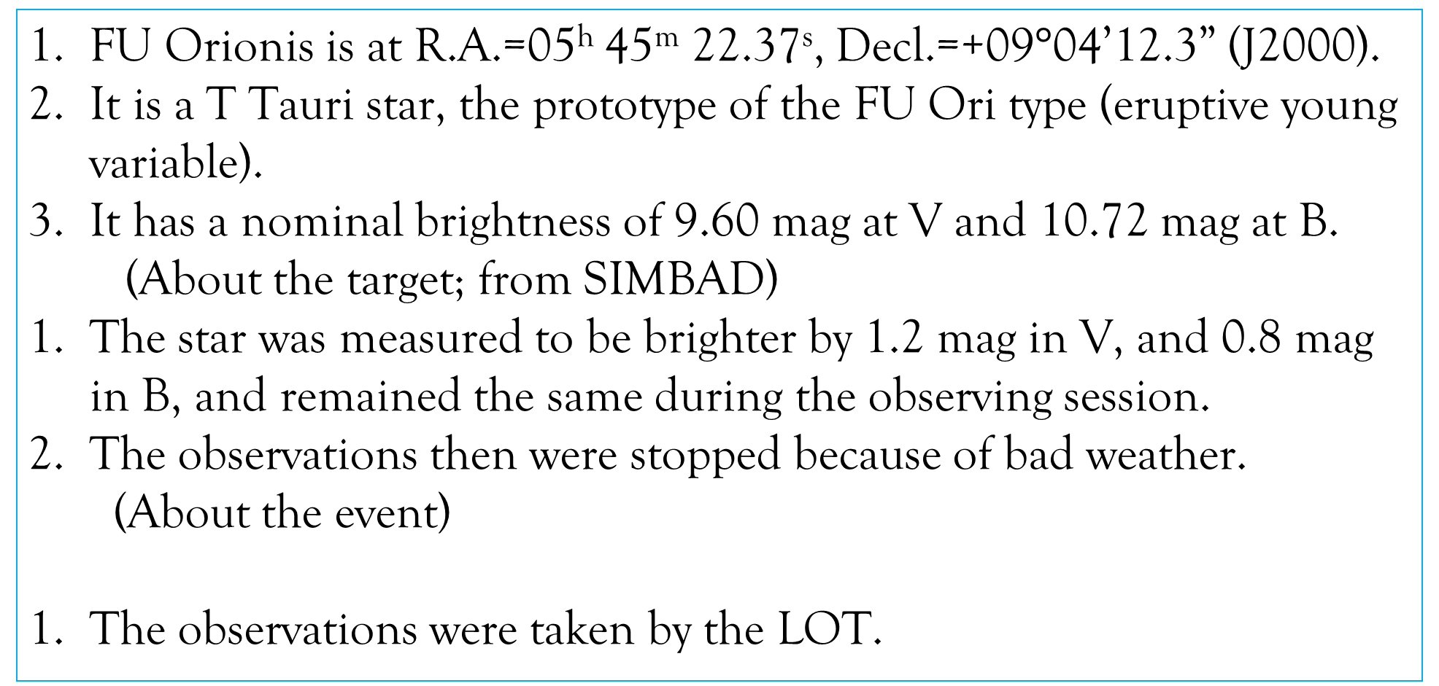
Information
FU Orionis is at R.A.=05^{h} 45^{m} 22.37^{s}, Decl.=+09$°$04’12.3” (J2000).
It is a T Tauri star, the prototype of the FU Ori type (eruptive young variable).
It has a nominal brightness of 9.60 mag at V and 10.72 mag at B.
(About the target; from SIMBAD)
The star was measured to be brighter by 1.2 mag in V, and 0.8 mag in B, and remained the same during the observing session.
The observations then were stopped because of bad weather.
(About the event)
The observations were taken by the LOT.

Slide 32
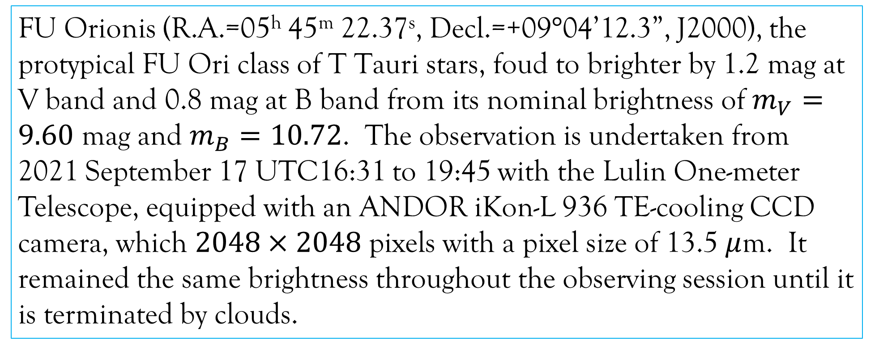
Original submission
FU Orionis (R.A.=05^{h} 45^{m} 22.37^{s}, Decl.=+09$°$04’12.3”, J2000), the protypical FU Ori class of T Tauri stars, foud to brighter by 1.2 mag at V band and 0.8 mag at B band from its nominal brightness of $m_{V}=9.60$ mag and $m_{B}=10.72$. The observation is undertaken from 2021 September 17 UTC16:31 to 19:45 with the Lulin One-meter Telescope, equipped with an ANDOR iKon-L 936 TE-cooling CCD camera, which $2048×2048$ pixels with a pixel size of 13.5 $μ$m. It remained the same brightness throughout the observing session until it is terminated by clouds.

Slide 33
Corrected version

Slide 34
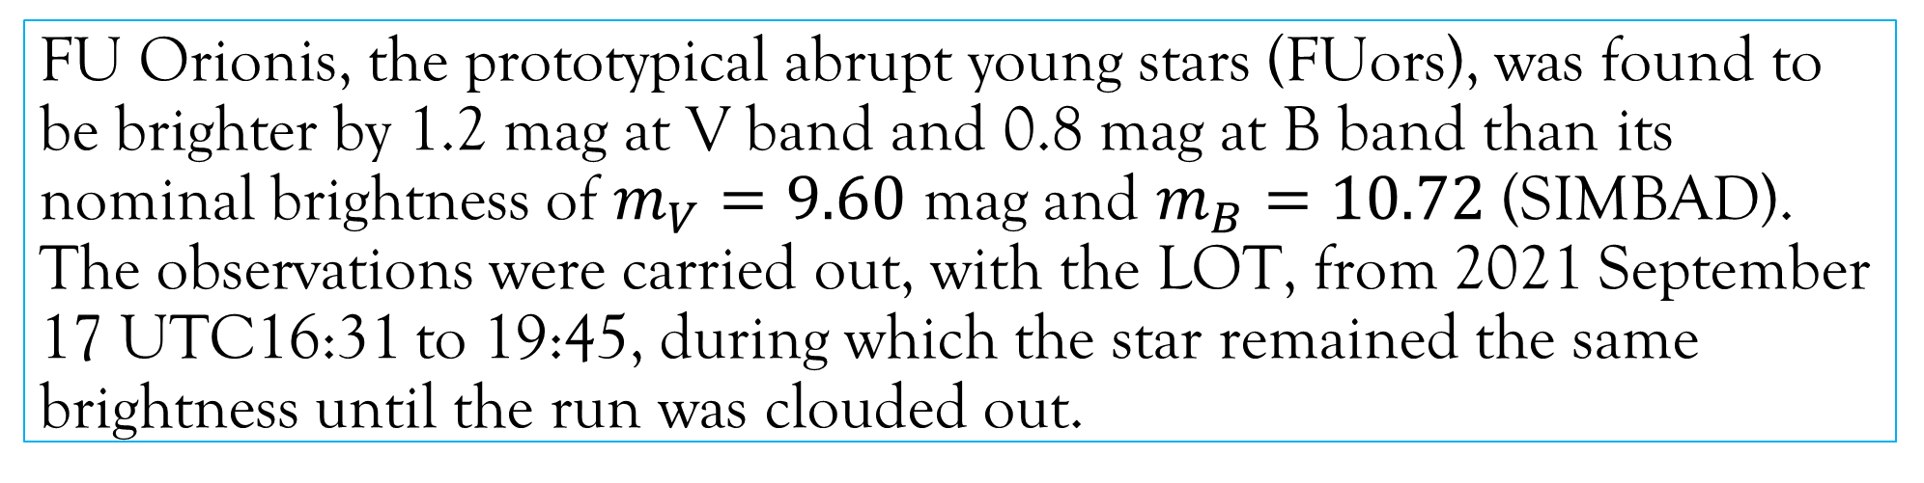
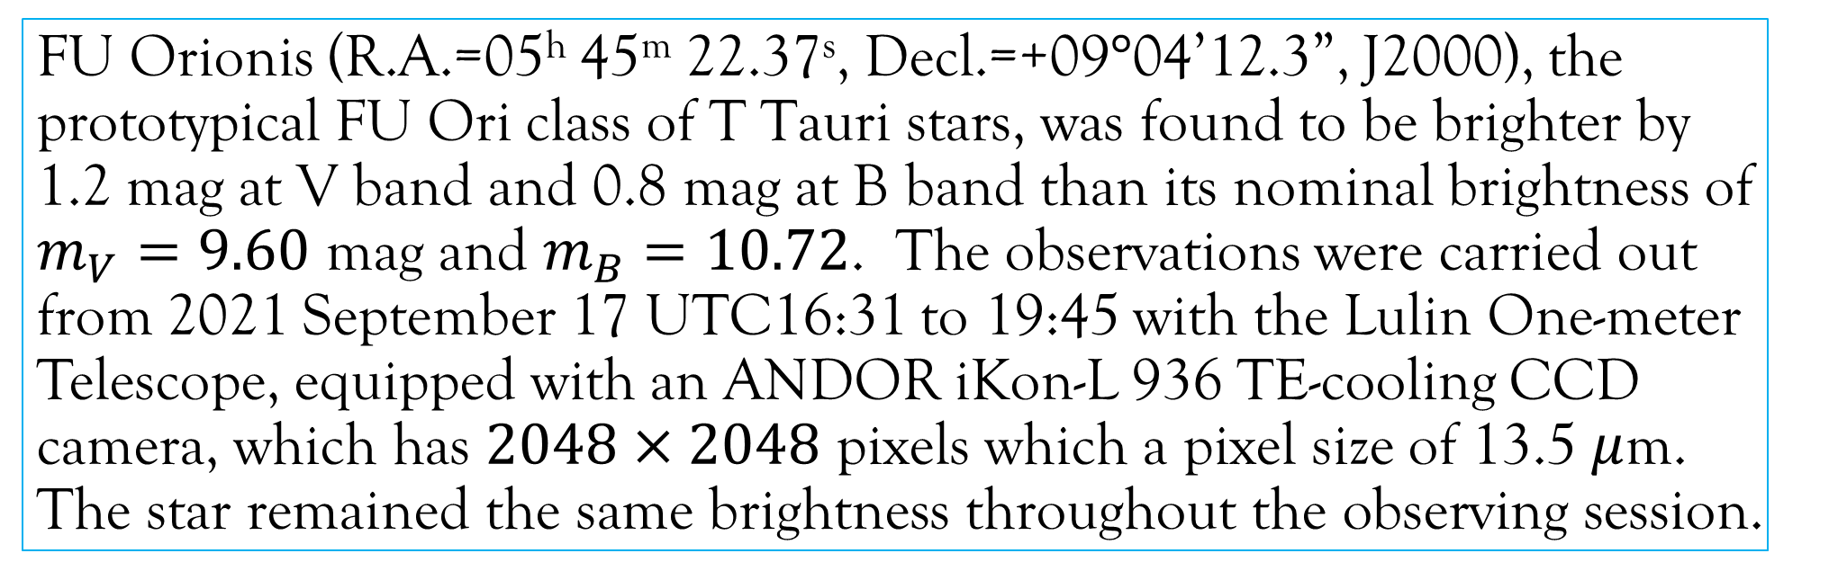
FU Orionis (R.A.=05^{h} 45^{m} 22.37^{s}, Decl.=+09$°$04’12.3”, J2000), the prototypical FU Ori class of T Tauri stars, was found to be brighter by 1.2 mag at V band and 0.8 mag at B band than its nominal brightness of $m_{V}=9.60$ mag and $m_{B}=10.72$. The observations were carried out from 2021 September 17 UTC16:31 to 19:45 with the Lulin One-meter Telescope, equipped with an ANDOR iKon-L 936 TE-cooling CCD camera, which has $2048×2048$ pixels which a pixel size of 13.5 $μ$m. The star remained the same brightness throughout the observing session.
FU Orionis, the prototypical abrupt young stars (FUors), was found to be brighter by 1.2 mag at V band and 0.8 mag at B band than its nominal brightness of $m_{V}=9.60$ mag and $m_{B}=10.72$ (SIMBAD). The observations were carried out, with the LOT, from 2021 September 17 UTC16:31 to 19:45, during which the star remained the same brightness until the run was clouded out.

Slide 35
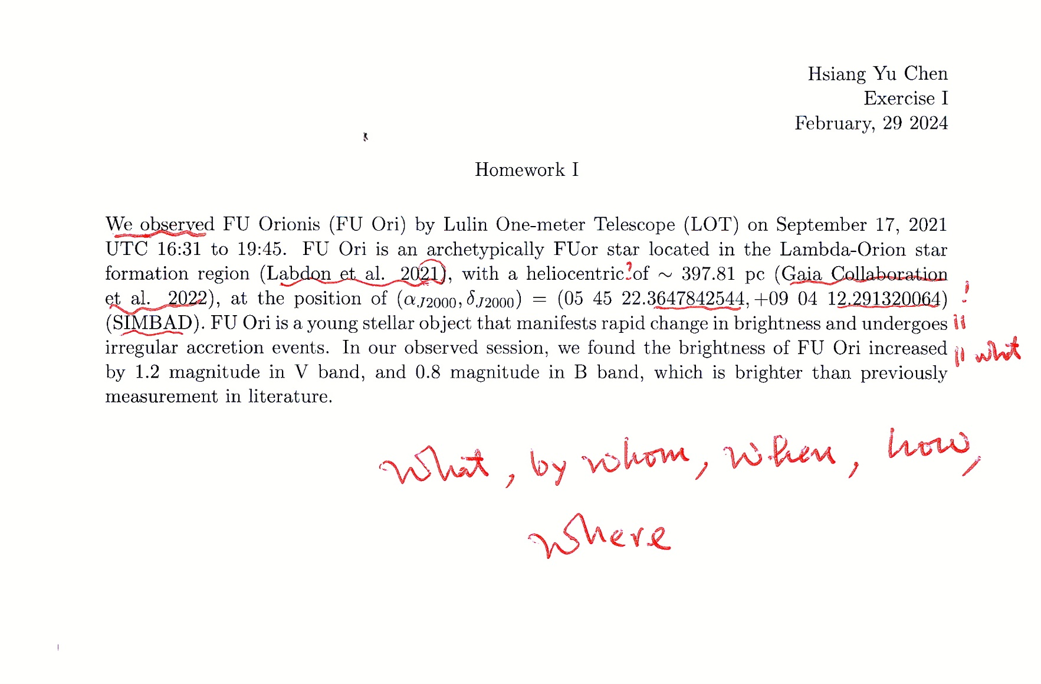

Slide 36
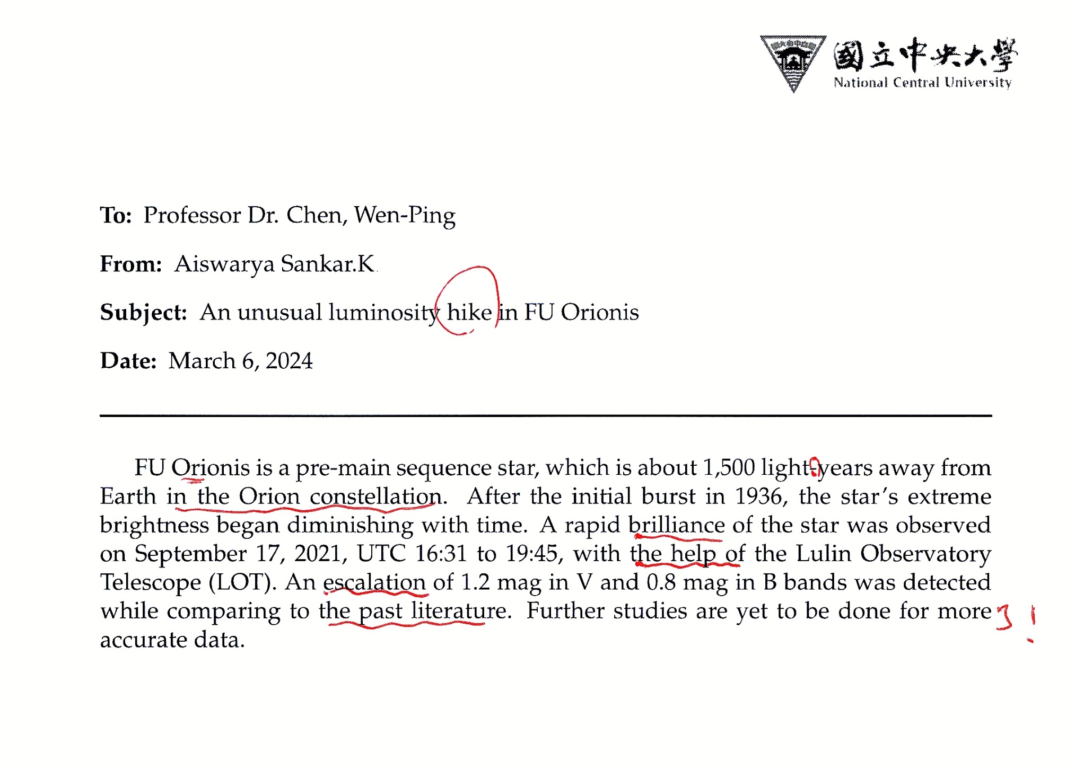

Slide 37
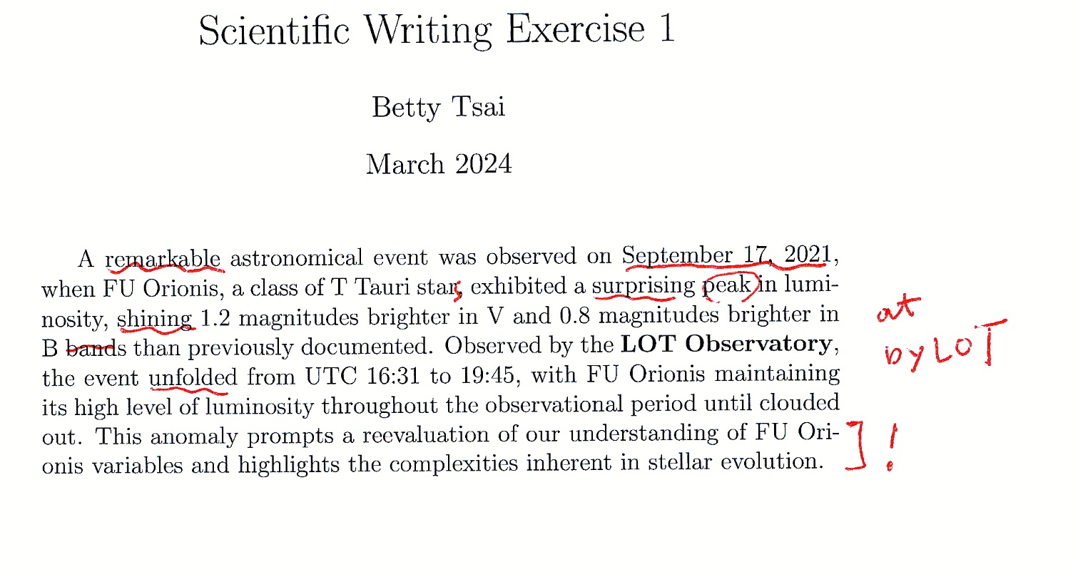

Slide 38
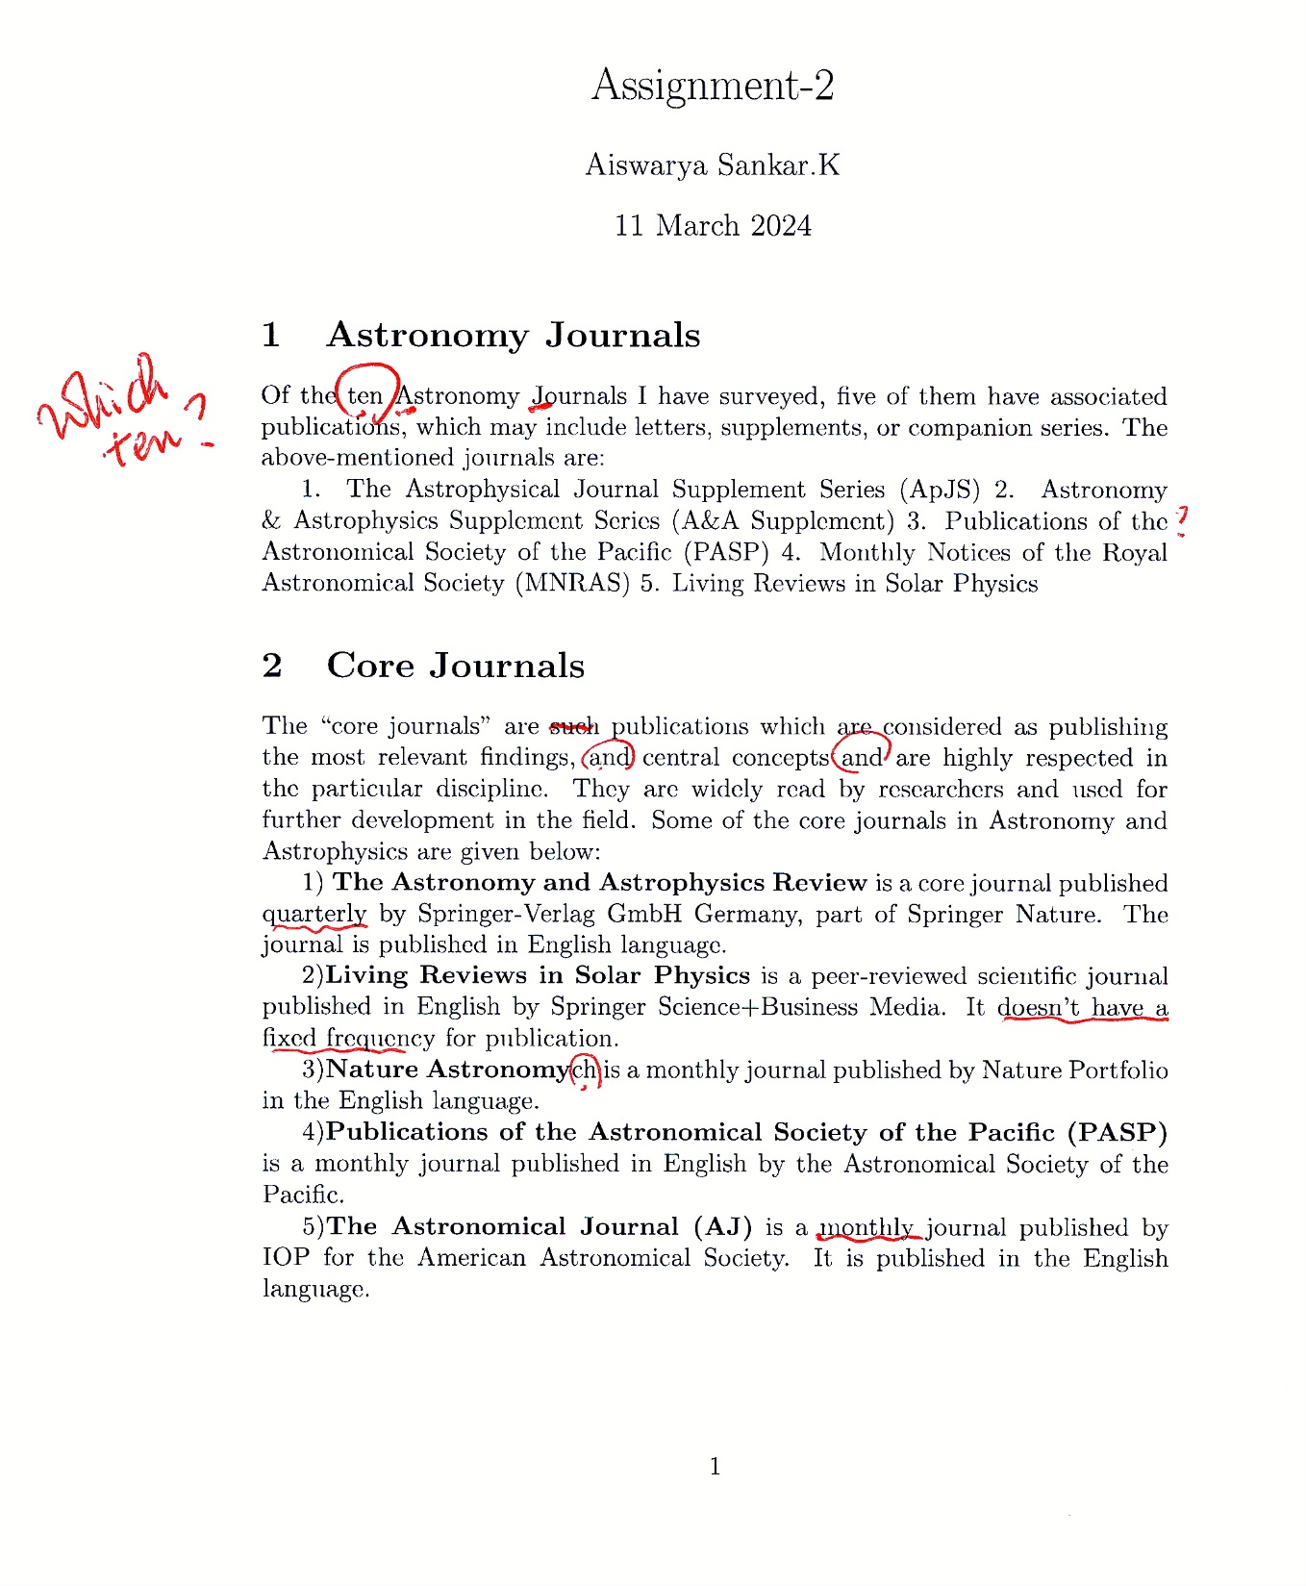

Slide 39
Mind the spelling, grammar, clarity …
Yes, we all have problems/questions/issues … but …
What are your (favorite) tools … spellchecker, Word, Grammarly
This is what I used at all times, other than a hard copy
https://www.dictionary.com/ infrared-excess, red shift, x rays
Also useful (I use even more frequently) is
https://www.thesaurus.com/

Slide 40
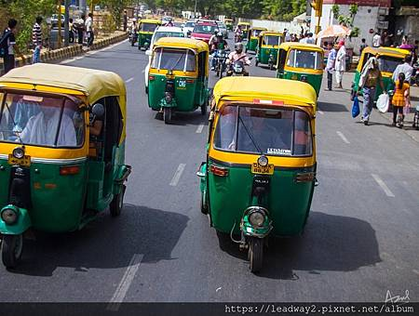
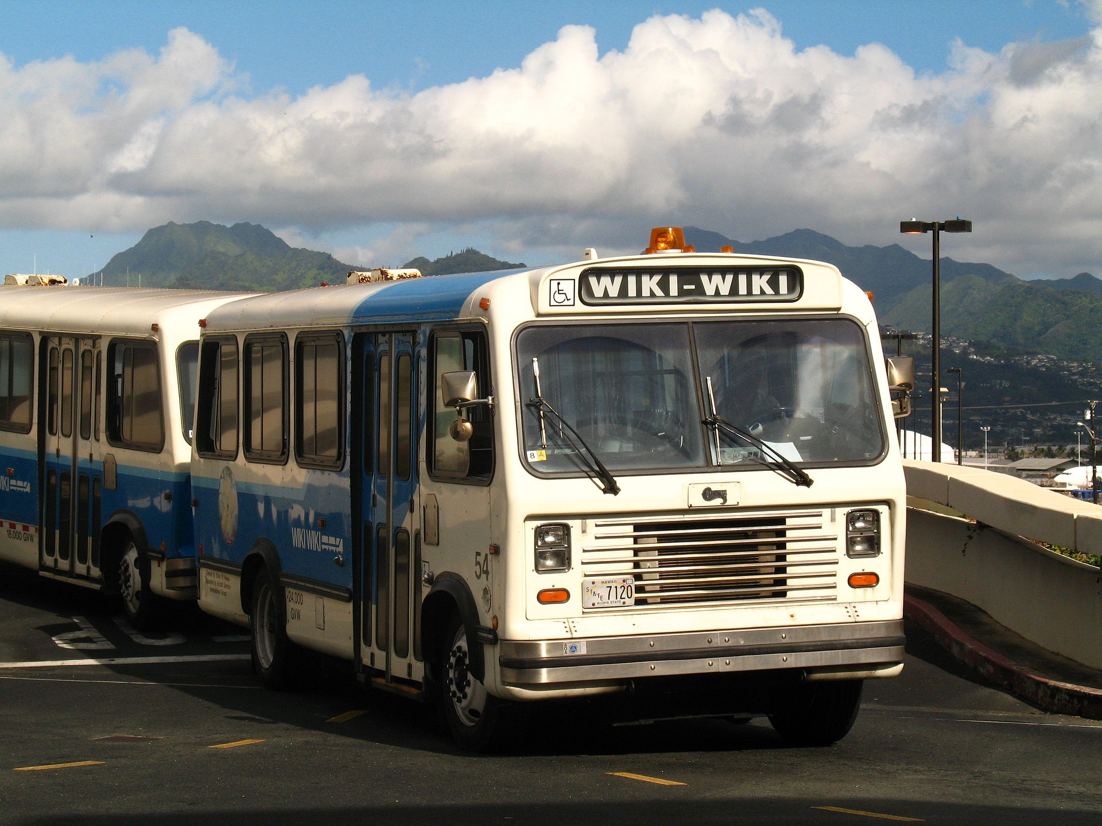
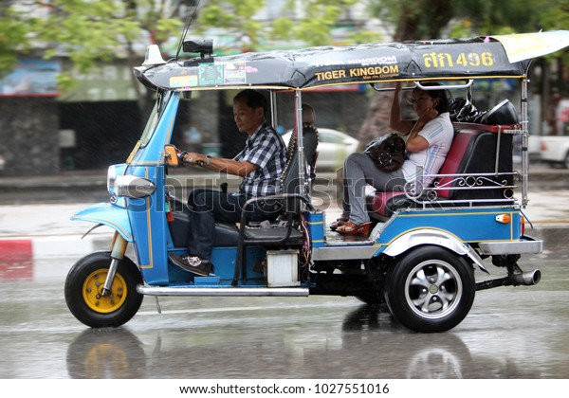
Wikipedia (wiki+encycropedia) is OK if properly used as a portal to further knowledge.
“wiki wiki” shuttle at Honolulu airport
“tuck-tuck” in India
“tuk-tuk” in Thailand

