Slide 1
Astrophysics Seminar 2012 Fall
To Read
journal papers, news, …, anything
To Present
how to show (what you want to show) by a
talk? By a poster?
To Listen
how to be an audience
To Write
term papers, conference proceedings
journal papers

Slide 2
Homework Assignment
Do a survey, as comprehensive as possible, of journals that publish astronomy- or astrophysics-related research results. Which of them have associated publications, e.g., letters or supplements?
How often does each journal publish?
In what language?
(By what publisher?)
(Do we subscribe to it?) …
How does the ‘style’ of each journal differ from each other? Note the title, abstract, references.
Zoom in to one particular ‘core’ journal and browse through one recent paper in it. Do the same for one off-core journal.
What is the Science Citation Index? What is the Impact Factor? What is the Open Access policy?

Slide 3
How to do a presentation …
Why? What? To whom? When? Where?
Be prepared (to show only 10% of what you know/prepare)
Be confident
Practice efficient language
Use proper media (overhead, slides, PowerPoint; words only, blackboard …)
Write legibly (text & graphics)

Slide 4
How to do a presentation …
Why? What? To whom? When? Where?
Be prepared (to show only 10% of what you know/prepare)
Be confident
Practice efficient language
Use proper media (overhead, slides, PowerPoint; words only, blackboard …)
Write legibly (text & graphics)

Slide 5
How to do a presentation …
Why? What? To whom? When? Where?
Be prepared (to show only 10% of what you know/prepare)
Be confident
Practice efficient language
Use proper media (overhead, slides, PowerPoint; words only, blackboard …)
Write legibly (text & graphics)

Slide 6
How to do a presentation …
Why? What? To whom? When? Where?
Be prepared
  ready to show only 10% of what you know/prepare
Be confident
Practice efficient language
Use proper media
  overhead, slides, PowerPoint; words only, blackboard …
Write legibly (text & graphics)

Slide 7
How to do a presentation (cont.)
Exercise gestures/body language (walk around sometimes)
Do NOT block the screen
Stick to the time limit
Pay attention to your audience
Sprinkle a touch of humor (yes, only a touch!)

Slide 8
How to be an audience?
Homework/preview work
Learn a thing or/then two
Do NOT chat with others
Ask questions
…

Slide 9
Publication of a Journal Paper
Original research results
Nature of the paper? Targeted readership?
Leading astronomy/astrophysics journals
  Astrophysical Journal (ApJ)
  Astronomical Journal (AJ)
  Astronomy & Astrophysics (A&A)
  Monthly Notices of the Royal Astronomical Society (MNRAS)
  Publication of the Astronomical Society of the Pacific (PASP)
  Icarus
  PASJ, PASA, JAA…

Slide 10
What about Nature, Science, Ann Rev Astron & Astrophy?
Name 1-2 recently established journals not listed above.
Write in a clear and concise way; select a personal “model” paper.

Slide 11



Slide 12


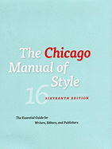

Common English mistakes made by native Chinese speakers
by Philip Guo
天文物理類英文科技論文寫作的常見問題 張雙南、許云

Slide 13
Evolution of a manuscript
– An example
- the draft
- a revised version
- the final submitted version

Slide 14
Publication of a Journal Paper
Typesetting the manuscript
  Latex vs Word or other word processors
  Text, figures, and tables
Peer review by referee(s)
Preprint and astro-ph submissions
Galley proofs
… in preparation; in submission; in press
… private communications

Slide 15
A sample Latex file
\documentclass[12pt,preprint]{aastex}
\usepackage{graphicx} \usepackage{natbib}
\slugcomment{To be submitted to AJ; today is \today}
\begin{document}
\title{Typesetting by Latex for Graduate Seminar Course }
\author{ W. P. Chen\altaffilmark{1} }
\altaffiltext{1}{Institute of Astronomy, National Central University, Jhongli 32001, Taiwan}
%
\begin{abstract}
%
This is a sample Latex file, to see how professional typesetting is done.
%
\end{abstract}
\section{Introduction}
So this is how it works.
The original file includes some ``commands'', but the contents are in ASCII. Latex is
particularly convenient to effectively produce Greek letters, $\alpha, \beta, \Omega$, and
math $\int_0^{100} \sin\omega d\omega$.
\end{document}

Slide 16
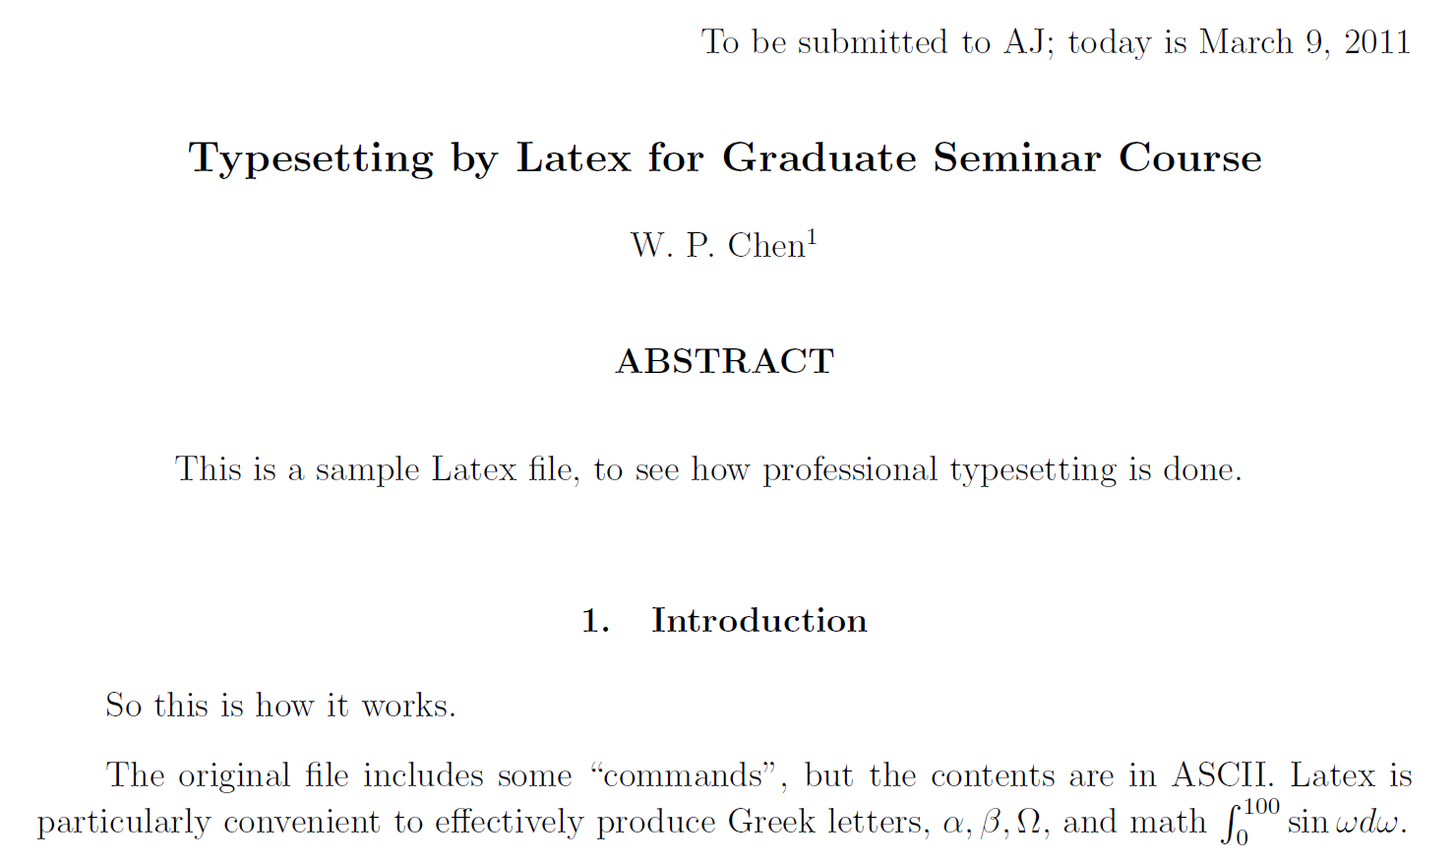
Output of the Latex file

Slide 17
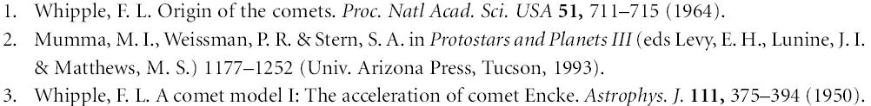
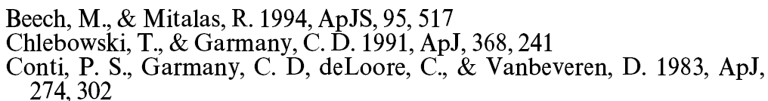
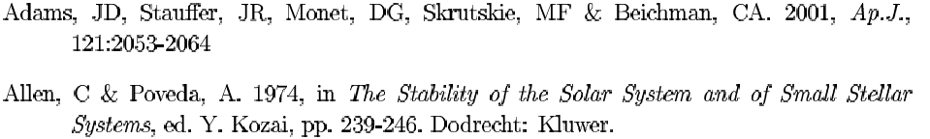
Reference Styles
Nature
Astrophysical Journal
Annual Review of Astronomy and Astrophysics

Slide 18
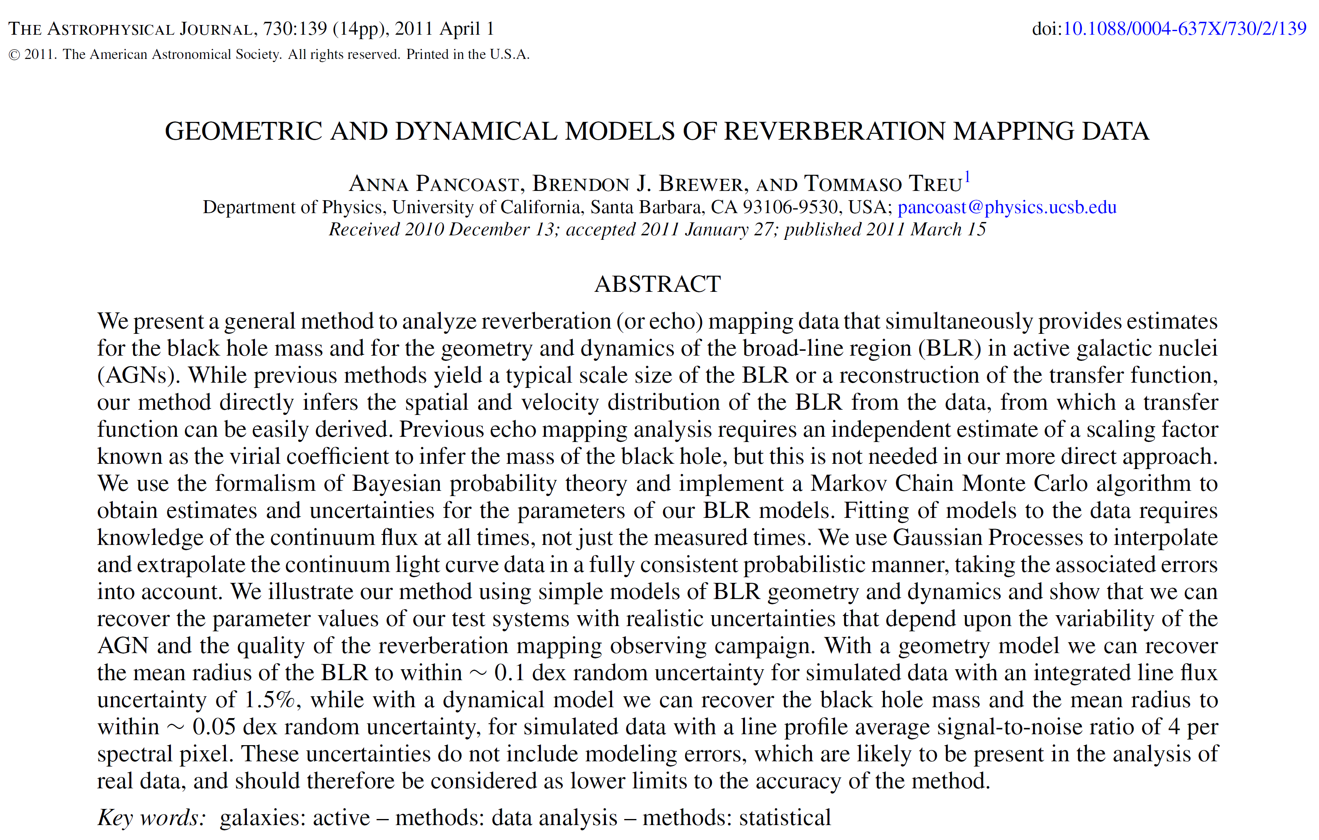
A sample ApJ paper heading …
Digital Object Identifier

Slide 19
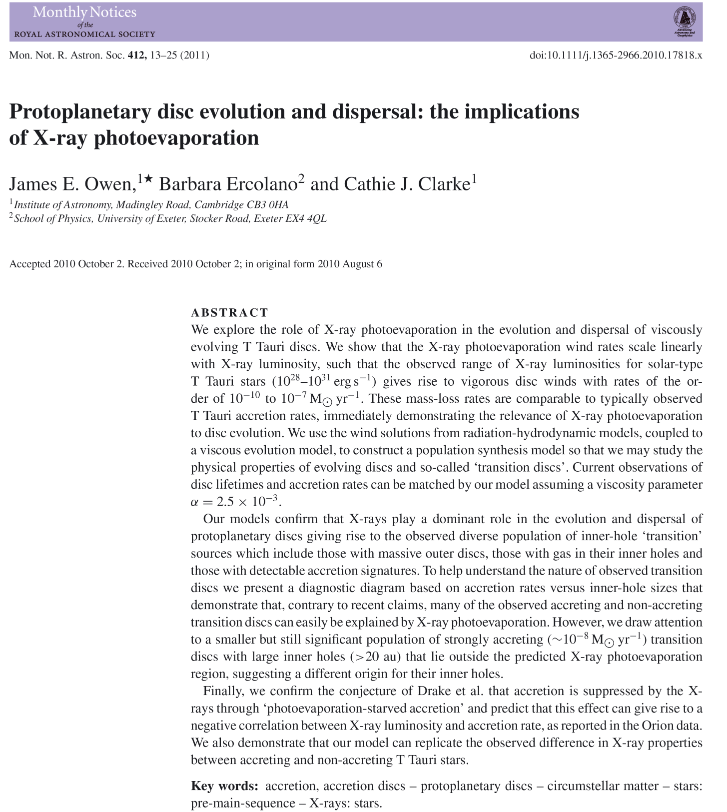

Slide 20
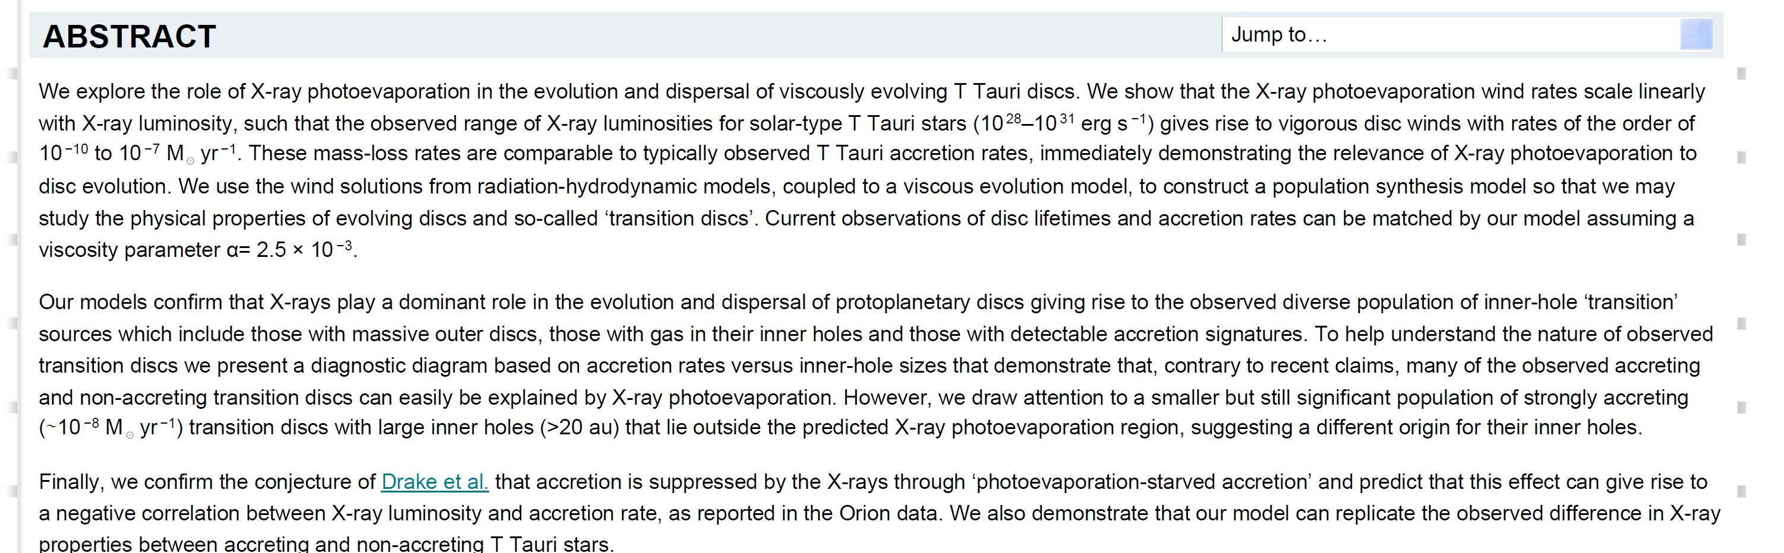
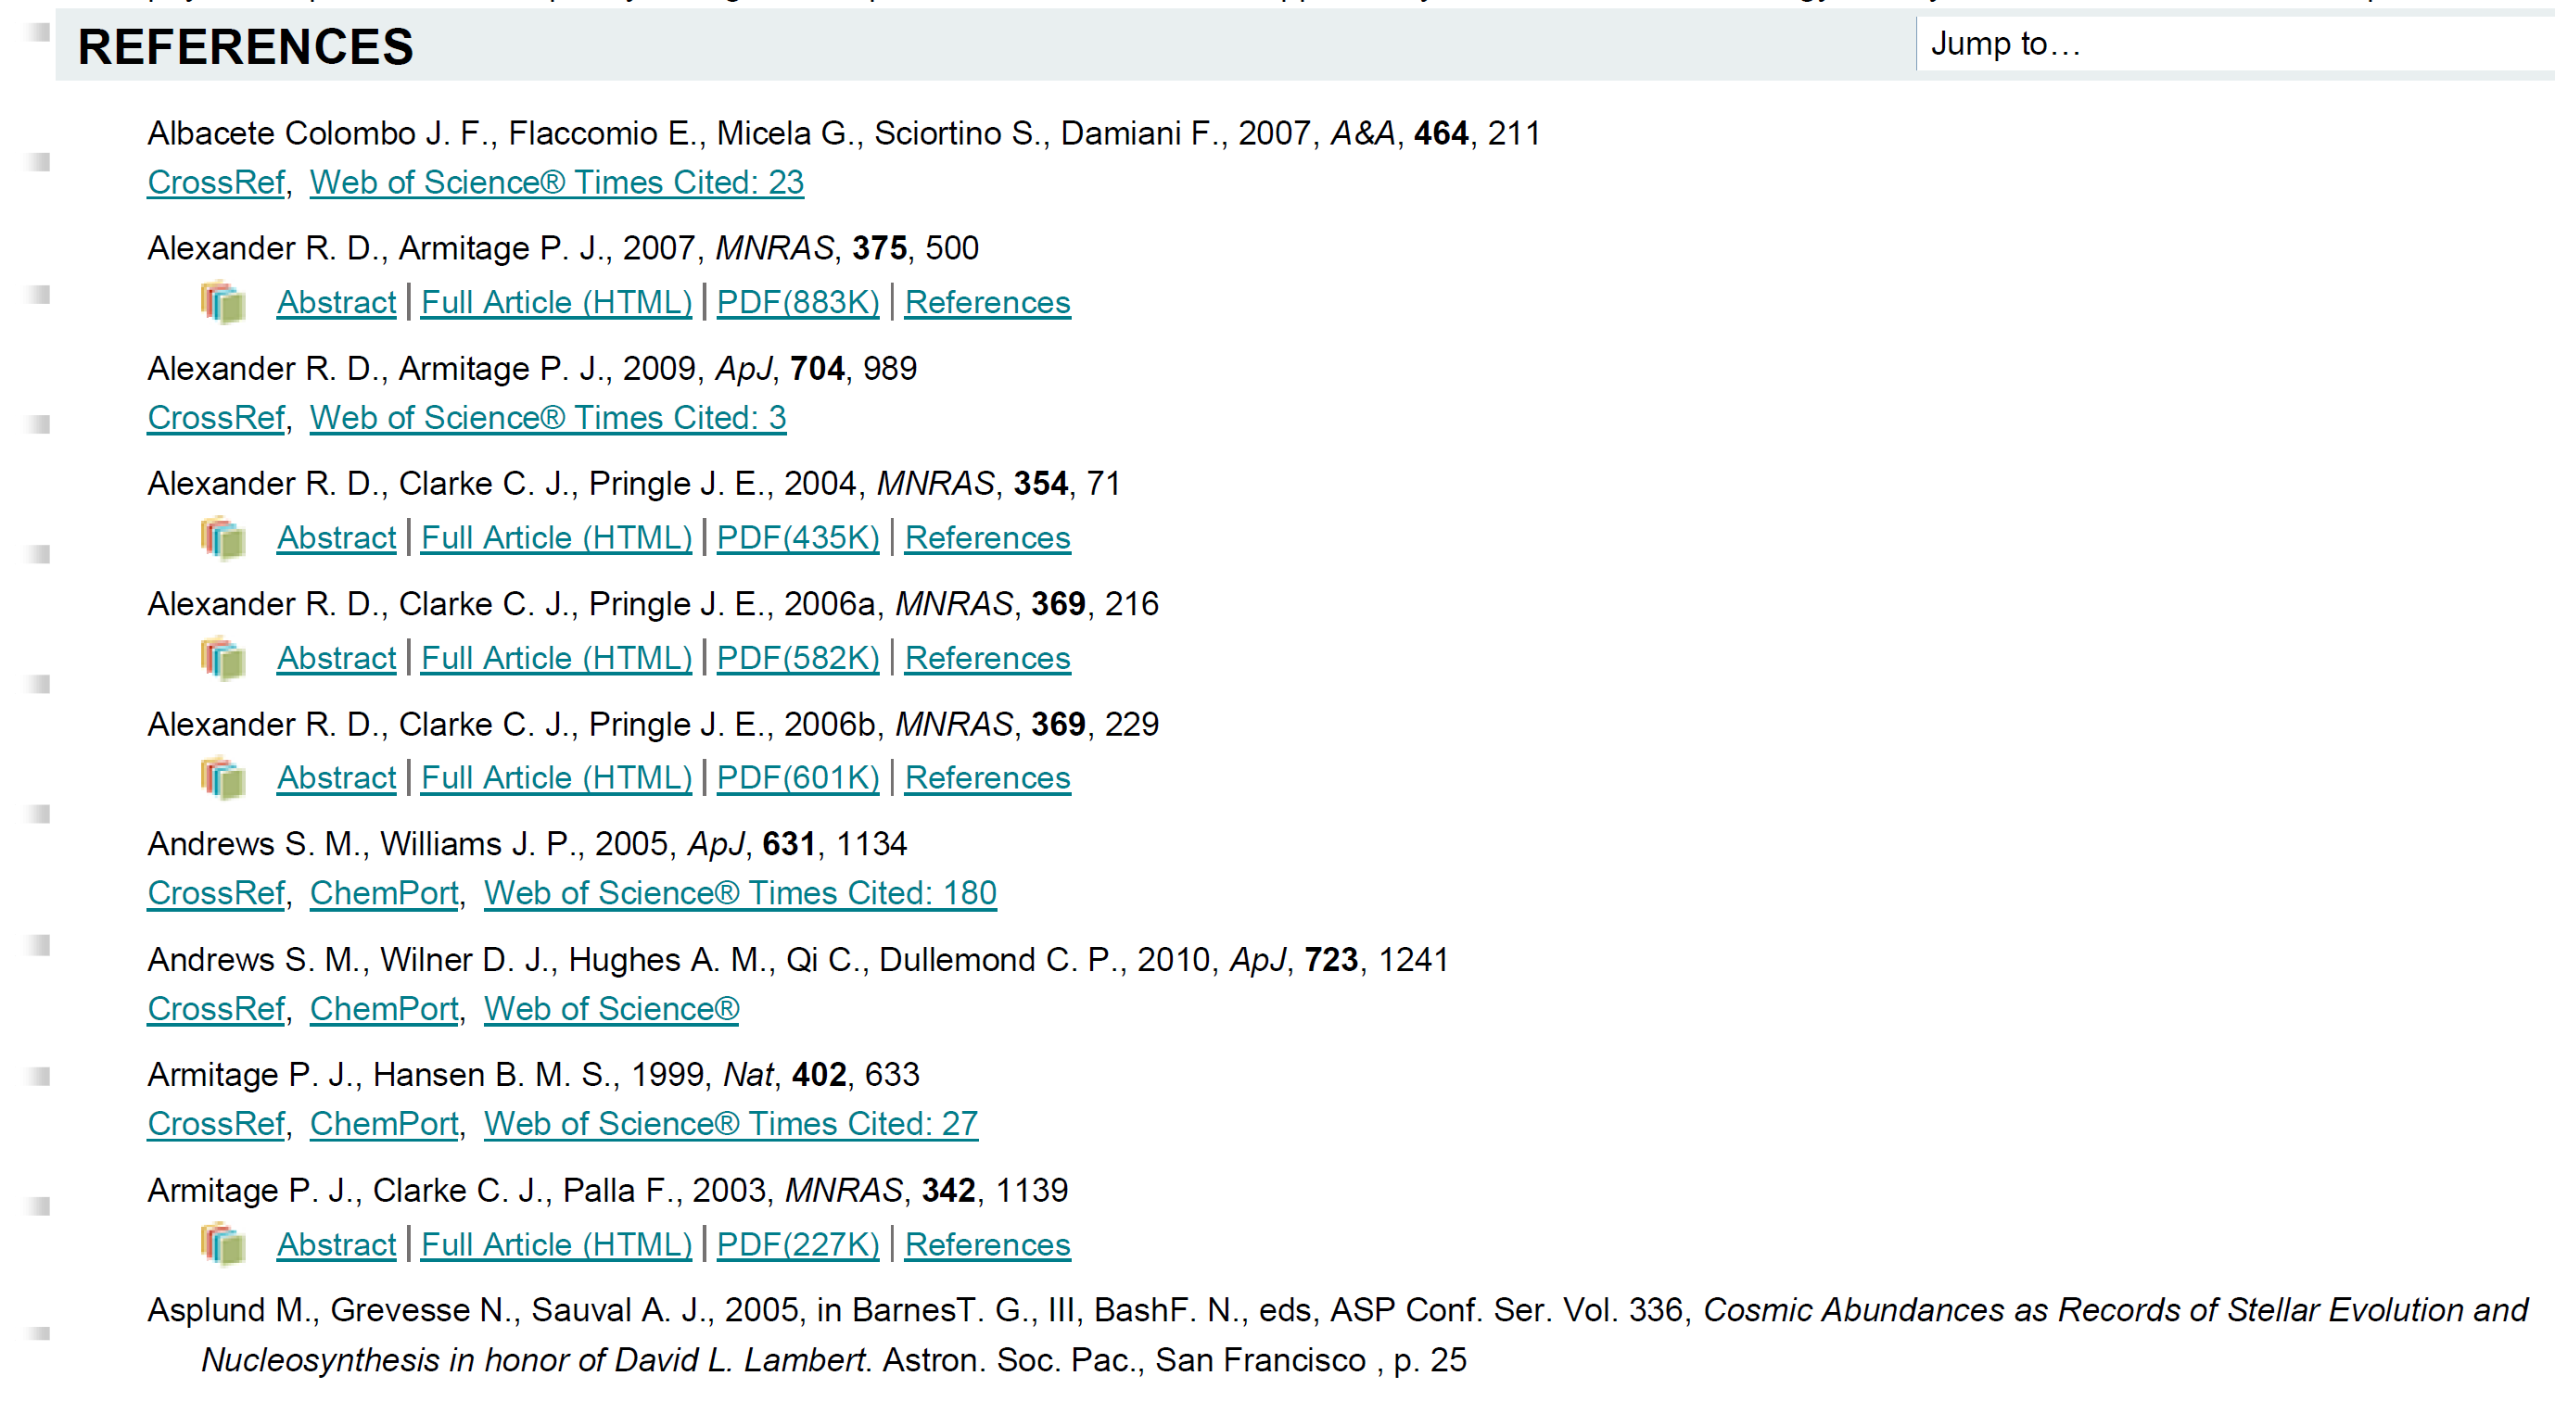
A sample online HTML version

Slide 21
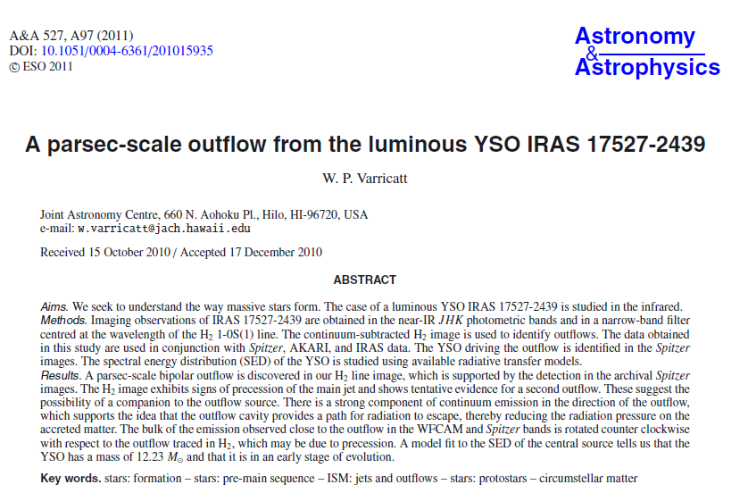
A sample A&A paper heading …
100% cut and paste

Slide 22
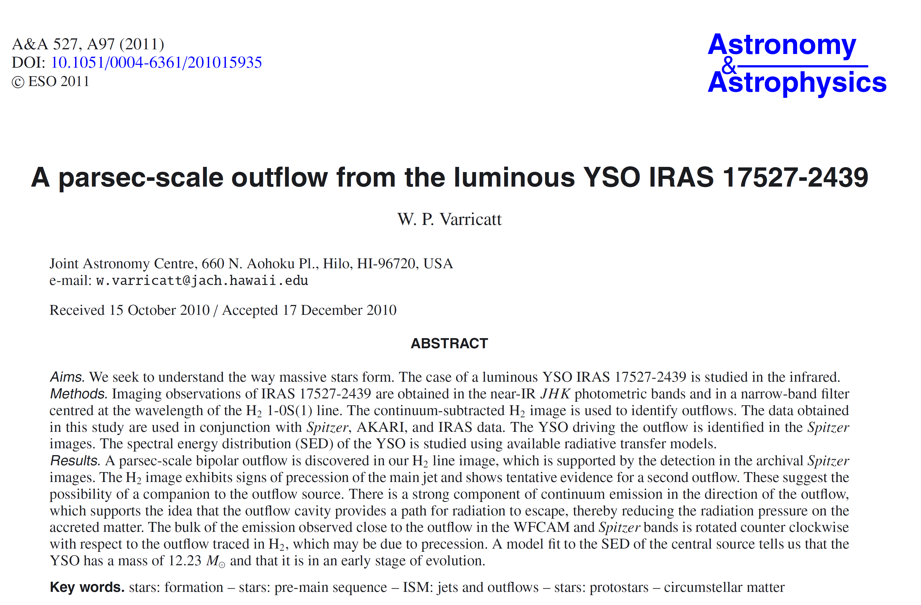
The same …
400% cut, paste, and shrink

Slide 23
Class Exercise --- A sample letter
Dear Takahashi-san
I am so concern about the devastations triggering by terrible earthquake and tsunami in Japan. Everyday, I read news and pray for the things will going well many times.
GAO is quite close to the Toyko. Are people and every things in GAO allright?
God Bless you and eveyone in GAO
What does this letter try to say?
What are the problems with it?
Let us try to improve it.

Slide 24
Mind the Pronunciation
Read out loud and listen to yourself
morphology vs morphological
molecule vs molecular
analysis vs analyze/analyse
spectra vs spectroscopy vs spectroscopic

Slide 25
Mind the Sentence Structure
We would like to find out what the dark energy is.
You may wonder “What is the dark energy?”

Slide 26
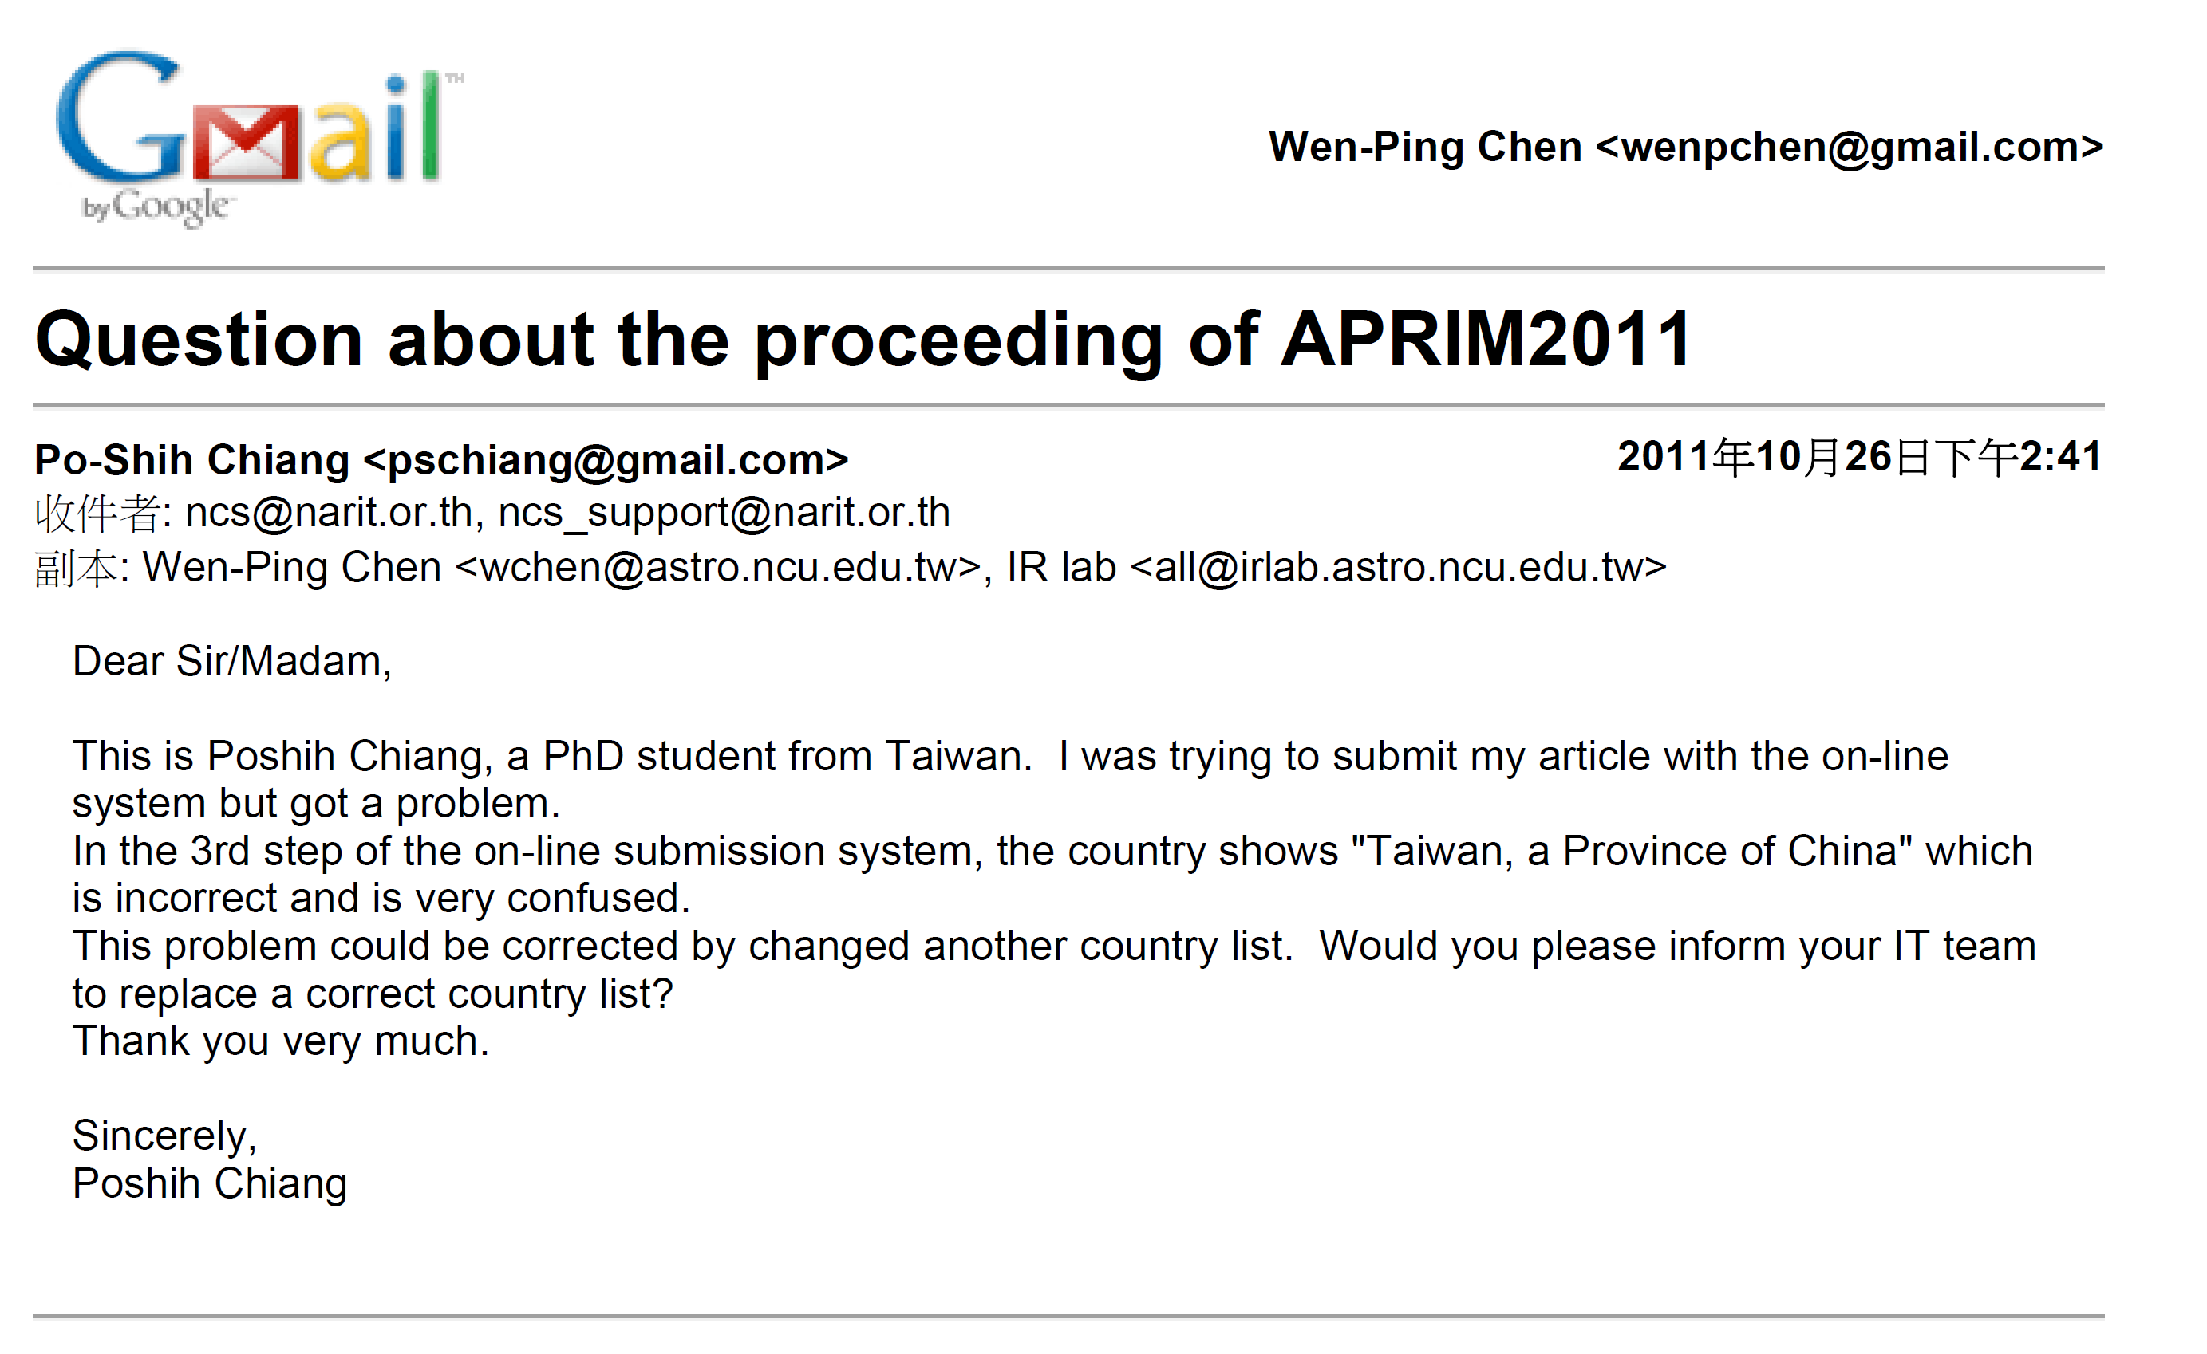

Slide 27
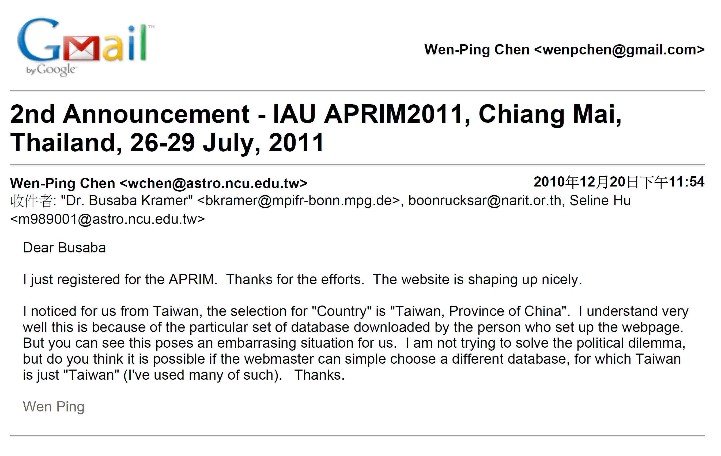
simply

Slide 28
Nicknames in English --- you should know these, but do not use them unless you know the person very well.
FEMALE
Amanda | Mandy
Catherine | Cathy, Cath
Christine | Chris, Chrissy
Cynthia | Cindy, Cynth
Deborah | Deb, Debbie
Elizabeth | Betty, Beth, Liz, Bess
Florence | Flo
Frances | Fran, Francie
Janet | Jan
Katherine | Kathy, Kate
Janice | Jan
Nancy | Nan
Pamela | Pam
Patricia | Pat
Roberta | Bobbie
Sophia | Sophie
Susan | Sue, Suzie
Teresa | Terry
Valerie | Val
Veronica | Ronnie
Yvonne | Vonna
MALE
Albert | Al
Andrew | Andy
Anthony | Tony
Arthur | Art, Arty
Bernard | Bernie, Bern
Charles | Charlie, Chuck
Christopher | Chris
Daniel | Dan, Danny
Donald | Don
Edward | Ed, Eddie
Eugene | Gene
Francis | Frank, Fran
Frederick | Fred, Freddy
Henry | Hank
Irving | Irv
James | Jim, Jimmy
Joseph | Joe
John | Jack, Jacky
Lawrence | Larry
Leonard | Leo
Nathan | Nat, Nate
Nicholas | Nick
Patrick | Pat
Peter | Pete
Raymond | Ray
Richard | Dick, Rick
Robert | Bob, Bobby, Rob
Ronald | Ron, Ronny
Russell | Russ
Samuel | Sam, Sammy
Stephan | Steve
Stuart | Stu
Theodore | Ted, Teddy
Thomas | Tom, Thom, Tommy
Timothy | Tim, Timmy
Walter | Walt, Wally
William | Bill, Billy, Will, Willy

Slide 29
My Model paper …

Slide 30
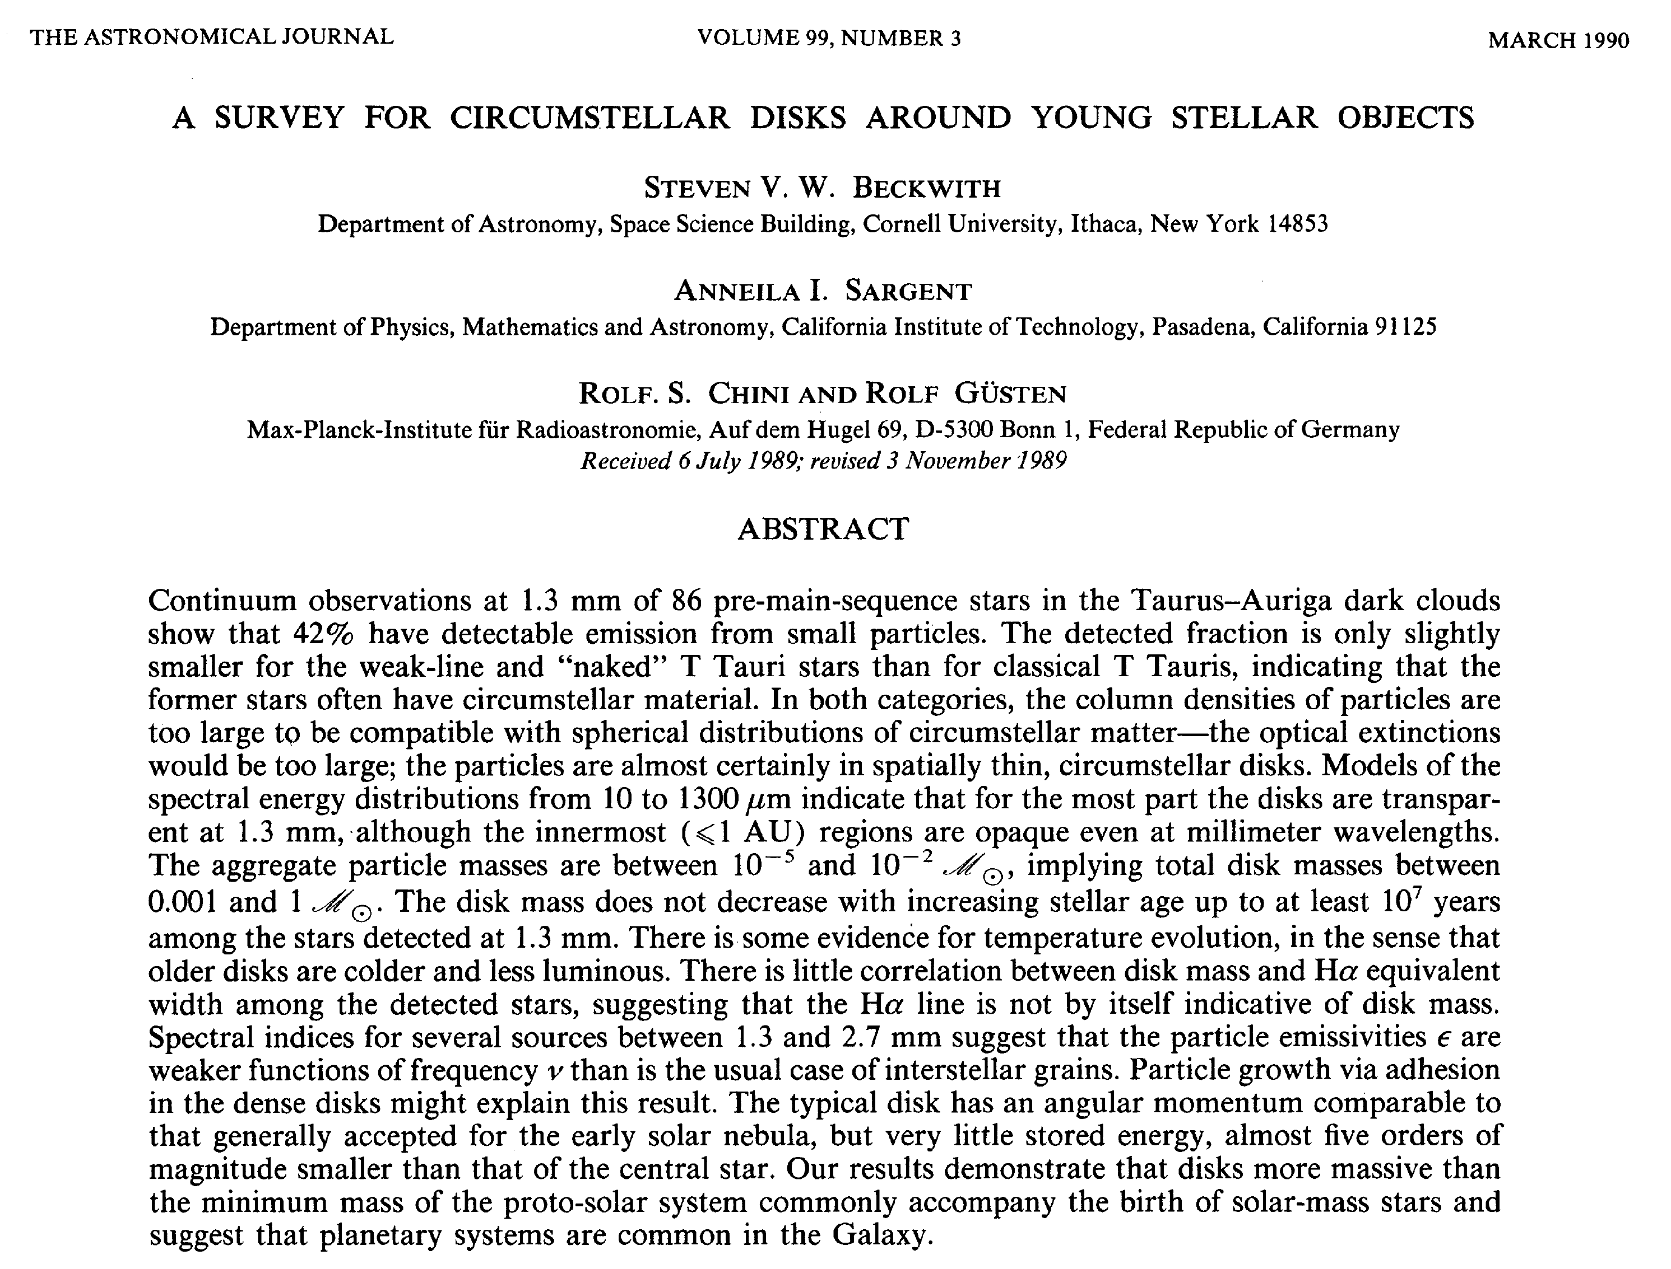

Slide 31
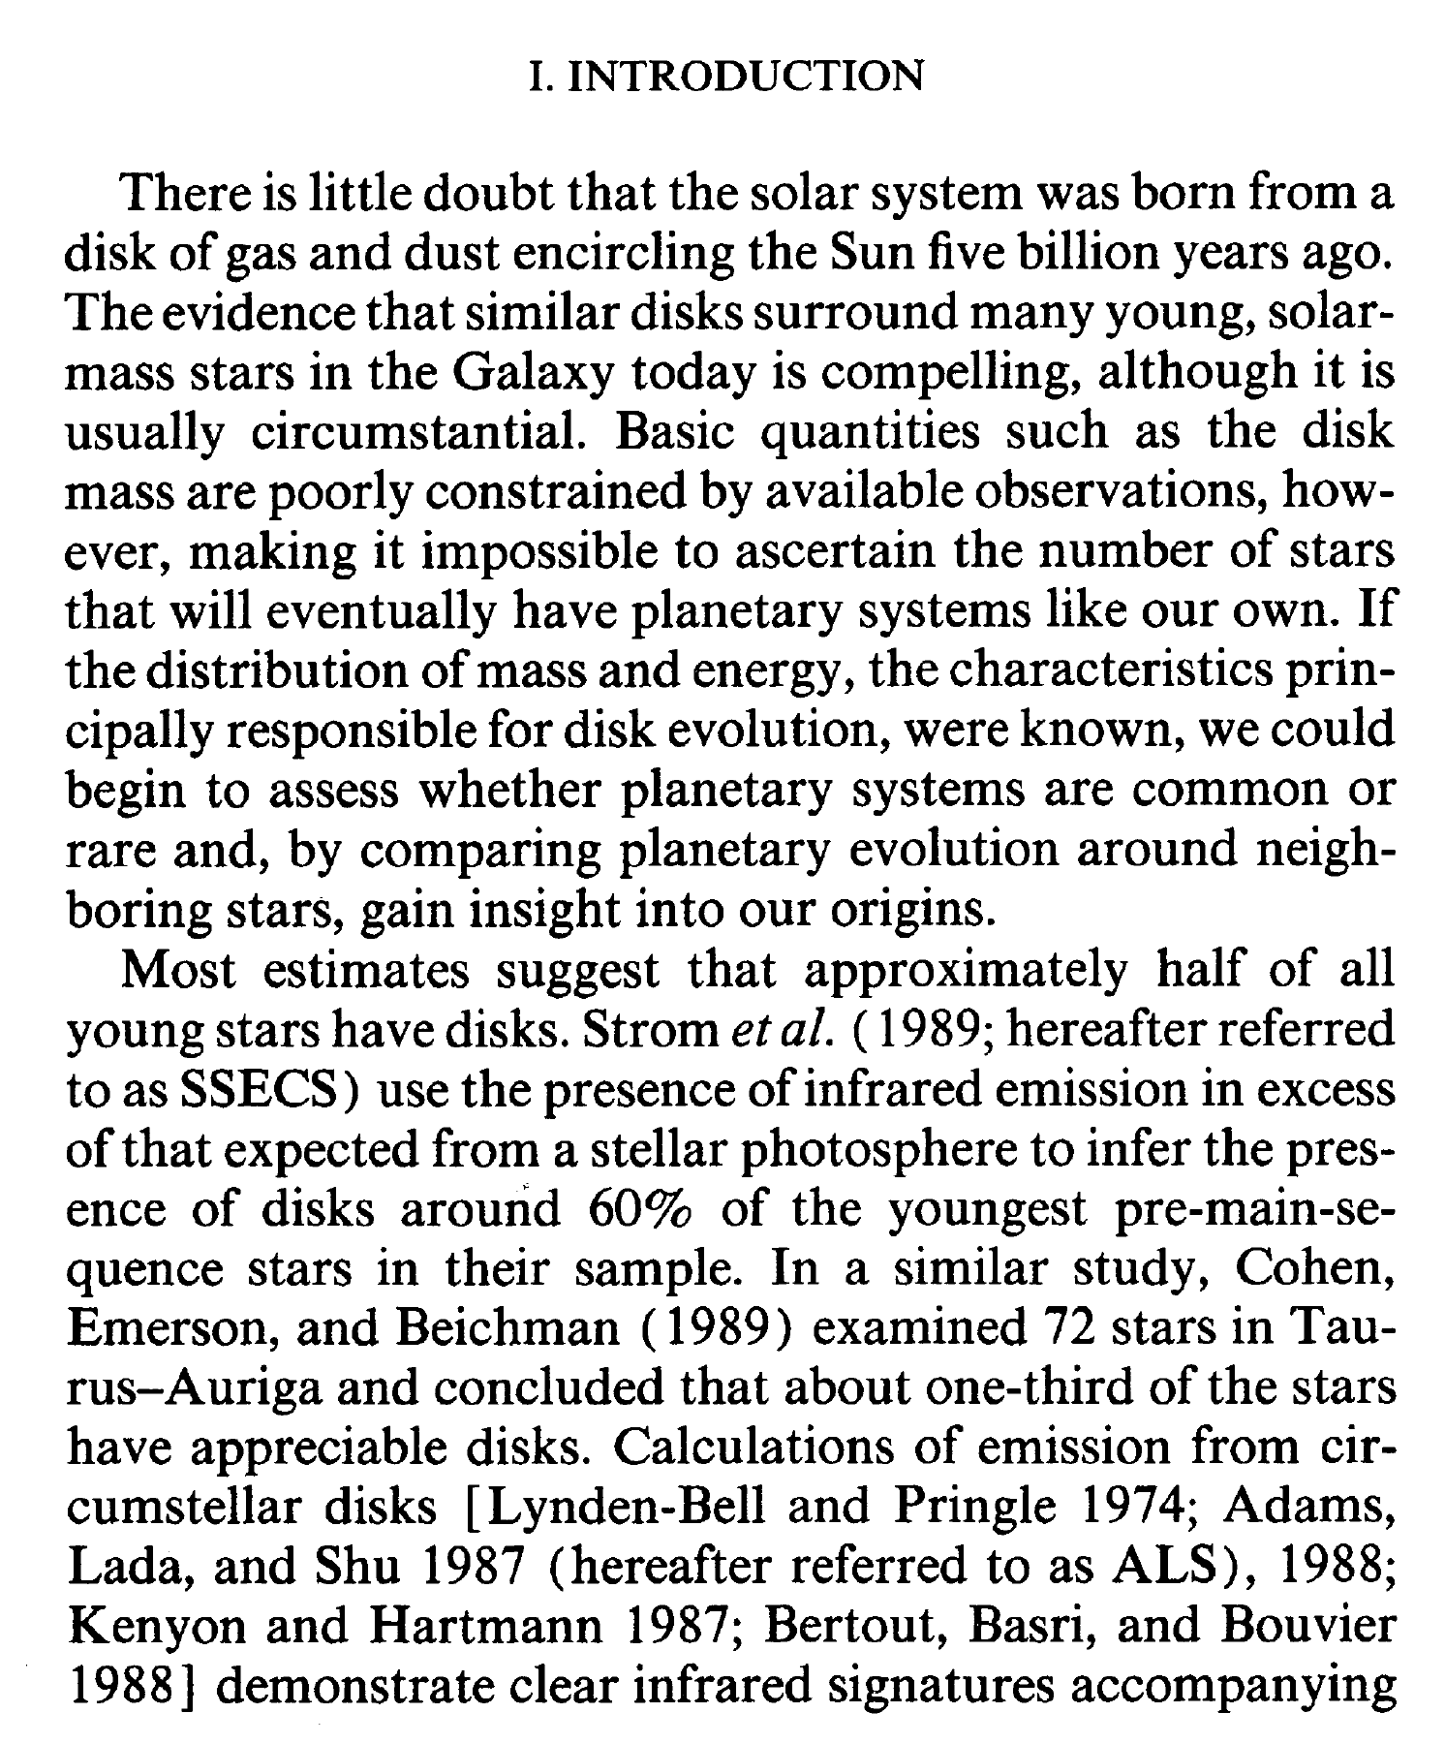

Slide 32
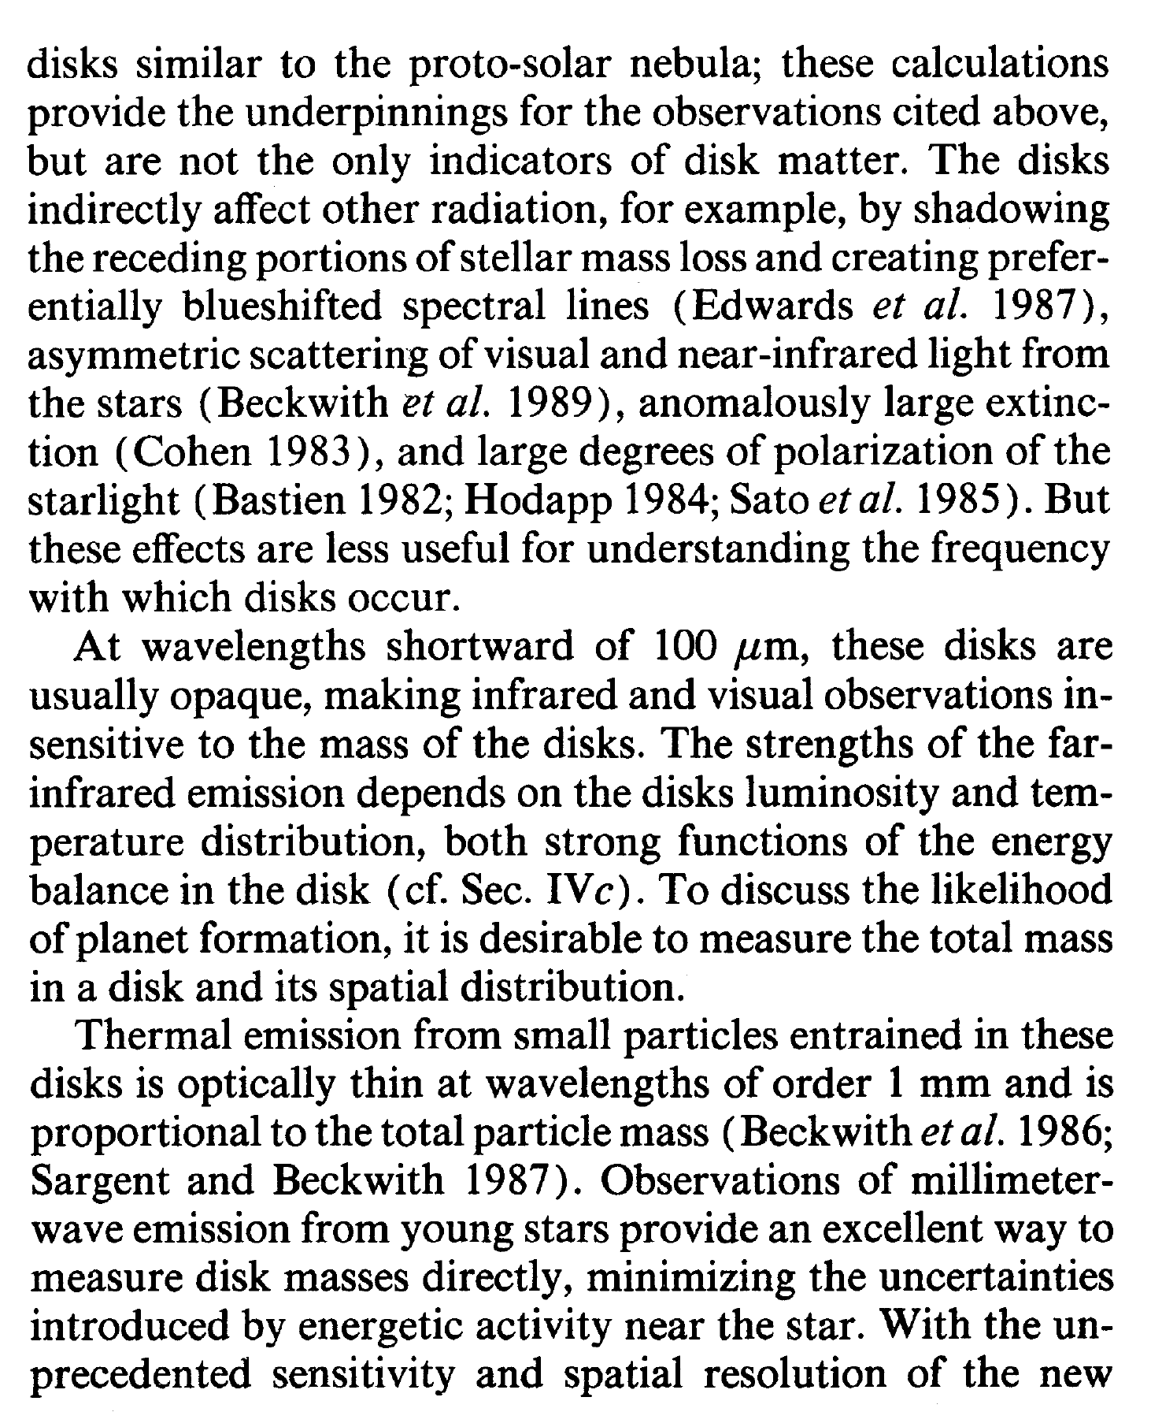

Slide 33
Sketch a Writing Plan
(A rough title, clear contents)
Section headings, subsections …
Then to each paragraph, and each sentence
Once concept/issue per paragraph.
Mind the overall structure of the article.
Introduction, Observations and Data Analysis, Results
and Discussions, Conclusions
Then tackle a sentence at a time.

Slide 34
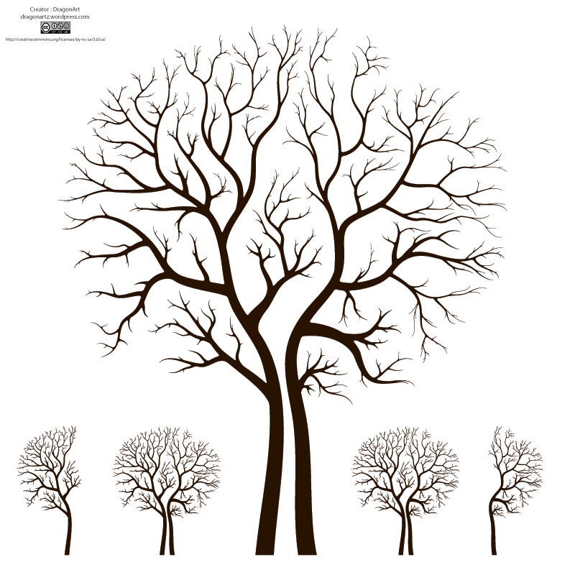
Paper Structure
Title = face
Abstract = heart
Key Words = address
Headings = skeleton
Introduction = hands
Data and Analysis
Discussion
Visuals = voice
Conclusion = smile
References

Slide 35
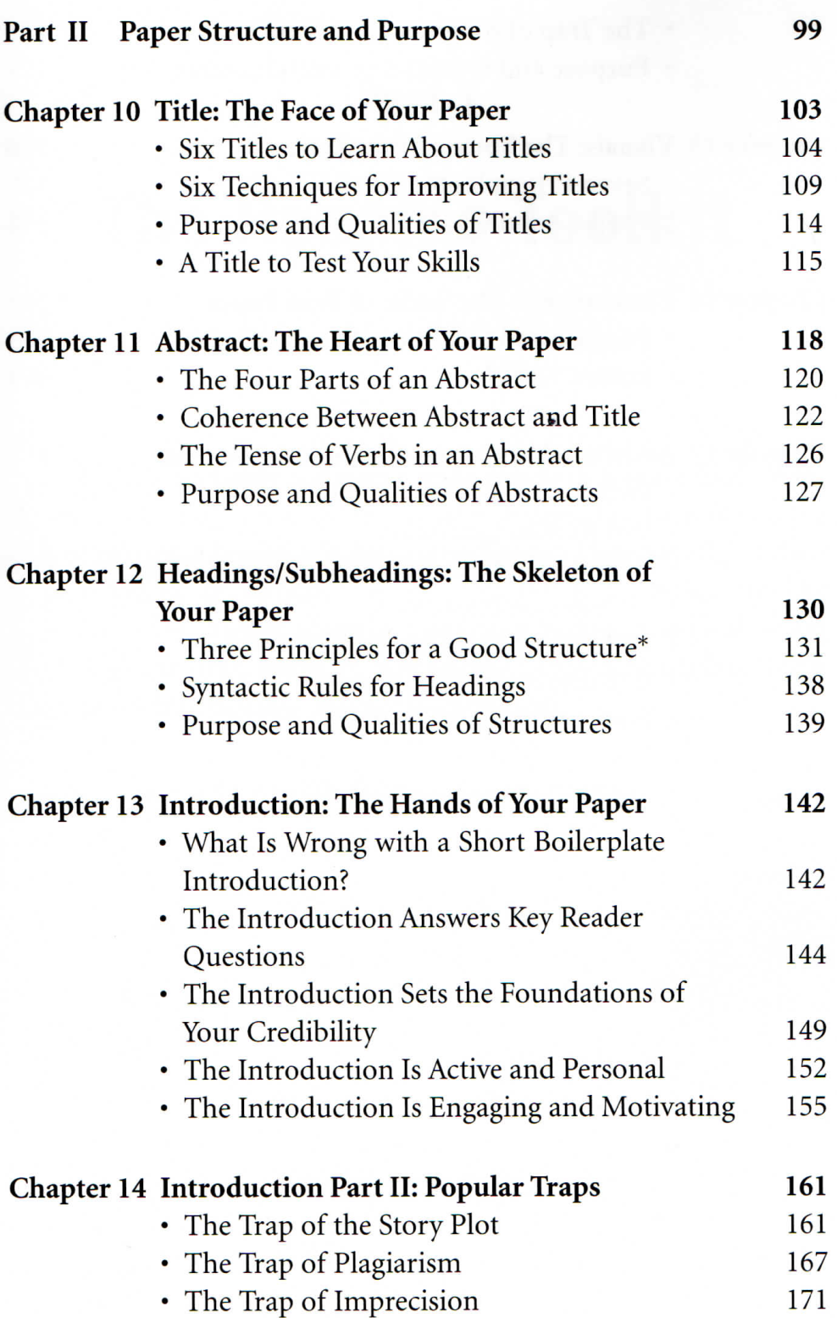
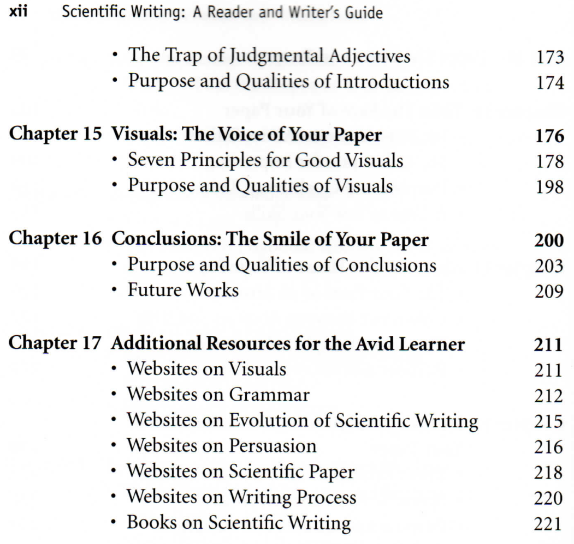

Slide 36
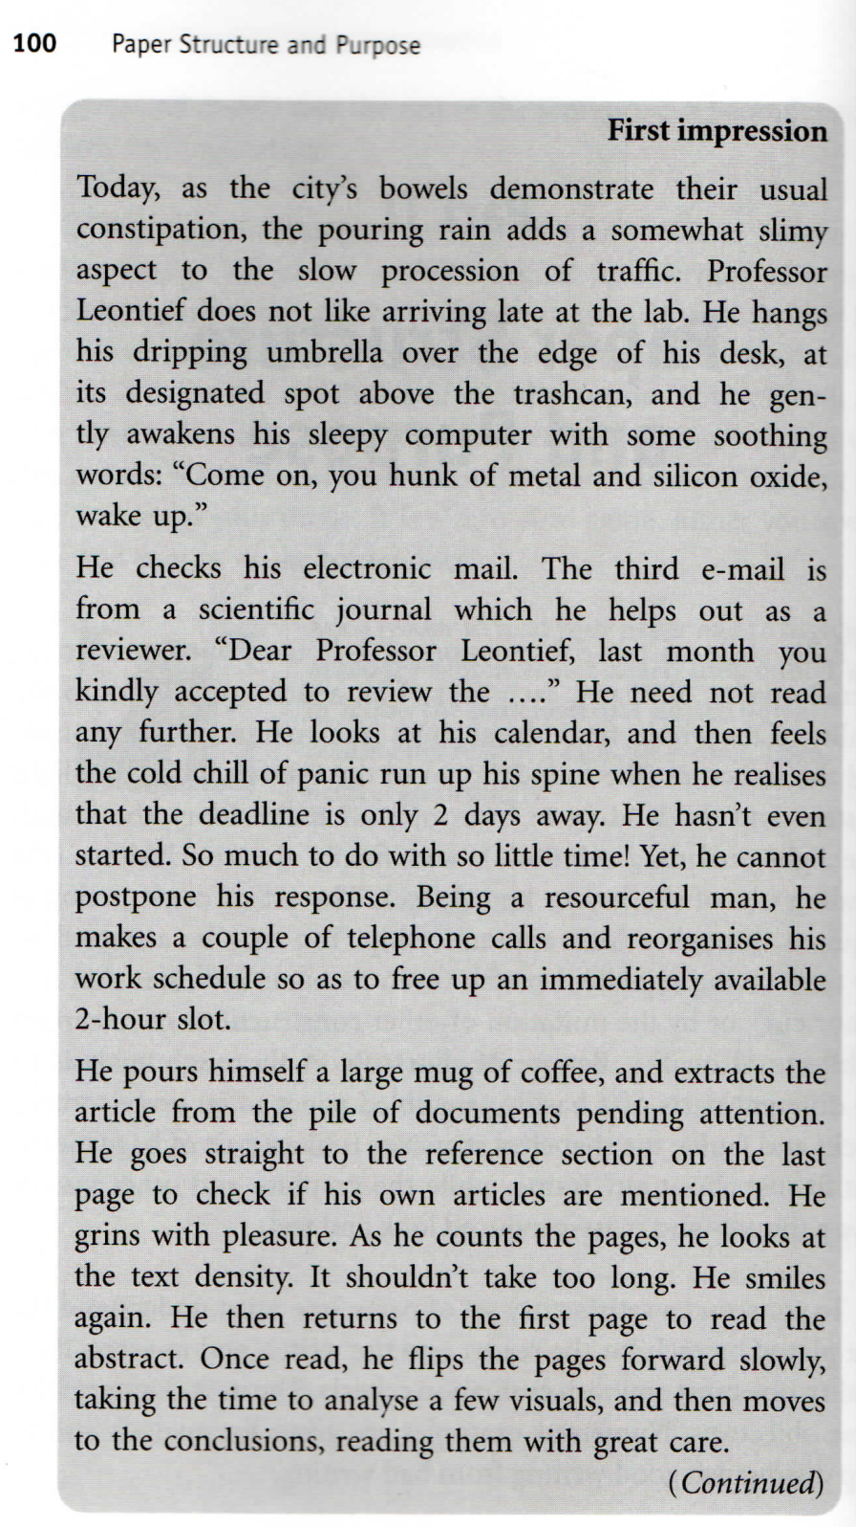
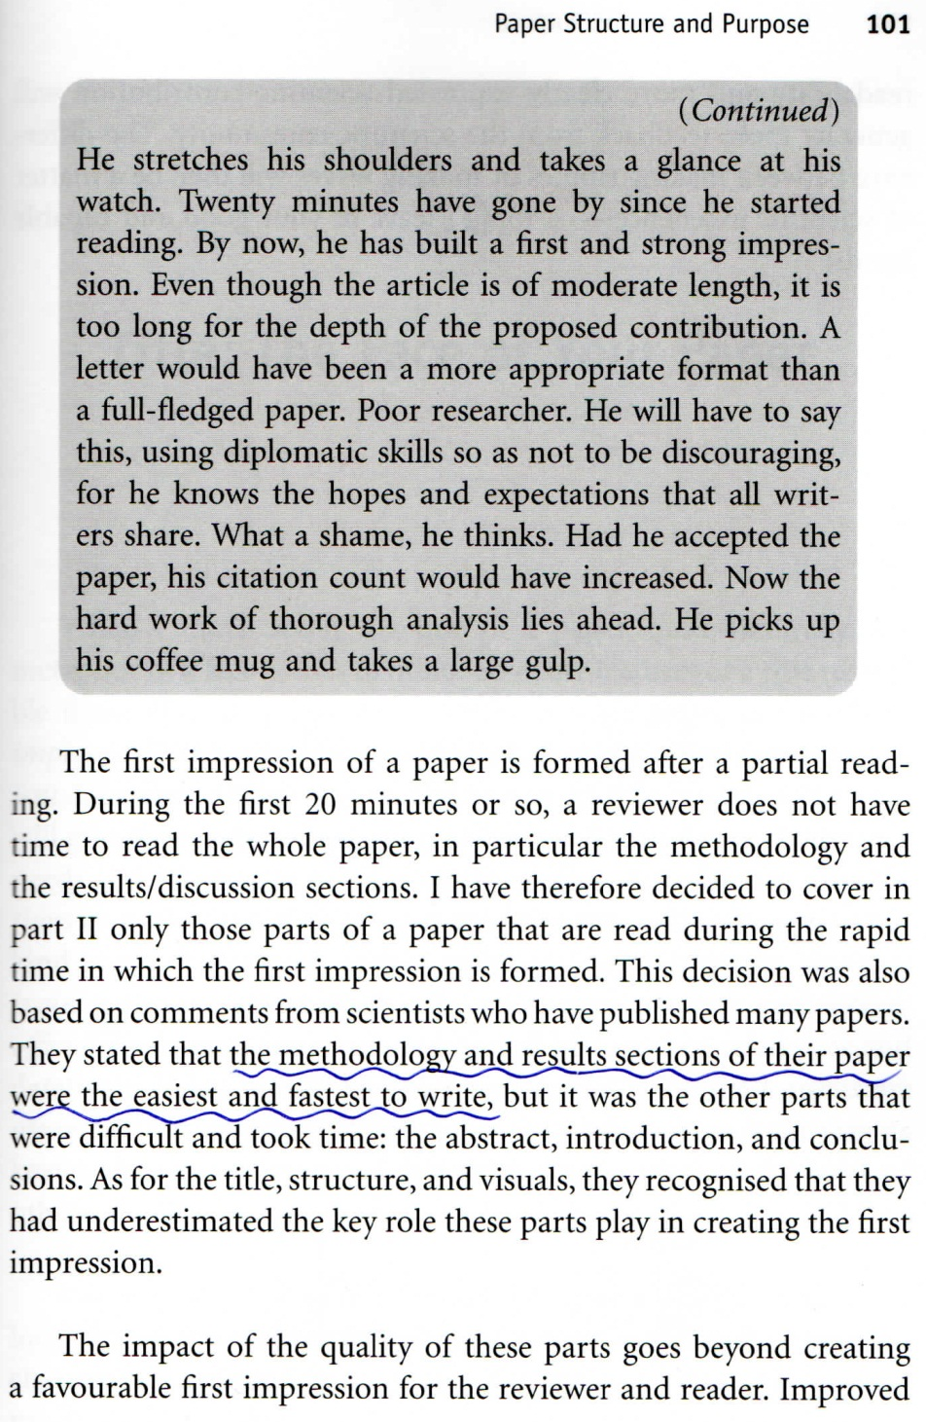

Slide 37
Title --- How to select one
Try alternative titles …
What are the differences
Pair elimination
The best one should be tempting and informative
Author’s contribution should come first

Slide 38
Title (cont.)
The title is not read; it is scanned, within 2 seconds at most
A long easily understood title is better than a short one with nouns to be unpacked, which in turn is better than an ambiguous one
An old or popular subject → a longer title in order to specify the contribution

Slide 39
Six Techniques to improve titles
Placement of Contribution First
  For a full sentence, the new information usually appears at the end and the old information at the beginning.
  In a verbless title, however, the situation is reversed.

Slide 40
2. Using Verbal Forms
  A verb gives energy. So use gerunds （動名詞）or infinitives （不定詞）to energize your title.
  For example:
  Data learning: Understanding astronomical Data

Slide 41
3. Using Adjectives or Numbers to
Stress contribution
  Fast, highly efficient, robust, but not new or novel
  The most specific, the better, e.g., 5 Hz sampling is better than fast sampling
4. Clear and Specific Keywords
Easier to locate by a search engine or
database

Slide 42
5. Smart Choice of Keywords
  Pick your keywords from recent or often-cited titles close to your contribution
  → searches to retrieve those will also find
  yours
  If two keywords are equally good, choose one for the title and the other for the abstract.
6. Catchy Acronyms
  MACHO, TAOS

Slide 43
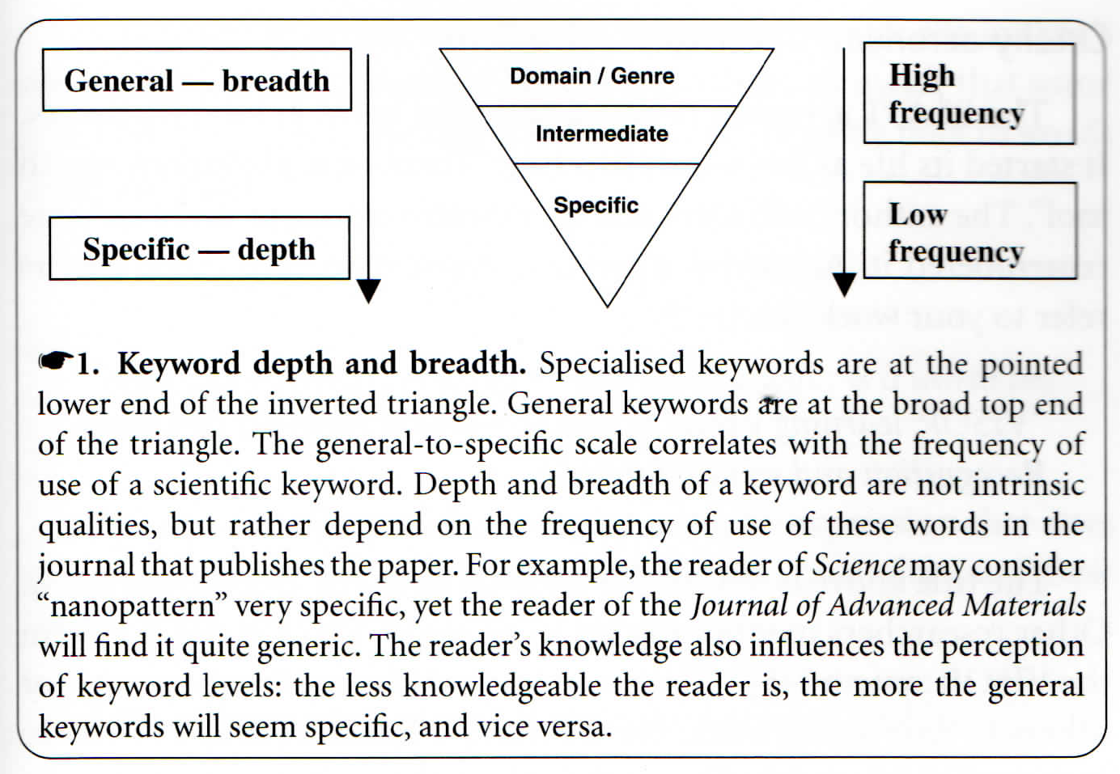

Slide 44
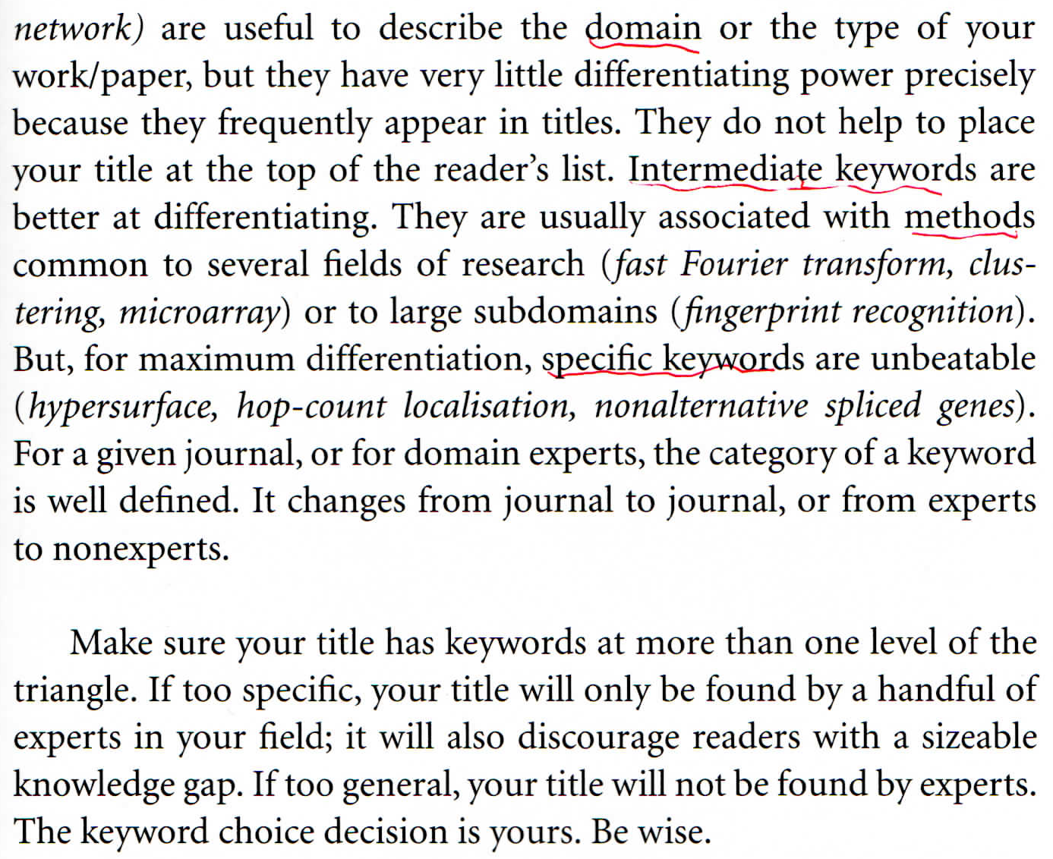

Slide 45
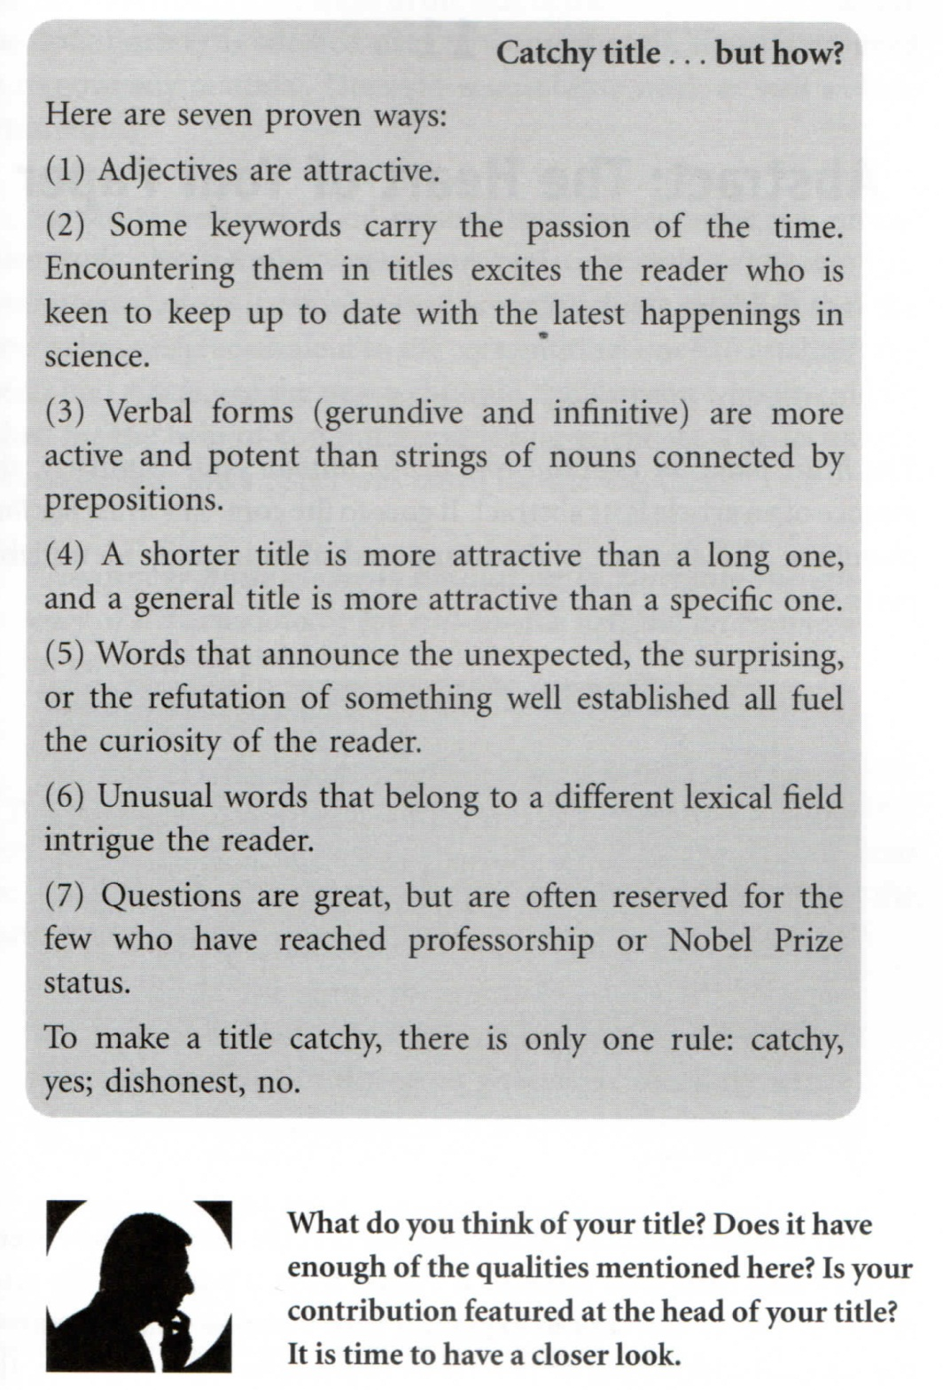
So a good title should be
  unique, lasting, concise, clear, easy to find, honest and representative, and (if possible) catchy
  A question for the title?

Slide 46
HW: Let us be critical …
  Select 10 titles from the latest
  ApJ issue. Do the same for 10 titles in RAA.
What is the title you have come up with for your thesis/paper? Bring it to our discussion.

