Slide 1
Typesetting by TeX and LaTeX

Slide 2
LaTex (from Tex)
a document preparation system (typesetting)
https://www.latex-project.org/
across platforms, e.g., Linux, Mac OS X, Windows, …
particularly useful for input math and special symbols
commonly used by astronomers, and adopted by almost every astronomy journal
no license fees
Github feedback/group developments
Numerous online tutorials
Online ‘overleaf’ interface (collaborative/group writing)
https://www.overleaf.com/project
Sign up your account today. ‘Hand in’ (submit) your homework with it.
https://en.wikipedia.org/wiki/LaTeX
https://zh.wikipedia.org/wiki/LaTeX

Slide 3
‘Over’ and ‘leaf’
How many words can you write down that include ‘over’, prefixed or suffixed?
Check them out, e.g., ‘over-’, in a dictionary.
頁背
https://www.dictionary.com/browse/prefix

Slide 4
American Astronomical Society (AAS) cf the ASROC.
AASTeX for AAS journals
(what are they?)
https://journals.aas.org/aastexguide/
Most journals (e.g., MNRAS) have their own class/style files.

Slide 5
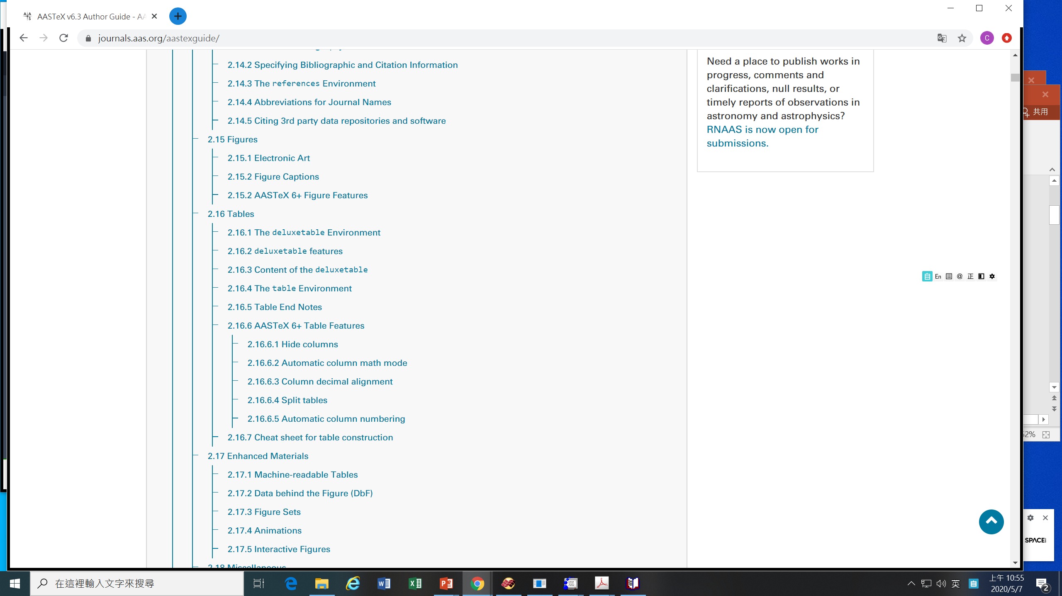

Slide 6
The ORCID is your scholar ID. Get one for yourself today.

Slide 7
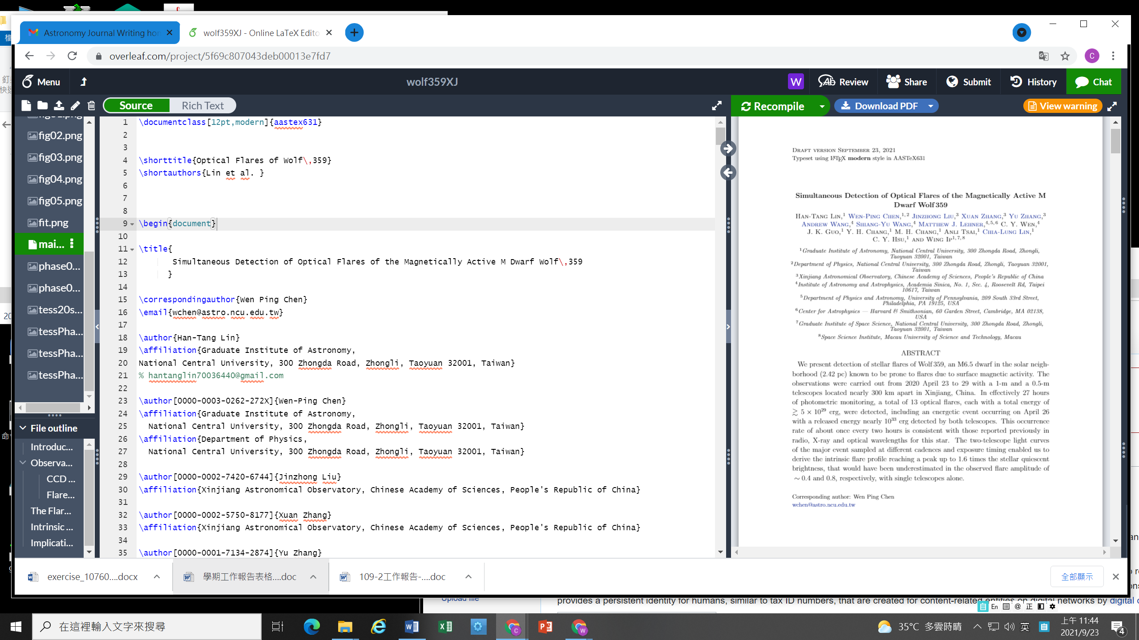

Slide 8
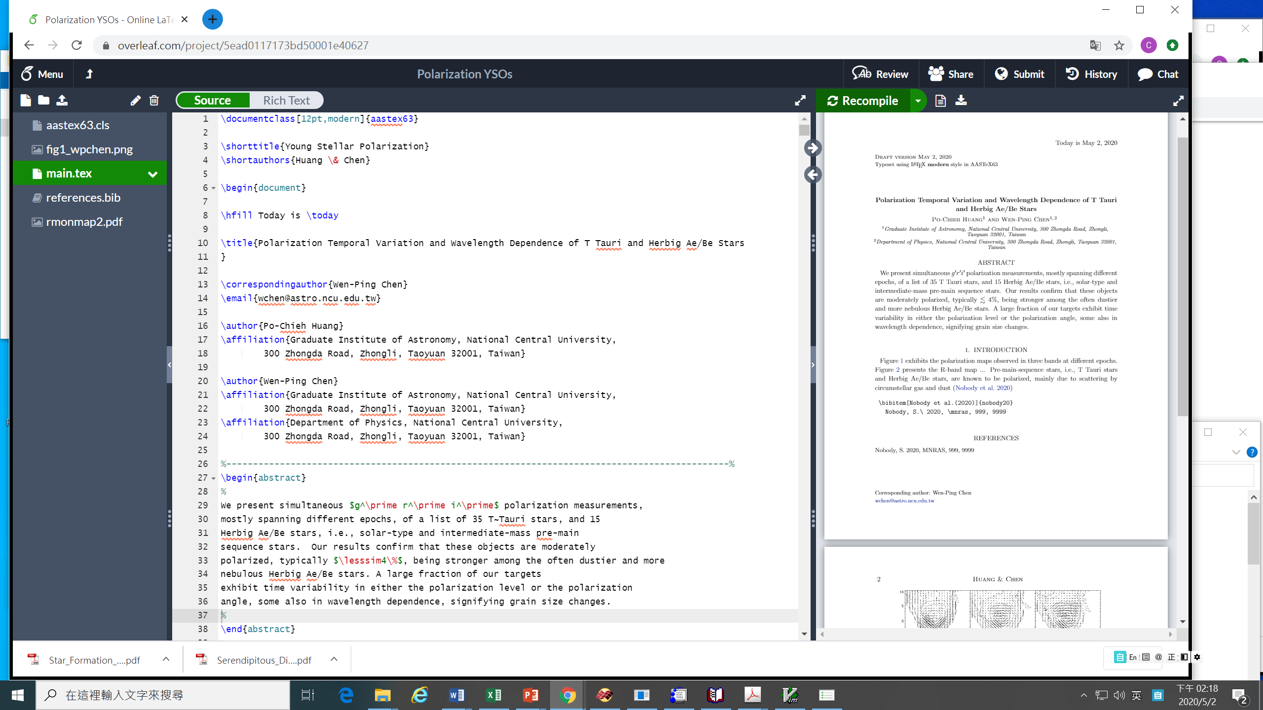

Slide 9
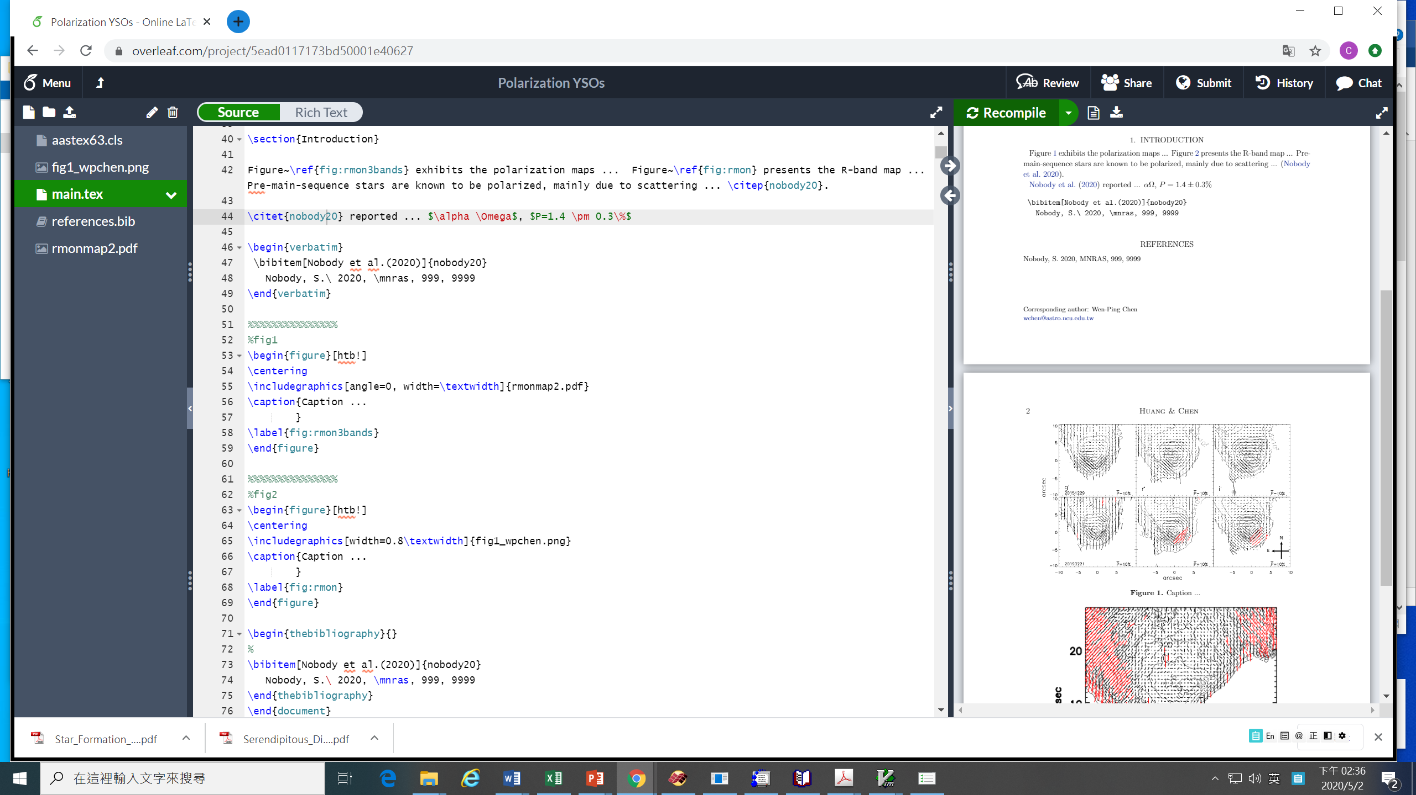

Slide 10
\documentclass[12pt,modern]{aastex631}
\begin{document}
\title{
Simultaneous Detection of Optical Flares of the
Magnetically Active M Dwarf Wolf\,359
}
\author[0000-0003-0262-272X]{Wen-Ping Chen}
\affiliation{
Graduate Institute of Astronomy, National Central University,
300 Zhongda Road, Zhongli, Taoyuan 32001, Taiwan
}
\end{document}

Slide 11
https://authortools.aas.org/aastex/aassymbols.pdf

Slide 13
natbib

Slide 17
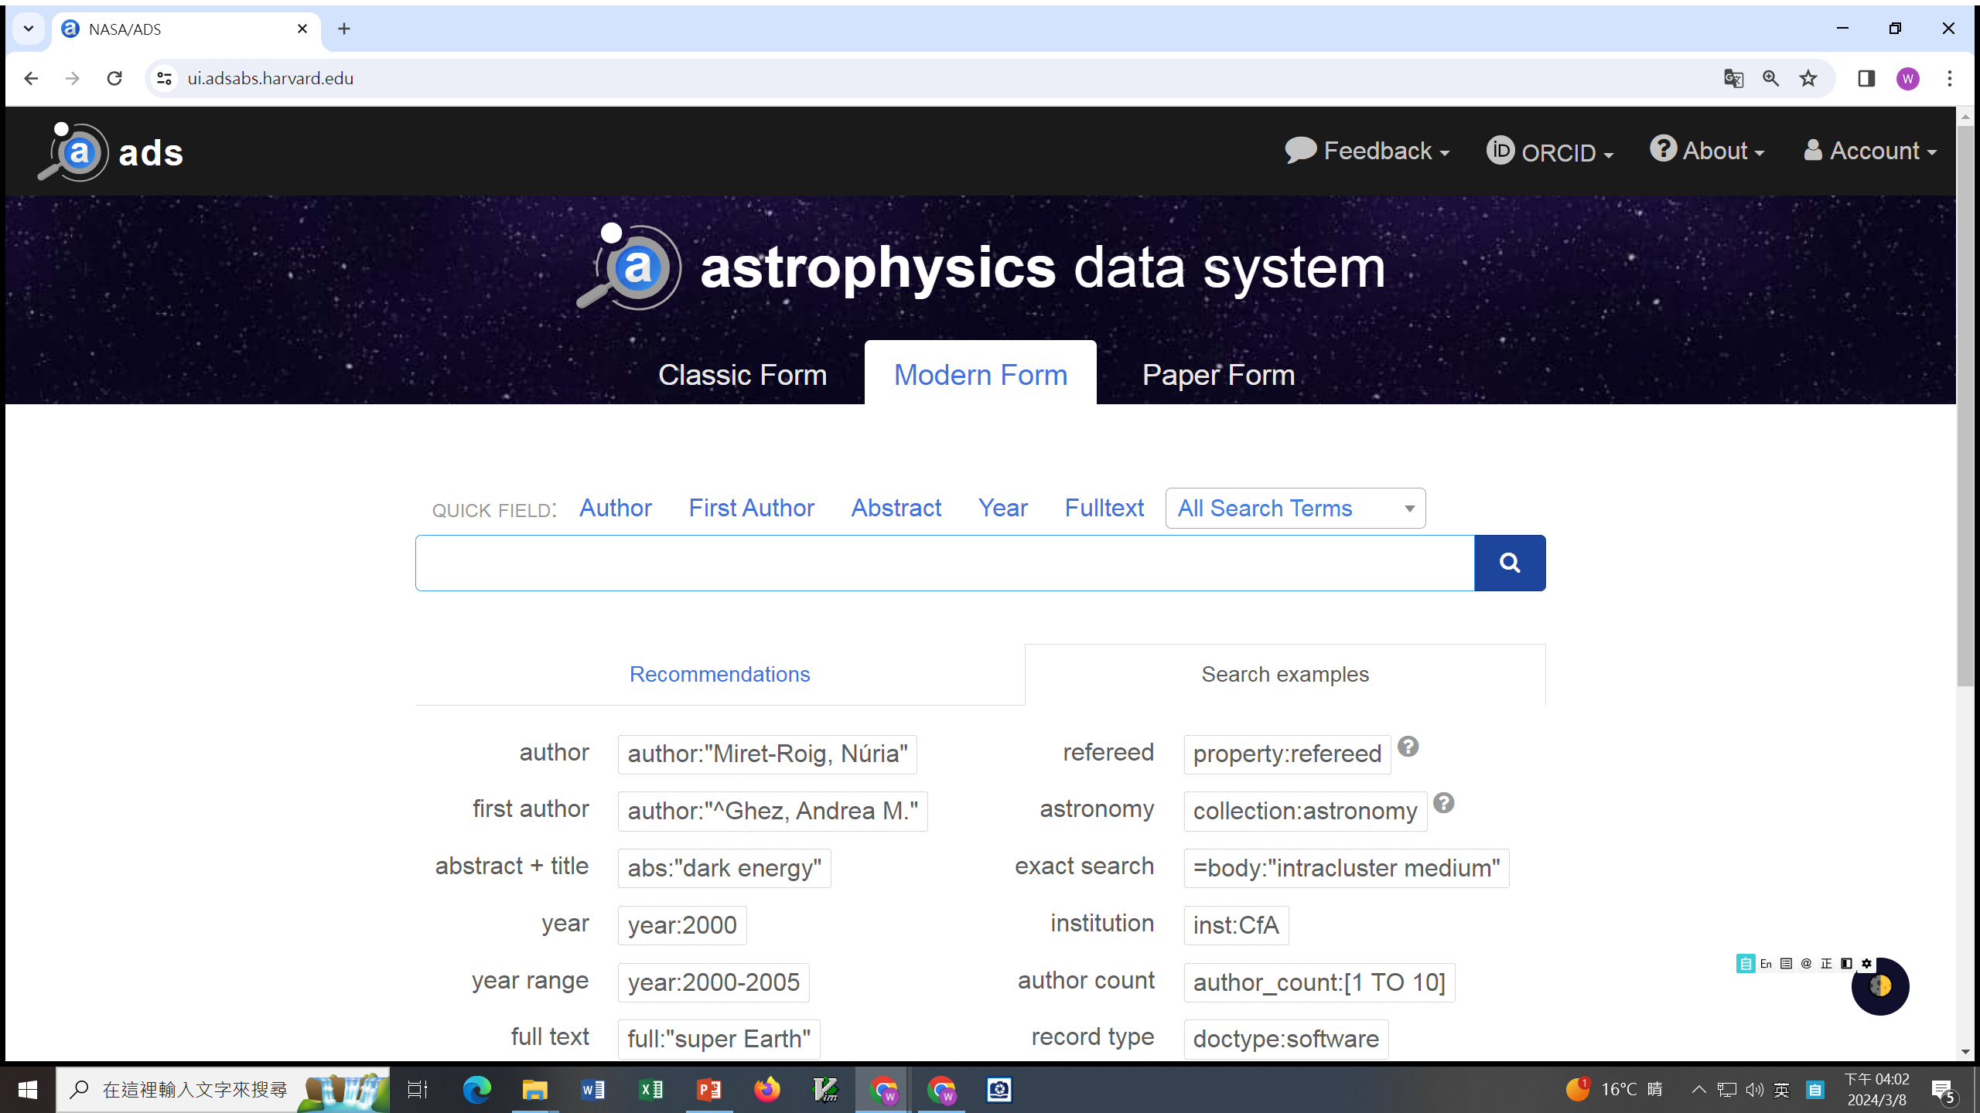
Preparing the references with ADS

Slide 18
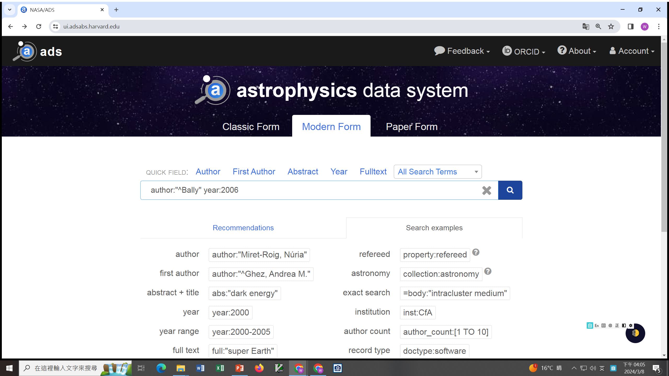

Slide 19
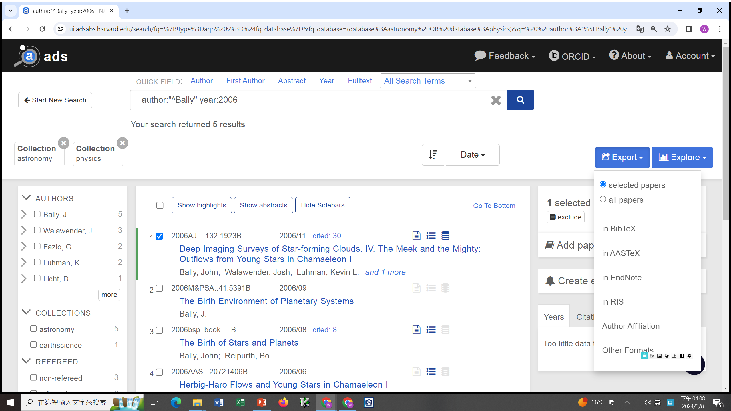

Slide 20
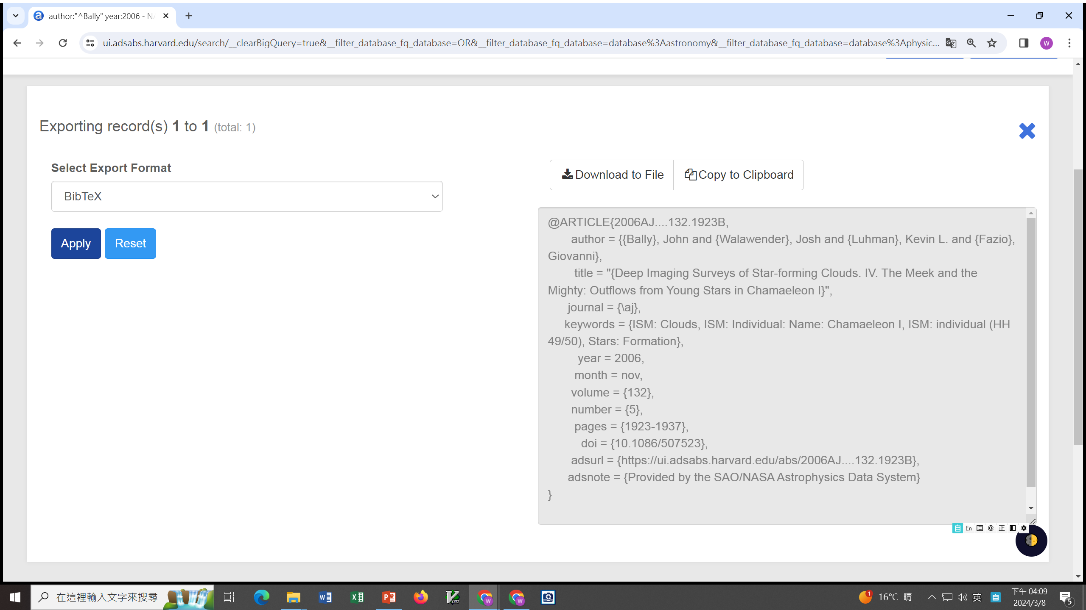

Slide 21
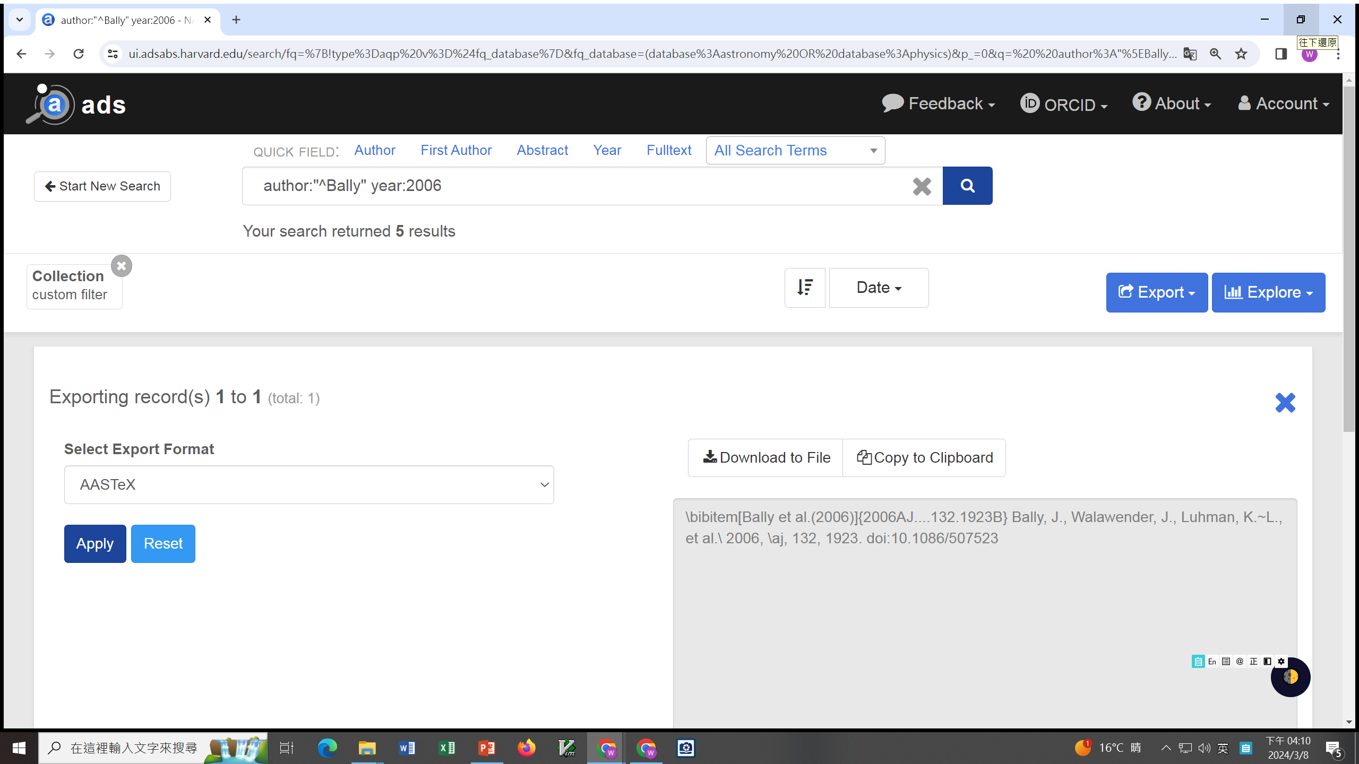

Slide 22
1. Listing the references
%\bibliography{editor}
% For BibTex% For non-BibTex:
\begin{thebibliography}{}
\bibitem[Alcal{\’a} et al.(2008)]{alc08} Alcal{\’a}, J.~M., Spezzi, L., Chapman, N., et al.\ 2008, \apj, 676, 427.
doi:10.1086/527315
\bibitem[Bally et al.(2006)]{bal06} Bally, J., Walawender, J., Luhman, K.~L., et al.\ 2006, \aj, 132, 1923.
doi:10.1086/507523
\end{thebibliography}

Slide 23
https://journals.aas.org/aastexguide/#tables

Slide 24
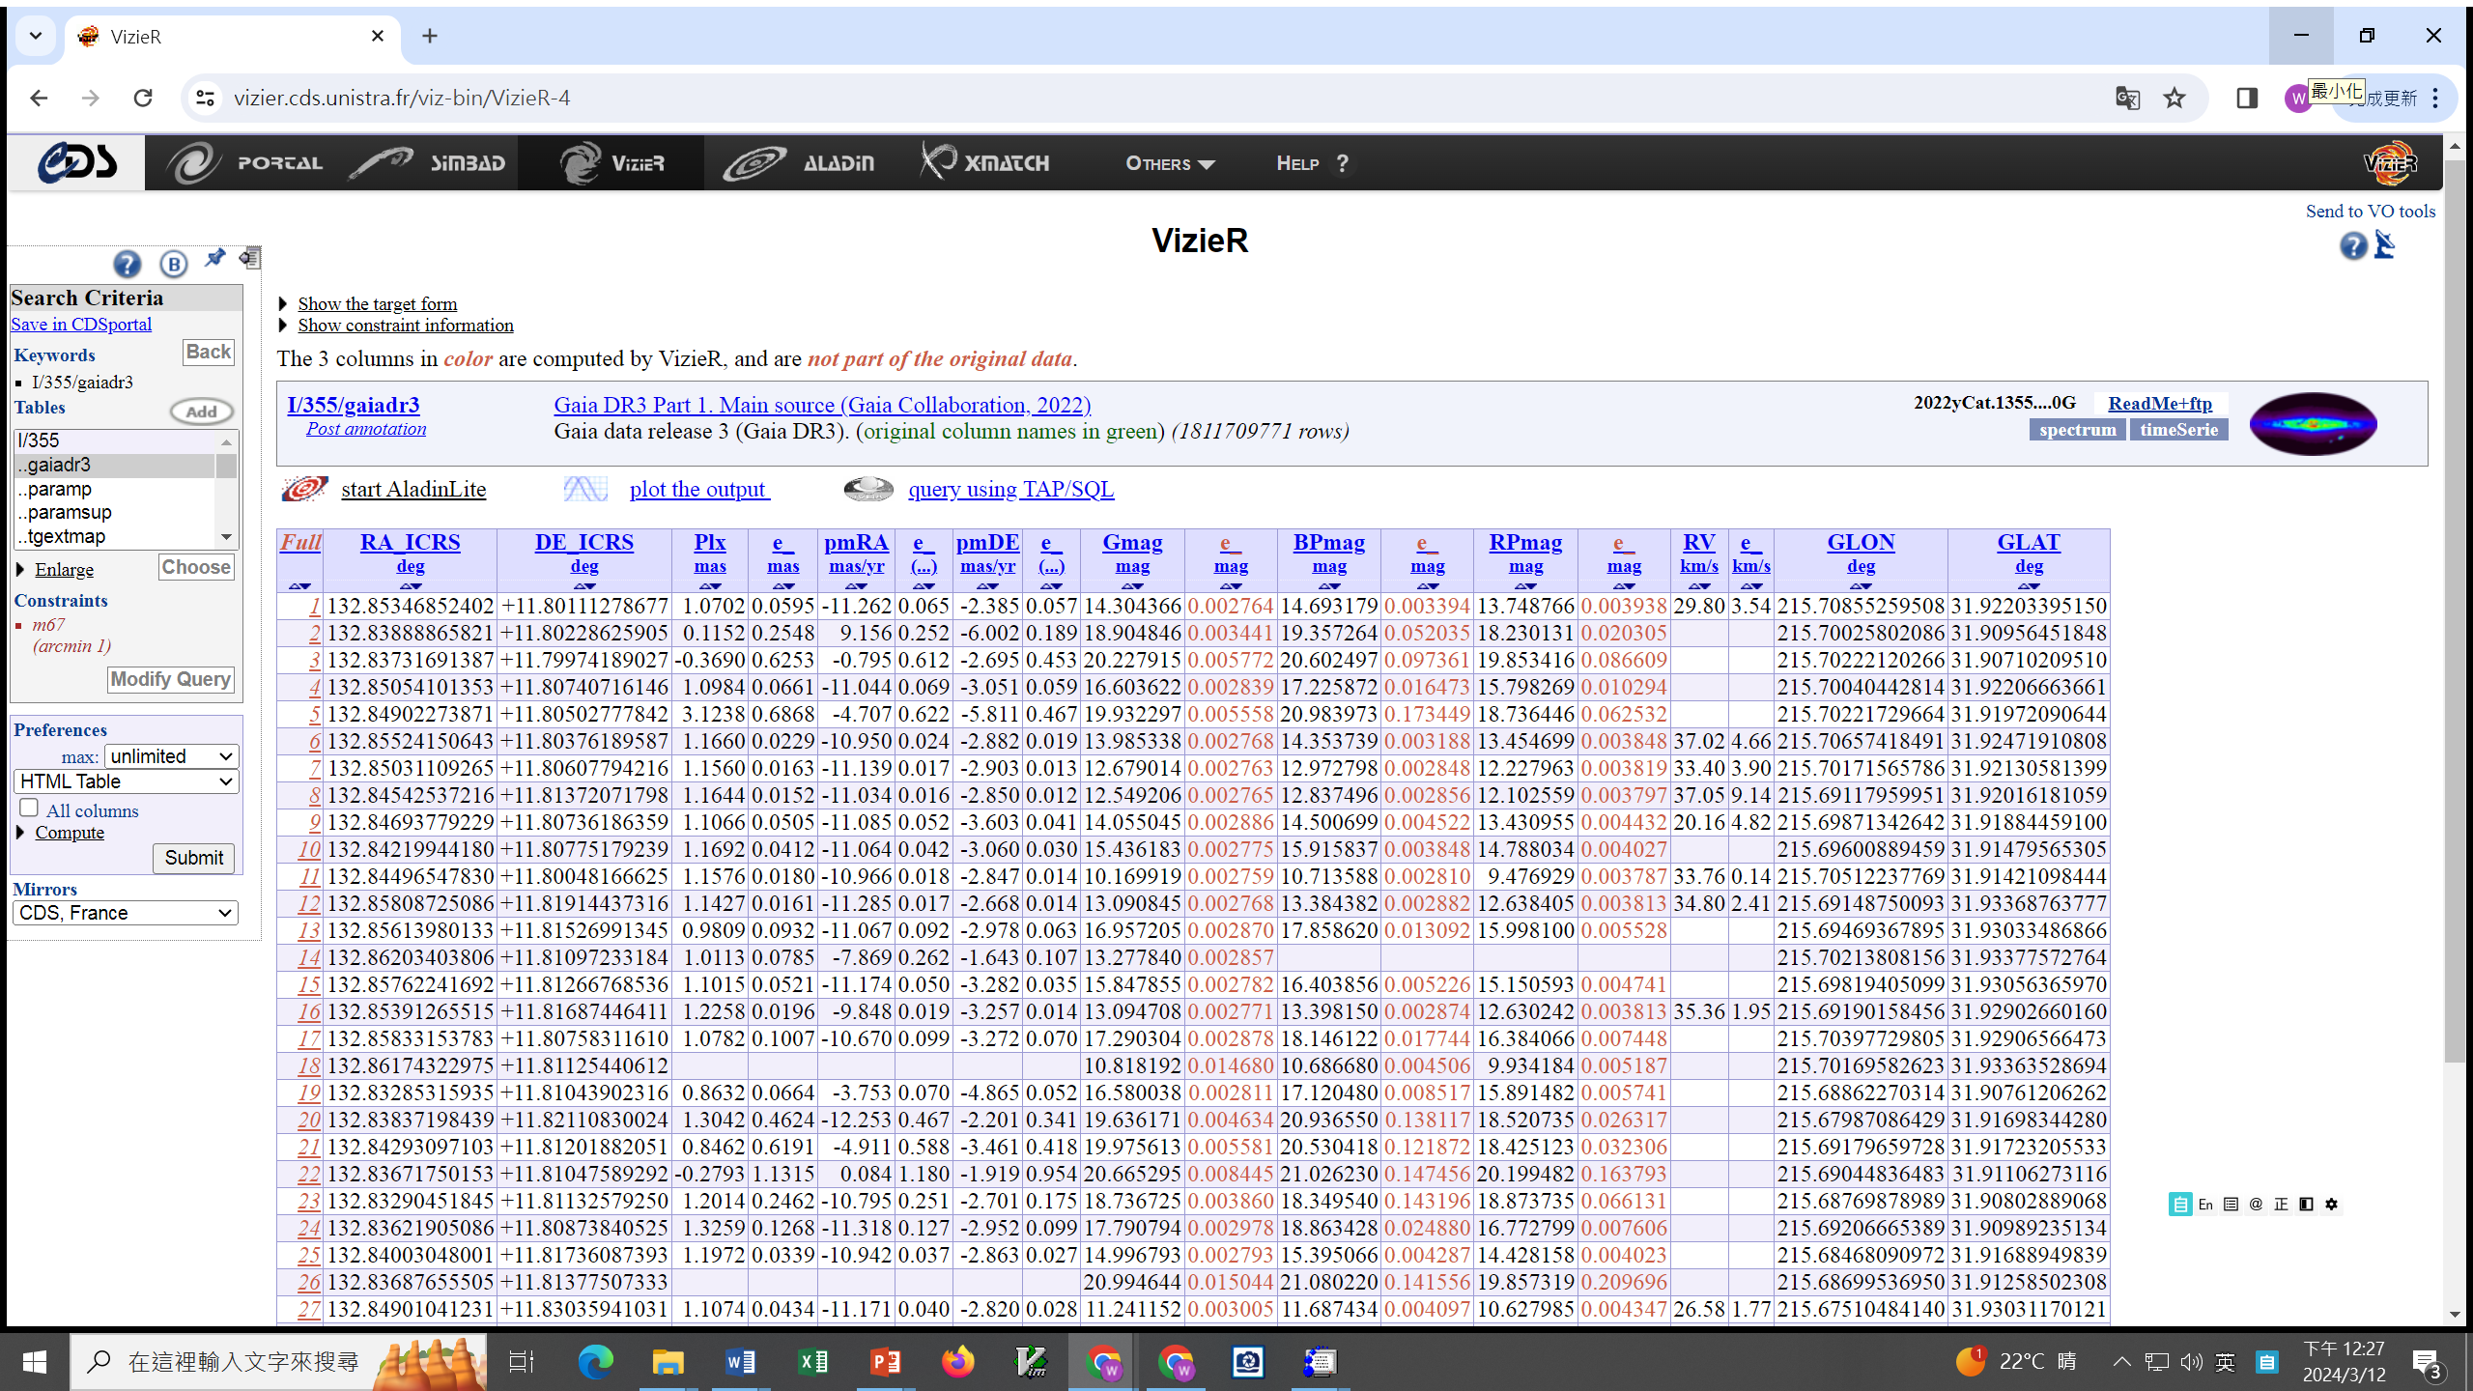
M67 Gaia DR3 1’

Slide 25
\newpage
\begin{longrotatetable}
\begin{deluxetable*}{cCC CCC CCC CCC cccc}
\tablecaption{LAMOST Brown Dwarf Candidates\label{tab:DBs}
\tabletypesize{\scriptsize}
\tablewidth{0pt} \tablehead{
\colhead{No.}& \colhead{R.A.} & \colhead{Decl.} & \colhead{$PS_i$} &
\colhead{$PS_z$} & \colhead{$PS_y$} &
\colhead{$J$} & \colhead{$H$} & \colhead{$K$} &
\colhead{$G$}&\colhead{$G_{BP}$}&\colhead{$G_{RP}$}&
\colhead{$W1$} & \colhead{$W2$} & \colhead{$W3$} &
\colhead{$phot-D$} \\ \colhead{ } & \colhead{(deg 2000)} &
\colhead{(deg 2000)} & \multicolumn{12}{c}{(mag))} &
\colhead{pc} }
\startdata
1& 0.29067& 7.30335& 15.157& 14.147& 13.585& 12.151& 11.508&
11.160& 16.169& 18.269& 14.412& 10.950& 10.733& 10.565& 20.160\\
2& 2.23202& 49.31638& 13.688& 12.722& 12.286& 10.864& 10.320&
9.980& 14.409& 16.791& 13.008& 9.769& 9.556& 9.359& 11.510 \\
\enddata
\end{deluxetable*}
\end{longrotatetable}

Slide 27
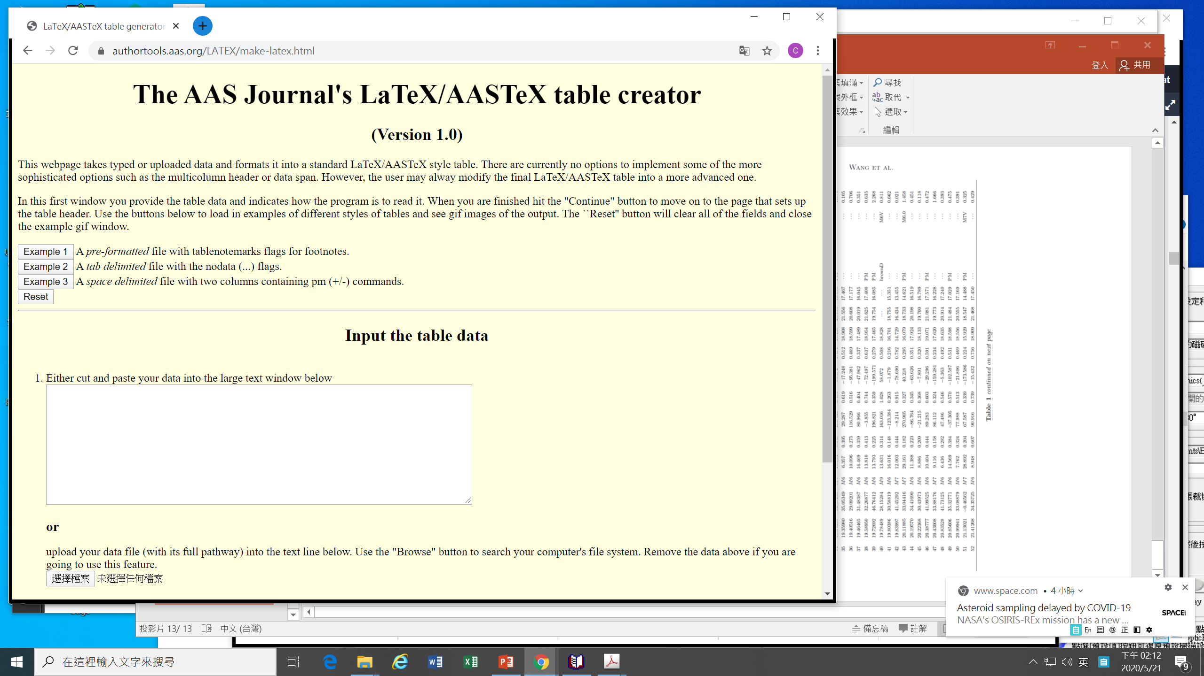
https://authortools.aas.org/LATEX/make-latex.html

Slide 28
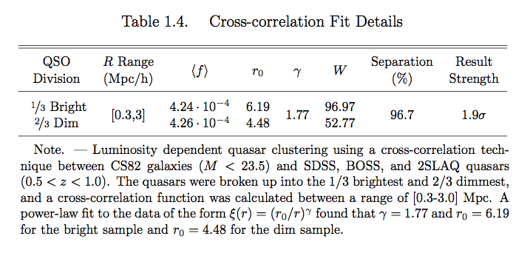
https://www.astrobetter.com/blog/2013/09/13/how-to-make-awesome-latex-tables/

Slide 29
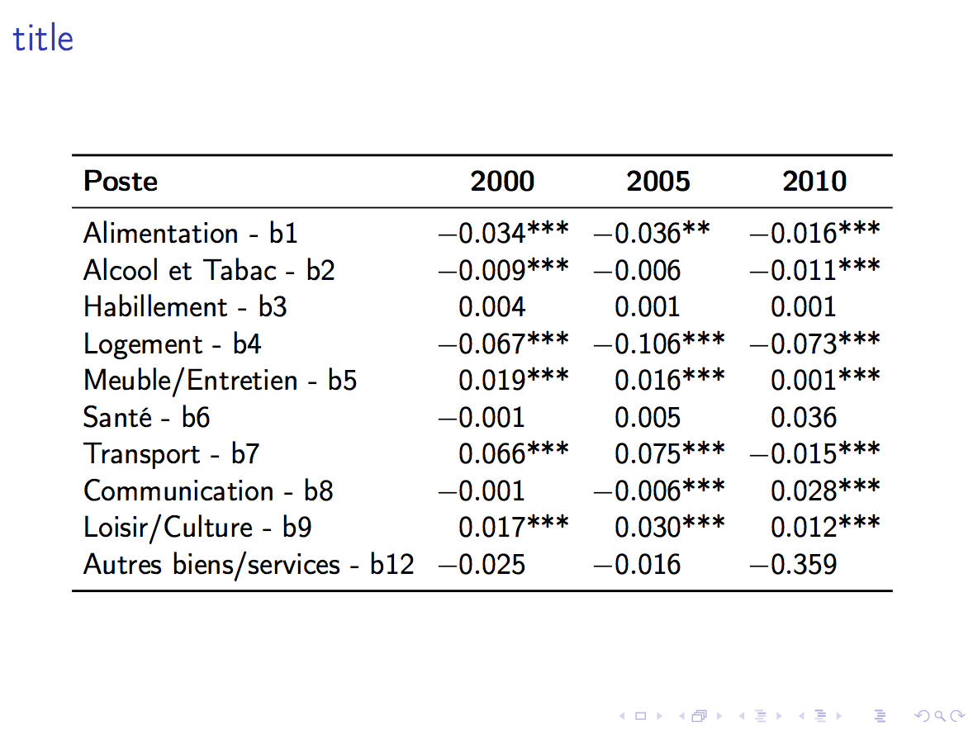
To align decimal points …
https://tex.stackexchange.com/questions/245086/align-numbers-on-decimal-point-in-tabular-except-for-the-column-title?rq=1

Slide 30
\citet{nobody20} reported ... $\alpha \Omega$, $P=1.4 \pm 0.3\%$
\begin{verbatim}
\bibitem[Nobody et al.(2020)]{nobody20}
Nobody, S.\ 2020, \mnras, 999, 9999
READCOL, 'file.txt', skip=3, $
rastar, destar, gmag, bpmag, rpmagPLOT, rastar, destar, /ynozero
\end{verbatim}

Slide 31
%%%%%%%%%%%%%%%
%fig1
\begin{figure}[htb!]
\centering
\includegraphics[angle=0,width=\textwidth]{rmonmap2.pdf}
\caption{Caption ...
}
\label{fig:rmon3bands}
\end{figure}
%%%%%%%%%%%%%%%

Slide 32
Mind the differences of -, --, and ---
\documentclass{aastex63}
\begin{document}
\LARGE
  hyphen~~~~~NCU-Delta award
  En-dash~~~~~from 100—105
  Em-dash~~~~~ Observations were carried out --- again --- last night.
  mathmatical 'minus' ~~~~~ $-35$
  with a speed of $-35.7$~km~s$^{-1}$
  An angular separation of $0\farcs15$
  with a color of $\bv=0.17$~mag
  bserved at 12~\micron
  the mass is 12.8 $M_\sun$
  $x \ga 13$, $x \la 19.5$
  $k \sim 14$, $ \Omega \approx -99$
\end{document}

Slide 33
NCU thesis template example,
https://www.overleaf.com/latex/templates/ncu-master-slash-phd-thesis-template/ykpprbmqrdfp

Slide 34
https://www.aanda.org/for-authors/latex-issues/typography

