Slide 1
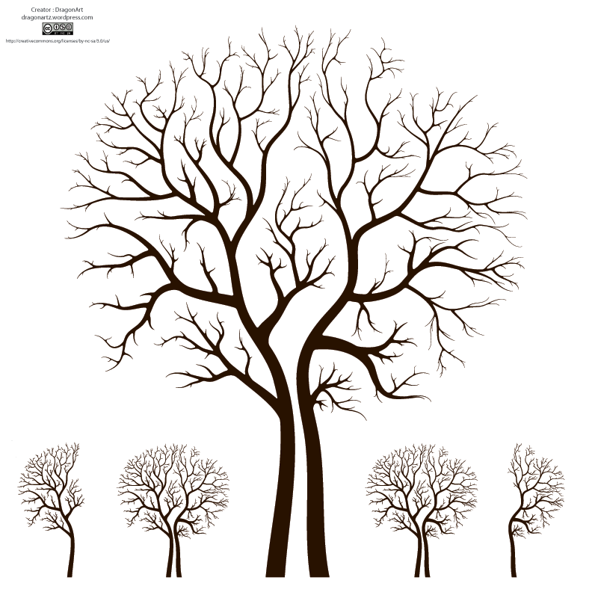
Paper Structure
Title = face
Abstract = heart
Key Words = address
Headings = skeleton
Introduction = hands
Data and Analysis
Discussion Visuals = voice
Conclusion = smile
References

Slide 2
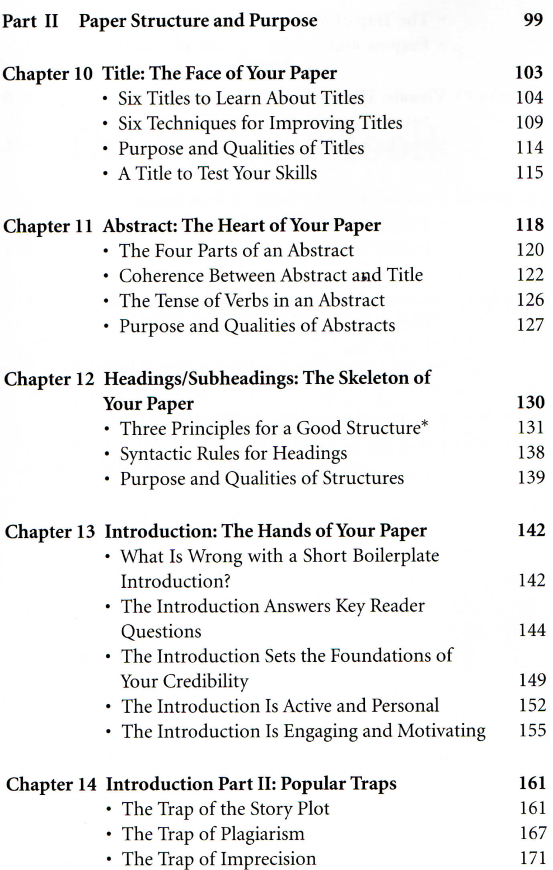
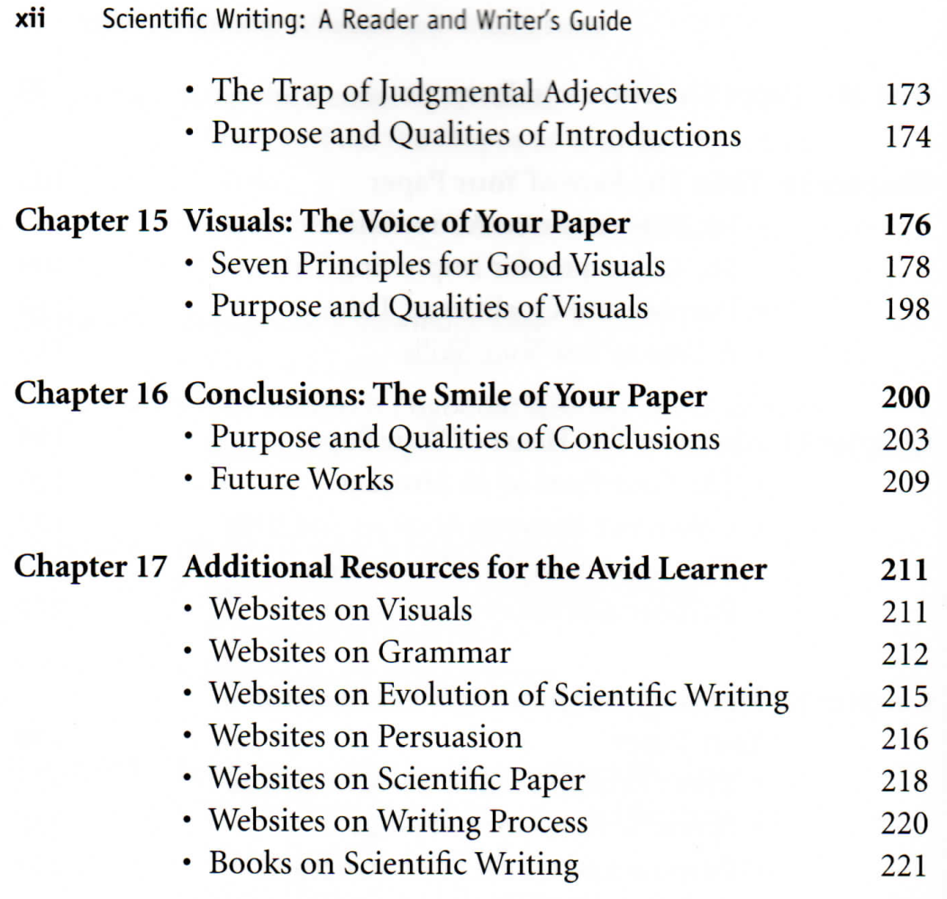

Slide 3
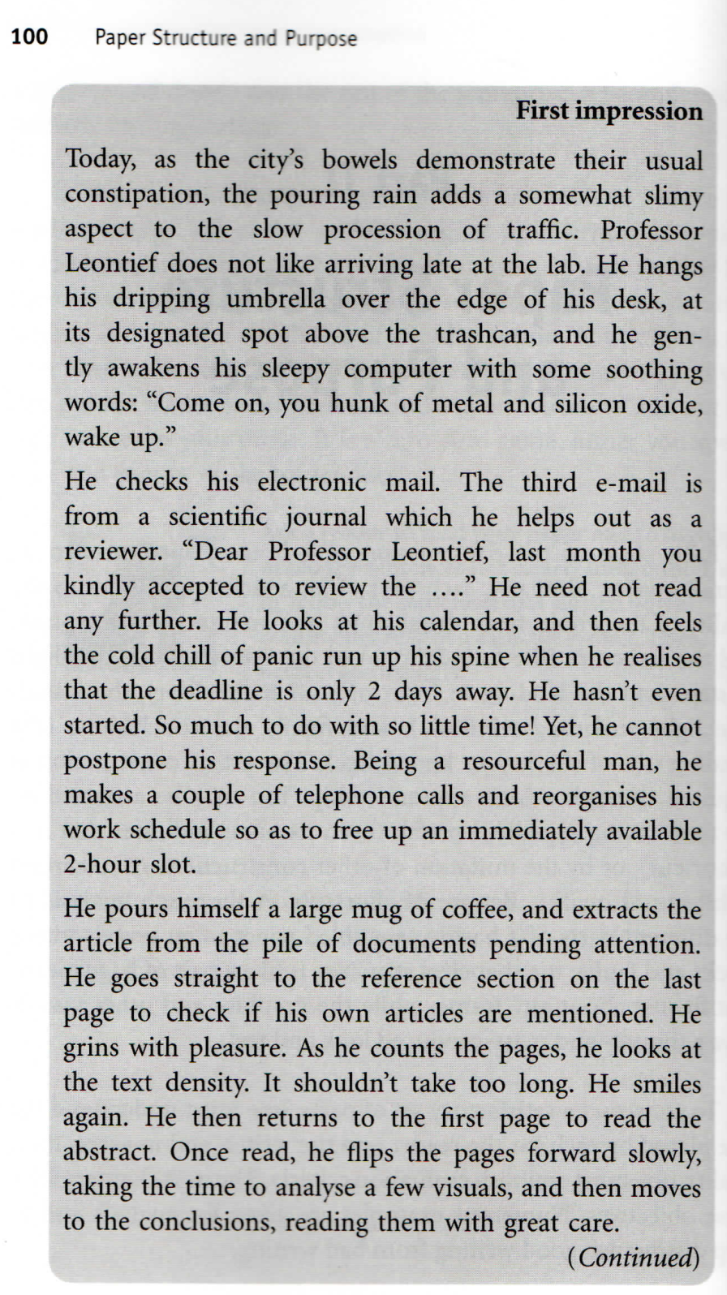
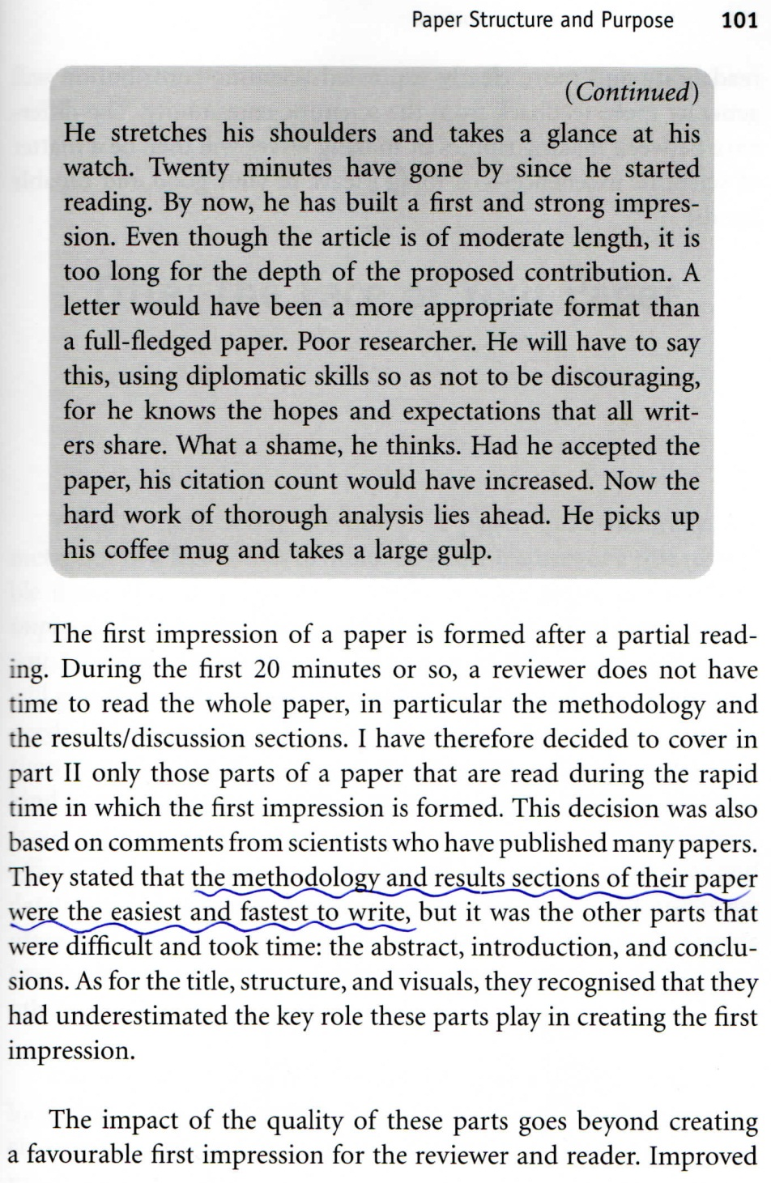

Slide 4
Title --- How to select one
Try alternative titles …
What are the differences
Pair elimination
The best one should be tempting and informative
Author’s contribution should come first

Slide 5
Title (cont.)
The title is not read; it is scanned, within 2 seconds at most
A long easily understood title is better than a short one with nouns to be unpacked, which in turn is better than an ambiguous one
An old or popular subject → a longer title in order to specify the contribution

Slide 6
Six Techniques to improve titles
Placement of Contribution First
For a full sentence, the new information usually appears at the end and the old information at the beginning.
In a verbless title, however, the situation is reversed.

Slide 7
2. Using Verbal Forms
A verb gives energy. So use gerunds （動名詞）or infinitives （不定詞）to energize your title.
For example: Data learning: Understanding astronomical Data

Slide 8
3. Using Adjectives or Numbers to Stress contribution
Fast, highly efficient, robust, but not new or novel
The most specific, the better, e.g., 5 Hz sampling is better than fast sampling
4. Clear and Specific Keywords
Easier to locate by a search engine or database

Slide 9
5. Smart Choice of Keywords
Pick your keywords from recent or often-cited titles close to your contribution → searches to retrieve those will also find yours
If two keywords are equally good, choose one for the title and the other for the abstract.
6. Catchy Acronyms
MACHO, TAOS

Slide 10
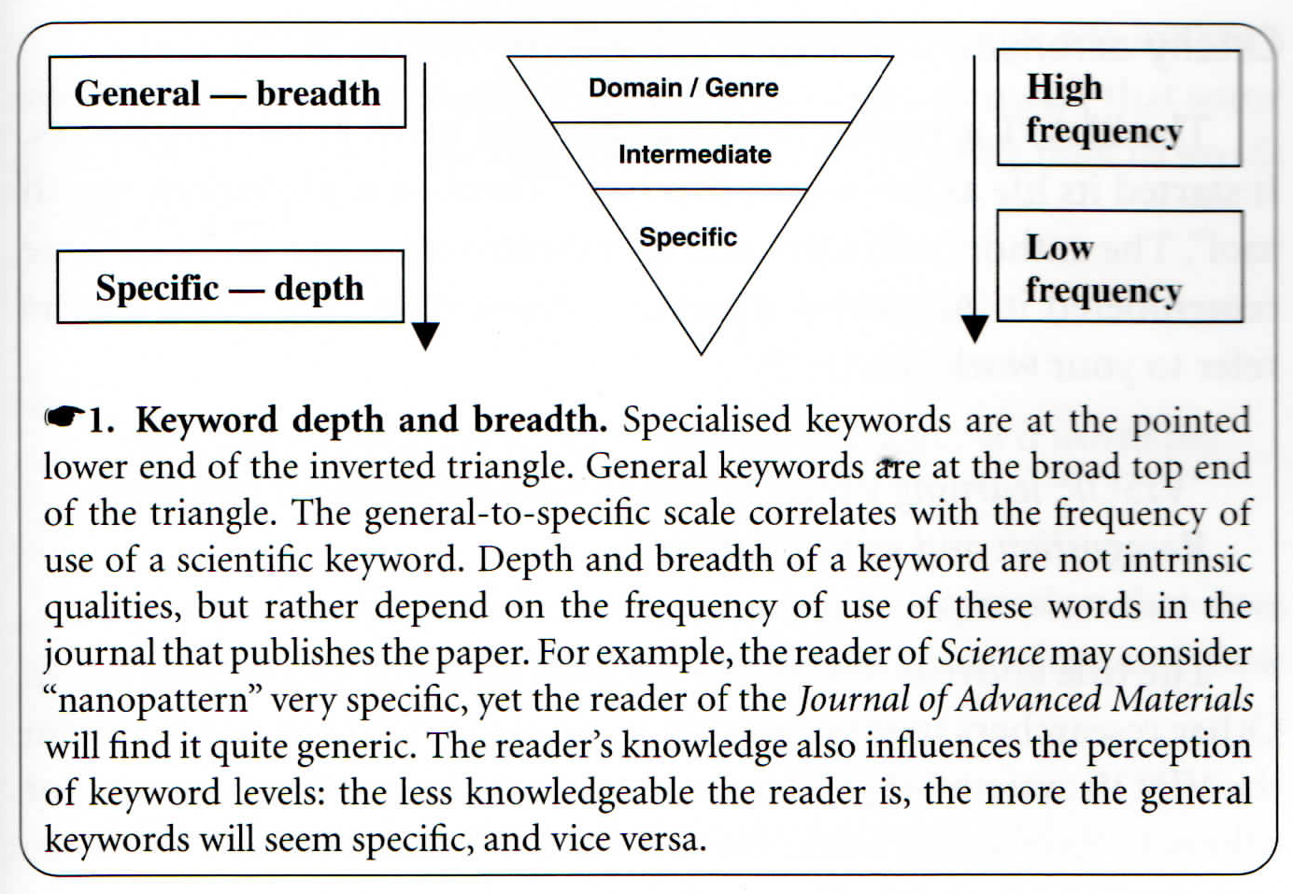

Slide 11
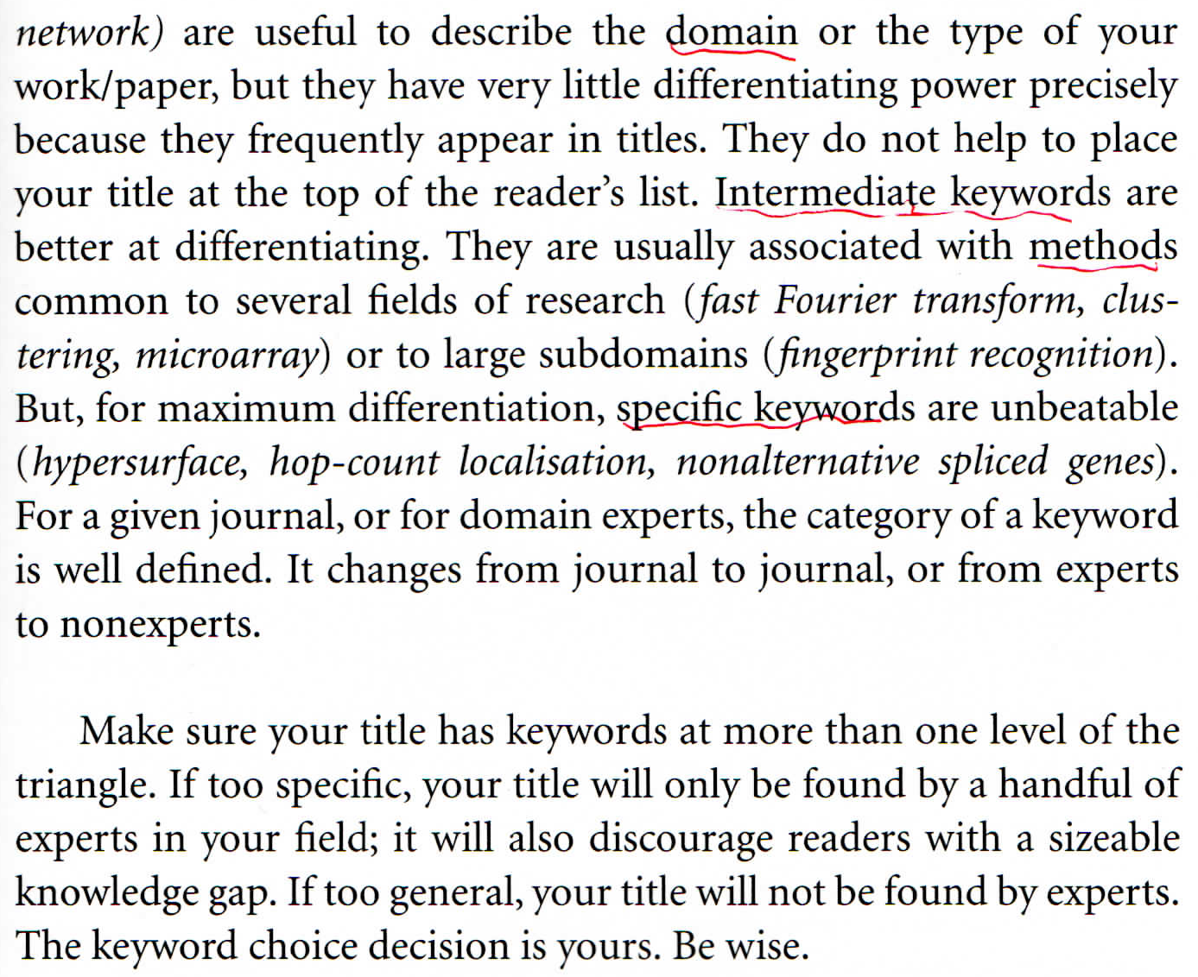

Slide 12
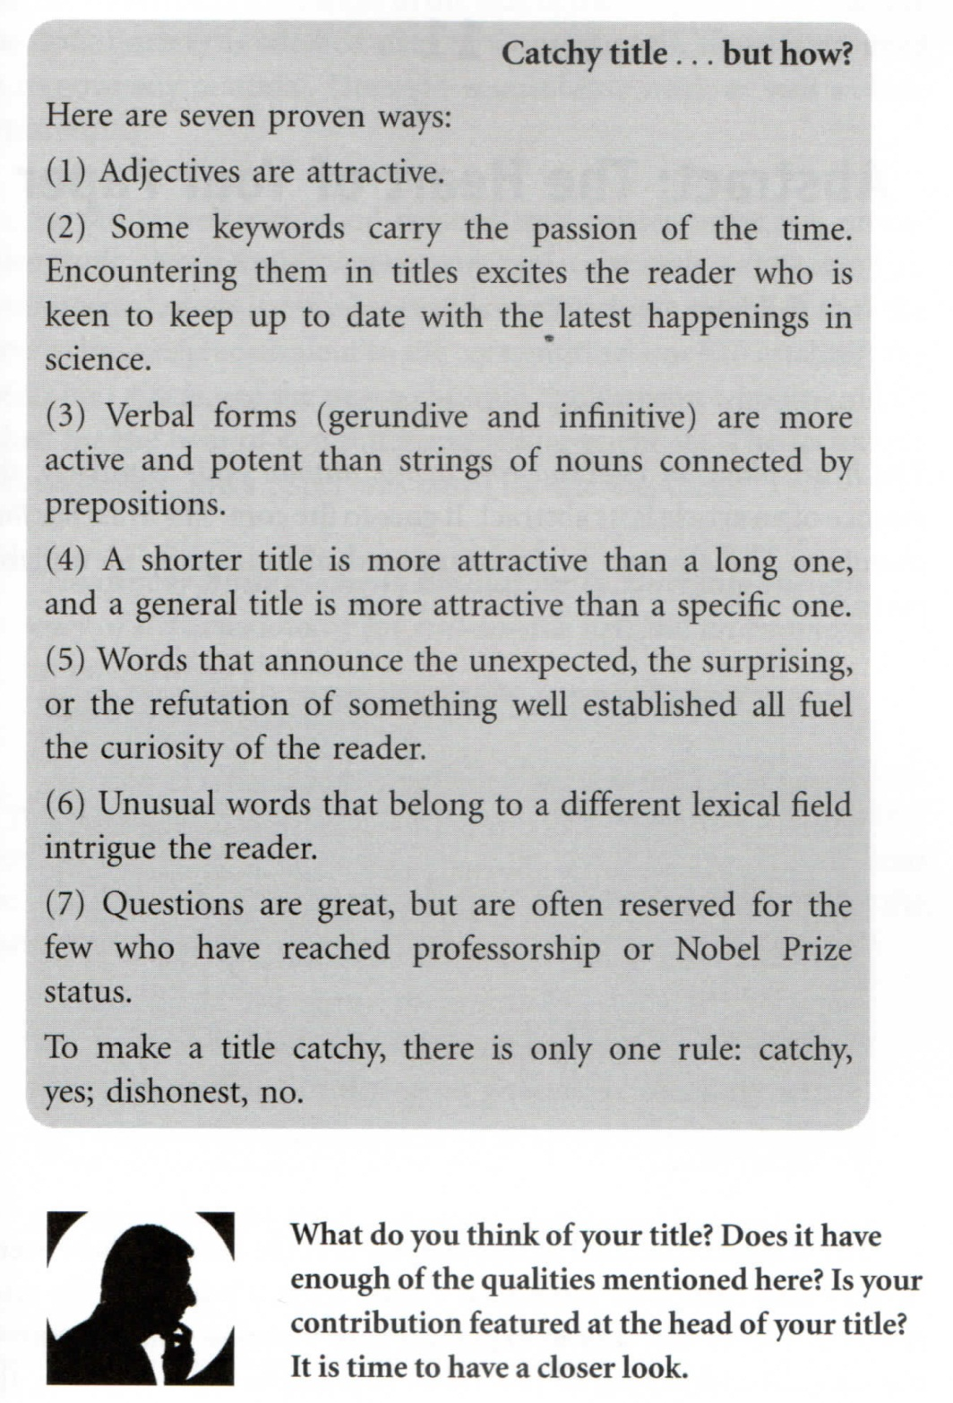
So a good title should be
unique, lasting, concise, clear, easy to find, honest and representative, and (if possible) catchy
A question for the title?

Slide 13
HW: Let us be critical …
Select 10 titles from the latest ApJ issue. Do the same for 10 titles in RAA.
What is the title you have come up with for your thesis/paper? Bring it to our discussion.

Slide 14
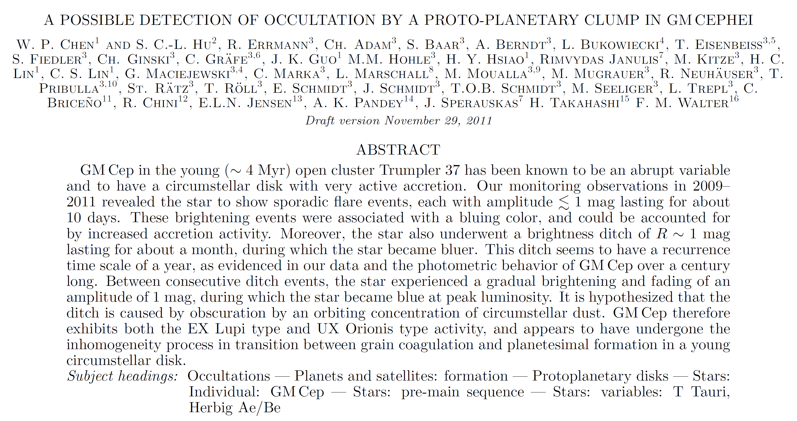
A paper I am writing now …

Slide 15
Abstract --- the heart of your paper
Chapter 11 of Jean-Luc Lebrun
What does a reader expect to see in an abstract?
What do you expect to see as a reader?

Slide 16
Four parts of an abstract
What
What is the problem? What is the topic of this paper?
How
How is the problem solved (methodology)?
Results
What are the specific results? How well is the problem solved? Visuals in abstracts?
Impact
So what? How useful is this to science or to the reader?

Slide 17
Very often, the fourth part (impact) is missing, because
The maximum number of words allowed by the journal ran out too quickly with a long rambling start.
The author (mistakenly) considered that the results should speak for themselves.
The author was not able to assess the impact of the scientific contribution.
“a result of the myopia caused by the atomization of research tasks among many researchers” 見樹不見林

Slide 18
The parts with the largest number of words = contribution
Adjectives ok in the title, but precision in the abstract
Coherence between abstract and title
30%~80% (i.e., > 1/3) significant title words are in the first sentence of the abstract. There are exceptions, but usually at least there should be one word from the title. Otherwise, sentences 2 and 3 mention most of the other title words.
The first sentence should expand, not just repeat, the title.

Slide 19
All title words should be in the abstract. Otherwise, why does a word deserve a “title” status of your paper? One exception is using an alternative, interchangeable keyword in the field → to increase the chance of being found by search engines.
If a title word is not important, remove it.
If a title word is missing in the abstract and is important, put it in.
If the abstract contains a keyword that should be in the title, rewrite the title to incorporate that keyword.

Slide 20
The abstract needs to set the problem, but does not need to justify why it is important (the introduction does that.) The abstract, however, needs to justify the significance of the results.
The abstract should NOT (1) mention the work of other researchers (it is done in the introduction), unless the paper is an extension of a previous paper; (2) why the problem is important (also the role of the introduction). The abstract should concentrate on the importance of the results.

