Slide 1
Exercise:
Conduct a survey as comprehensive as possible of at least 10 journals that publish astronomy- or astrophysics-related research results. Which of them have associated publications, e.g., letters or supplements?
Select a handful of ‘core’ journals (definition?), and summarize how often each journal publishes, in what language, by what publisher.
Compare the ‘style’ of the core journals. Note the layout of the title, abstract, references, etc. (e.g., ApJ vs A&A)
Zoom in to one journal and browse through one recent paper of your choice. What is it about? By whom?
Identify one off-core journal. Does our library subscribe to it.
What is the Science Citation Index? What is the Impact Factor?
What is the Open Access policy? PLOS One?

Slide 2
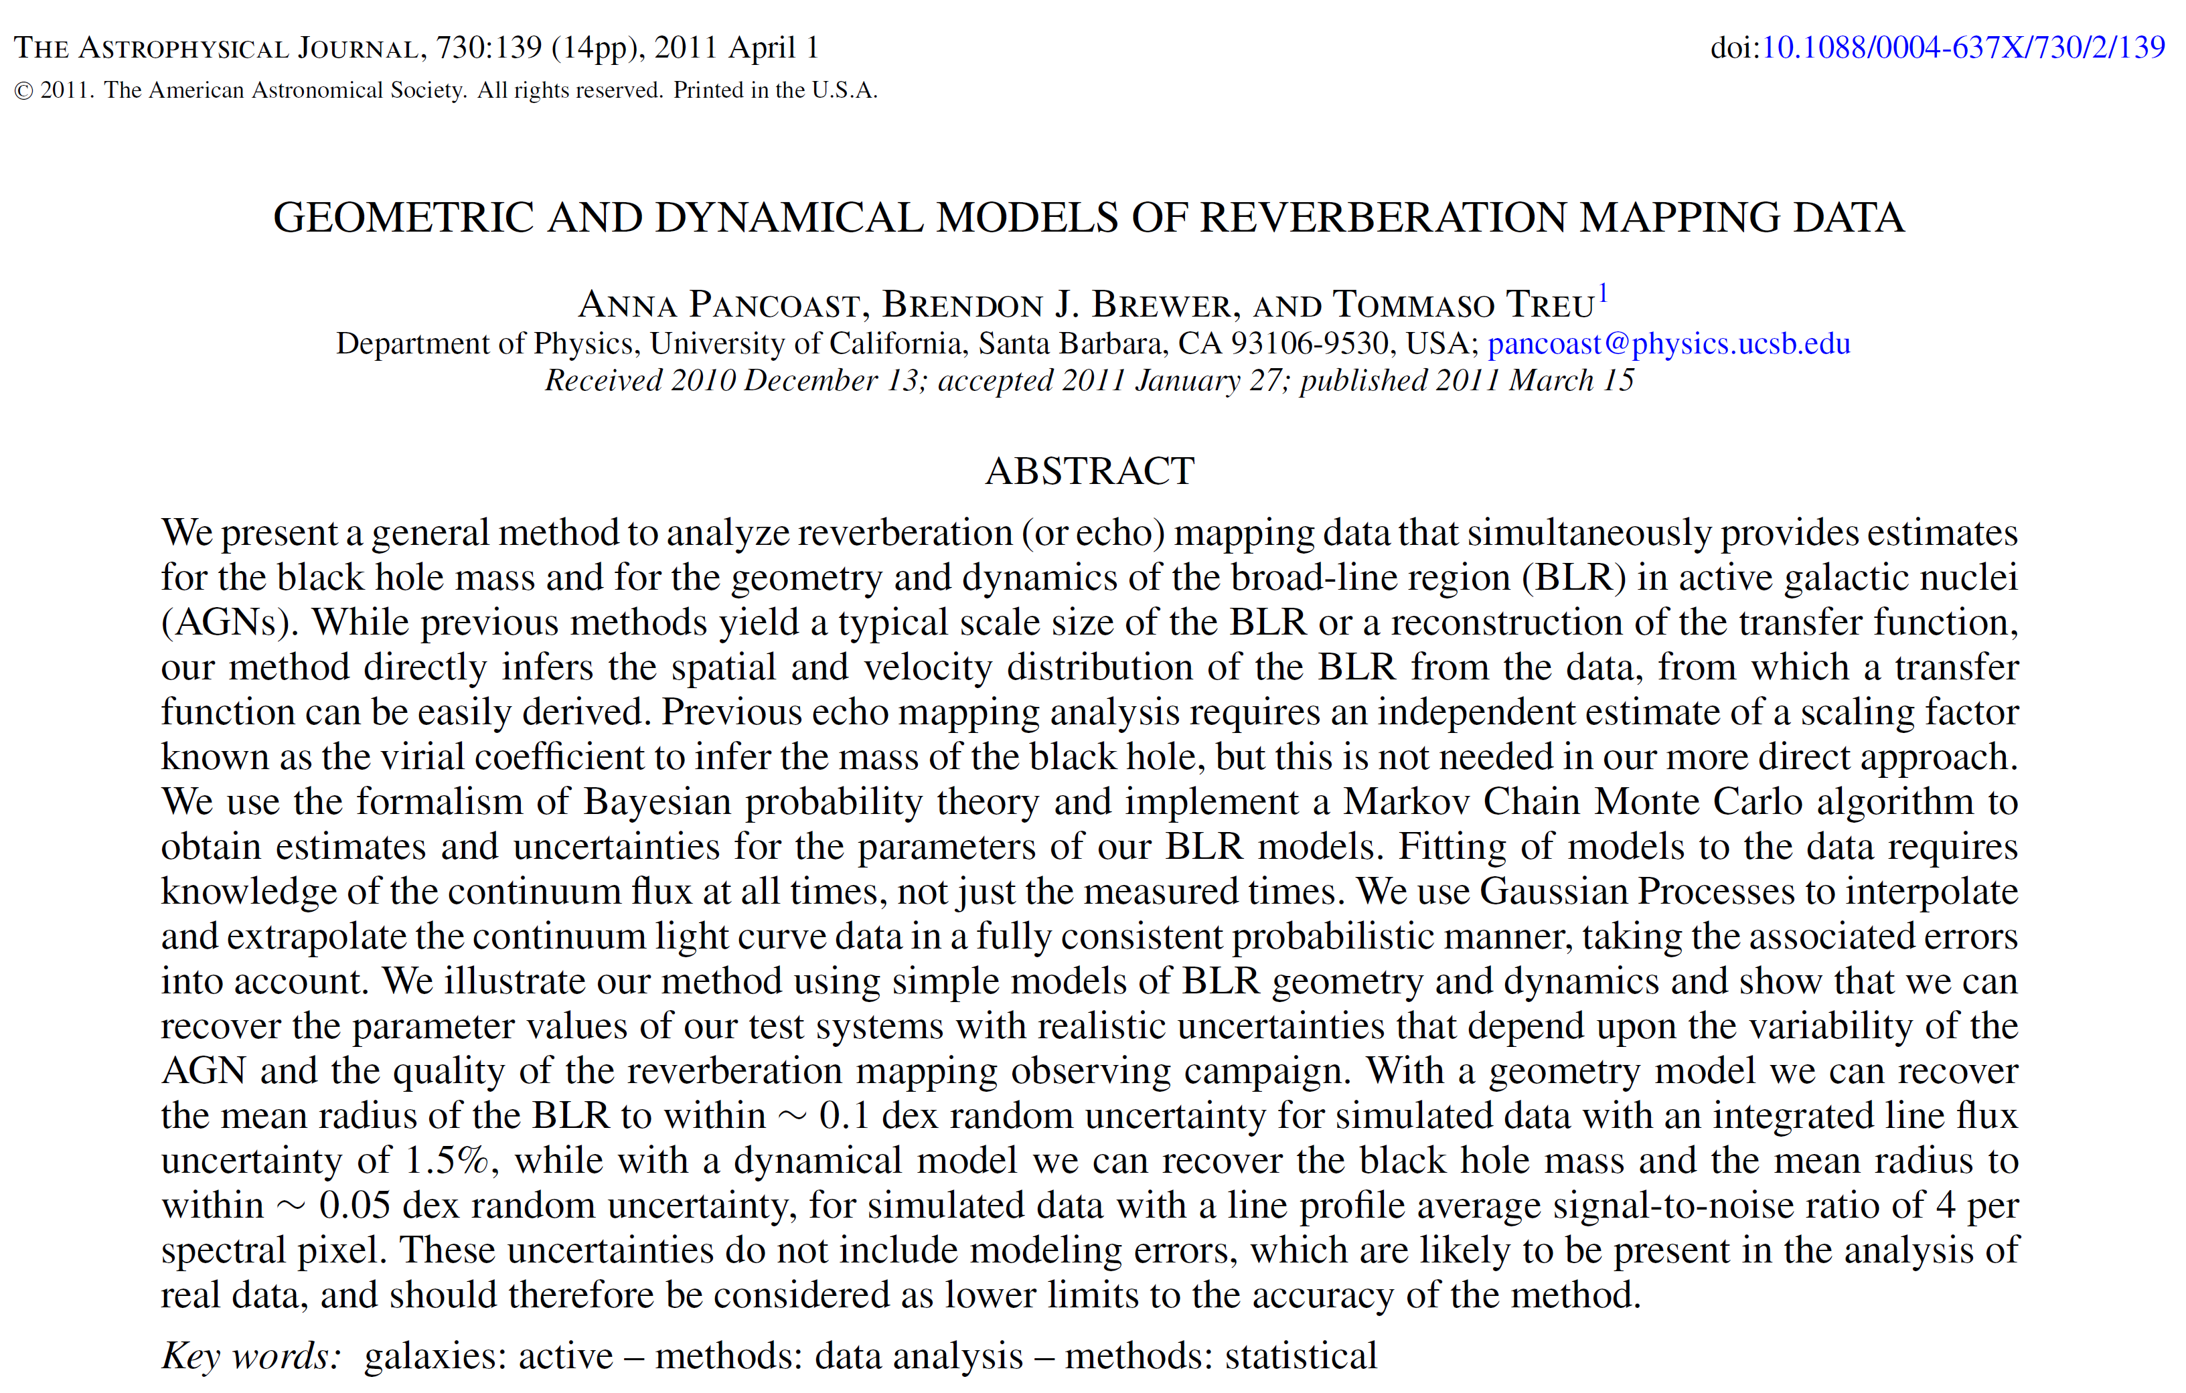
A sample paper in the Astrophysical Journal (ApJ)
Digital Object Identifier

Slide 3
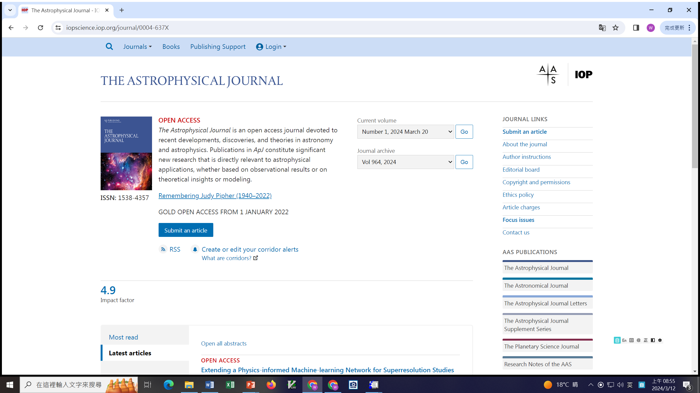

Slide 4
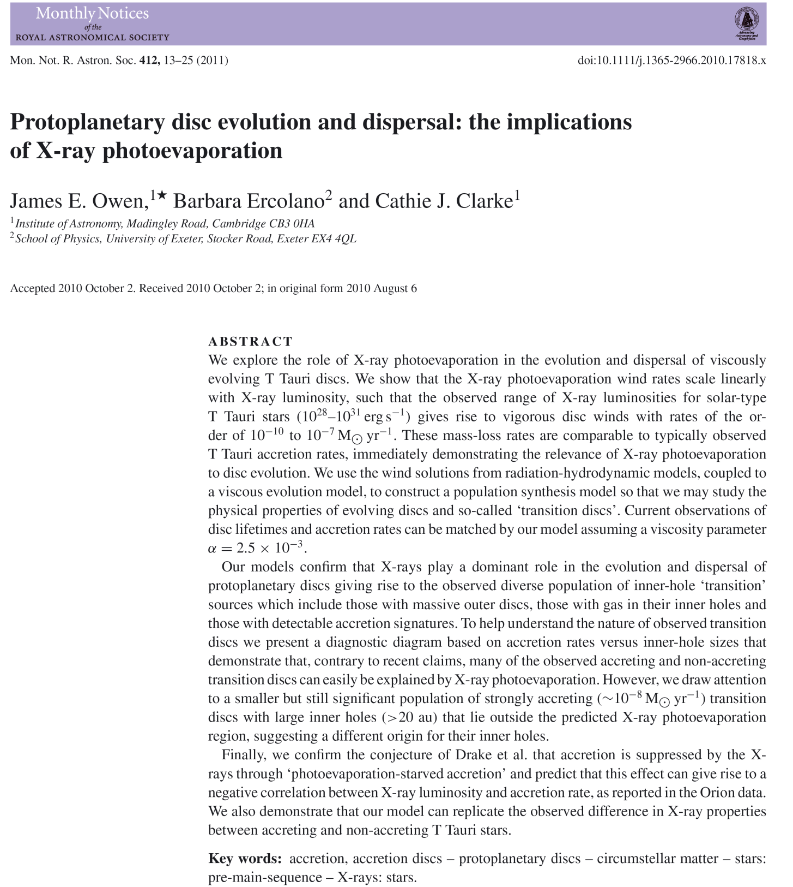
A sample paper in the
Monthly Notices of the Royal Astronomical Society (MNRAS)

Slide 5
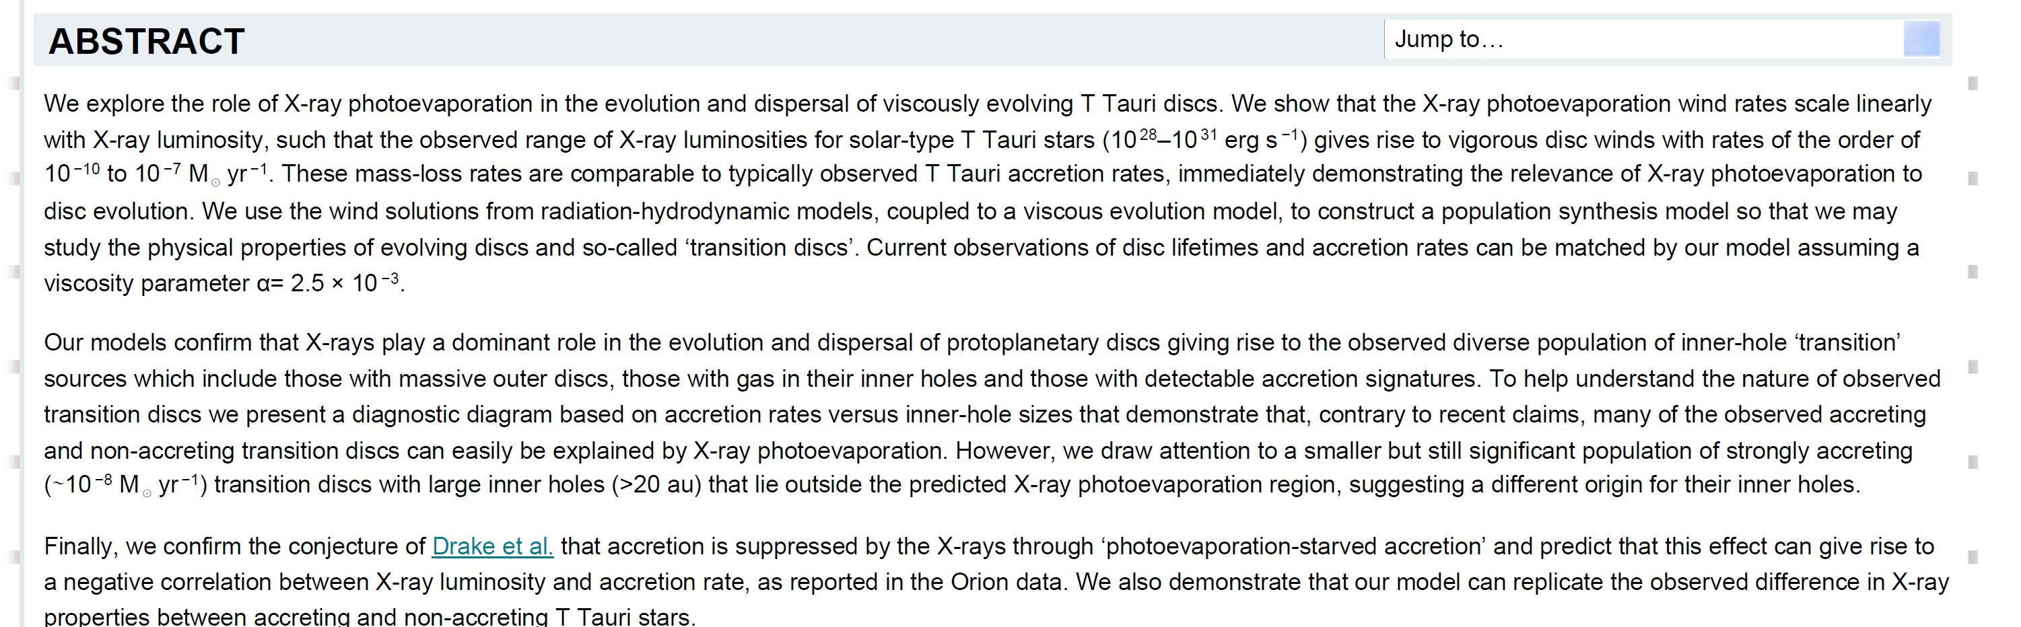
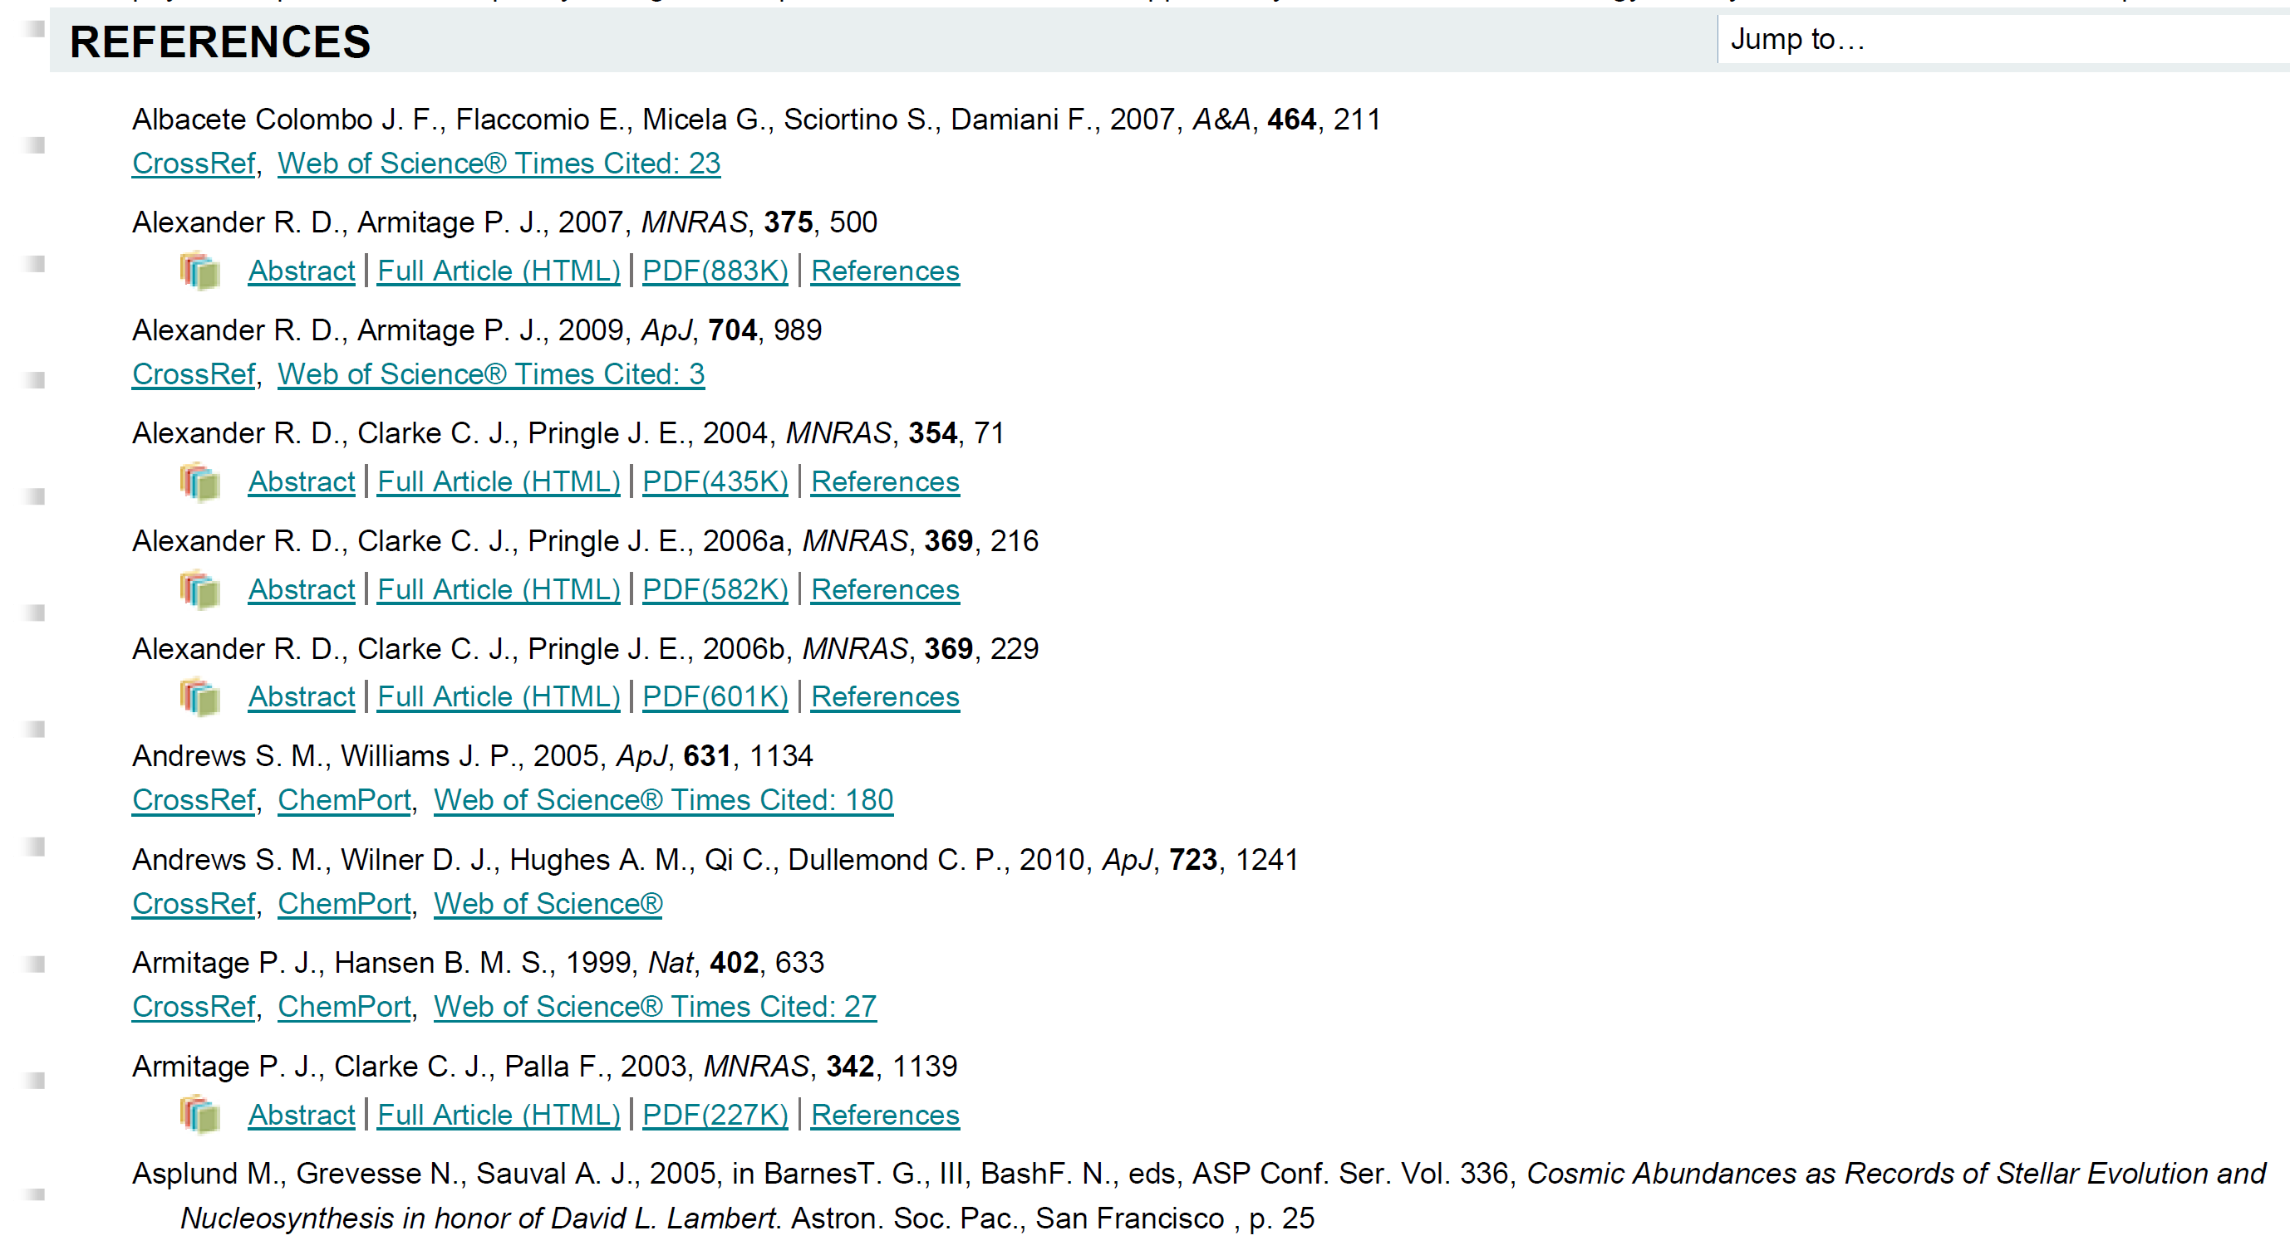
A sample online HTML version

Slide 6
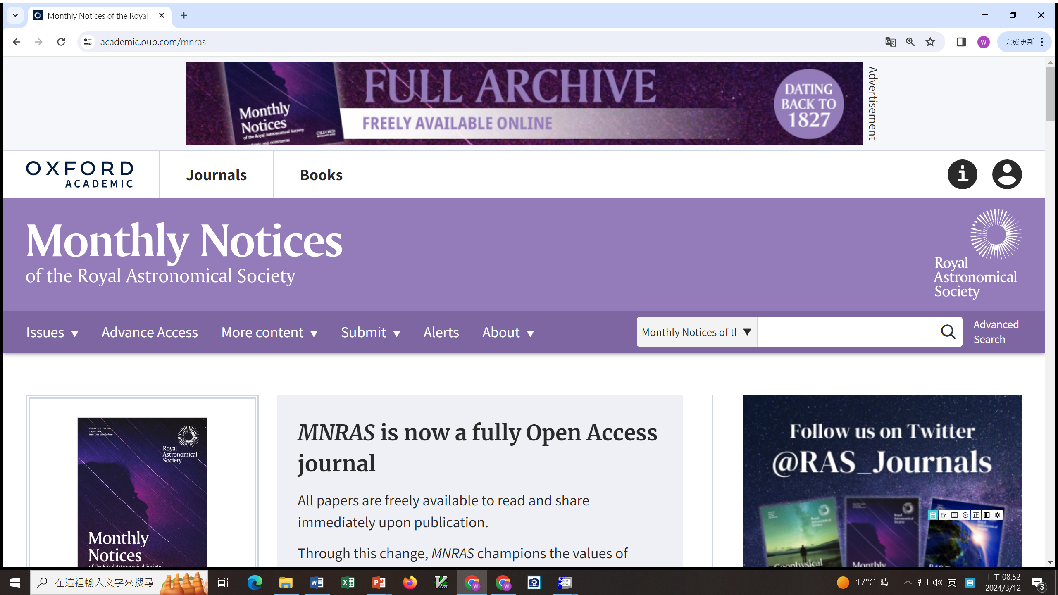

Slide 7
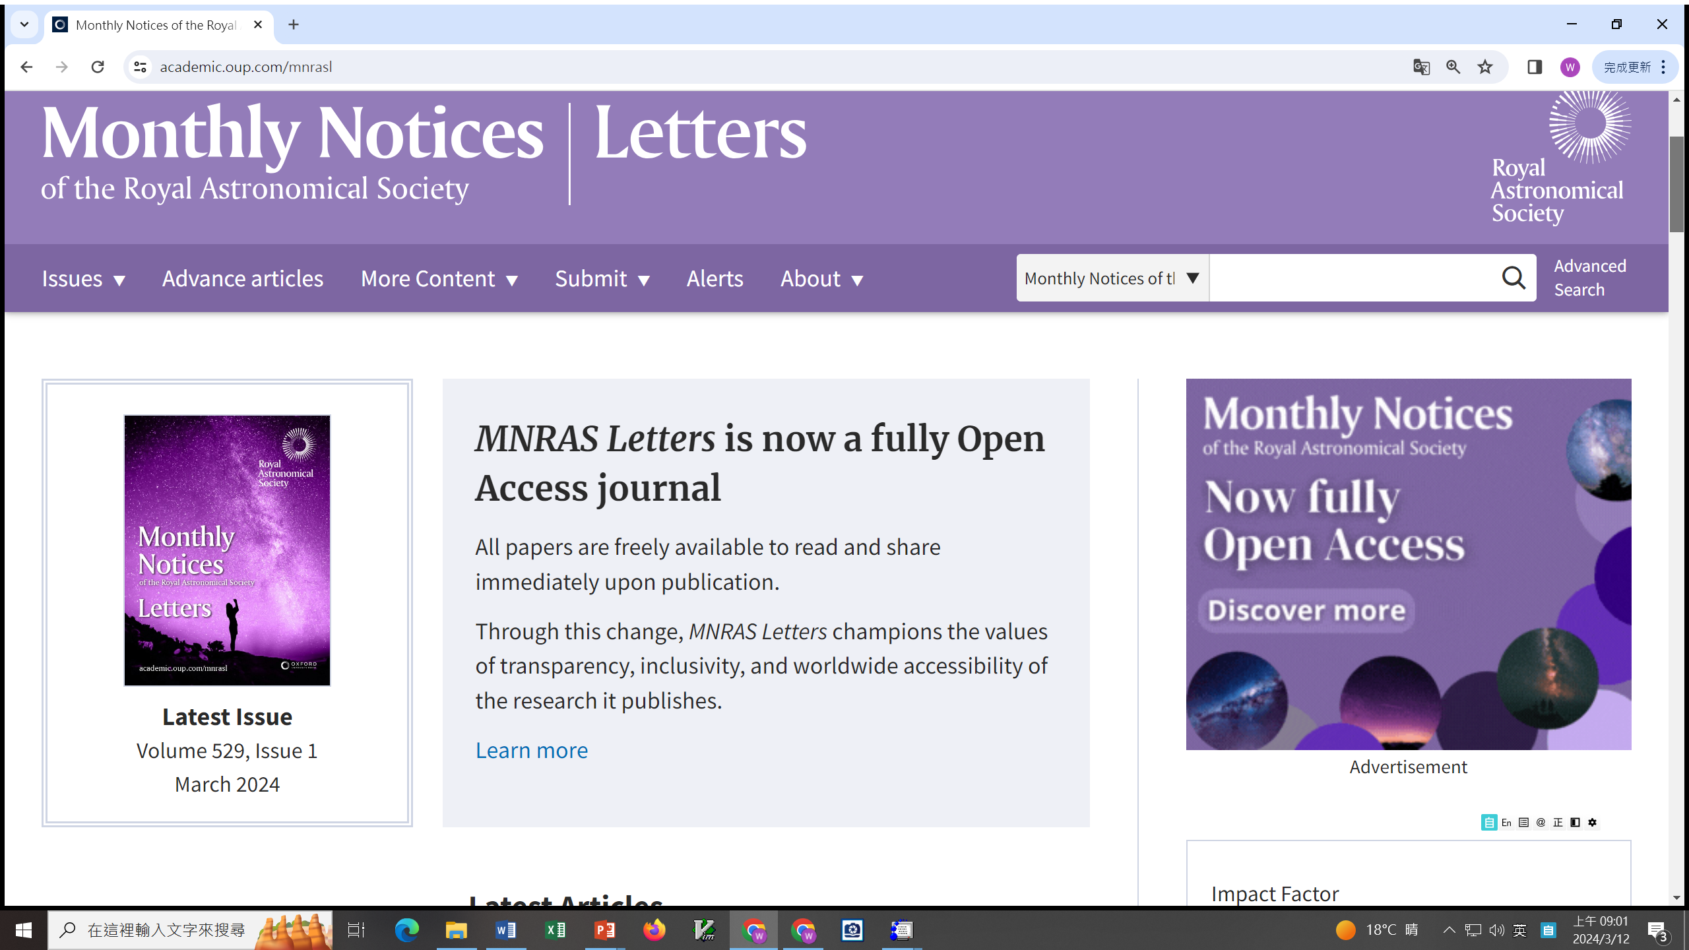

Slide 8
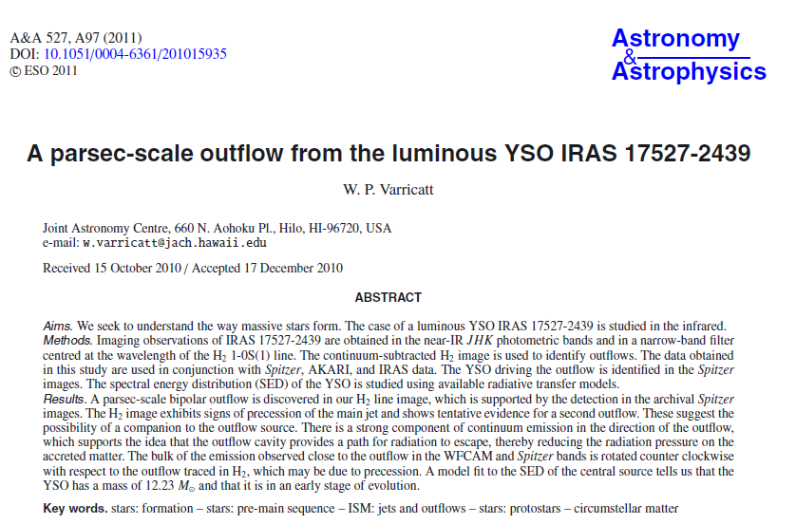
A sample paper in the Astronomy and Astrophysics (A&A)
100% cut and paste

Slide 9
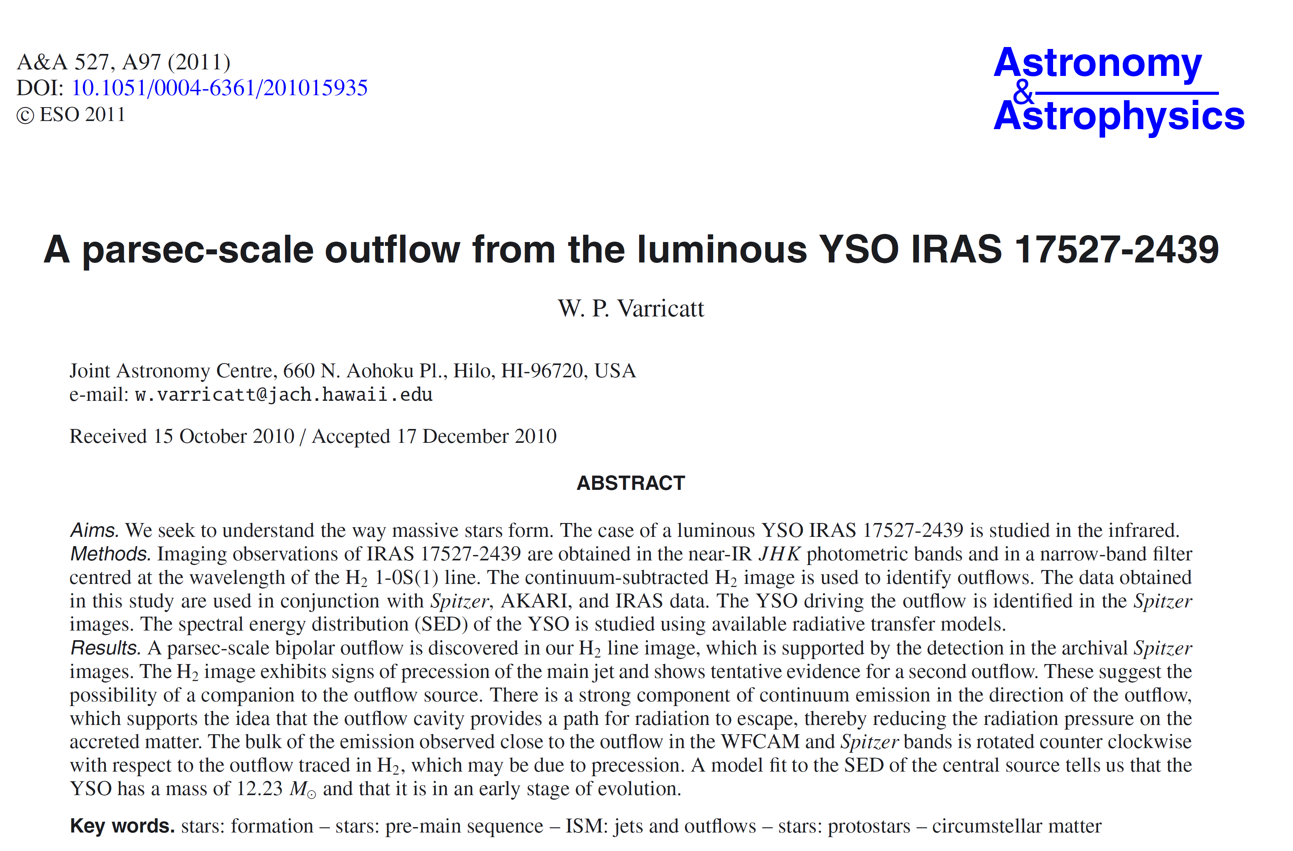
The same …
400% cut, paste, then shrink

Slide 10
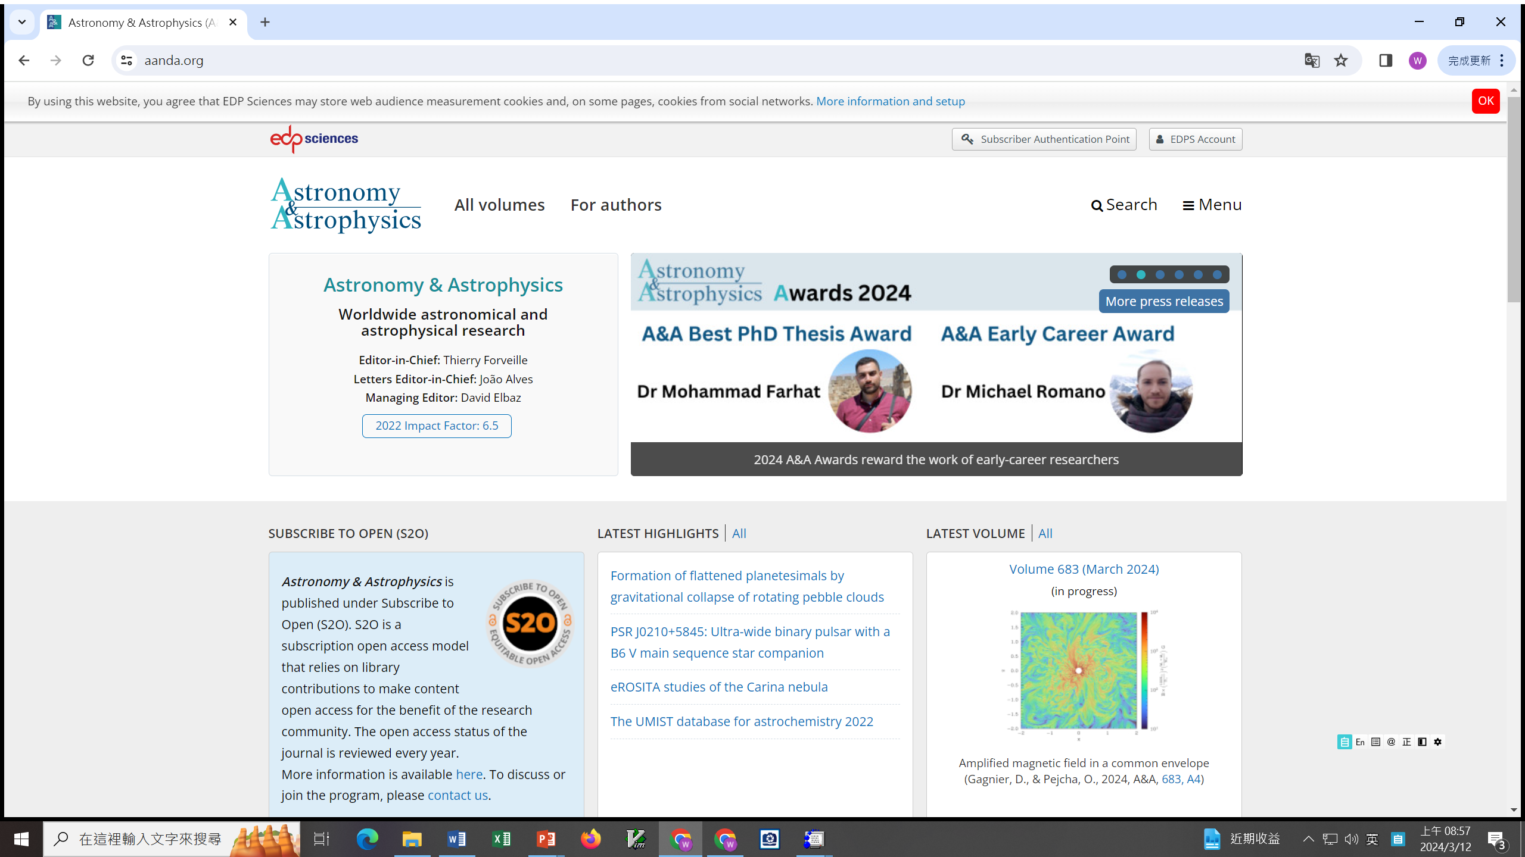

Slide 12
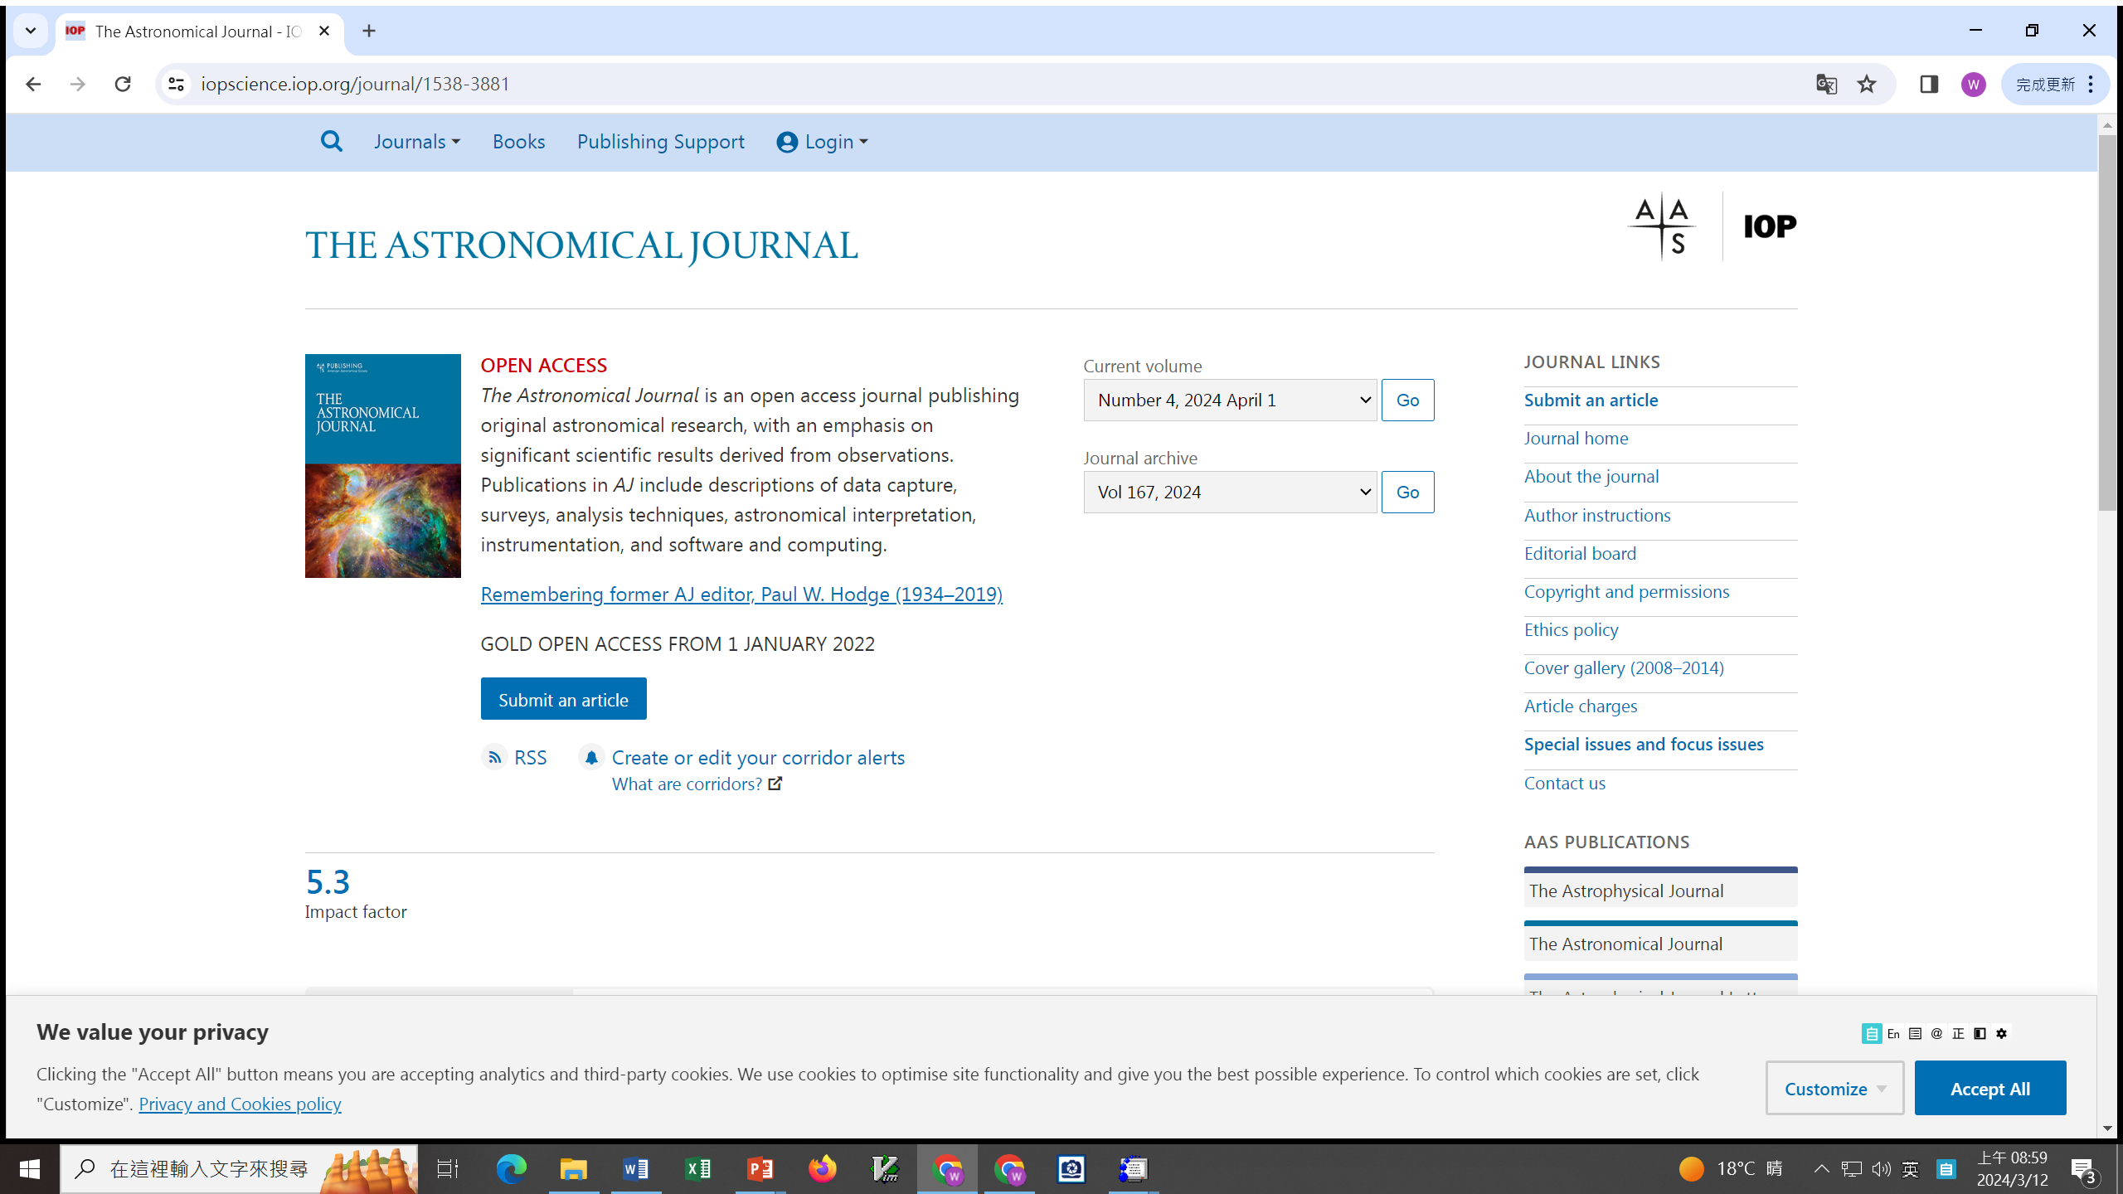

Slide 17
https://astrothesaurus.org/

Slide 21
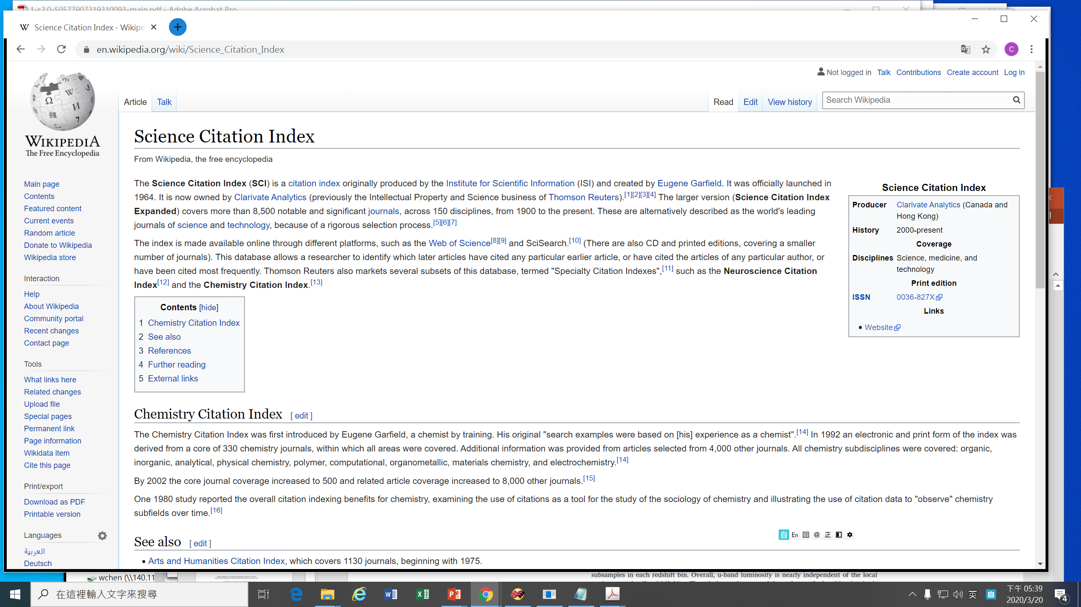

Slide 22
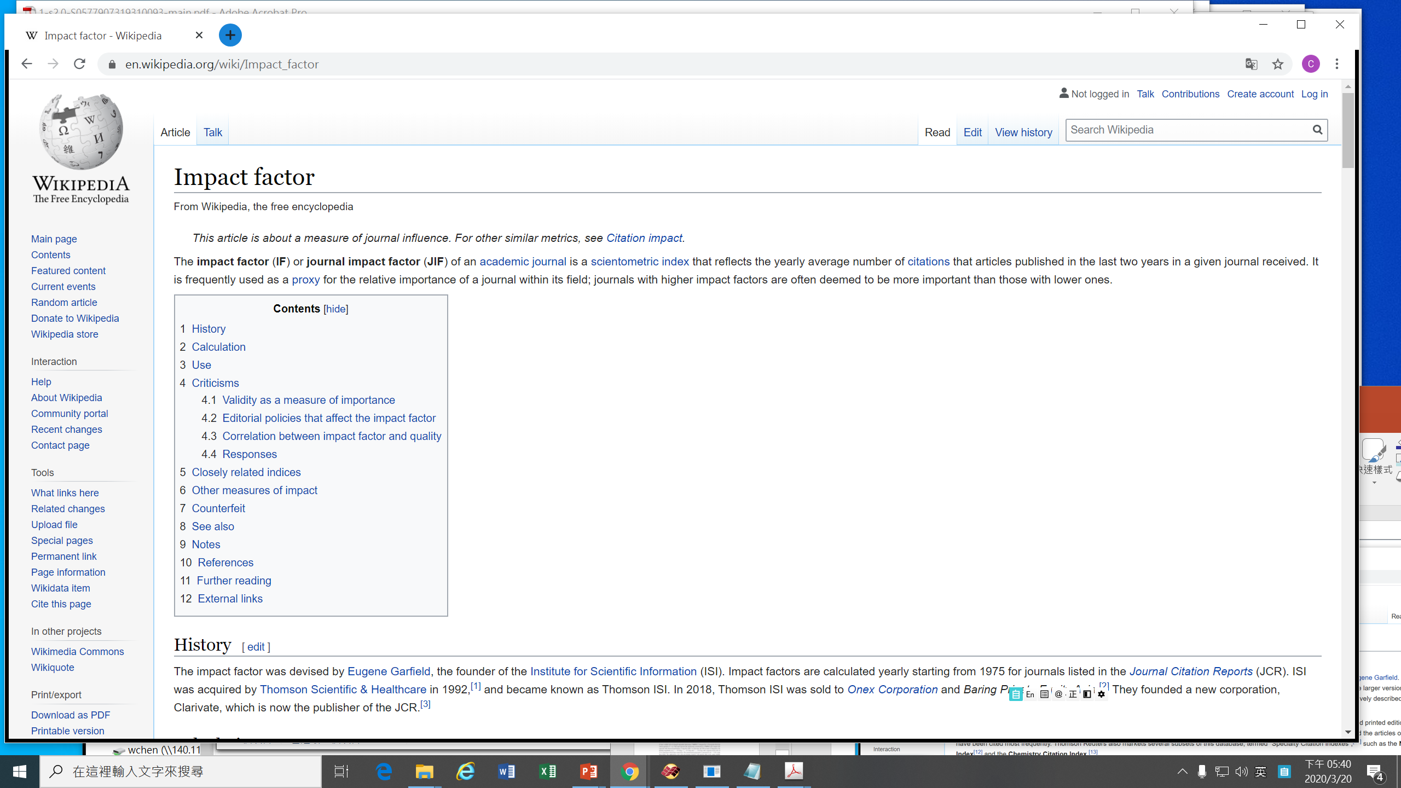

Slide 23
Journal | Impact Factor (2018) | Scimago (SJR) (2018)
Nature | 43.070 | 16.345
Science | 41.063 | 13.251
ARA&A | 37.8 (2016) | 17.101
A&A Review | 11.611 | 5.247
A&A | 6.209 | 2.527
ApJ | 5.580 | 2.741
ApJL | 8.374 | 3.864
ApJS | 8.311 | 4.545
AJ | 5.497 | 2.770
MNRAS | 5.231 | 2.422
Nature Astronomy | 10.500 | 2.862
Icarus | 3.565 | 2.241

Slide 24
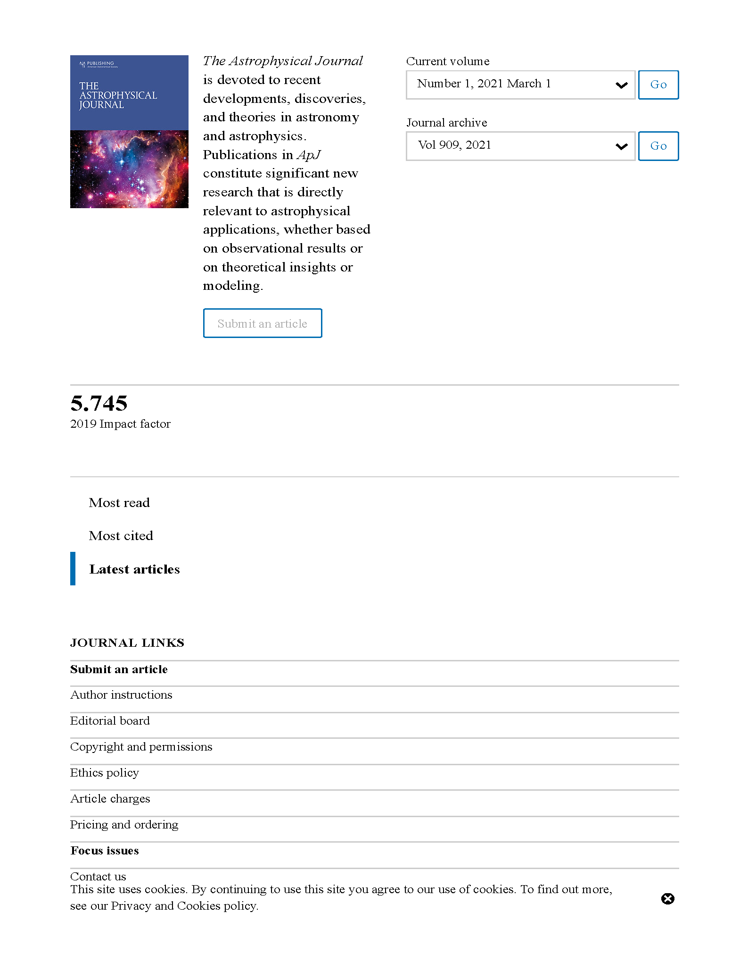
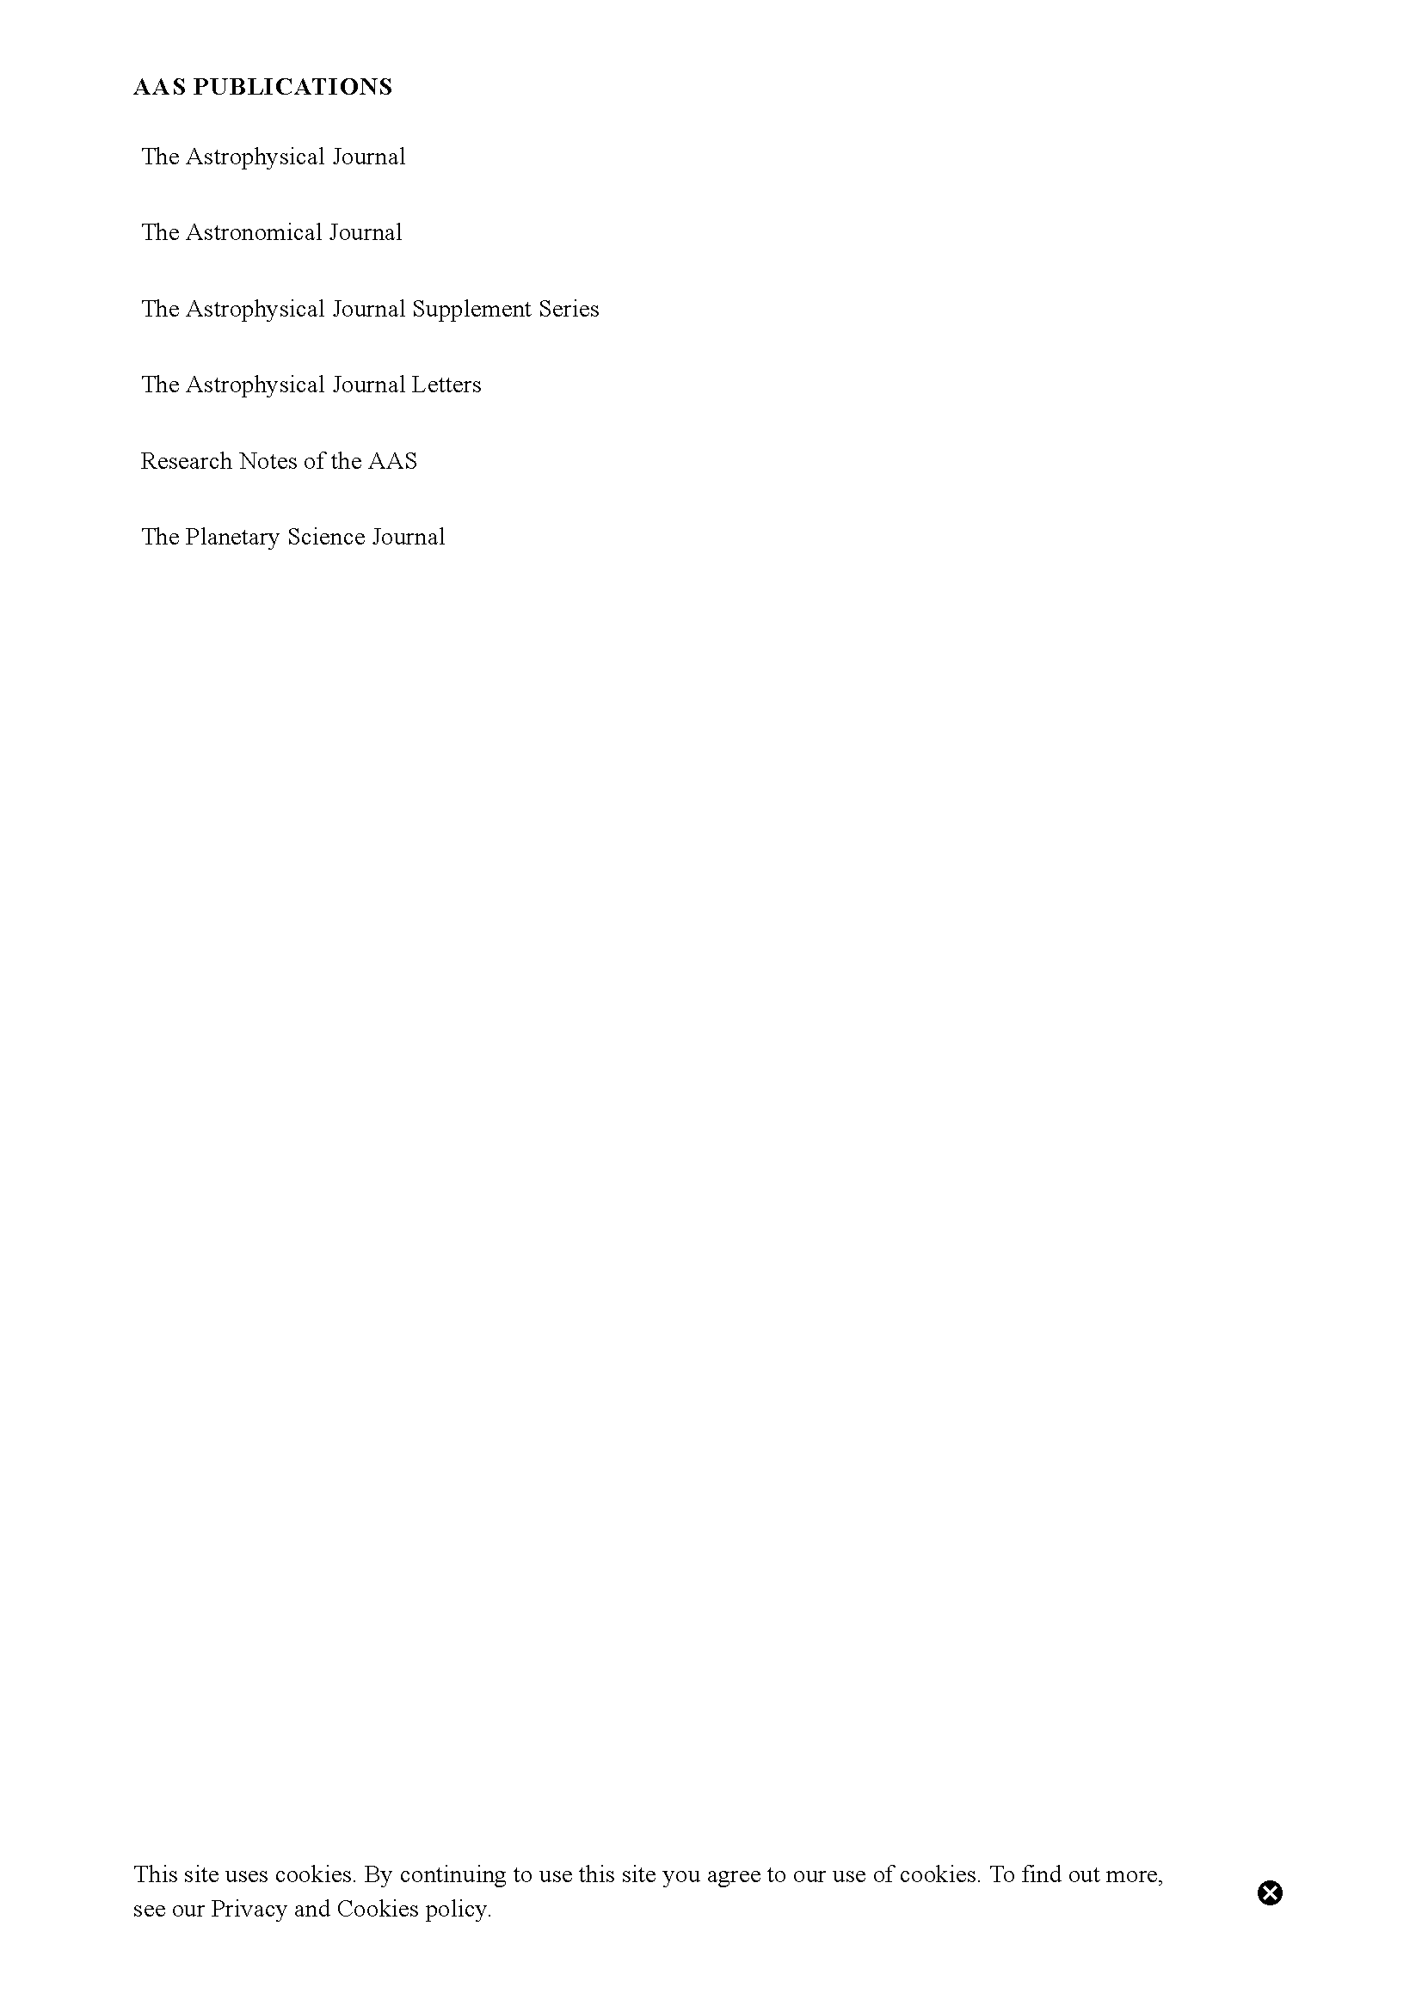

Slide 26
