Slide 1
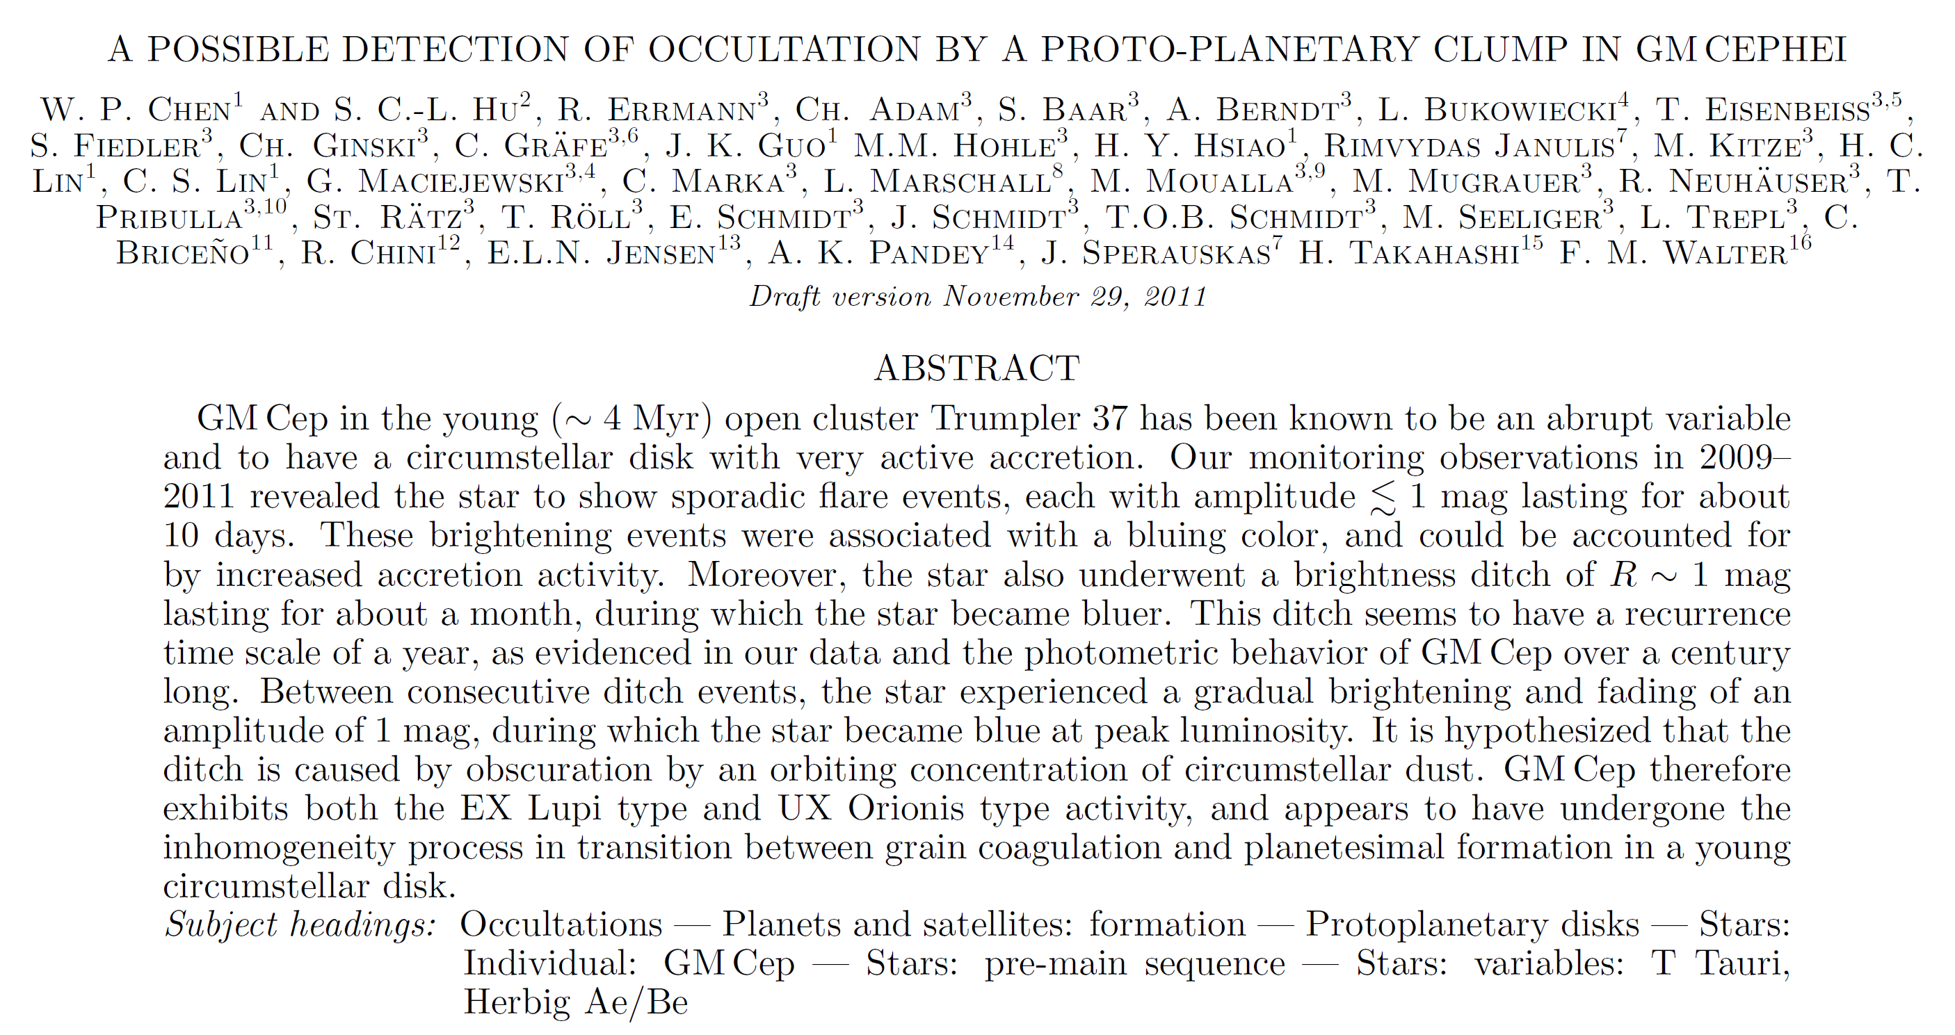
A paper I am writing now …

Slide 2
Abstract --- the heart of your paper
Chapter 11 of Jean-Luc Lebrun
What does a reader expect to see in an abstract?
What do you expect to see as a reader?

Slide 3
Four parts of an abstract
What
What is the problem? What is the topic of this paper?
How
How is the problem solved (methodology)?
Results
What are the specific results? How well is the problem solved? Visuals in abstracts?
Impact
So what? How useful is this to science or to the reader?

Slide 4
Very often, the fourth part (impact) is missing, because
The maximum number of words allowed by the journal ran out too quickly with a long rambling start.
The author (mistakenly) considered that the results should speak for themselves.
The author was not able to assess the impact of the scientific contribution.
“a result of the myopia caused by the atomization of research tasks among many researchers” 見樹不見林

Slide 5
The parts with the largest number of words = contribution
Adjectives ok in the title, but precision in the abstract
Coherence between abstract and title
30%~80% (i.e., > 1/3) significant title words are in the first sentence of the abstract. There are exceptions, but usually at least there should be one word from the title. Otherwise, sentences 2 and 3 mention most of the other title words.
The first sentence should expand, not just repeat, the title.

Slide 6
All title words should be in the abstract. Otherwise, why does a word deserve a “title” status of your paper? One exception is using an alternative, interchangeable keyword in the field → to increase the chance of being found by search engines.
If a title word is not important, remove it.
If a title word is missing in the abstract and is important, put it in.
If the abstract contains a keyword that should be in the title, rewrite the title to incorporate that keyword.

Slide 7
The abstract needs to set the problem, but does not need to justify why it is important (the introduction does that.) The abstract, however, needs to justify the significance of the results.
The abstract should NOT (1) mention the work of other researchers (it is done in the introduction), unless the paper is an extension of a previous paper; (2) why the problem is important (also the role of the introduction). The abstract should concentrate on the importance of the results

Slide 8
Use the present tense in the abstract is ok. Once the tense is chosen, keep it throughout the abstract.
Use the past tense in the conclusion.
The abstract should be stand-alone. It needs nothing else. It sets expectations for the reader.
It should not be longer than necessary.
It should tie to the title.

