Slide 1
Publication of a Journal Paper
Publish or perish.
Original research results
Nature of the paper? Targeted readership?
Targeted journal?
  Astrophysical Journal (ApJ)
  Astronomical Journal (AJ)
  Astronomy & Astrophysics (A&A)
  Monthly Notices of the Royal Astronomical Society (MNRAS)
  Icarus
  Publication of the Astronomical Society of the Pacific (PASP)
  PASJ, PASA, RAA…

Slide 2
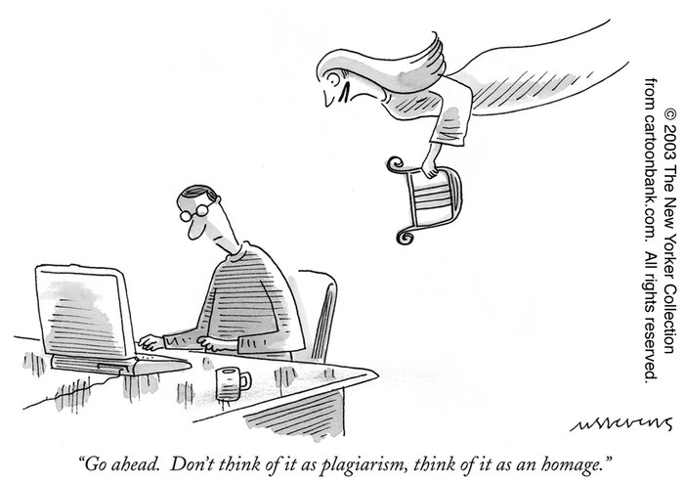
Plagiarism: using some one's ideas or data/information without proper referencing/citation or acknowledgment
It is unethical and often unlawful.
https://www.facebook.com/retractionwatch/

Slide 3
Sketch a Writing Plan
(A rough title, clear contents)
Figures first (what is the story?)
Section headings, subsections …
Then each paragraph (a key word), and each sentence
One concept/issue per paragraph
Overall structure of the article
Introduction, Observations/Data Analysis, Results/Discussions, Conclusions
Then tackling a sentence at a time
Simple (dull) sentences OK; get the “facts/results” in as placeholders

Slide 4
Evolution of a manuscript
– An example
- the draft
- a revised version
- the final submitted version

Slide 5
Publication of a Journal Paper
Typesetting the manuscript
  LaTex vs Word or other word processors overleaf
  Text, figures, and tables
Peer review by referee(s)
Preprint and astro-ph (astrophysics – arXiv)
Galley proof
… in preparation; in submission; in press
… private communications

Slide 6
A sample Latex file
\documentclass[12pt,preprint]{aastex}
\usepackage{graphicx} \usepackage{natbib}
\slugcomment{To be submitted to AJ; today is \today}
\begin{document}
\title{Typesetting by Latex for Graduate Seminar Course }
\author{ W. P. Chen\altaffilmark{1} }
\altaffiltext{1}{Institute of Astronomy, National Central University, Jhongli 32001, Taiwan}
%
\begin{abstract}
%
This is a sample Latex file, to see how professional typesetting is done.
%
\end{abstract}
\section{Introduction}
So this is how it works.
The original file includes some ``commands'', but the contents are in ASCII. Latex is
particularly convenient to effectively produce Greek letters, $\alpha, \beta, \Omega$, and
math $\int_0^{100} \sin\omega d\omega$.
\end{document}

Slide 7
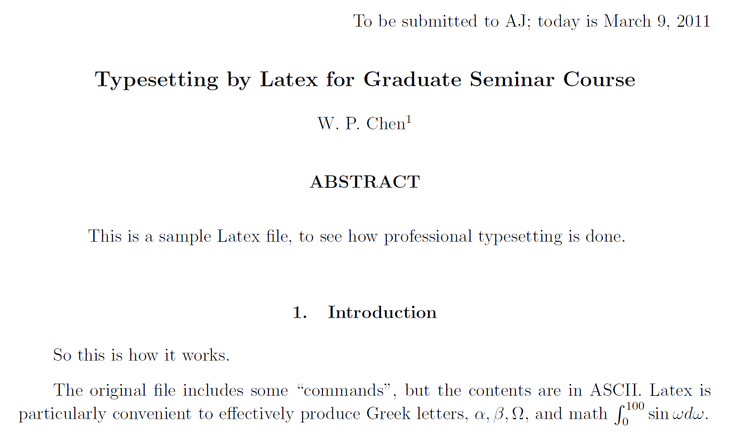
Output of the LaTex file

Slide 8
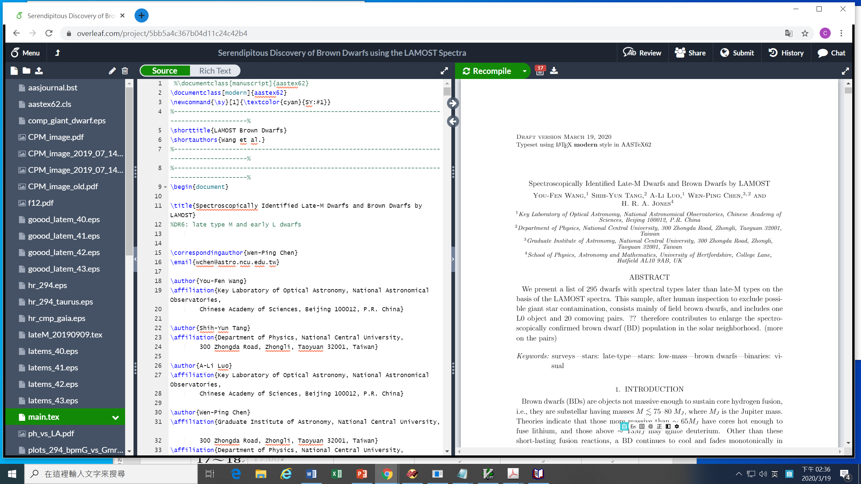

Slide 11
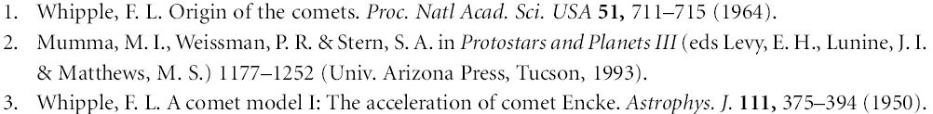
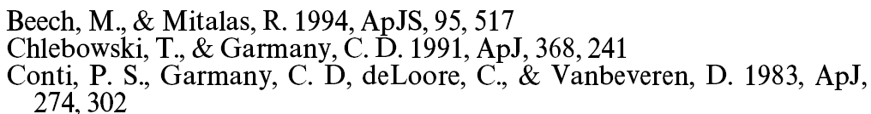
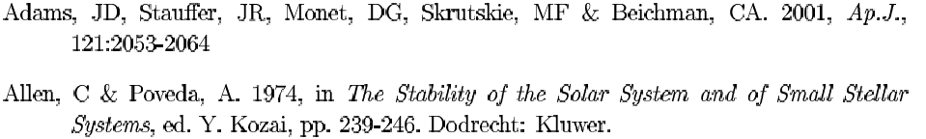
Reference Styles
Nature
Astrophysical Journal
Annual Review of Astronomy and Astrophysics
Last (family) name, (middle), first name (initials)

Slide 12
Class Exercise --- A sample letter
Dear Takahashi-san
I am so concern about the devastations triggering by terrible earthquake and tsunami in Japan. Everyday, I read news and pray for the things will going well many times.
GAO is quite close to the Toyko. Are people and every things in GAO allright?
God Bless you and eveyone in GAO
What does this letter try to say?
What are the problems with it?
Let us try to improve it.

Slide 13
V-ed … passive, to me
We are interested in the event. I am bored.
V-ing … active, to others
The movie is interesting. I am boring (!)

Slide 14
A referee report …

Slide 15
Mind the Pronunciation
Read out loud and listen (to yourself)
morphology vs morphological
molecule vs molecular
analysis vs analyze/analyse
spectra vs spectroscopy vs spectroscopic
Magnetic vs magnetism

Slide 16
Mind the Sentence Structure/Grammar
We would like to find out what the dark energy is.
You may wonder “What is the dark energy?”
The value of using multiple databases is consistency.

Slide 17
Mind the Uses/Meaning of Words
I look forward to it. Looking forward to seeing you.
I do not know what you mean.
I used to go to school in Taipei.
I am used to it.
I have little money.
The light went out, because the power was out. (direct reasoning/causality)
The power must be out, for the light went out. (conjecture, inference)
It is morning, because the birds are singing. (X)
Since you are here, you may as well stay. (nature result; 既然）
As I was not sure, I changed the text.

Slide 18
Exercise
Select a personal “model” paper. In one paragraph, describe its main contents. In another paragraph, explain why it is your model paper. List the headings, and subheadings if any, of the paper. Paraphrase in your own words its first two paragraphs in the “Introduction” section.

Slide 19
My Model paper …

Slide 20
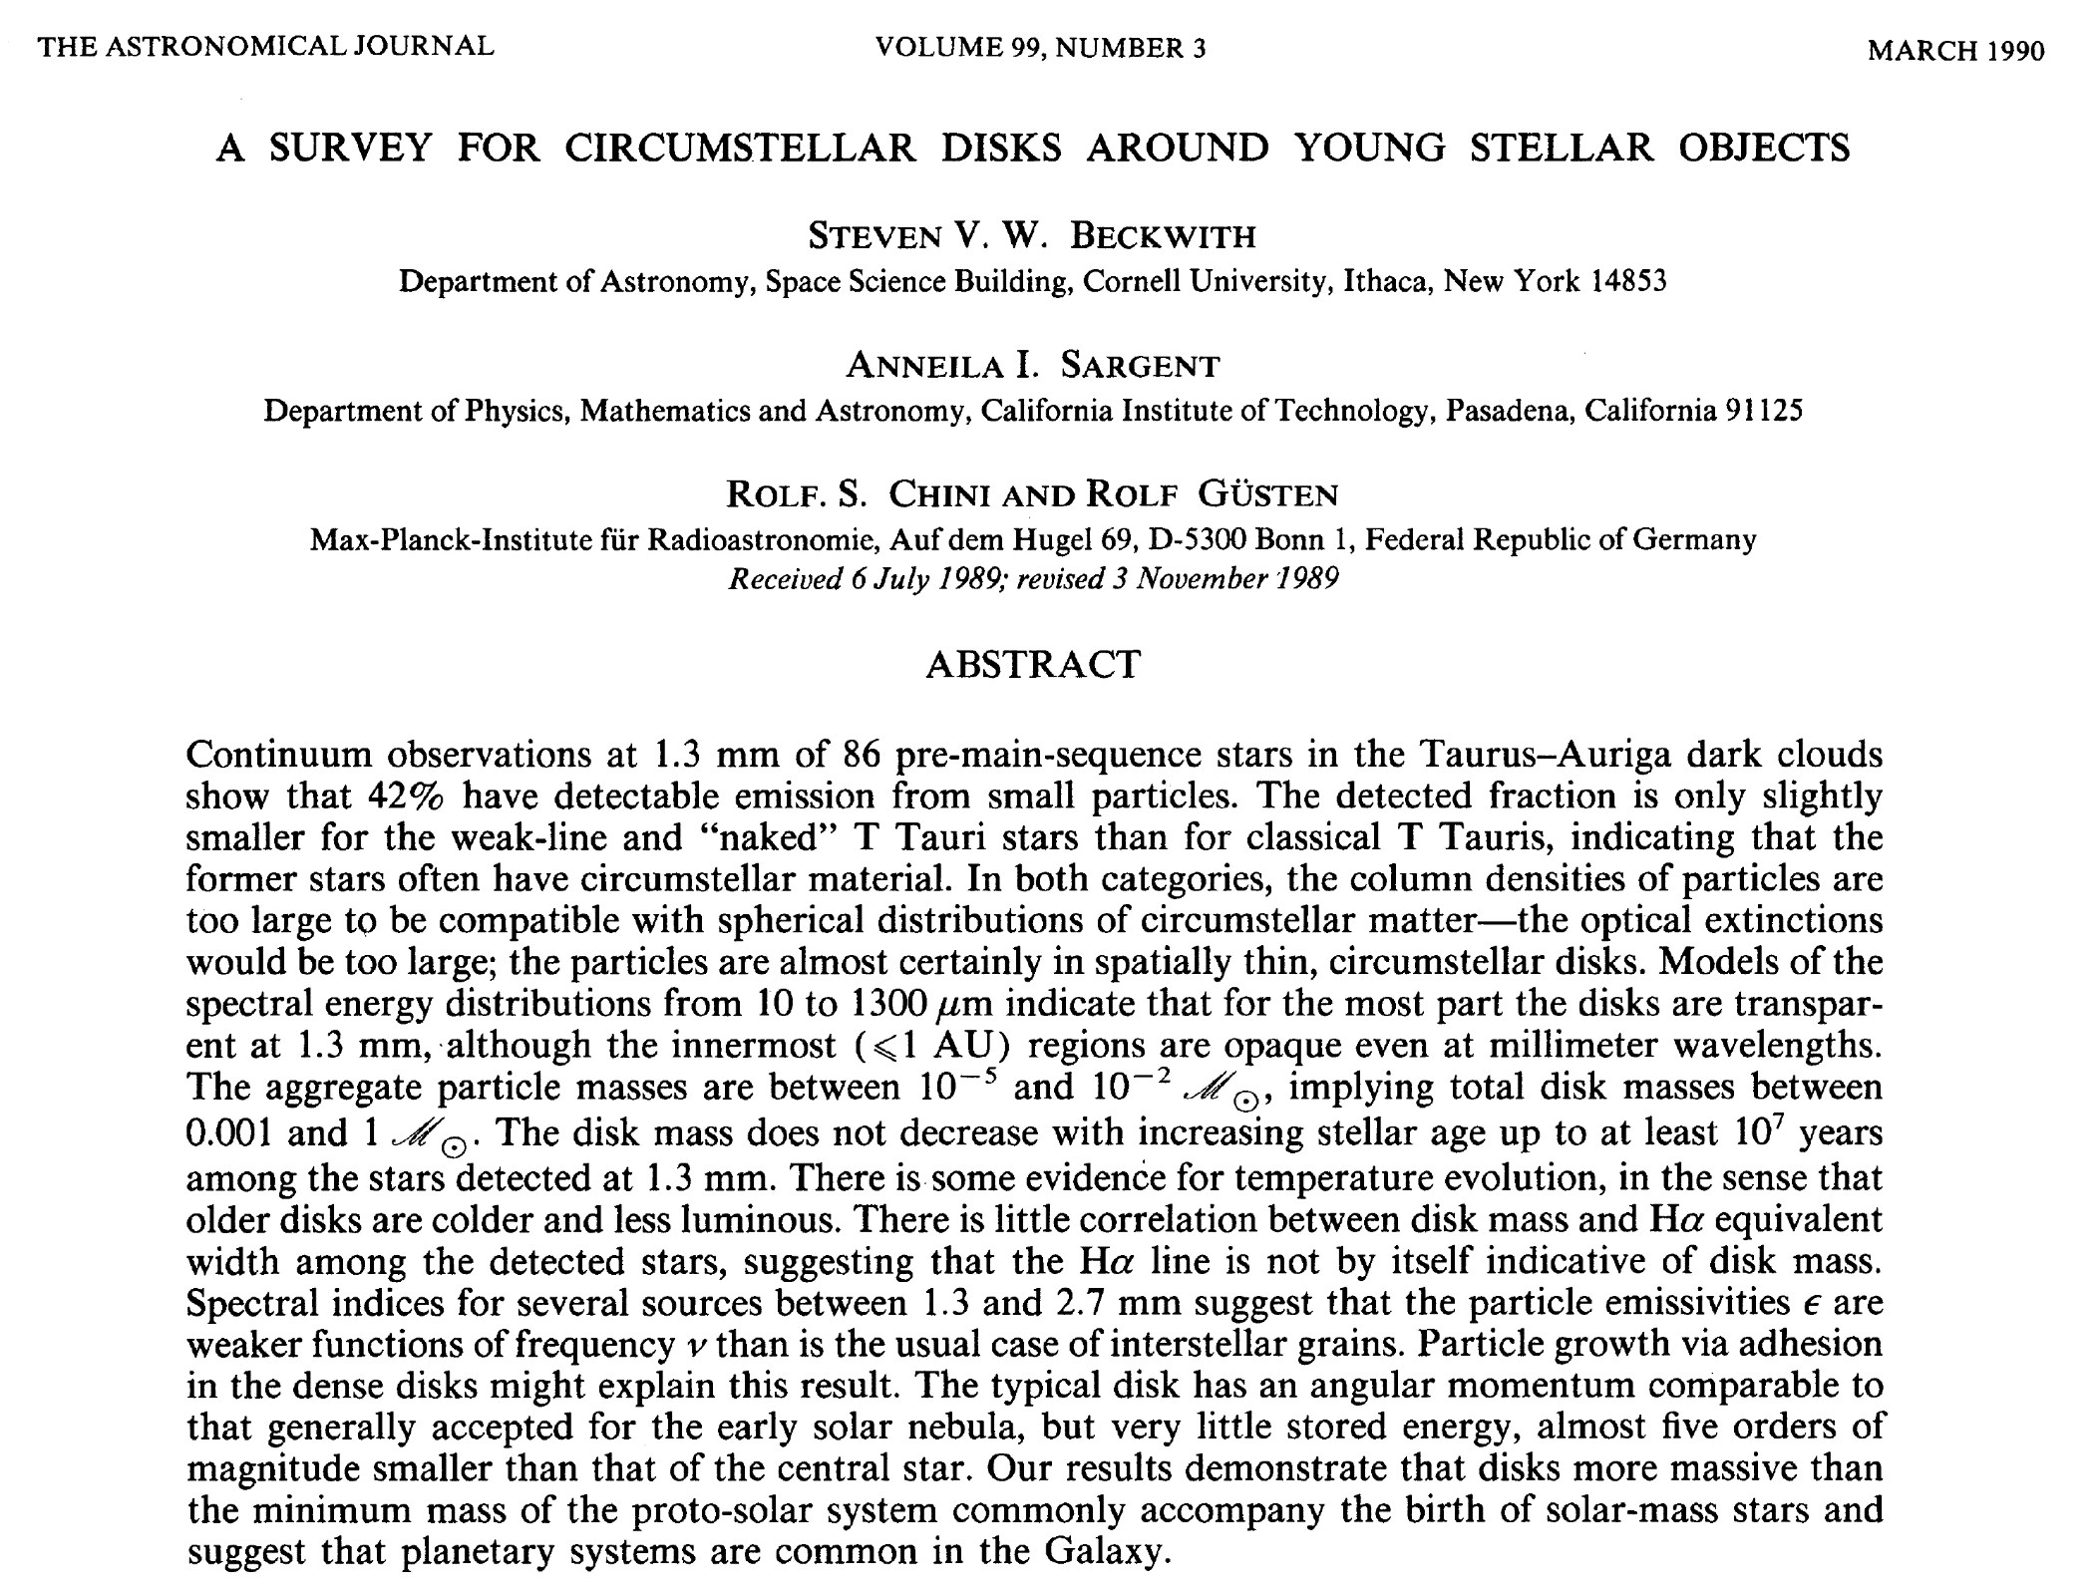

Slide 21
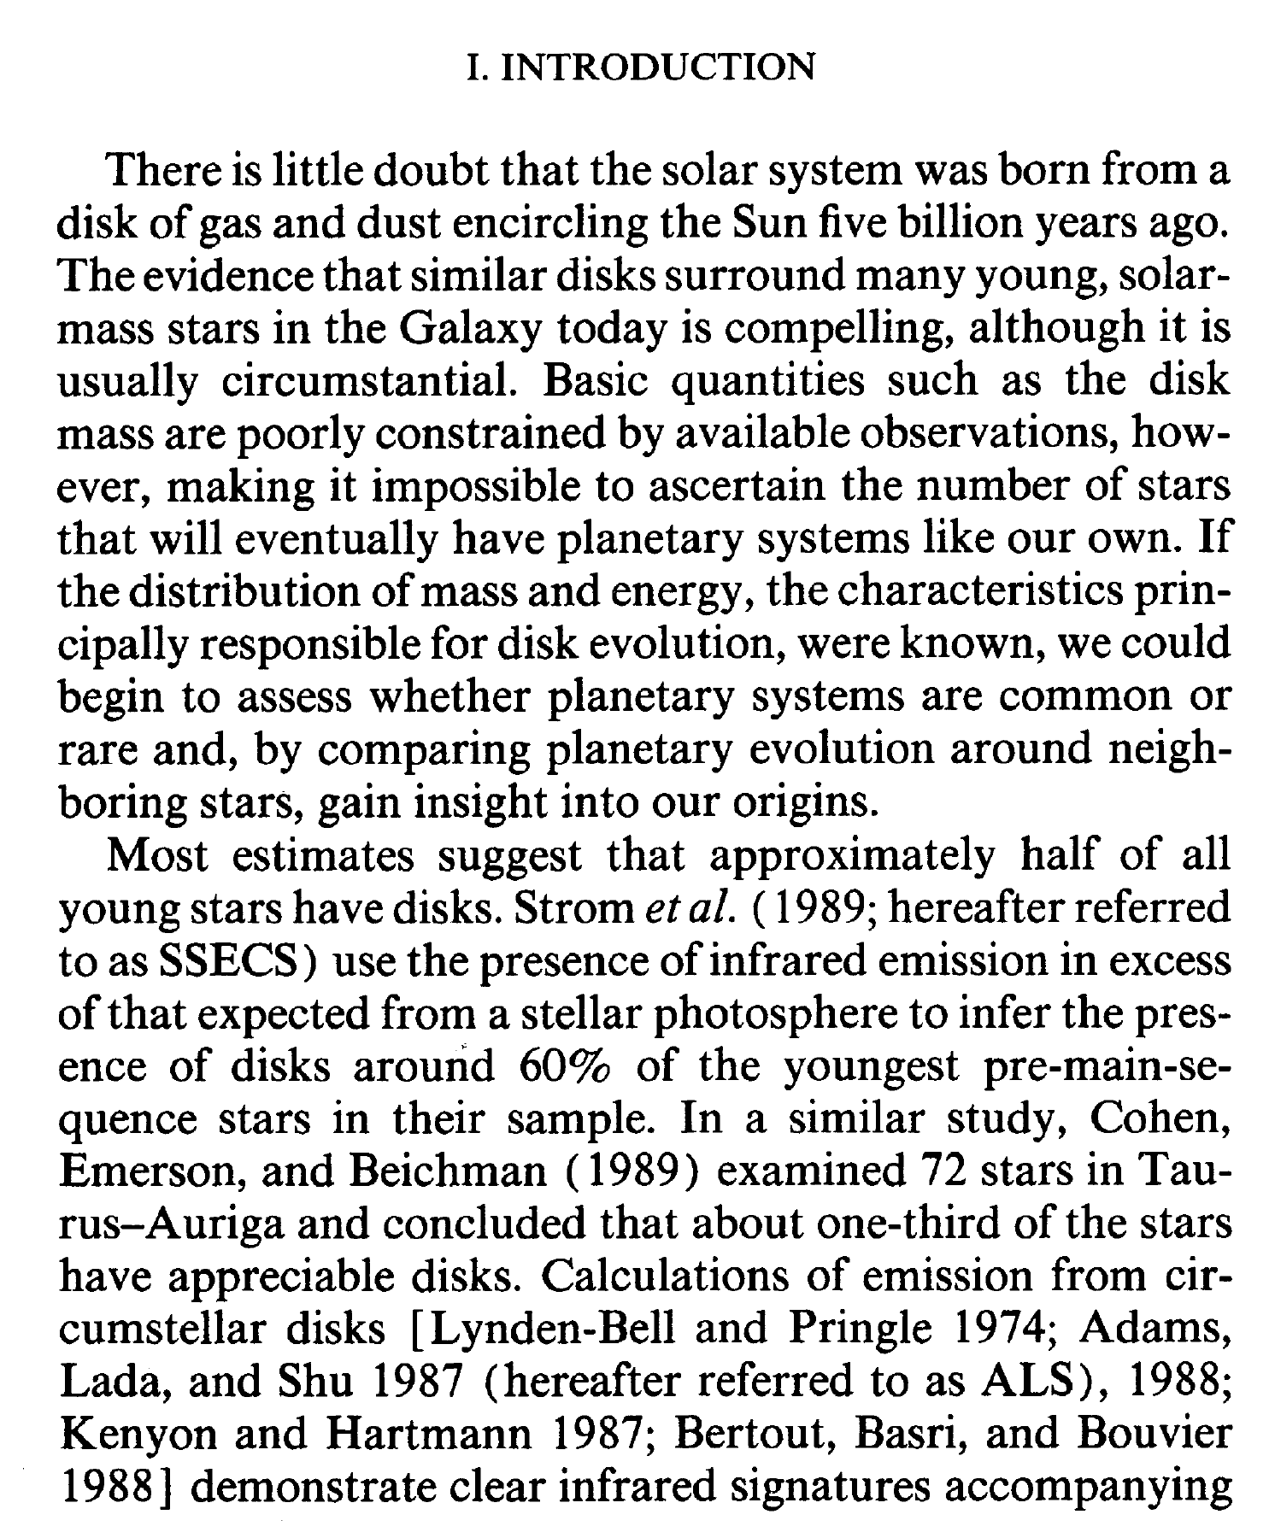
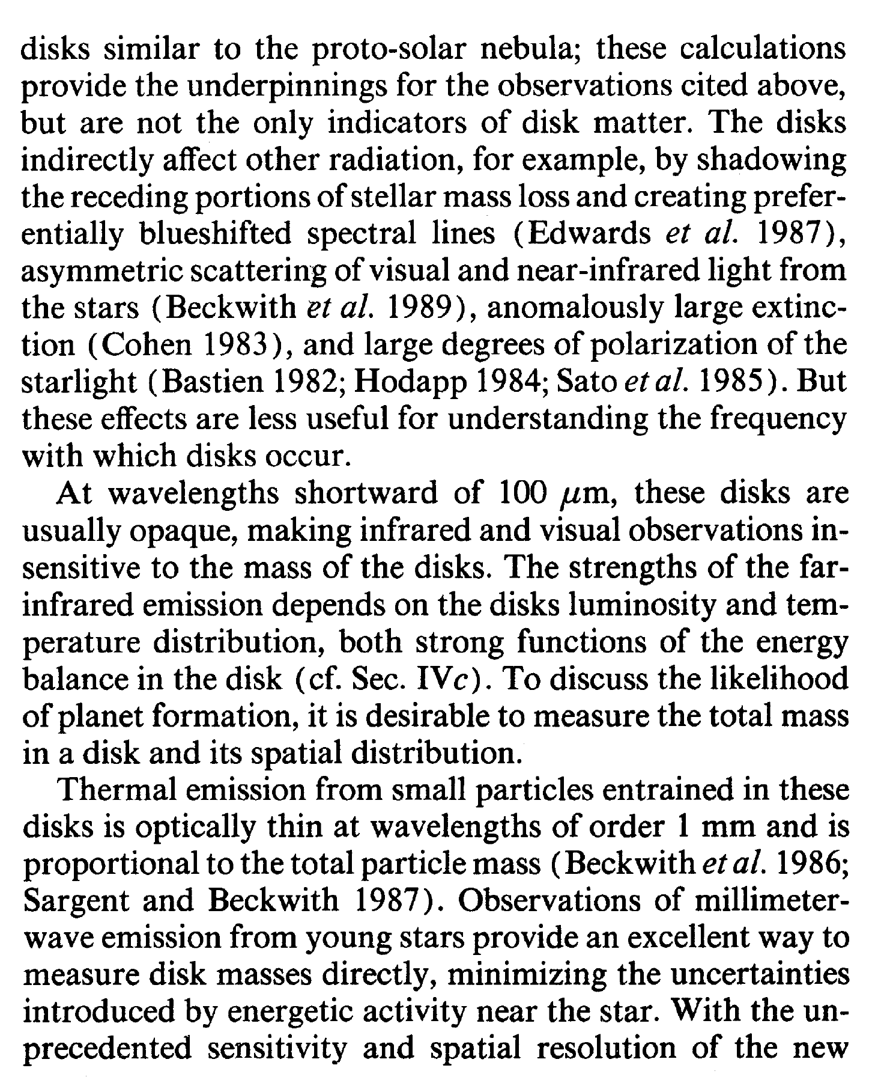

Slide 23
Your model paper is not just a paper, or the only one you have read; it should be the one that you hope to write like that some day.
“There is always a better way.”
Always strive to do your best, even though currently your best may not be good enough.

Slide 24
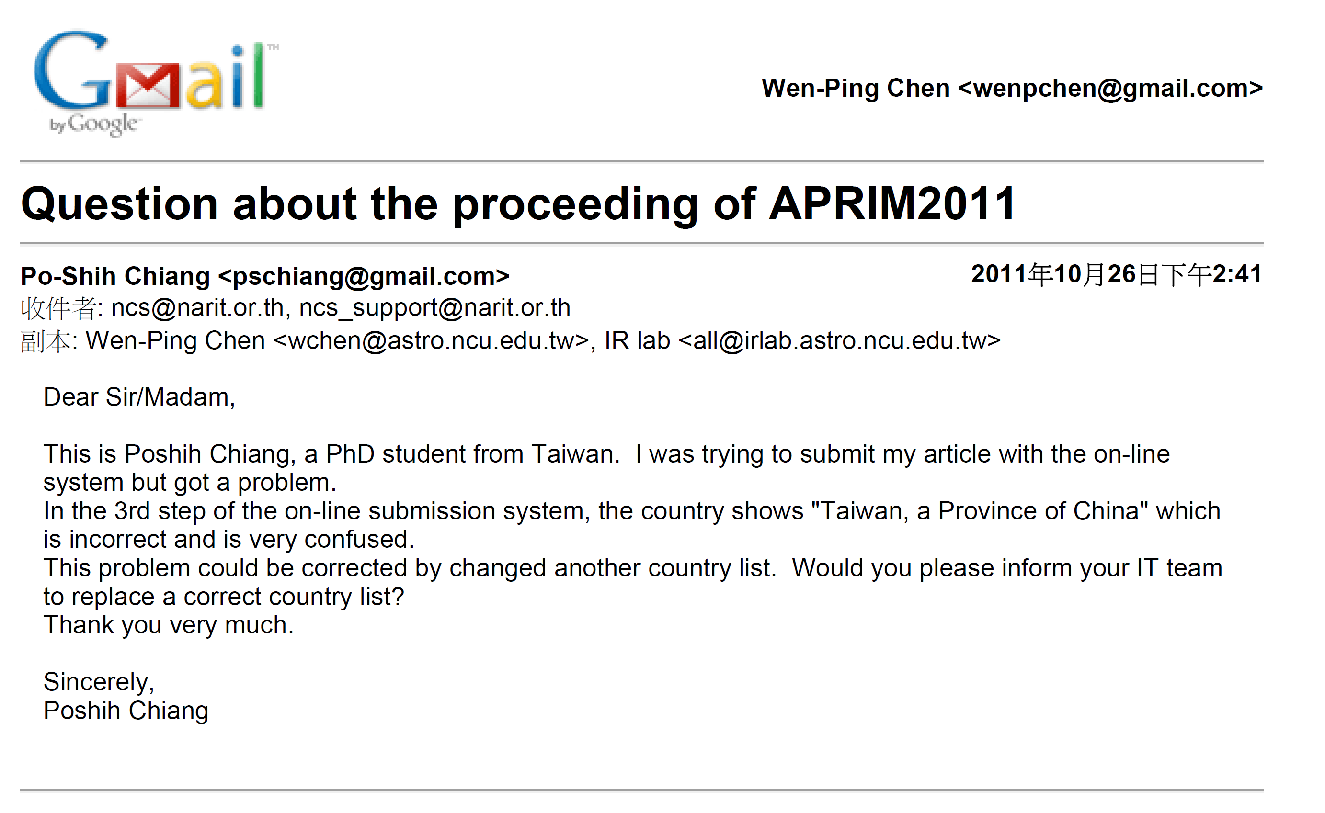

Slide 25
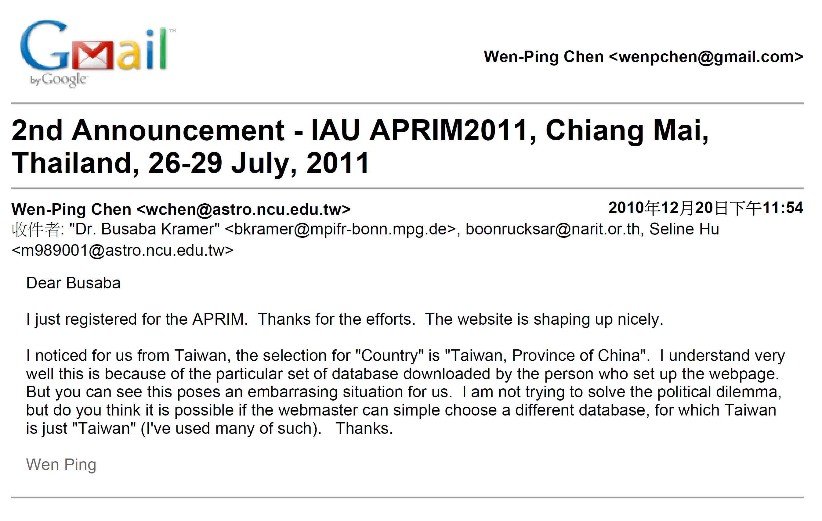
simply

Slide 26
A recent one 2021.08.21 for a Maidanak Users Meeting
I am glad the dates have been extended, as I missed the August 1 deadline. I just tried to register but was dismayed of the choice of country as “a province of China". I am not trying to solve the grandiose political issue, but this is simply confusing, and could be solved with replacing with a different template pull-down table.
Please consider. Thank you.
Wen Ping
2021.08.21

Slide 27
Nicknames in English --- you should know these, but do not use them unless you know the person very well.
FEMALE
Amanda | Mandy
Catherine | Cathy, Cath
Christine | Chris, Chrissy
Cynthia | Cindy, Cynth
Deborah | Deb, Debbie
Elizabeth | Betty, Beth, Liz, Bess
Florence | Flo
Frances | Fran, Francie
Janet | Jan
Katherine | Kathy, Kate
Janice | Jan
Nancy | Nan
Pamela | Pam
Patricia | Pat
Roberta | Bobbie
Sophia | Sophie
Susan | Sue, Suzie
Teresa | Terry
Valerie | Val
Veronica | Ronnie
Yvonne | Vonna
MALE
Albert | Al
Andrew | Andy
Anthony | Tony
Arthur | Art, Arty
Bernard | Bernie, Bern
Charles | Charlie, Chuck
Christopher | Chris
Daniel | Dan, Danny
Donald | Don
Edward | Ed, Eddie
Eugene | Gene
Francis | Frank, Fran
Frederick | Fred, Freddy
Henry | Hank
Irving | Irv
James | Jim, Jimmy
Joseph | Joe
John | Jack, Jacky
Lawrence | Larry
Leonard | Leo
Nathan | Nat, Nate
Nicholas | Nick
Patrick | Pat
Peter | Pete
Raymond | Ray
Richard | Dick, Rick
Robert | Bob, Bobby, Rob
Ronald | Ron, Ronny
Russell | Russ
Samuel | Sam, Sammy
Stephan | Steve
Stuart | Stu
Theodore | Ted, Teddy
Thomas | Tom, Thom, Tommy
Timothy | Tim, Timmy
Walter | Walt, Wally
William | Bill, Billy, Will, Willy

Slide 28
Anthropomorphism （擬人）
Experiments/data do not prove or explain; figures/tables do not compare. They “show” or “indicate”.
(X) This experiment attempts to demonstrate that …
(O) The purpose of this experiment is to demonstrate that …
(X) The research found that …
(O) The researchers found that …
(X) Their paper discussed the possible relation of …
(O) Lin et al. (2013) discussed the possible relation of …

Slide 30
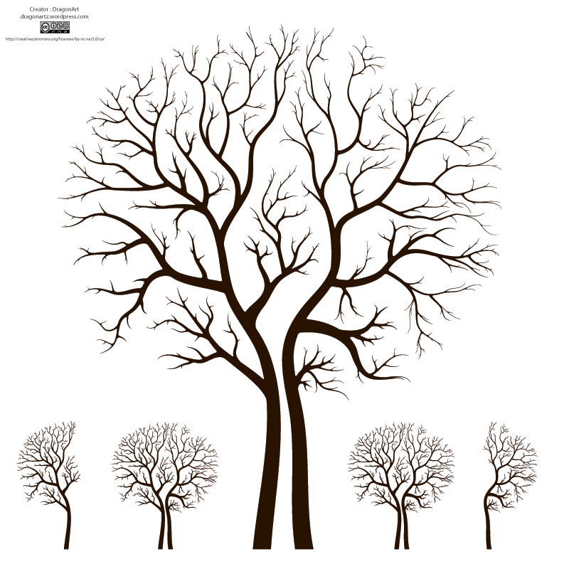
Paper Structure --- the skeleton
Title = face
Abstract = heart
Key Words = address
Headings = skeleton
Introduction = hands
Data and Analysis
Discussion (visuals) = voice
Conclusion = smile
References

Slide 32
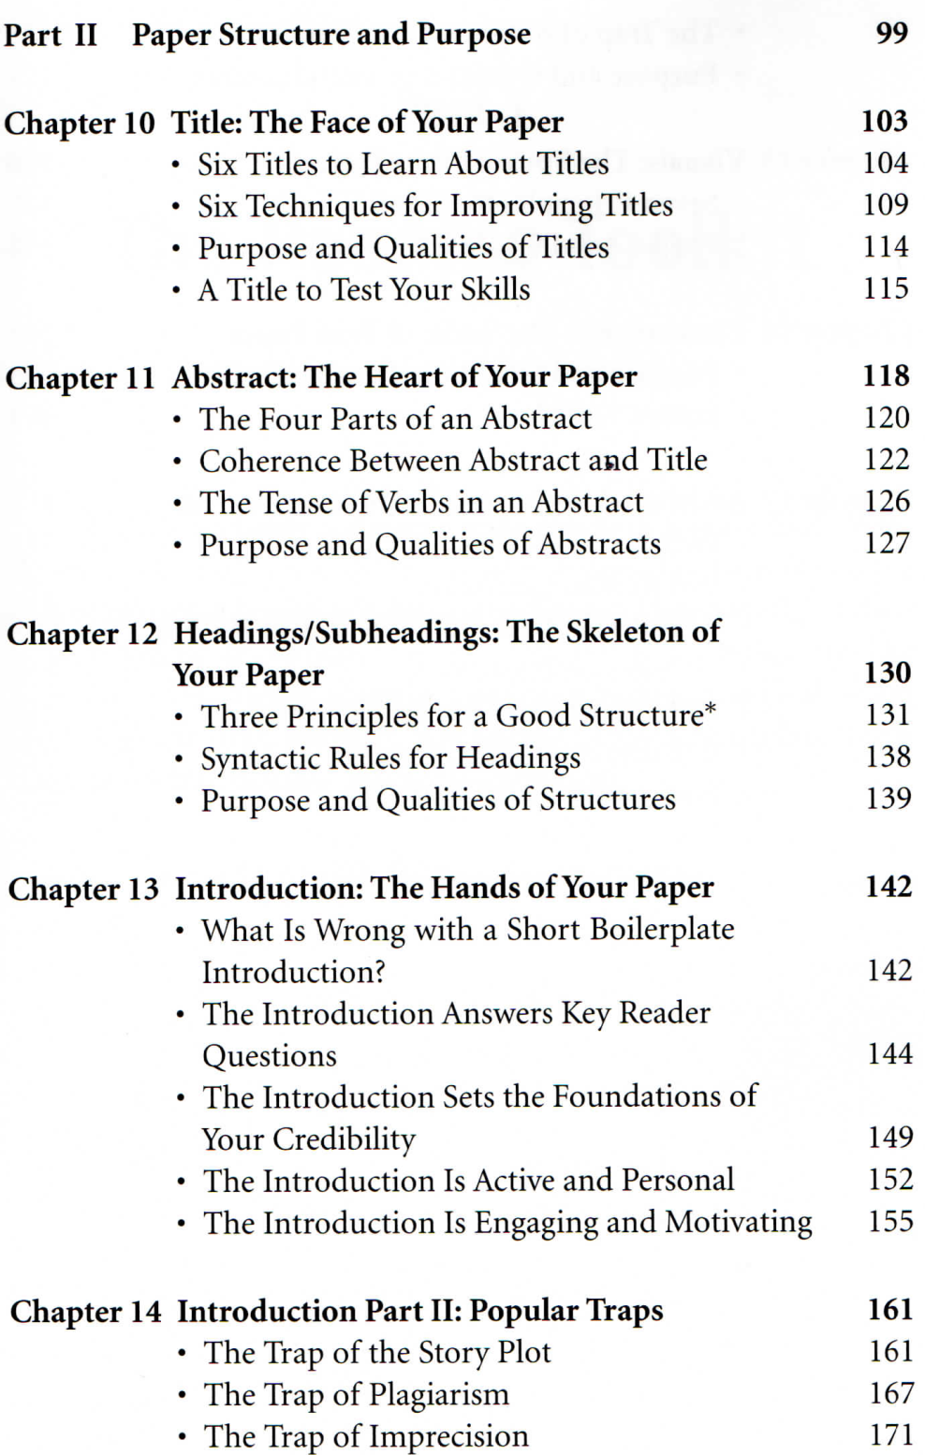
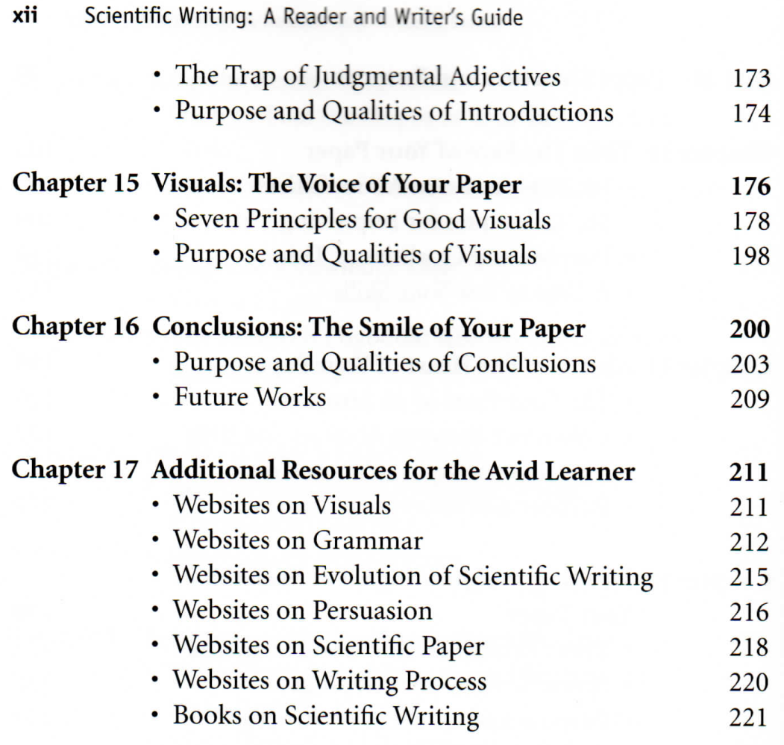

Slide 33
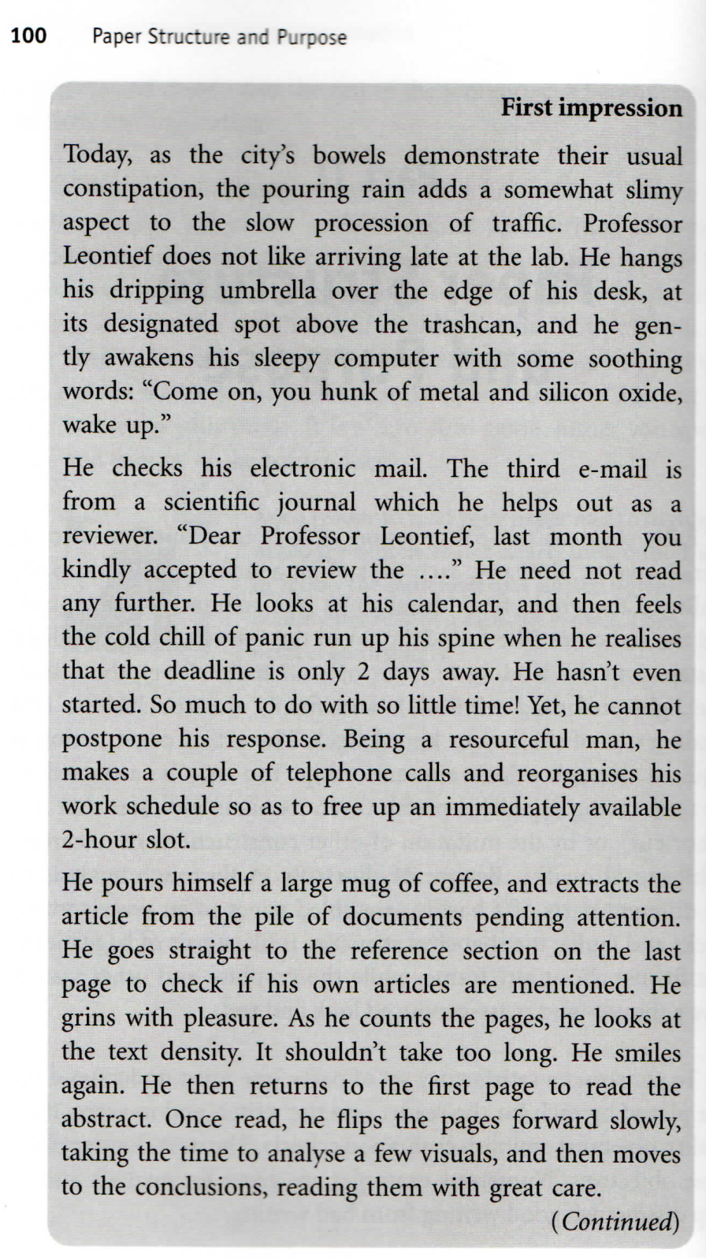
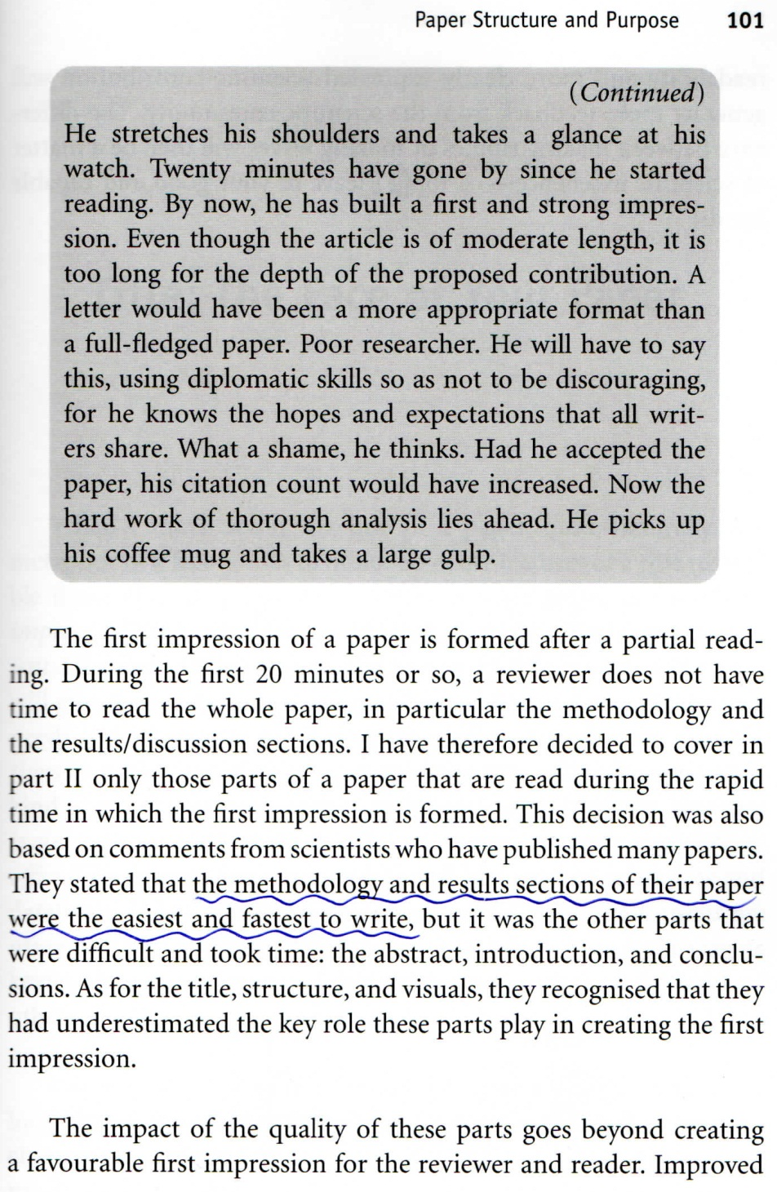

Slide 34
Writing Plan (cont.)
(Placeholder)
Title, possible coauthors (affiliations)
Who should be included anyway?
Abstract can wait
Figures
Section headings, subsections …
Introduction, Observations/Data Analysis, Results/Discussions, Conclusions
Then each paragraph (a concept or an issue; a key word)
Expansion of each key word
5-10 sentences? Combination to form more sophisticated sentences.

Slide 38
cluster formation and destruction

Slide 39
destruction process and timescales

Slide 40
problems, difficulties & solutions

Slide 41
Target background info, literature

Slide 42
this work

Slide 44
Retraction Watch
https://www.facebook.com/retractionwatch
How to respond to a referee report
https://twitter.com/JonWolfMueller/status/1411699729851994112
https://www.asbmb.org/asbmb-today/careers/102821/how-to-reply-to-reviewers-comments?fbclid=IwAR1RqciHf-fiwKQjfnBYxpk3v4M0M9goOu9HQUXrs4_gfr34_reut9JYGnk
How to write a referee report
https://courses.physics.illinois.edu/phys598PEN/sp2021/lectures/WritingRefereeReports_SP21.pdf

