Slide 1
Introduction
The hands of your paper
Chapter 13-14 of Lebrun (2007)

Slide 2
Introduction is something more difficult to write than the methodology or results section.
It should bring the reader up to speed and reduce the initial knowledge gap. It poses the problem, the proposed solution, and the scope. It answers the questions raised by the title and the abstract.
The introduction should be written, or at least in a preliminary form, right at the beginning of the writing, or even when the research project starts (when the observing proposal was written). It shows the skill of communication of the writer, in a personal way.
Much of the readership may be outside of your field. So many of your readers, sometime even the referee, will require an introduction of your paper.

Slide 3
Too often an introduction contains (i) a short paragraph to describe the problem, (ii) a paragraph to place the contribution in context with densely packed references, and (iii) a final “table of contents”. Only a few experts in the field --- who are familiar with the material already anyway --- would appreciate this kind of an introduction. What purpose does it serve?

Slide 4
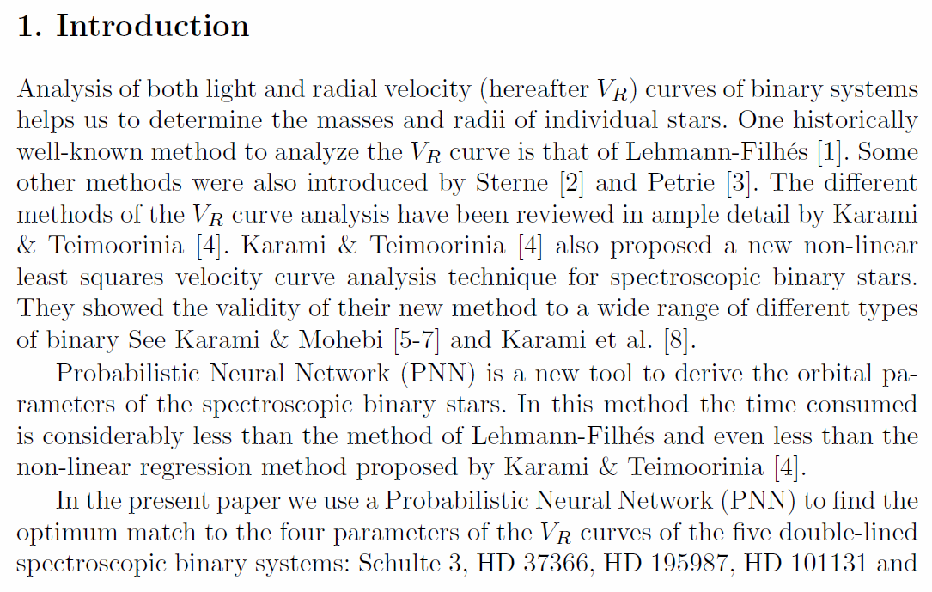
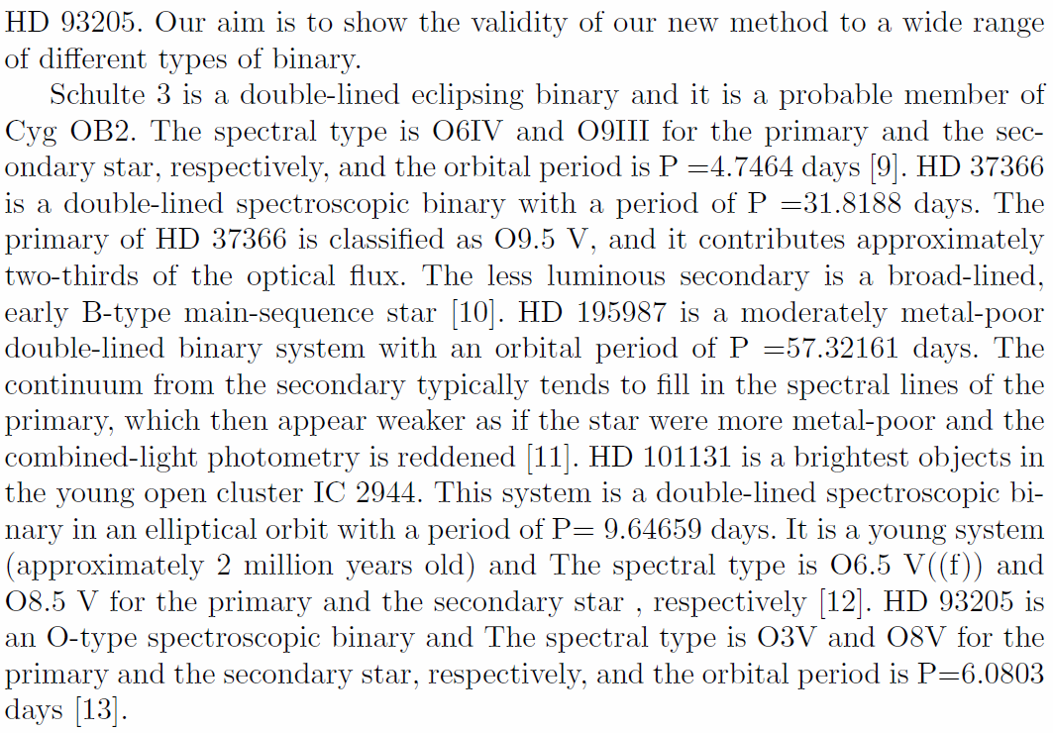

Slide 5
An introduction should
be clear of the objectives/motivations, and of what is new in the paper.
answer key questions. Identify the question that your title and abstract are supposed to answer. If you cannot phrase your contribution in a question form, you are not ready to write the paper. State the question as soon as possible in your introduction. Why now? Why this? Why this way? Why should the reader care? The readers rely on you to answer these questions.
set the foundation of your credibility. One should present both sides of an issue, i.e., “intellectual honesty”. What are the limitations of your work?

Slide 6
An introduction should
justify your choice of method in the introduction to strengthen the credibility.
Our classification algorithm does not make any assumption on the resolution of the images, nor does it make any assumption on the shape of a galaxy.
give your own definition; frame your own scope of the of your contribution.
An effective classification scheme should have the following desirable features …
be active and personal. You want to tell a story, your story, not a report. Use “we” or “our”.
We were curious to see whether we could resolve the discrepancy between these models by using our new observations.
Passive voice is acceptable in the rest of your paper. But in introduction, use active voice.

Slide 7
An introduction should
be engaging and motivating. The readers should want to read further. They should appreciate you as a writer, not just as a scientist.
“I do not usually read introductions. Most of what’s in there is repeated verbatim elsewhere in the paper anyway. They are a water of time. They always say the same thing: the problem is important, everybody else but the author is doing it wrong, and they usually end up with a boring table of contents. So, I skip them.”
--- quoted from “Kumar” in Lebrun’s book
Lebrun thinks some introductions are repetitive because they are written after the work is done, so the fun and excitement are gone! Write the introduction early, with the tantalizing hypothesis, supportive preliminary data, and fruitful methods.

Slide 8
An introduction should
avoid a vacuous false start
In the age of all-sky surveys, we are confronted with a large amount of data …
Significant progress in detector technology in general, and data analysis in particular, often prompts to enable …
(Reader OS: ) Is there anything I do not know already?
avoid a considerable false start
There has been a surge, in recent times, toward the increasing use of …
There has been considerable interest in recent years in this technology, and, as trends indicate, it is expected to show continuing growth over the next decade …
(Reader OS: ) Should I be excited by the sheer popularity of the problem (not the solution)?
avoid a dead table-of-contents ending

Slide 9
Do not cut and paste sentences from various parts of your paper into the introduction.
Check this example
Abstract … The HBLRs and non-HBLRs identified in this data set had significantly different [NII]/Fe ratios, in accord with analysis of other AGN samples. These results demonstrate the emission to originate from different regions …
Introduction … We demonstrate that the emission of HBLRs and non-HBLRs comes from different parts of the ….
The abstract is more precise than the introduction for key numerical results. The abstract is factual and passive “These results demonstrate …”; the introduction is personal and active “We demonstrate …”.

Slide 10
Popular Traps
The Trap of the Story Plot
A story (from Lebrun)
I’m so excited about telling you this great story. My father is on the front lawn cleaning the lawn mower. My sister is in the back kitchen making a cake. My mom has gone shopping, and I am playing my electric guitar in my bedroom.
Your readers are left ice cold. There is no plot, no relationship or connection between the elements of the story.
Identify your story plot in the introduction.

Slide 11
A better story --- with a thread
I’m so excited. I am going to tell you a great story. My father is on the front lawn cleaning the lawn mower. Do you know what this means? Trouble! He hates it. He wants everyone to help bring him this or that in order to feel less miserable. Whenever that happens, we all run away, not because we refuse to help him, but because he wants us to stand there and watch idly while he works. So, my sister is taking refuge in the back kitchen and is plunging her hand in flour to slowly making a cake. My mom has suddenly discovered that she is missing something, and has rushed out to shop, saying she would be gone for an hour or so. As for me, I am in my bedroom playing the electric guitar with my amplifier at maximum volume.

Slide 12
A terrible story
I’m so excited. I am going to tell you my second best story. A red Ferrari would take me to Vladimir Toldoff’s house in 5 hours. It is fast. However, it is very expensive. A red bicycle is much less expensive and is quite convenient for short trips. So, if Vladimir Toldoff came to live near my house, it would be quite cost effective. However, a bicycle that does not have a mudguard requires a bicycle clip so as not to dirty trousers. Since red athletic shoes do not require a bicycle clip, they are a better solution than a bicycle to travel short distances. However, their color is easily degraded by adverse weather conditions, particularly in the muddy rainy season. On the other hand, brownish open plastic sandals do not have any of the previous problems: they are cheap, convenient, require no bicycle clip, and do not show mud stains. Furthermore, they are easy to clean, and are fast to put on. However, contrary to the Ferrari, they reflect poorly on the status of their owners. Therefore, I am working on a framework to integrate self-awareness into the means of transportation, and will validate it through the popular Sims 2 simulation package.

Slide 13
The disconnect plot and however plot are frequently found because they are convenient:
They allow a list of loosely related references to be easily assembled.
The shallow analysis of related works is fast because it does not require extensive reading of other people’s works (abstracts or even titles are enough in most cases)
Usually a plot that works well in movies is also useful in scientific writing. It is all right if you show the readers how the story ends before it even starts. The readers have a full picture, so they can place your contribution in it. They know your limitations and expect that you will deal with them.

Slide 14
The Trap of Plagiarism
Plagiarism happens when someone else’s words are found in your paper without proper quotes or references.
For an academic position, plagiarism = end of career.
Changing a word here and there does not get rid of plagiarism → “patchwork plagiarism”
Changing every word except the keywords does not help.
Even quoting yourself can be dangerous. You might have coauthors. The copyright, after a paper is published, no longer belongs to you.
Free or open access does not imply free right of use.
Quoting is a good practice. You do not interpret; you cite.

Slide 15
When doing the electronic literature study, keep relevant documentation about the information source.
Completely rewrite without looking at the original, and express your point of view.
In apparent support of the cold dark matter cosmology, Chen (2012) provided observational evidence of …
With the skillful use of the word “apparent”, the author starts in the next paragraph with “However” to express disagreement.

Slide 16
The Trap of Imprecision
So your paper mentions 30 or more references. Did you read them all? Or did you just skim the abstracts?
Words like typical, generally, commonly, can/may, a number of, the majority of, substantial, probably, several, less, various, frequent, many, others, more, often, most, a few, the main…
Many people have been working on this problem [1,2,3,4,5,6,7,8,9,10], and others have recently improved on the method [11,12,13,14,15,16,17].
Very often, the rest of the paper does not contain as many references.
As a referee, how do you think of this paper?

Slide 17
If you read only the abstracts, or fill your paper with references of papers you have not read (or even do not have them), it will hurt you in the following ways:
Your paper will have superficial statements, so the referee will lower the value of your contribution.
Your research will be clearly positioned on the research landscape.
Your story will lack of details and, therefore, interest.
The reader will doubt your expertise. Why should they believe you otherwise?

Slide 18
The Trap of Judgmental Adjectives
When you refer to other’s work, some adjectives are dangerous (poor, good, fast, faster, not reliable, primitive, naïve, limited).
Every adjective is a claim, and in science, claims have to be substantiated. How do you justify “poor”?
Use those adjectives that you later justify with data or figures. Let adjectives be based on facts, or on quotes from other authors stating their own limitations of assumptions.

Slide 19
State that your work agrees (or disagrees) with another paper’s conclusions. State that your results are different or consistent.
Use facts and numbers.
Define your uniqueness.
Quote another paper that independently supports your views.

