Slide 1
Conventional structure
Title
Abstract, (key words),
Sections: introduction, data sources/observations and analysis, discussion, conclusion, acknowledgments, references, (appendices).
Each section: subsections, paragraphs, sentences, words
--- structured and layered information
Start with simple sentences, and later … if the presentation flow/logic is smooth, it is easy to string sentences together
… avoid all short-sentences … avoid long paragraphs …
(let the reader breathe.)

Slide 2
Sentence connections
Glasman-Deal 1.2.2

Slide 3
Mind the gap between sentences
- Using an overlapping statement
  One way to ascertain stellar youth is detection of
  the lithium absorption line. As a result, …
- Using a pronoun (it, then) or a pro-form
(this method, these data)
  One of the criteria for stellar membership in a star cluster is,
  in addition to aggregating in space volume, grouping in
  kinematics. The combination of proper motion plus distance,
  i.e., the tangential velocity, therefore renders …

Slide 4
Using a signaling sentence connector (therefore, however)
  The combination of proper motion plus distance, …. However,
  membership is not as constrained using radial velocity due to possible
  variations caused by binary orbital motion.
Avoid “since” (=because), “while” (=at the same time); try whereas
Using a semicolon or a relative clause (“which”)
      Circumstellar disks disperse in about 10 Myr; the ubiquity of exoplanets
      implies an efficient planet formation process.
      This is the method with which we used to analyzed the time-series data …
      The method was found not applicable, which led to modifications …
    “who” for a person’ “which” for otherwise;
    “that” for all, and for specification (any, same, very only …)\
      This is the same method that we adopted …

Slide 5
Elsevier: Author guideline
https://www.elsevier.com/connect/author-guidelines-and-submission-process
Writing tips
Show, don’t just tell.
Use action verbs; go easy on the adjectives
Choose active voice
Quotes should sound human
Avoid clichés
Say it simply
Define technical terms
Eliminate words that do not add meaning

Slide 6
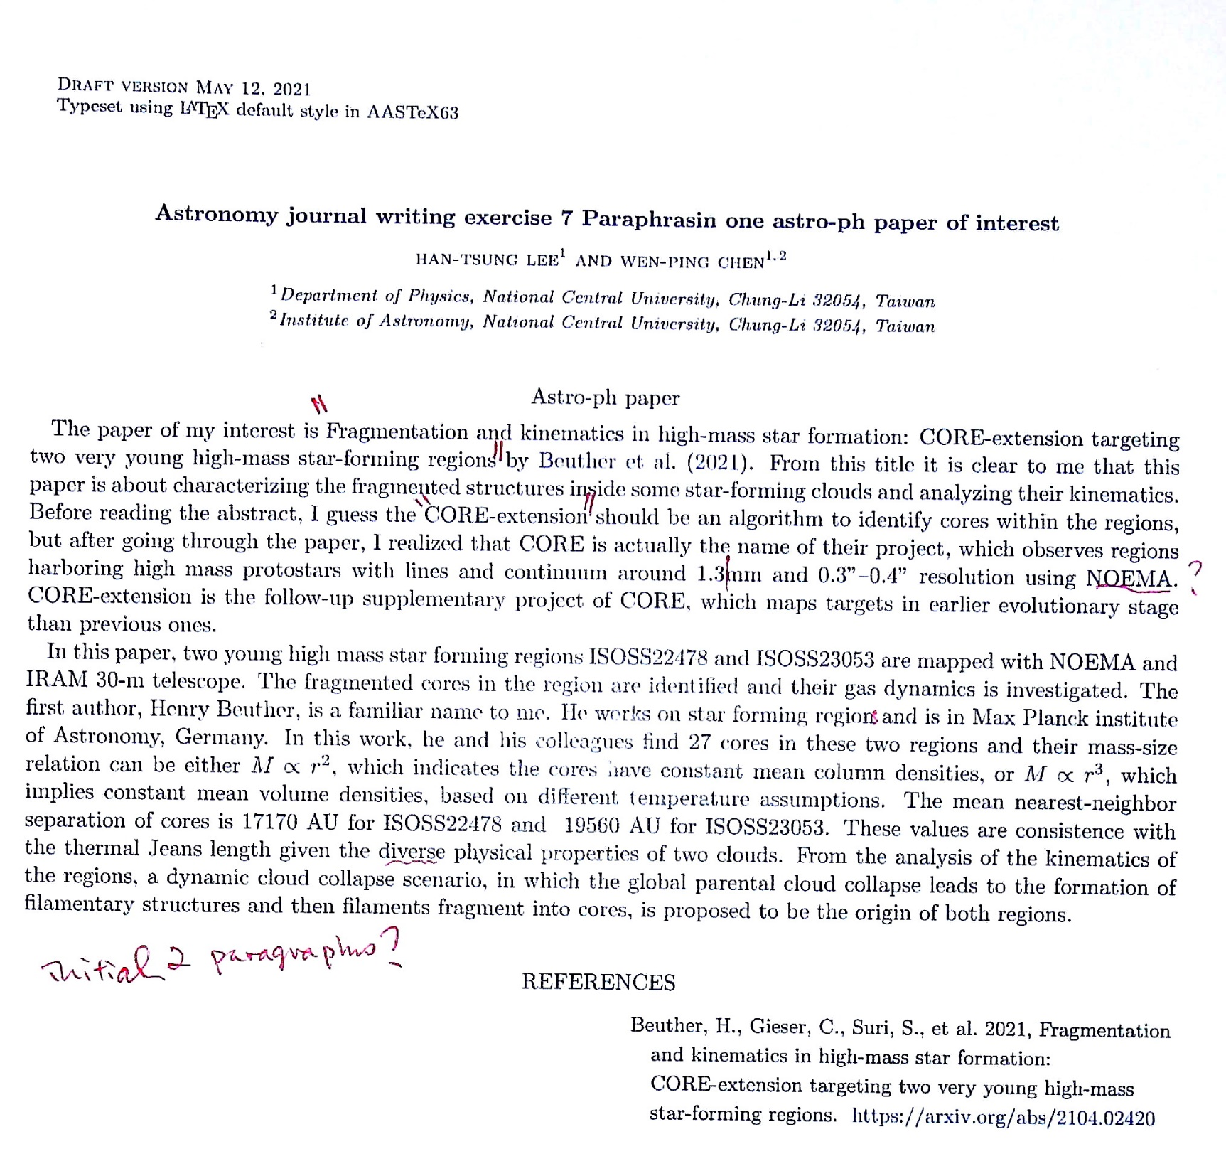

Slide 7
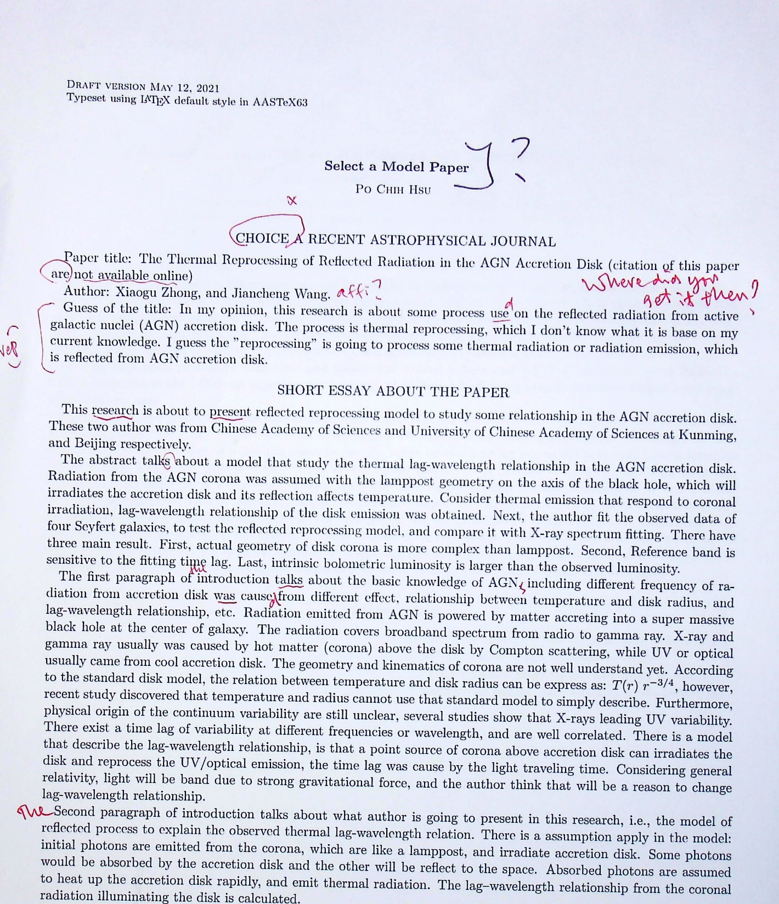

Slide 8
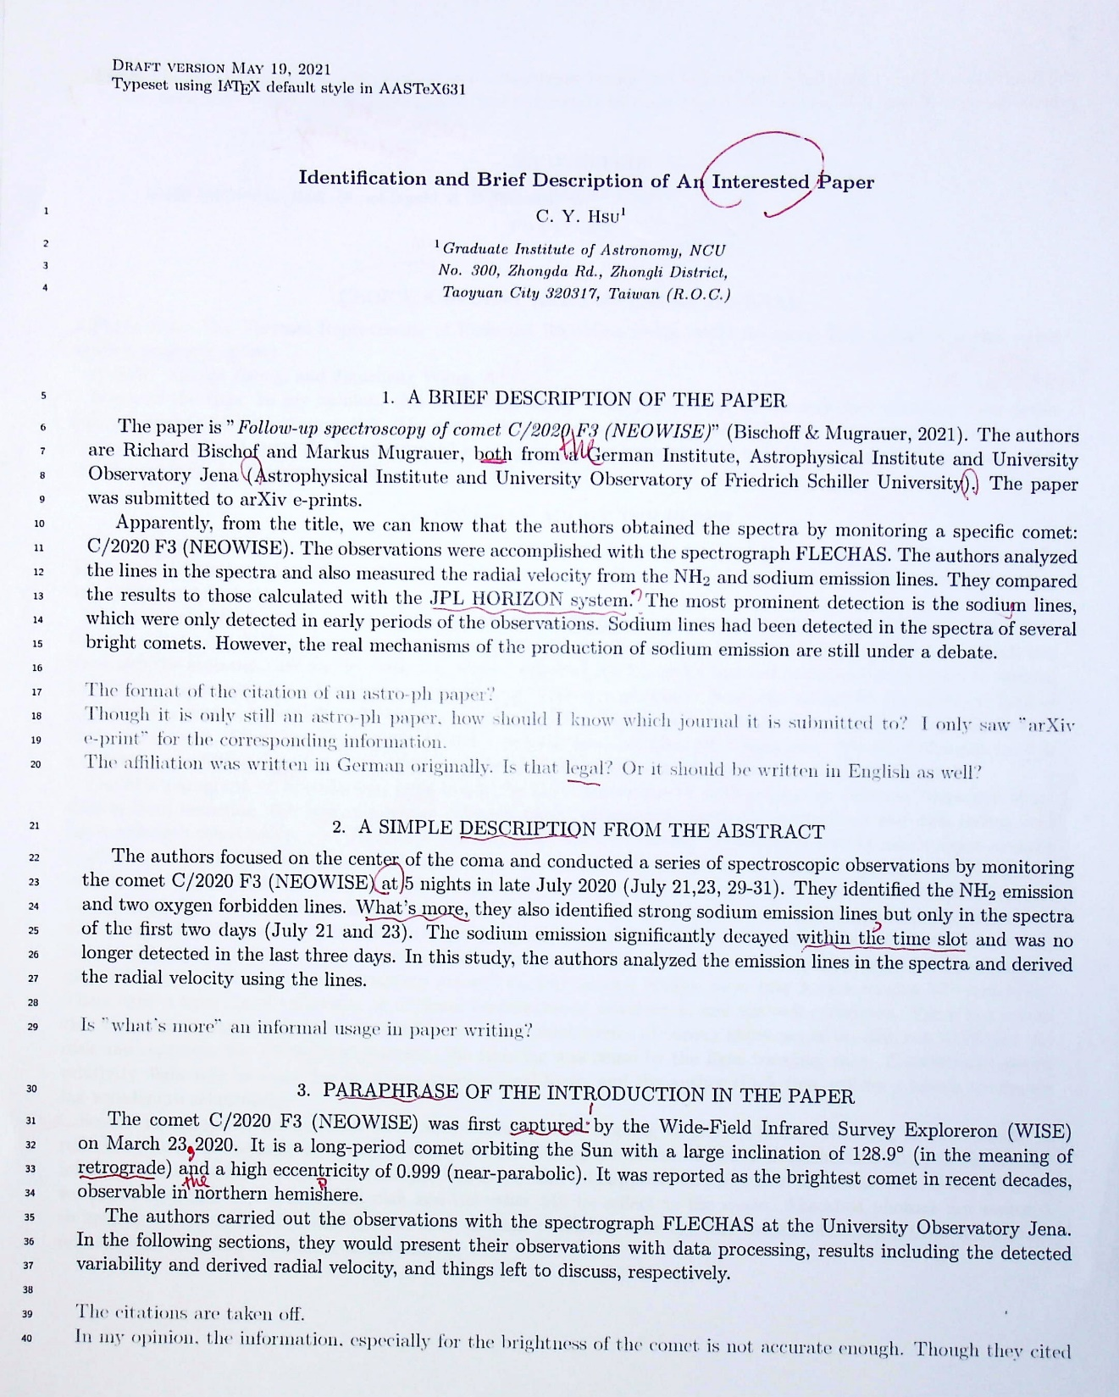

Slide 9
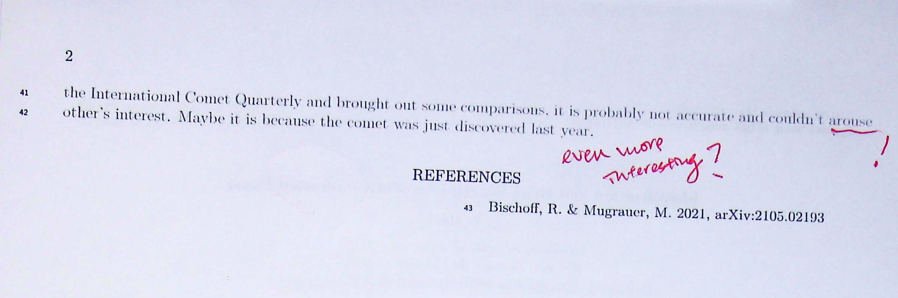

Slide 10
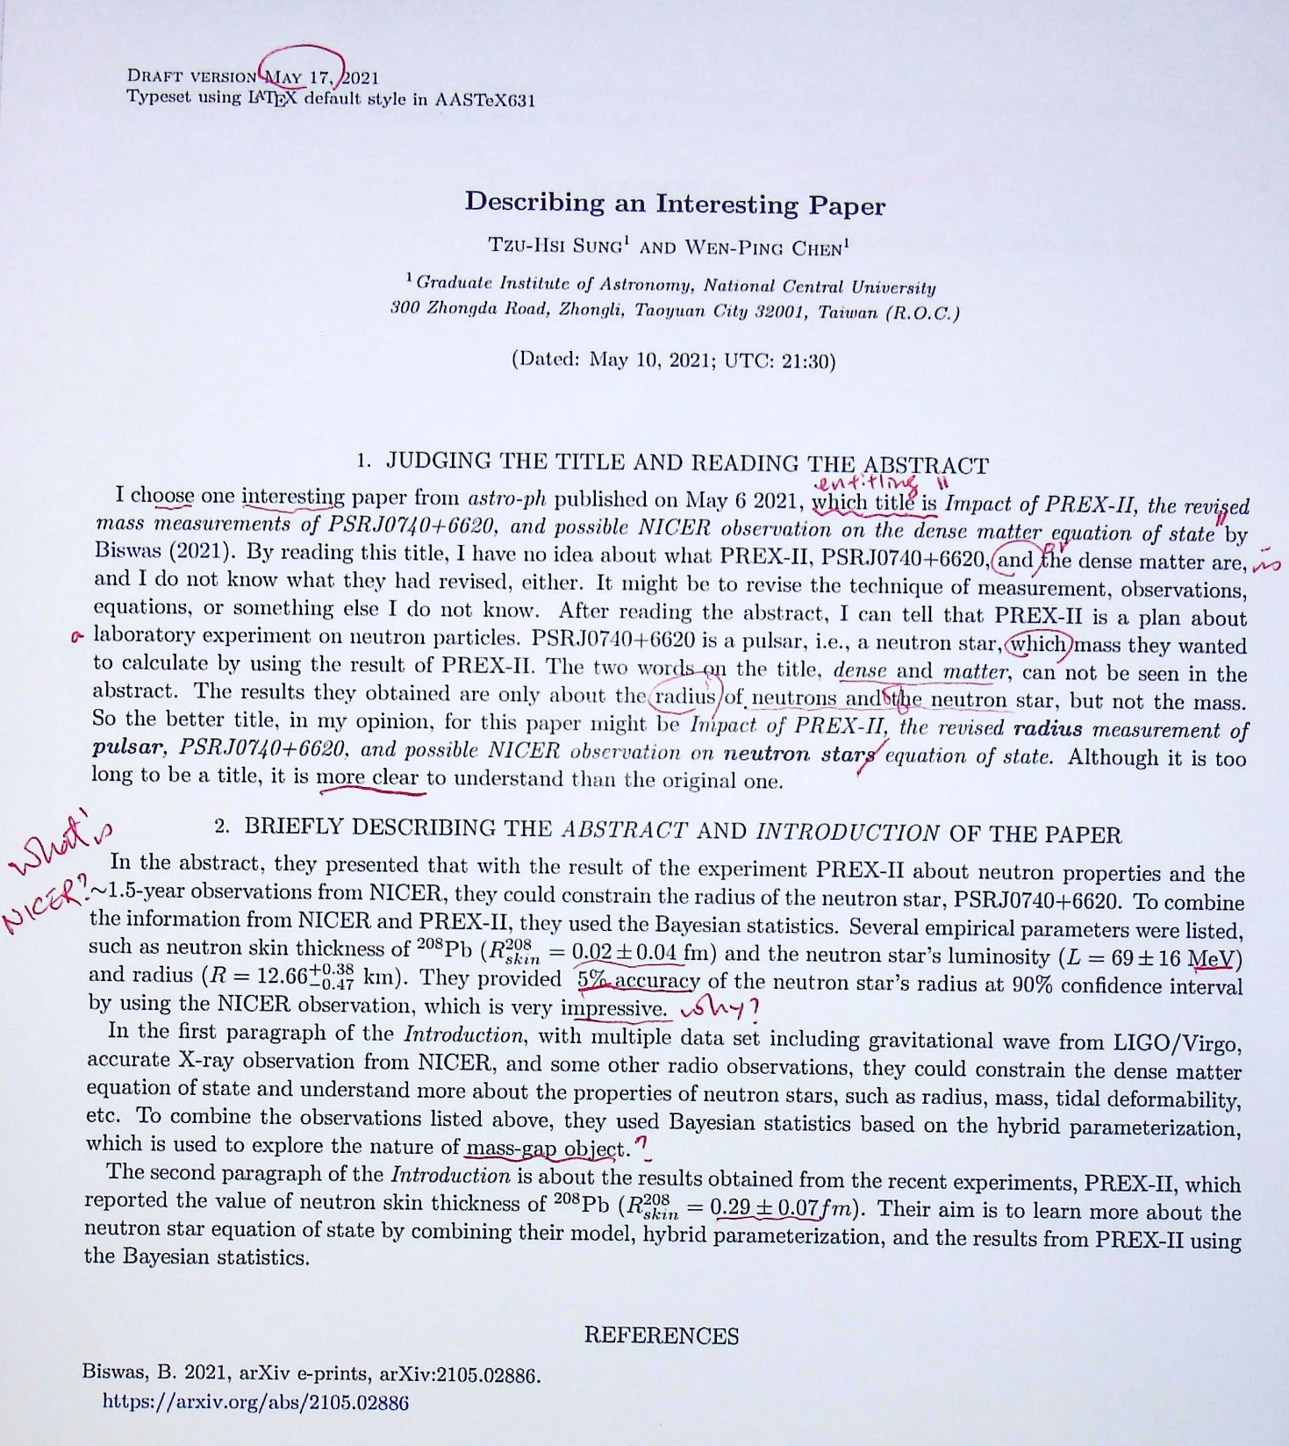

Slide 11
Introduction
The hands of your paper
Chapter 13-14 of Lebrun
Unit 1 of Glasman-Deal

Slide 12
Introduction is something more difficult to write than the “methodology” or “results/discussion” section.
It should bring the reader up to speed and reduce the initial knowledge gap. It poses the problem, the proposed solution, and the scope. It answers the questions raised by the title and the abstract.
The introduction should be written, or at least in a preliminary form, right at the beginning of the writing, or even when the research project starts (when the observing proposal was written). It shows the skill of communication of the writer, in a personal way.

Slide 13
Much of the readership may be outside of your subject. So many of your readers, sometime even the referee, will require an introduction of your paper.
Too often an introduction contains (i) a short paragraph to describe the problem, (ii) a paragraph to place the contribution in context with densely packed references, and (iii) a final “table of contents”. Only a few experts in the field --- who are familiar with the material already anyway --- would appreciate this kind of an introduction. What purpose does it serve?

Slide 14
Zooming in for Introduction …
- Big picture/story first …
- My approach …
- This contribution …
Zooming out for Discussion/Conclusion …
- Our results …
- The solution to the problem …
- Limitations, prospects ..

Slide 15
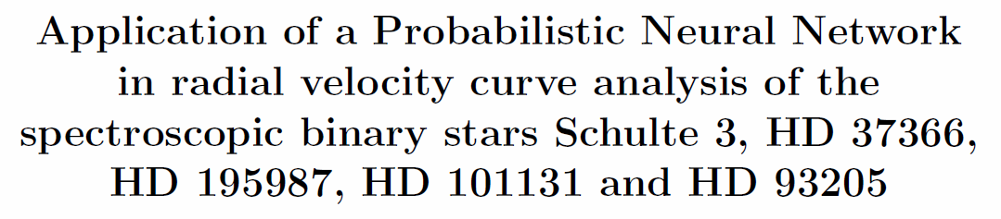
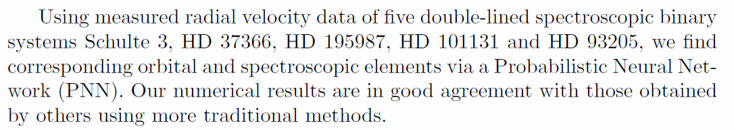
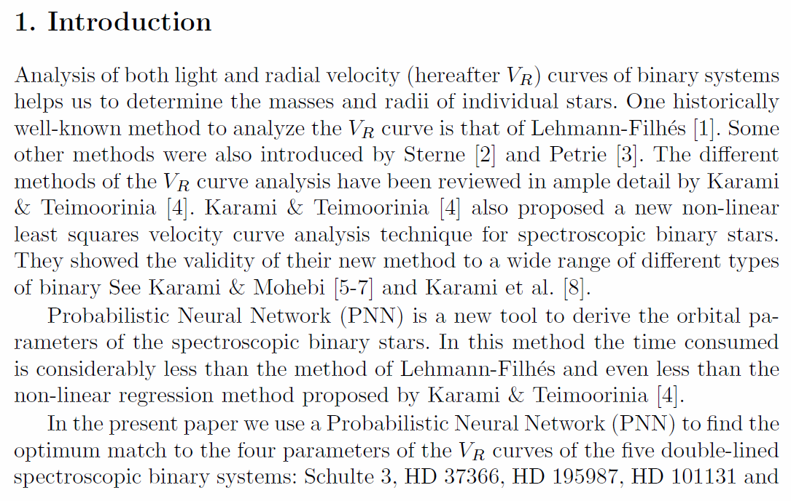
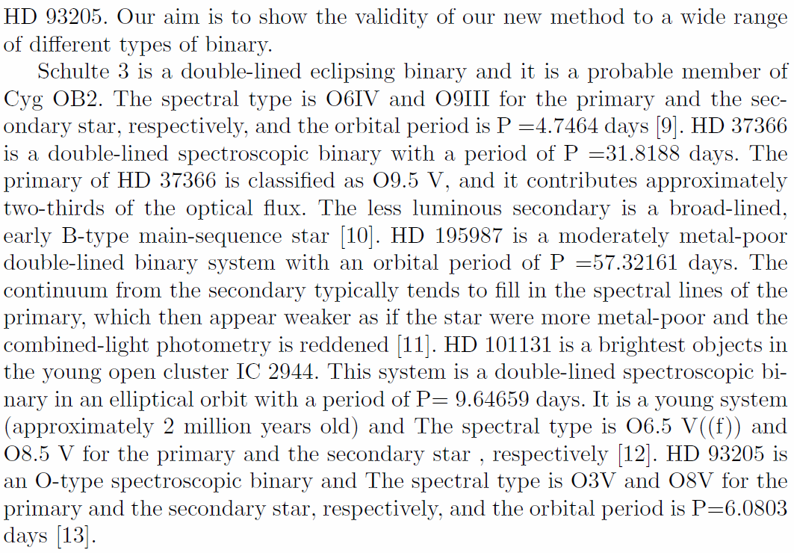
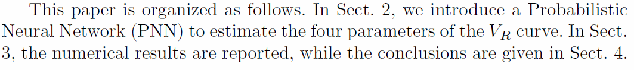
Using radial velocity data, we derived orbital elements, via the Probabilistic Neural Network technique, of five double-lined spectroscopic binary systems: Schulte 3, HD37366, HD 195987, HD 101131, and HD 93205 …. Our results are in good agreement … using traditional methods (!)

Slide 16
Series/Serial comma (Oxford comma, Harvard comma) is the final comma that is placed before a coordinating conjunction (“and” or “or”) in a set of three or more terms.
  We exercised different periodogram analysis schemes, the classical Fourier transform, Lomb-Scargle algorithm, and minimum phase dispersion …
  I invited to the party my two classmates, Trump and Obama.
  I invited to the party my two classmates, Trump, and Obama.
  (How many did you invite? Who else is your classmate, Biden?)
It is stylish, i.e., optional.
Its use is standard in the USA, but not, e.g., in the UK.
  e.g., (exempli gratia; for example=such as)
  i.e., (id est; that is=specifically=namely)
  cf (conferre; compare=cp=see)

Slide 17
Common-used Latin abbreviations
  e.g., (exempli gratia; for example=such as)
  i.e., (id est; that is=specifically=namely)
  cf (conferre; compare=cp=see)
  et al. (et alii; and others) for people
  etc./etc (et cetera; and the rest=and so on) for things
  erratum/errata (=error)
  ibid. (ibidem; in the same book/journal)
  viz. (videlicet; namely=that is to say)
  vs. (versus; against)
  ca./ca (circa; around=approximately)

Slide 18
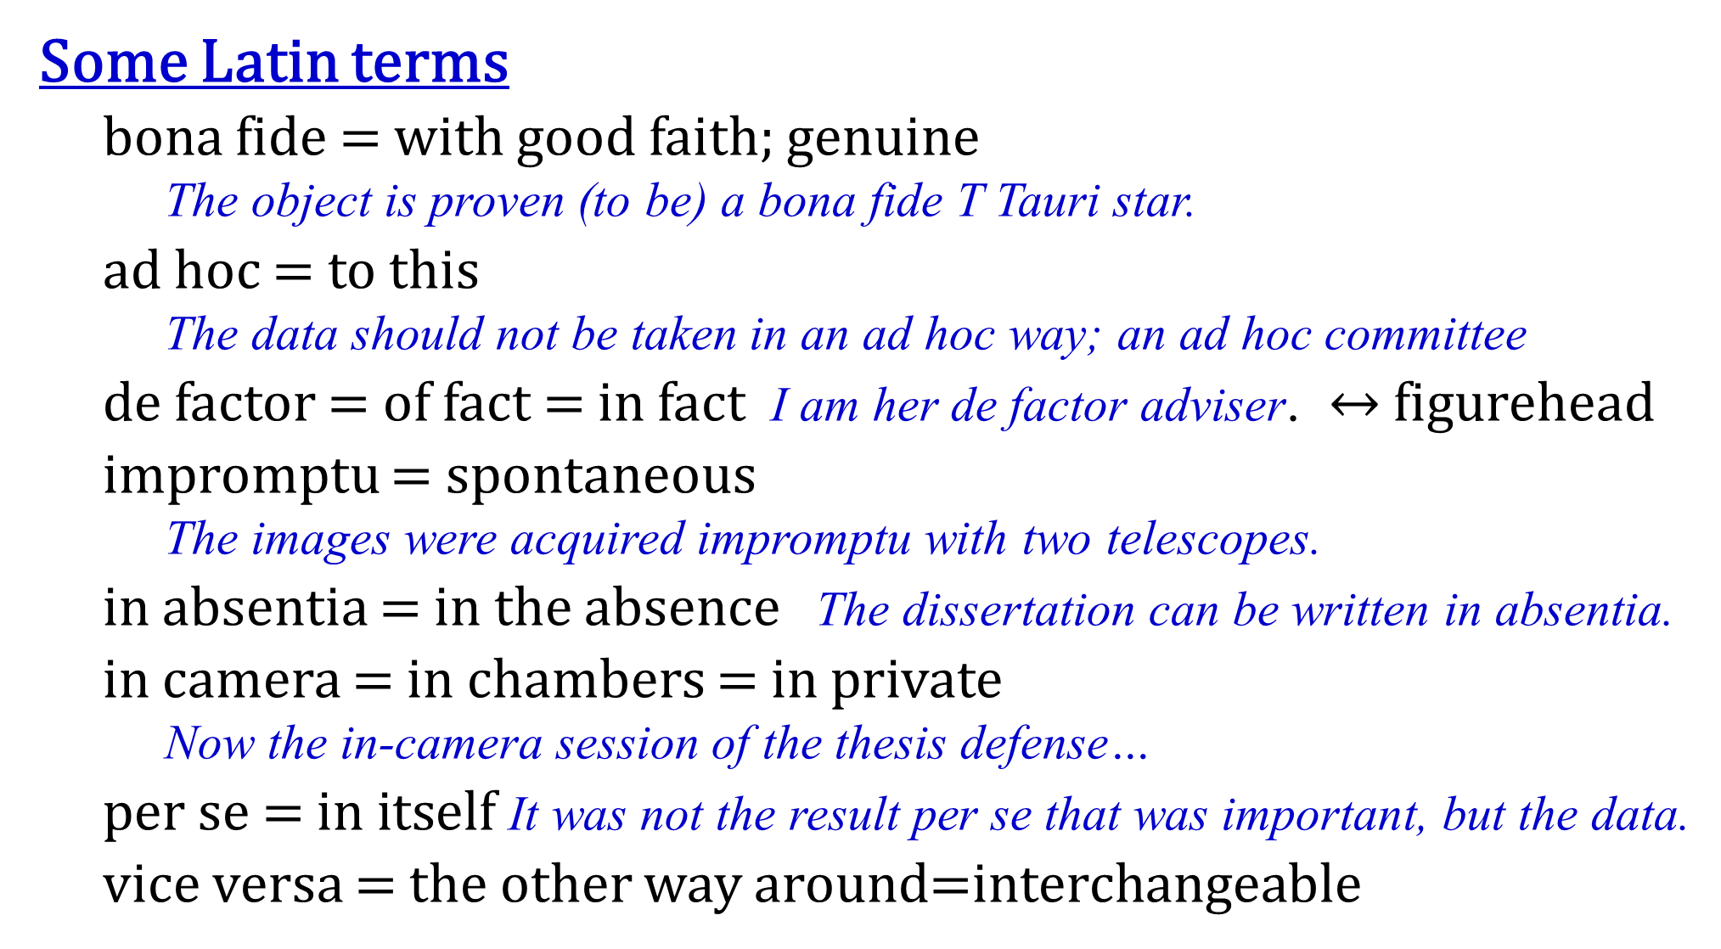
Some Latin terms
  bona fide = with good faith; genuine
  The object is proven (to be) a bona fide T Tauri star.
  ad hoc = to this
  The data should not be taken in an ad hoc way; an ad hoc committee
  de factor = of fact = in fact I am her de factor adviser. $↔$figurehead
  impromptu = spontaneous
  The images were acquired impromptu with two telescopes.
  in absentia = in the absence The dissertation can be written in absentia.
  in camera = in chambers = in private
  Now the in-camera session of the thesis defense…
  per se = in itself It was not the result per se that was important, but the data.
  vice versa = the other way around=interchangeable

Slide 19
An introduction should
be clear of the objectives/motivations, and of what is new in the paper.
answer key questions. Identify the question that your title and abstract are supposed to answer. If you cannot phrase your contribution in a question form, you are not ready to write the paper. State the question as soon as possible in your introduction. Why now? Why this? Why this way? Why should the reader care? The readers rely on you to answer these questions.
set the foundation of your credibility. One should present both sides of an issue, i.e., “intellectual honesty”. What are the limitations of your work?

Slide 20
An introduction should
justify your choice of method in the introduction to strengthen the credibility.
  Our classification algorithm does not make any assumption on the resolution of the images, nor does it make any assumption on the shape of a galaxy.
give your own definition; frame your own scope of your contribution.
  An effective classification scheme should have the following desirable
  features …

Slide 21
An introduction should
be active and personal. You want to tell a story, your story, not a report. Use “we” or “our”.
  We were curious to see whether we could resolve the discrepancy between these models by using the latest observations.
  Passive voice is acceptable in the rest of your paper. But in introduction, use active voice.
  OK to use a dummy subject.
  This paper presents a set of criteria to select membership of a star cluster against field stars.
  Our results testify that …

Slide 22
An introduction should
be engaging and motivating. The readers should want to read further. They should appreciate you as a writer, not just as a scientist.
  “I do not usually read introductions. Most of what’s in there is repeated verbatim elsewhere in the paper anyway. They are a water of time. They always say the same thing: the problem is important, everybody else but the author is doing it wrong, and they usually end up with a boring table of contents. So, I skip them.”
  --- quoted from “Kumar” in Lebrun’s book

Slide 23
Lebrun thinks some introductions are repetitive because they are written after the work is done, so the fun and excitement are gone! Write the introduction early, with the tantalizing hypothesis, supportive preliminary data, and fruitful methods.
Specify the importance of something, rather than just saying that “it is important.”
An introduction should
avoid a vacuous false start
  In the era of all-sky surveys, we are confronted with large
  amounts of data …
  Significant progress in detector technology in general, and
  data analysis in particular, often prompts to enable …
  (Reader OS: ) Is there anything I do not know already?

Slide 24
An introduction should
avoid a considerable false start
  There has been a surge, in recent times, toward the increasing
  use of …
  There has been considerable interest in recent years in this
  technology, and, as trends indicate, it is expected to show
  continuing growth over the next decade …
  (Reader OS: ) Should I be excited by the sheer popularity of the
  problem (not the solution)?
avoid a dead table-of-contents ending
Say more; “connect the dots”

Slide 25
Do not cut and paste sentences from various parts of your paper into the introduction.
The abstract is more precise than the introduction for key numerical results. The abstract is factual and can be passive “These results demonstrate …”; the introduction is personal and active “We demonstrate …”.
  Abstract … The HBLRs and non-HBLRs identified in this data set had significantly different [NII]/Fe ratios, in accord with analysis of other AGN samples. These results demonstrate the emission to originate from different regions …
  Introduction … We demonstrate that the emission of HBLRs and non-HBLRs comes from different parts of the ….

Slide 26
Popular Traps
The Trap of the Story Plot
A story (from Lebrun)
I’m so excited about telling you this great story. My father is on the front lawn cleaning the lawn mower. My sister is in the back kitchen making a cake. My mom has gone shopping, and I am playing my guitar in my bedroom.
Your readers are left ice cold. There is no plot, no relationship or connection between the elements of the story.
Identify your story plot in the introduction.

Slide 27
A better story --- with a thread
I’m so excited. I am going to tell you a great story. My father is on the front lawn cleaning the lawn mower. Do you know what this means? Trouble! He hates it. He wants everyone to help bring him this or that in order to feel less miserable. Whenever that happens, we all run away, not because we refuse to help him, but because he wants us to stand there and watch idly while he works. So, my sister is taking refuge in the back kitchen and is plunging her hand in flour to slowly making a cake. My mom has suddenly discovered that she is missing something, and has rushed out to shop, saying she would be gone for an hour or so. As for me, I am in my bedroom playing the electric guitar with my amplifier at maximum volume.

Slide 28
A terrible story
I’m so excited. I am going to tell you my second best story. A red Ferrari would take me to Vladimir Toldoff’s house in 5 hours. It is fast. However, it is very expensive. A red bicycle is much less expensive and is quite convenient for short trips. So, if Vladimir Toldoff came to live near my house, it would be quite cost effective. However, a bicycle that does not have a mudguard requires a bicycle clip so as not to dirty trousers. Since red athletic shoes do not require a bicycle clip, they are a better solution than a bicycle to travel short distances. However, their color is easily degraded by adverse weather conditions, particularly in the muddy rainy season. On the other hand, brownish open plastic sandals do not have any of the previous problems: they are cheap, convenient, require no bicycle clip, and do not show mud stains. Furthermore, they are easy to clean, and are fast to put on. However, contrary to the Ferrari, they reflect poorly on the status of their owners. Therefore, I am working on a framework to integrate self-awareness into the means of transportation, and will validate it through the popular Sims 2 simulation package.

Slide 29
The disconnect plot and however plot are frequently found because they are convenient:
They allow a list of loosely related references to be easily assembled.
The shallow analysis of related works is fast because it does not require extensive reading of other people’s works (abstracts or even titles are enough in most cases)
Usually a plot that works well in movies is also useful in scientific writing. It is all right if you show the readers how the story ends before it even starts. The readers have a full picture, so they can place your contribution in it. They know your limitations and expect that you will deal with them.

Slide 30
The Trap of Plagiarism
Plagiarism happens when someone else’s words are found in your paper without proper quotes or references.
For an academic position, plagiarism = end of career.
Changing a word here and there does not get rid of plagiarism → “patchwork plagiarism”
Changing every word except the keywords does not help.
Even quoting yourself can be dangerous. You might have coauthors. The copyright, after a paper is published, no longer belongs to you.
Free or open access does not imply free right of use.
Quoting is a good practice. You do not interpret; you cite.

Slide 31
When doing the electronic literature study, keep relevant documentation about the information source.
Completely rewrite without looking at the original, and express your point of view.
In apparent support of the cold dark matter cosmology, Chen (2012) provided observational evidence of …
With the skillful use of the word “apparent”, the author starts in the next paragraph with “However” to express disagreement.

Slide 32
The Trap of Imprecision
So your paper mentions 30 or more references. Did you read them all? Or did you just skim the abstracts?
Words like typical, generally, commonly, can/may, a number of, the majority of, substantial, probably, several, less, various, frequent, many, others, more, often, most, a few, the main…
Many people have been working on this problem [1,2,3,4,5,6,7,8,9,10], and others have recently improved on the method [11,12,13,14,15,16,17].
Very often, the rest of the paper does not contain as many references.
As a referee, how do you think of this paper?

Slide 33
If you read only the abstracts, or fill your paper with references of papers you have not read (or even do not have them), it will hurt you in the following ways:
Your paper will have superficial statements, so the referee will lower the value of your contribution.
Your research will be clearly positioned on the research landscape.
Your story will lack of details and, therefore, interest.
The reader will doubt your expertise. Why should they believe you otherwise?

Slide 34
The Trap of Judgmental Adjectives
When you refer to other’s work, some adjectives are dangerous (poor, good, fast, faster, not reliable, primitive, naïve, limited).
Every adjective is a claim, and in science, claims have to be substantiated. How do you justify “poor”?
Use those adjectives that you later justify with data or figures. Let adjectives be based on facts, or on quotes from other authors stating their own limitations of assumptions.

Slide 35
State that your work agrees (or disagrees) with another paper’s conclusions. State that your results are different or consistent.
Use facts and numbers.
Define your uniqueness.
Quote another paper that independently supports your views.

Slide 36
Gladman-Deal

Slide 41
Importance of the subject
Previous work/Literature
Problem
Our solution

Slide 46
An example …

Slide 59
