Slide 1
科技寫作與報告
陳文屏
中央大學 天文所
2018夏＠新疆天文台
www.astro.ncu.edu.tw/~wchen/Courses/Seminar/techwriting.pdf

Slide 2
To Read
journal papers, news, …, anything
To Present
how to show (what you want to show) by a talk?
By a poster? Over dinner? During an elevator ride?
To Listen
how to be an audience
To Write
term papers, conference proceedings,
journal papers

Slide 3
How to do a presentation …
Why? What? To whom? When? Where?
Be prepared (to show only 10% of what you know/prepare)
Be confident
Practice efficient language
Use proper media (overhead, slides, PowerPoint; words only, blackboard …)
Write legibly (text & graphics)

Slide 4
How to do a presentation …
Why? What? To whom? When? Where?
Be prepared (to show only 10% of what you know/prepare)
Be confident
Practice efficient language
Use proper media (overhead, slides, PowerPoint; words only, blackboard …)
Write legibly (text & graphics)

Slide 5
How to do a presentation …
Why? What? To whom? When? Where?
Be prepared (to show only 10% of what you know/prepare)
Be confident
Practice efficient language
Use proper media (overhead, slides, PowerPoint; words only, blackboard …)
Write legibly (text & graphics)

Slide 6
How to do a presentation …
Why? What? To whom? When? Where?
Be prepared
  ready to show only 10% of what you know/prepare
Be confident
Practice efficient language
Use proper media
  overhead, slides, PowerPoint; words only, blackboard …
Write legibly (text & graphics)

Slide 7
How to do a presentation (cont.)
Exercise gestures/body language (walk around sometimes)
Do NOT block the screen
Stick to the time limit
Pay attention to your audience
Sprinkle a touch of humor (yes, only a touch!)
Use (but do not overuse) different fonts and sizes

Slide 8
Different fonts, sizes, copy/paste (Time New Roman, 24 points)
Different fonts, sizes, copy/paste (Times New Roman, 32 points)
Different fonts, sizes, copy/paste (LM Roman Demi)
Different fonts, sizes, copy/paste (Cambria Math)
Different fonts, sizes, copy/paste (Elephant)
不同字型、大小 （新細明體；32號字）
不同字型、大小 Chen’s （標楷體；32號字）
不同字型、大小 Chen’s（標楷體＋Times New Roman；32號字）
不同字型、大小 （特明體＋Times New Roman；32號字）
段距 18 points

Slide 9
讀 pdf 檔 100％放大倍數，剪下後貼上，再放大成 ppt 頁面 → 不清晰

Slide 10
讀 pdf 檔 250％放大倍數，剪下後直接貼上 → 清晰得多

Slide 11
75％剪下貼上後拉大
250％剪下後直接貼上

Slide 12
How to be an audience?
Homework/preview work
Learn a thing or/then two
Do NOT chat with others
Show feedback (asking questions)
…

Slide 14
http://www.pgbovine.net/chinese-english-mistakes.htm
https://arxiv.org/ftp/arxiv/papers/1011/1011.5973.pdf

Slide 15
Homework Assignment
Do a survey, as comprehensive as possible, of journals that publish astronomy- or astrophysics-related research results. Which of them have associated publications, e.g., letters or supplements? Why?
How often is each journal published? In what language? By which publisher? Do we subscribe to it? …
How does the ‘style’ of each journal differ from each other? Note the “looks” of the title, abstract, and references.
Zoom in to one particular ‘core’ journal and browse through one recent paper in it. Do the same for one of the off-core journals.
What is the Science Citation Index? What is the Impact Factor? What is the Open Access policy?

Slide 16
What about Nature, Science, Ann Rev Astron & Astrophy?
Name 1-2 recently established journals not listed above.
Select a personal “model” paper. In one minute, describe its main contents. In another minute, explain why it is your model paper.

Slide 17
Evolution of a manuscript
– An example
- the draft
- a revised version
- the final submitted version

Slide 18
Publication of a Journal Paper
Typesetting the manuscript
  LaTex vs Word or other word processors
  Text, figures, and tables
Peer review by referee(s)
Preprint and astro-ph submissions
Galley proof
… in preparation; in submission; in press
… private communications

Slide 19
A sample Latex file
\documentclass[12pt,preprint]{aastex}
\usepackage{graphicx} \usepackage{natbib}
\slugcomment{To be submitted to AJ; today is \today}
\begin{document}
\title{Typesetting by Latex for Graduate Seminar Course }
\author{ W. P. Chen\altaffilmark{1} }
\altaffiltext{1}{Institute of Astronomy, National Central University, Jhongli 32001, Taiwan}
%
\begin{abstract}
%
This is a sample Latex file, to see how professional typesetting is done.
%
\end{abstract}
\section{Introduction}
So this is how it works.
The original file includes some ``commands'', but the contents are in ASCII. Latex is
particularly convenient to effectively produce Greek letters, $\alpha, \beta, \Omega$, and
math $\int_0^{100} \sin\omega d\omega$.
\end{document}

Slide 20
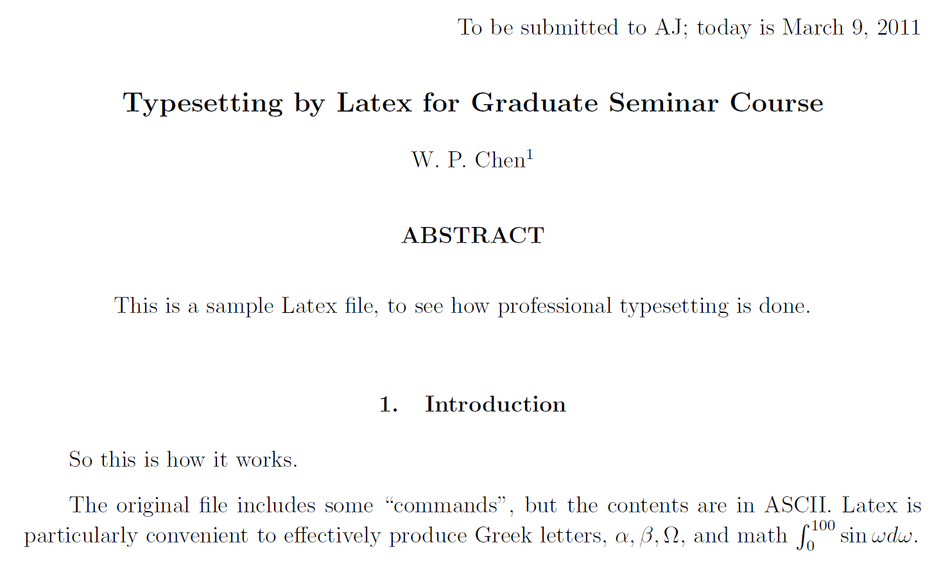
Output of the LaTex file

Slide 21
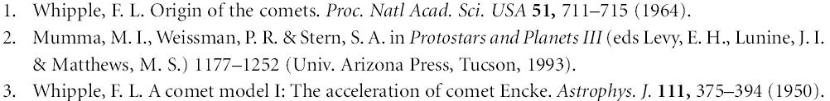
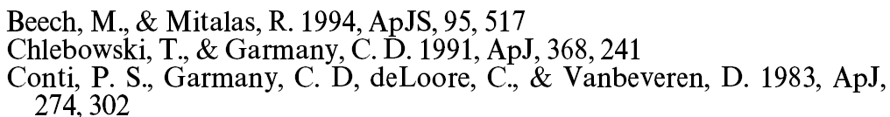
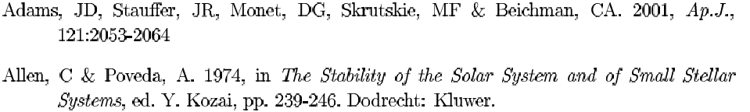
Reference Styles
Nature
Astrophysical Journal
Annual Review of Astronomy and Astrophysics
Last (family) name, (middle), first name (initials)

Slide 22
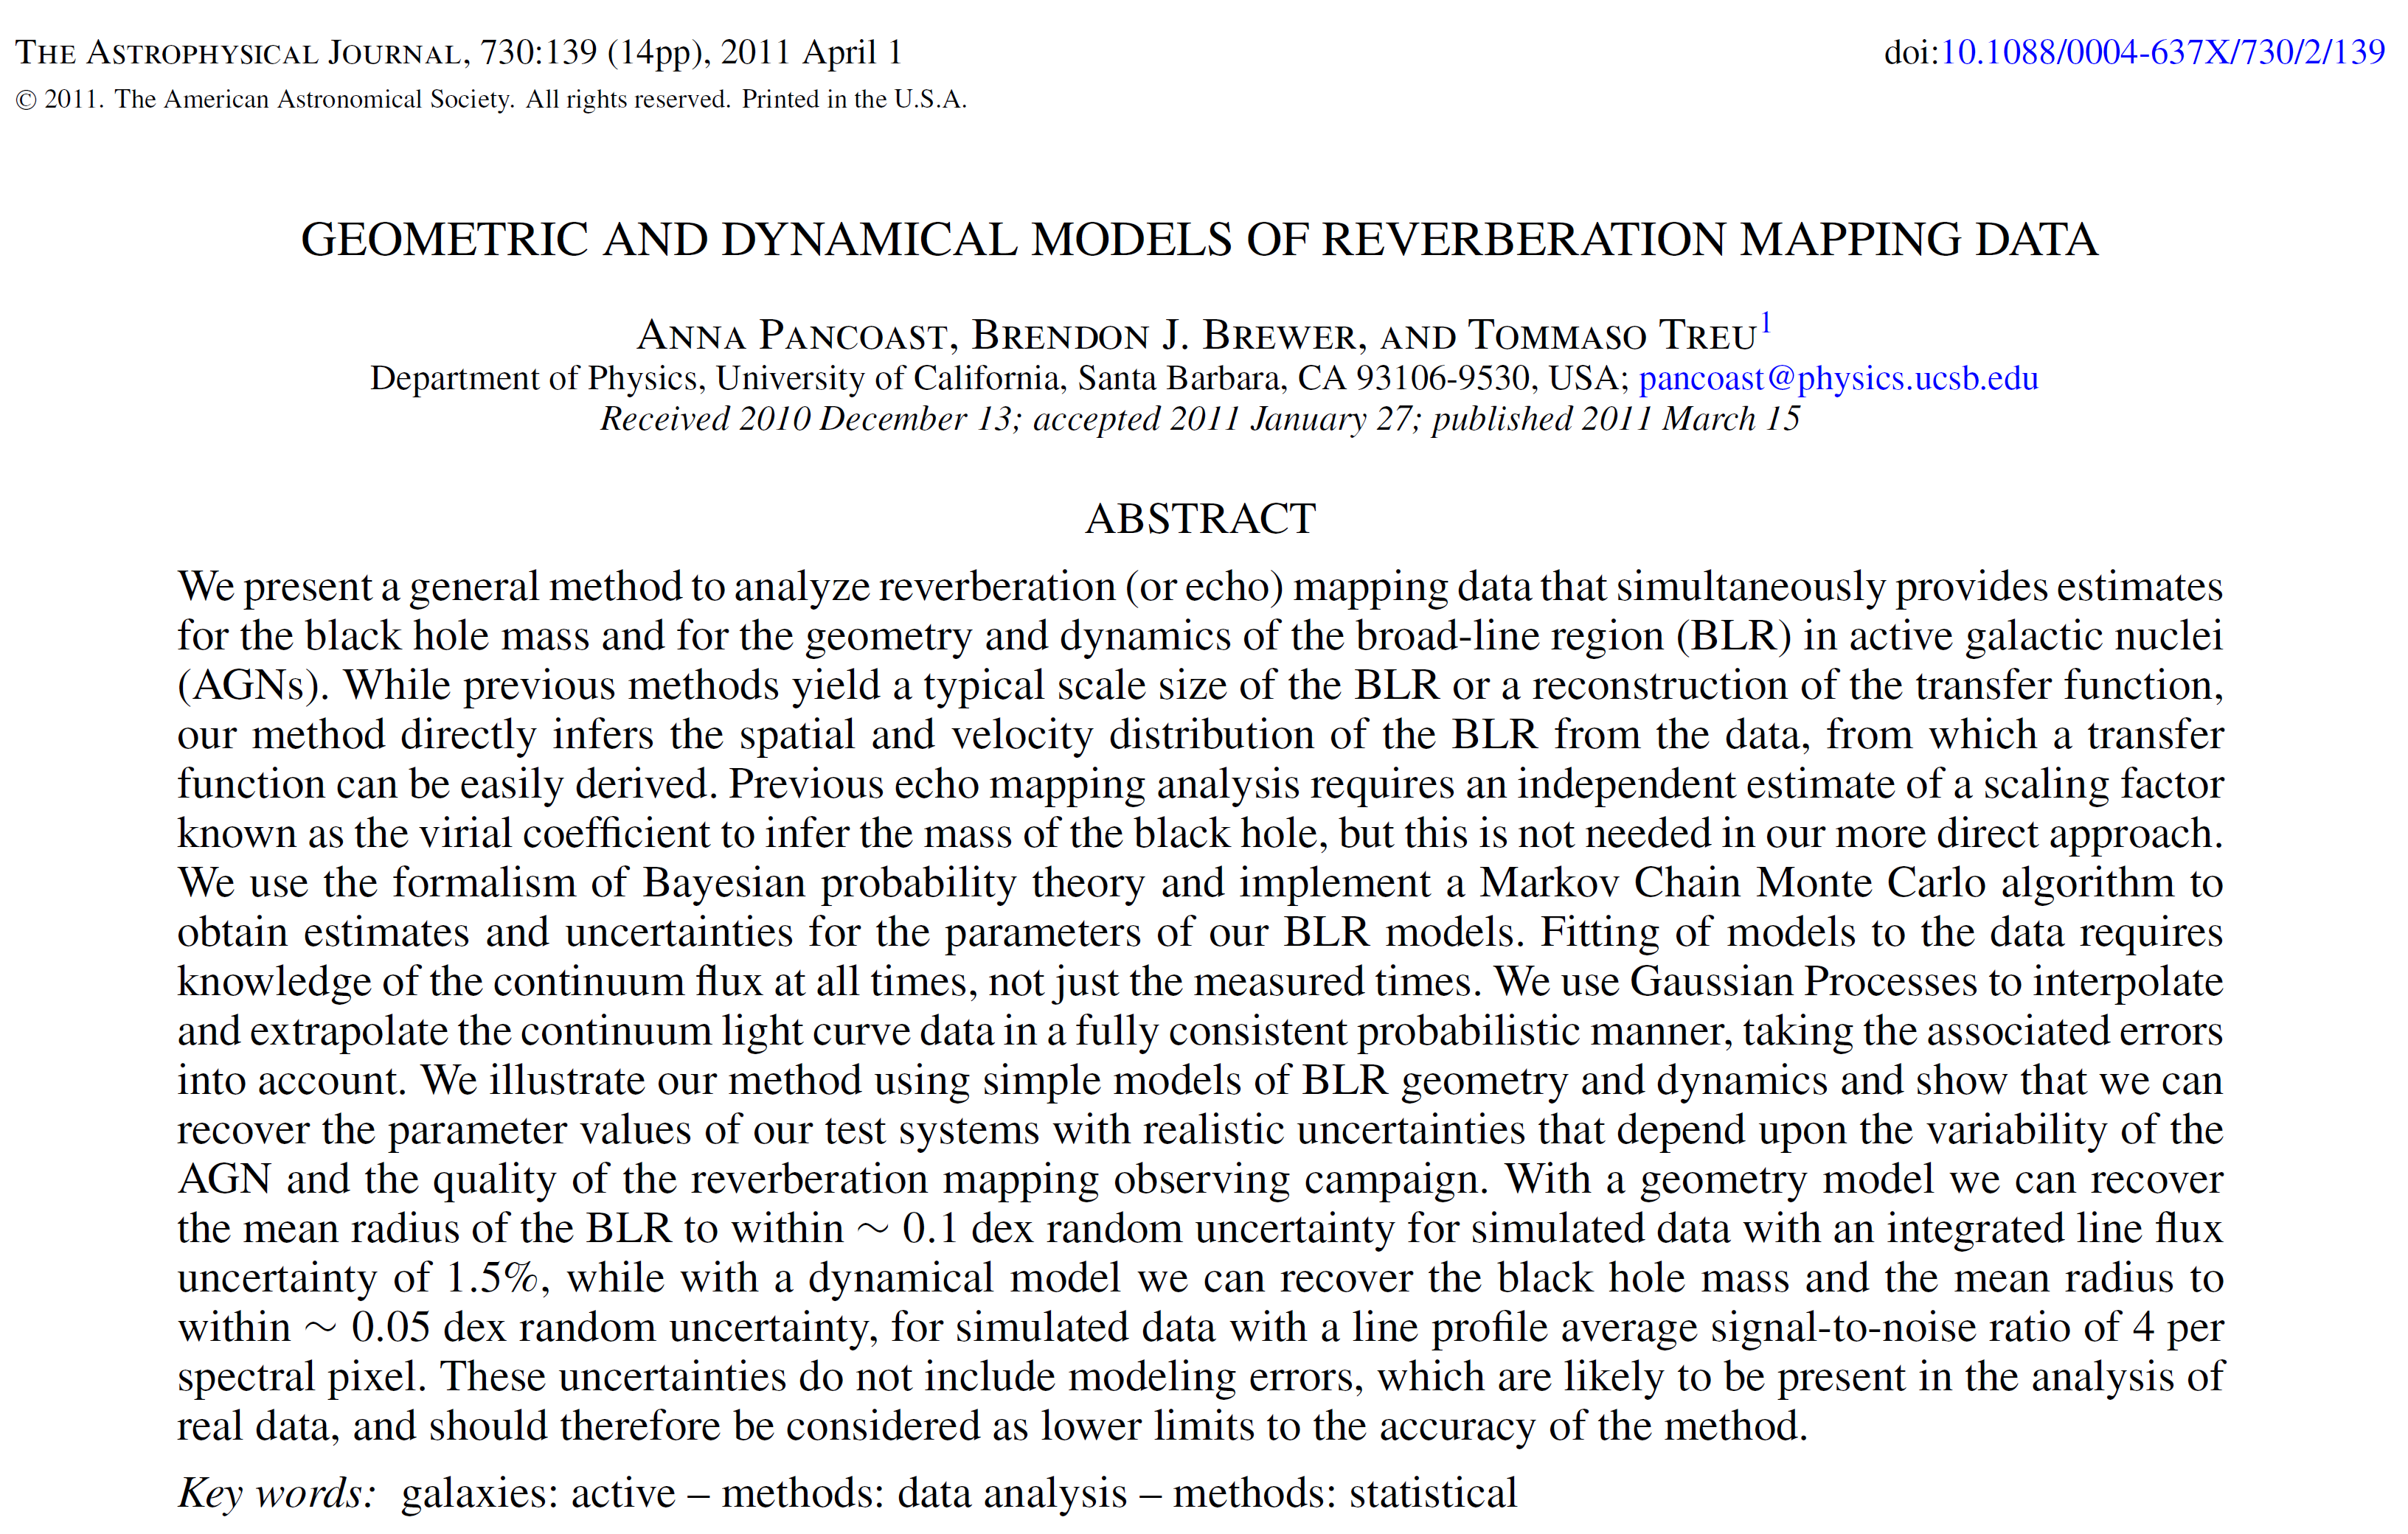
A sample ApJ paper heading …
Digital Object Identifier

Slide 23
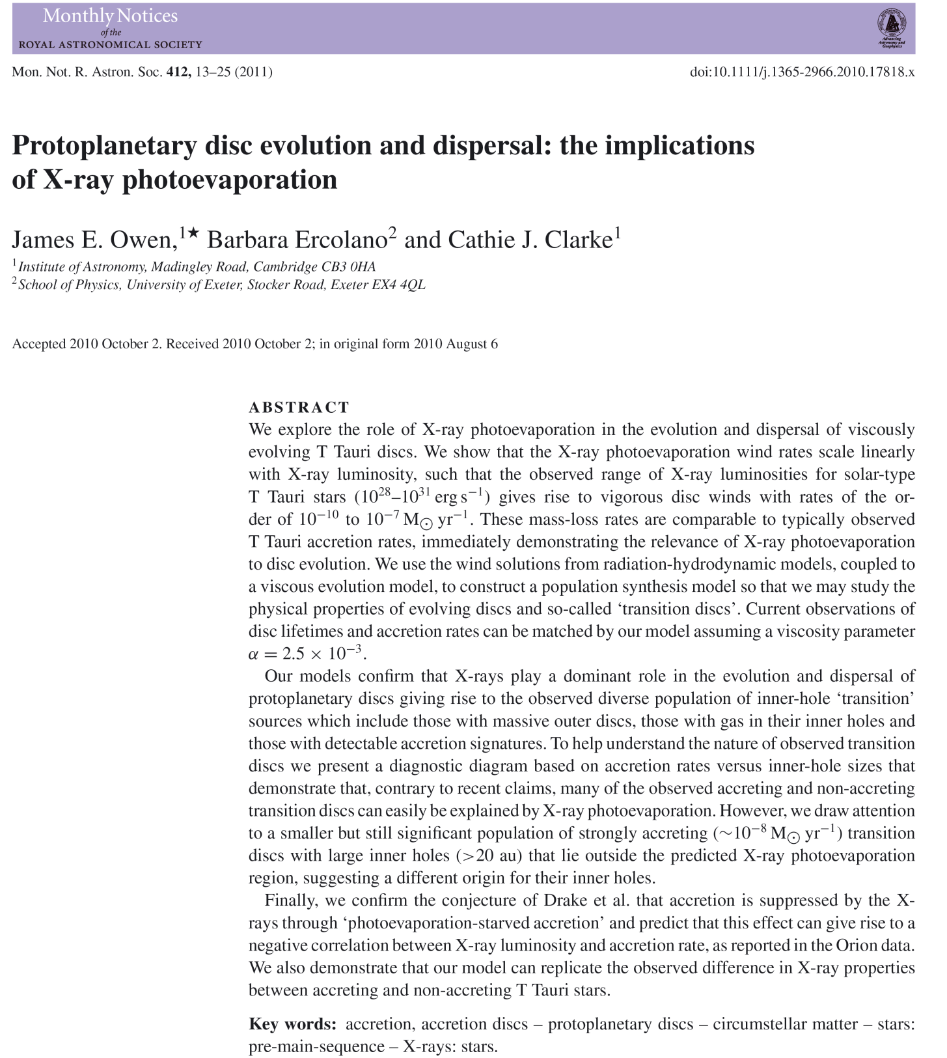

Slide 24
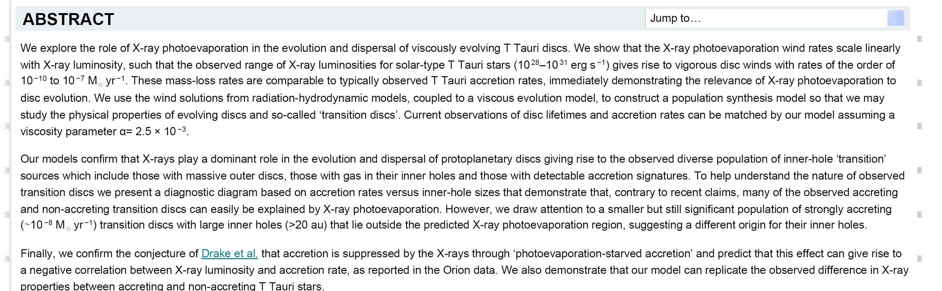
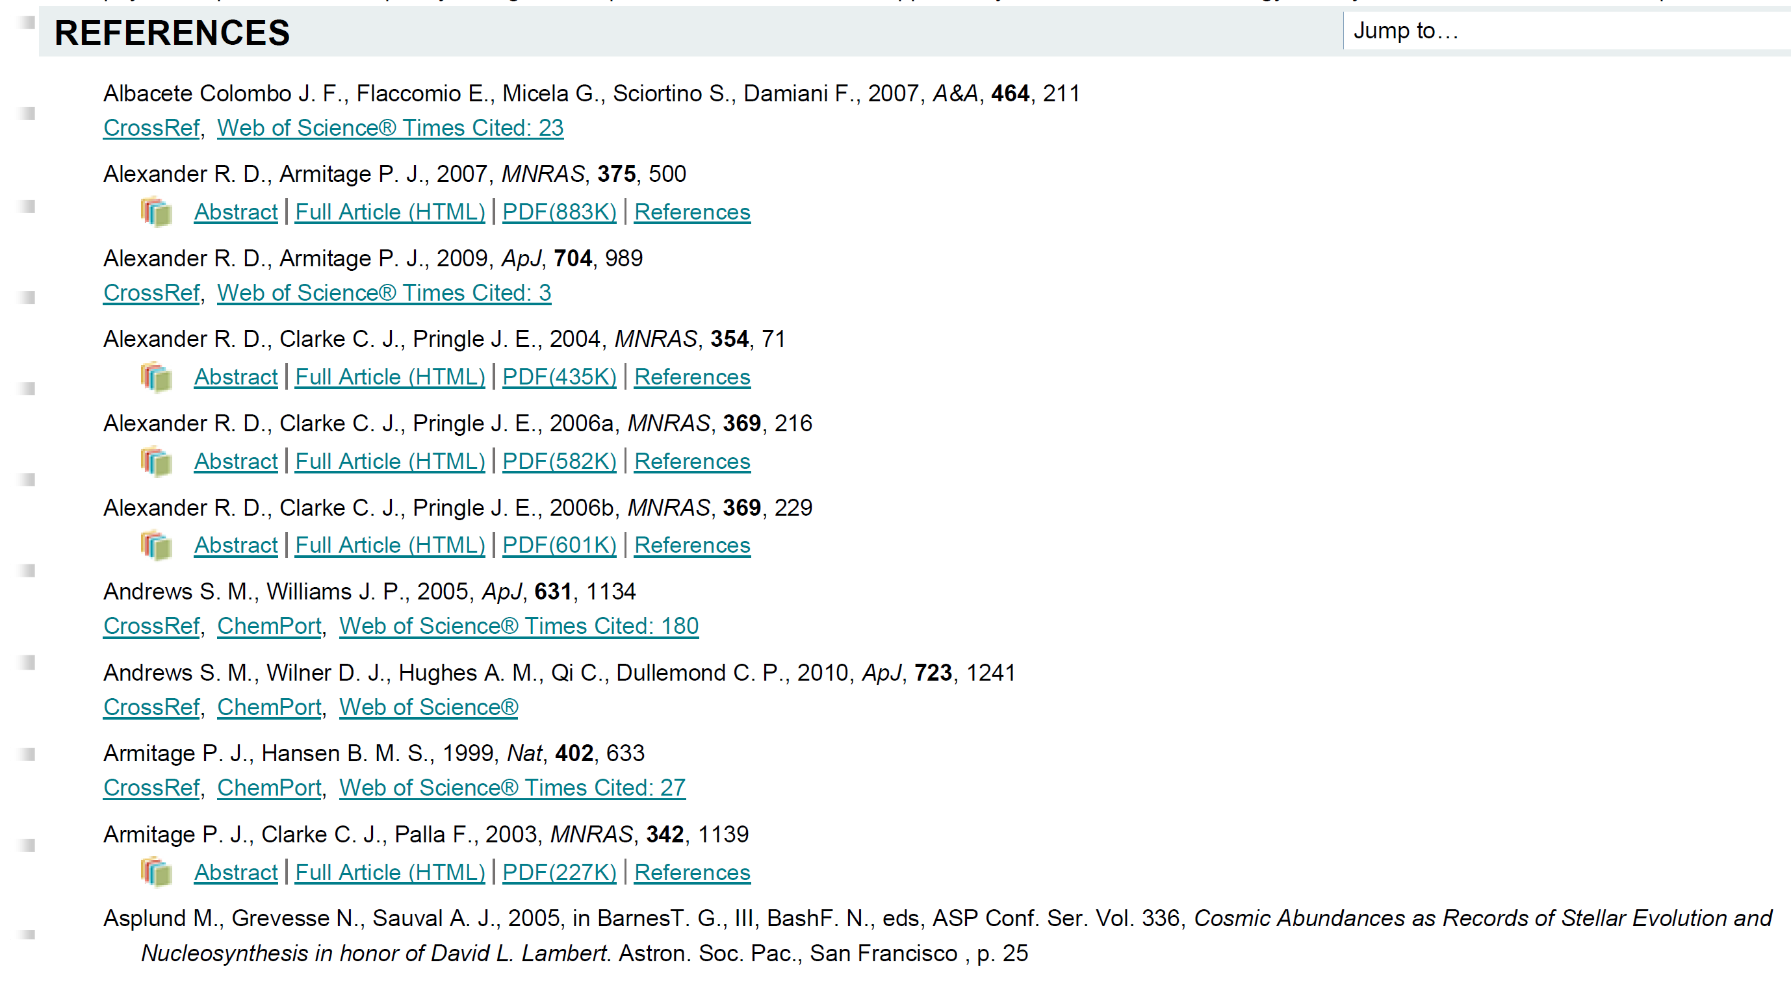
A sample online HTML version

Slide 25
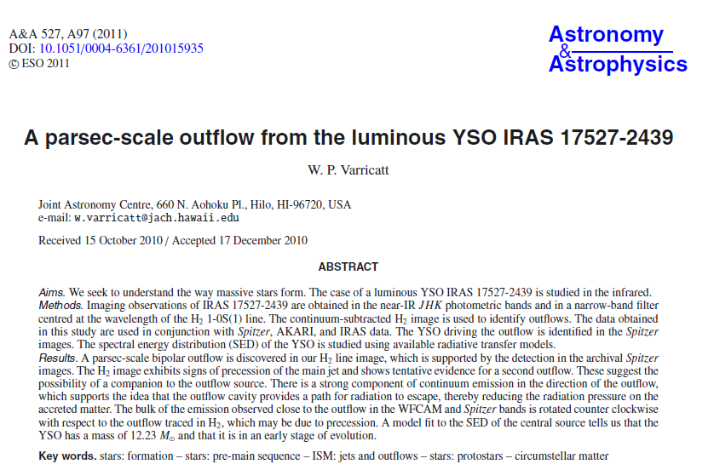
A sample A&A paper heading …
100% cut and paste

Slide 26
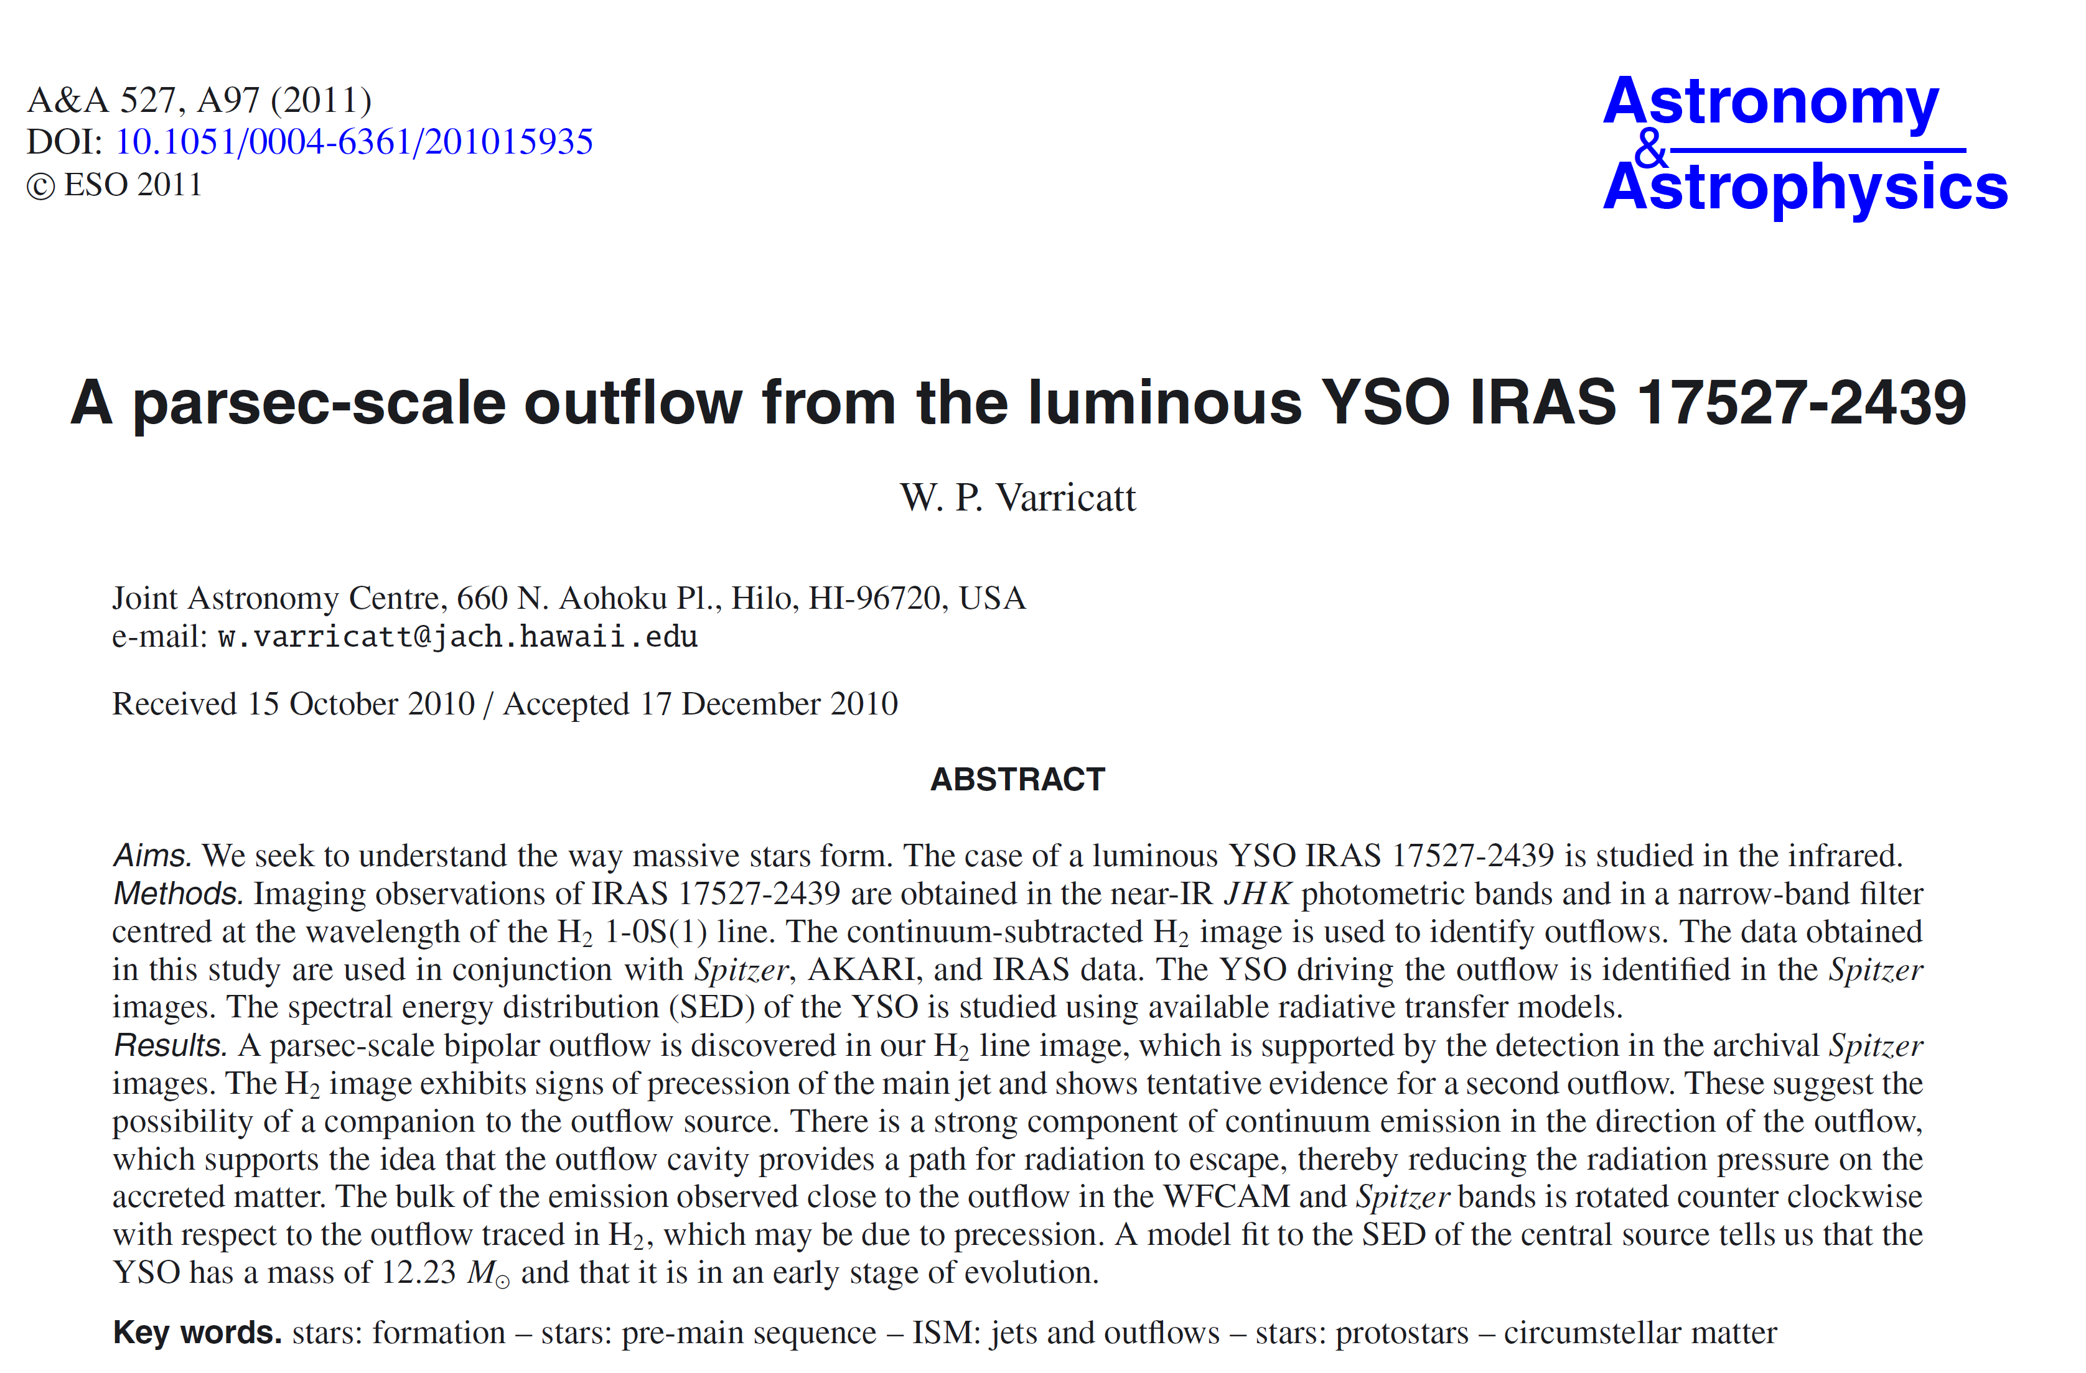
Ditto …
400% cut, paste, and shrink

Slide 27
Class Exercise --- A sample letter
Dear Takahashi-san
I am so concern about the devastations triggering by terrible earthquake and tsunami in Japan. Everyday, I read news and pray for the things will going well many times.
GAO is quite close to the Toyko. Are people and every things in GAO allright?
God Bless you and eveyone in GAO
What does this letter try to say?
What are the problems with it?
Let us improve it.

Slide 28
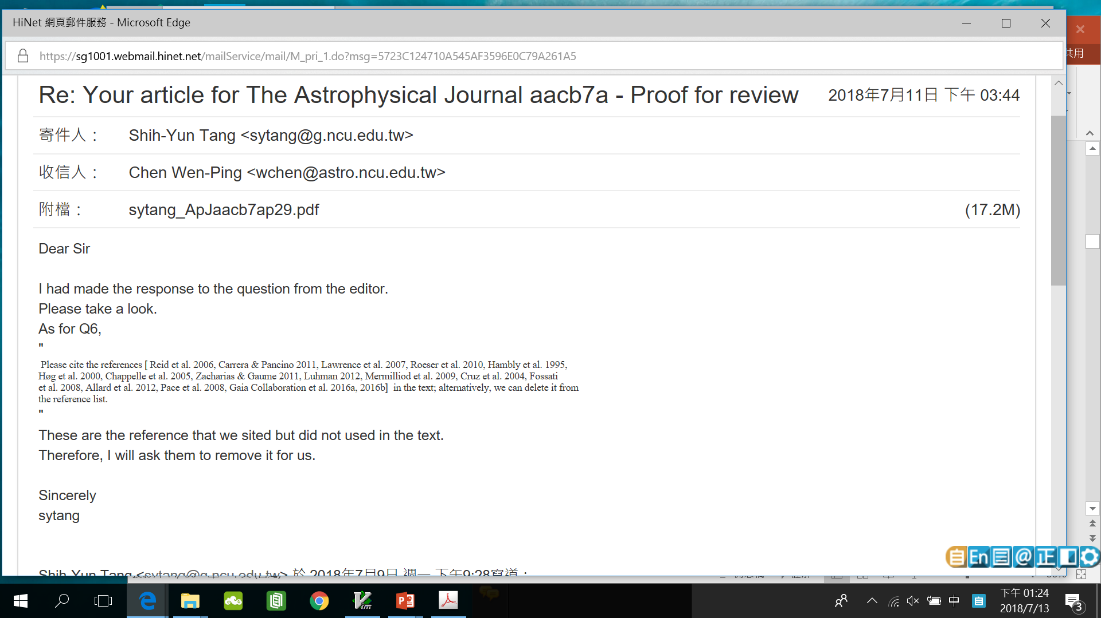

Slide 29
Mind the Pronunciation
Read out loud and listen to yourself
morphology vs morphological
molecule vs molecular
analysis vs analyze/analyse
spectra vs spectroscopy vs spectroscopic
Magnetic vs magnetism

Slide 30
Mind the Sentence Structure/Grammar
We would like to find out what the dark energy is.
You may wonder “What is the dark energy?”
The value of using multiple databases is consistency.

Slide 31
Anthropomorphism （擬人）
Experiments/data do not prove or explain; figures/tables do not compare. They “show” or “indicate”.
(X) This experiment attempts to demonstrate that …
(O) The purpose of this experiment is to demonstrate that …
(X) The research found that …
(O) The researchers found that …
(X) Their paper discussed the possible relation of …
(O) Lin et al. (2013) discussed the possible relation of …

Slide 32
Nicknames in English --- you probably have seen these, but do not use them unless you know the person very well.
FEMALE
Amandapr | Mandy
Catherine | Cathy, Cath
Christine | Chris, Chrissy
Cynthia | Cindy, Cynth
Deborah | Deb, Debbie
Elizabeth | Betty, Beth, Liz, Bess
Florence | Flo
Frances | Fran, Francie
Janet | Jan
Katherine | Kathy, Kate
Janice | Jan
Nancy | Nan
Pamela | Pam
Patricia | Pat
Roberta | Bobbie
Sophia | Sophie
Susan | Sue, Suzie
Teresa | Terry
Valerie | Val
Veronica | Ronnie
Yvonne | Vonna
MALE
Albert | Al
Andrew | Andy
Anthony | Tony
Arthur | Art, Arty
Bernard | Bernie, Bern
Charles | Charlie, Chuck
Christopher | Chris
Daniel | Dan, Danny
Donald | Don
Edward | Ed, Eddie
Eugene | Gene
Francis | Frank, Fran
Frederick | Fred, Freddy
Henry | Hank
Irving | Irv
James | Jim, Jimmy
Joseph | Joe
John | Jack, Jacky
Lawrence | Larry
Leonard | Leo
Nathan | Nat, Nate
Nicholas | Nick
Patrick | Pat
Peter | Pete
Raymond | Ray
Richard | Dick, Rick
Robert | Bob, Bobby, Rob
Ronald | Ron, Ronny
Russell | Russ
Samuel | Sam, Sammy
Stephan | Steve
Stuart | Stu
Theodore | Ted, Teddy
Thomas | Tom, Thom, Tommy
Timothy | Tim, Timmy
Walter | Walt, Wally
William | Bill, Billy, Will, Willy

Slide 33
My Model paper …

Slide 34
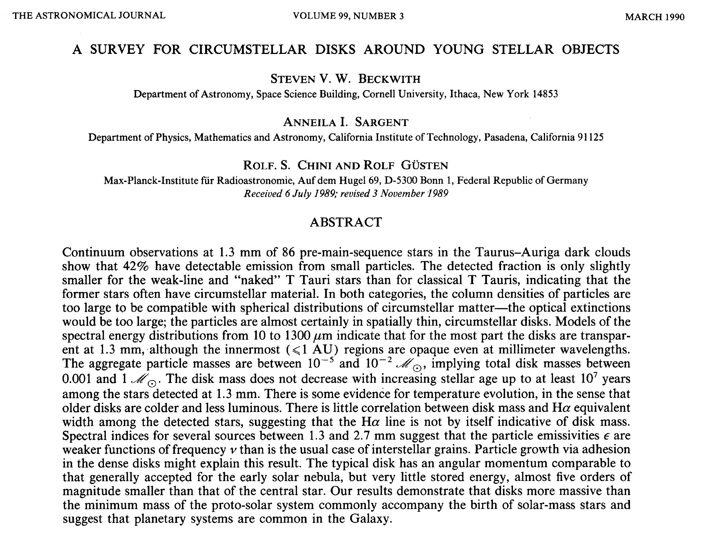

Slide 35
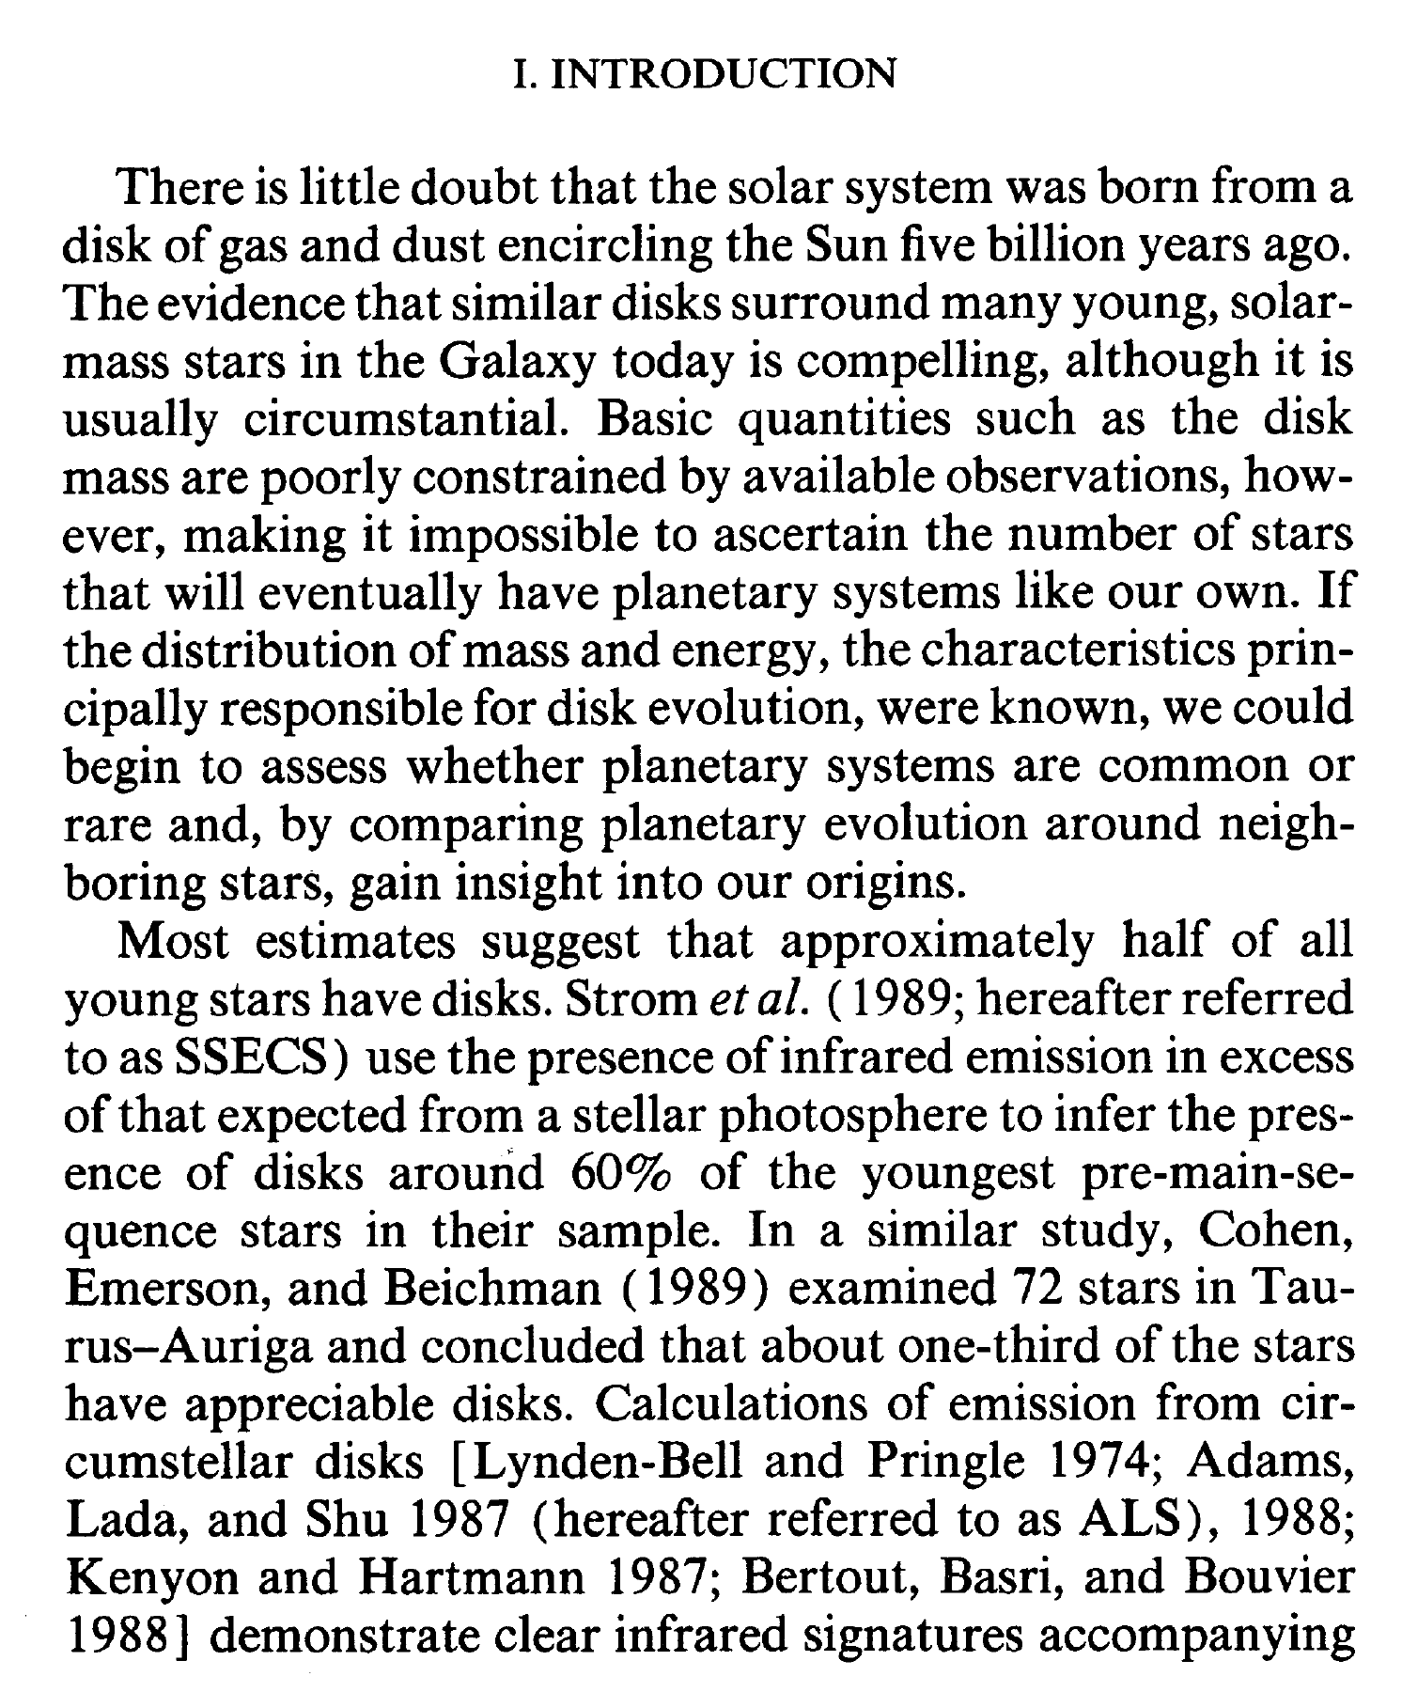

Slide 36
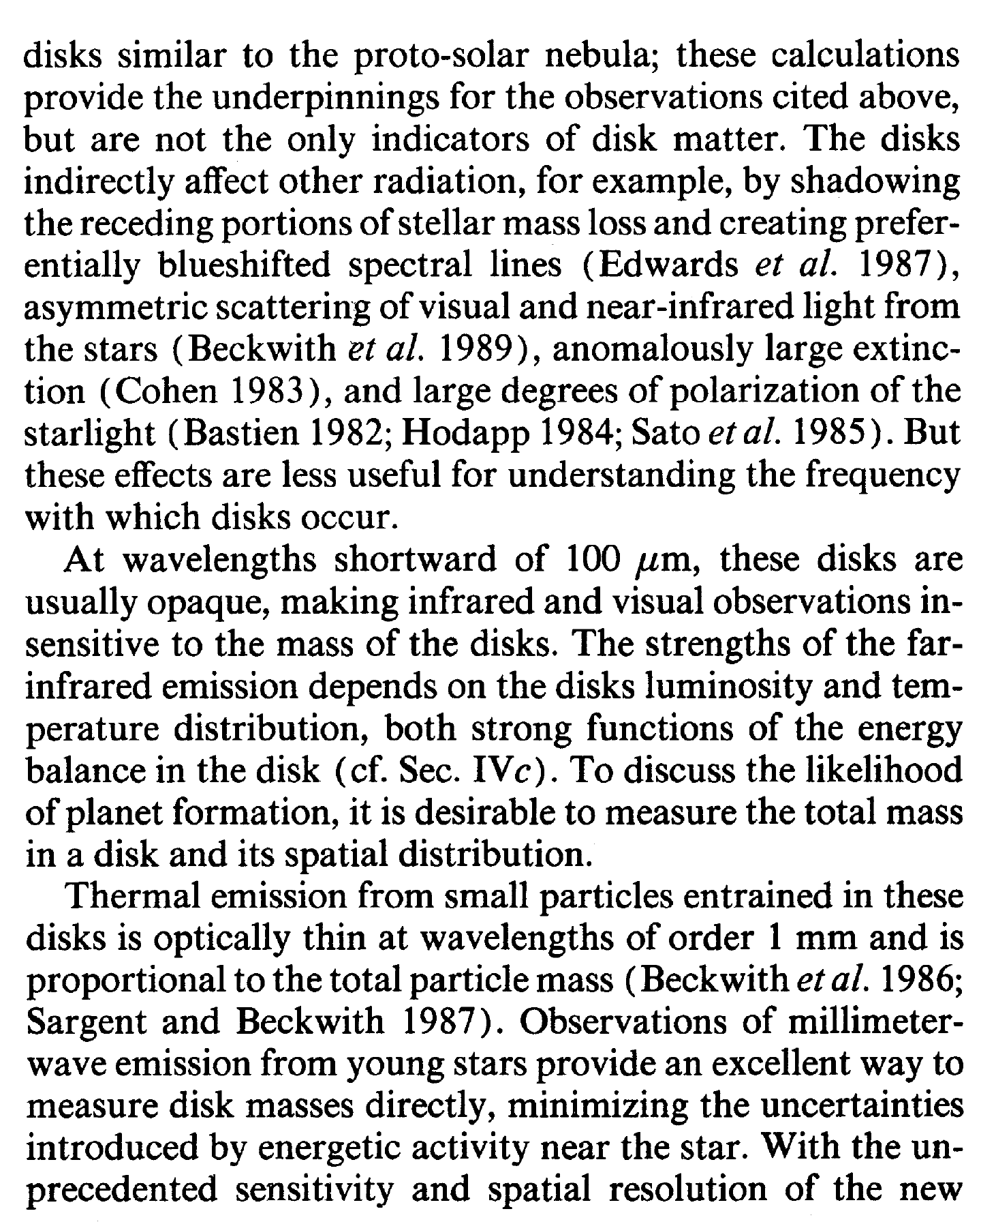

Slide 37
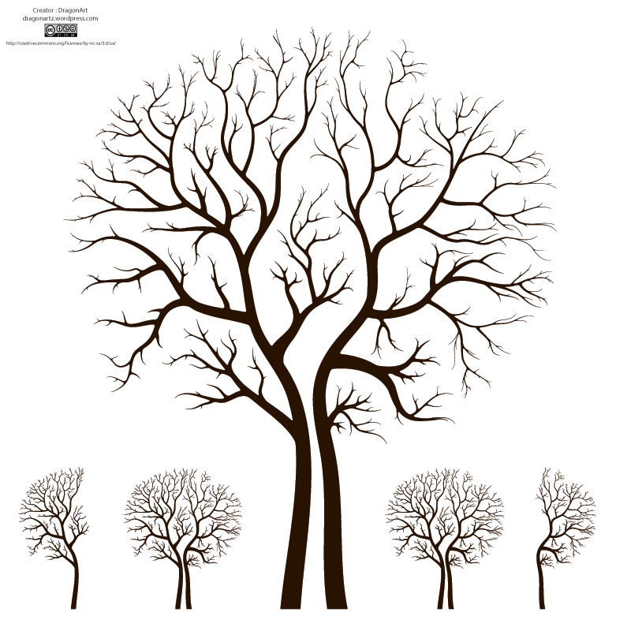
Paper Structure
Title = face
Abstract = heart
Key Words = address
Headings = skeleton
Introduction = hands
Data and Analysis
Discussion
Visuals = voice
Conclusion = smile
References

Slide 38
Sketch a Writing Plan
(A rough title, clear contents)
Figures first (what is the story?)
Section headings, subsections …
… then to each paragraph, each sentence
Once concept/issue per paragraph.
Mind the overall structure of the article.
Introduction, Observations and Data Analysis, Results
and Discussions, Conclusions
Then tackle a sentence at a time.

Slide 40
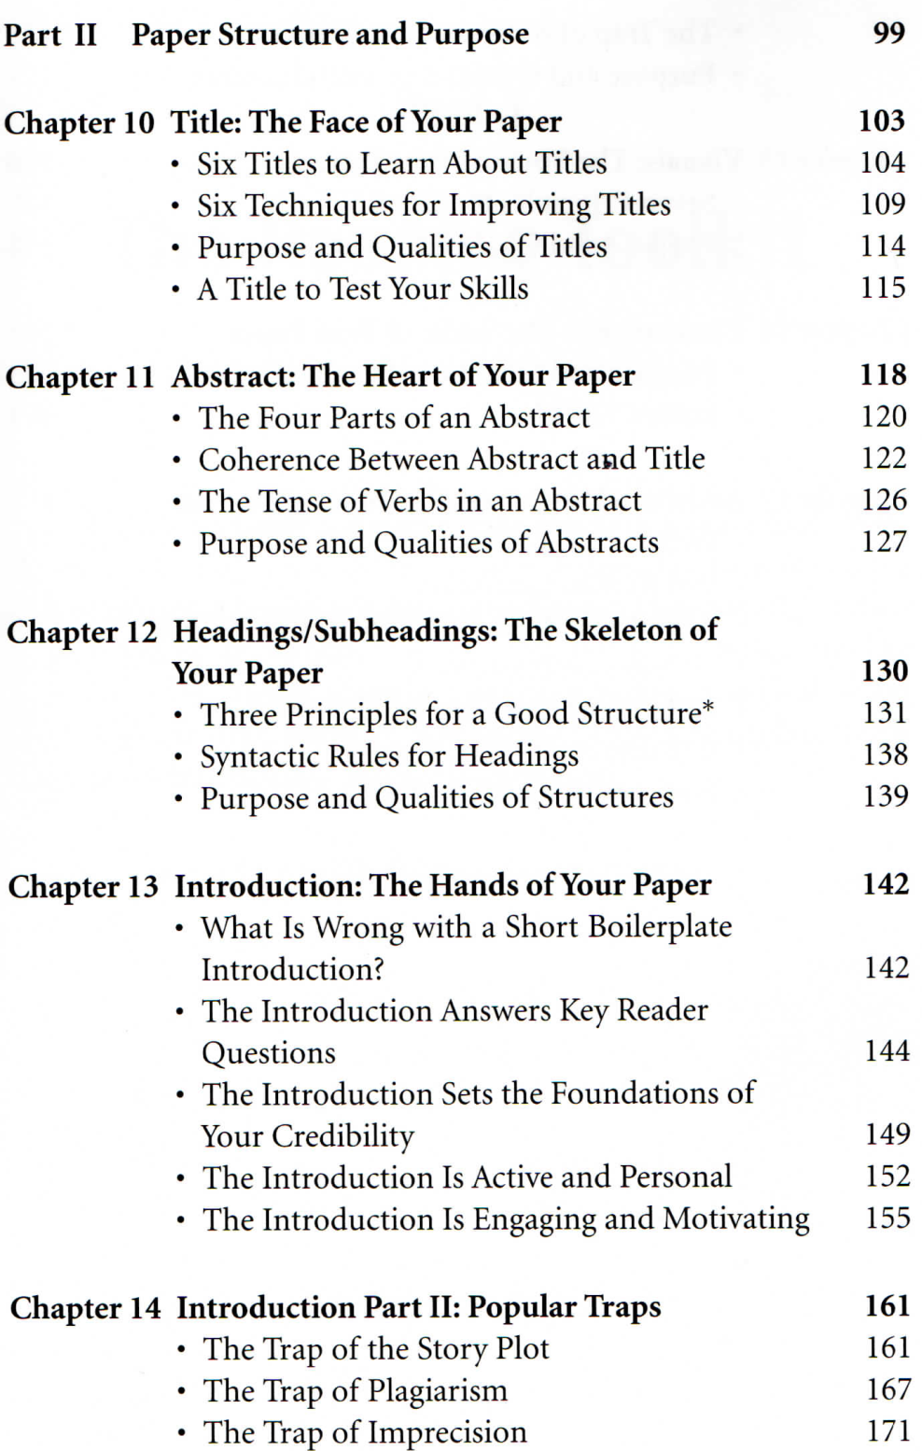
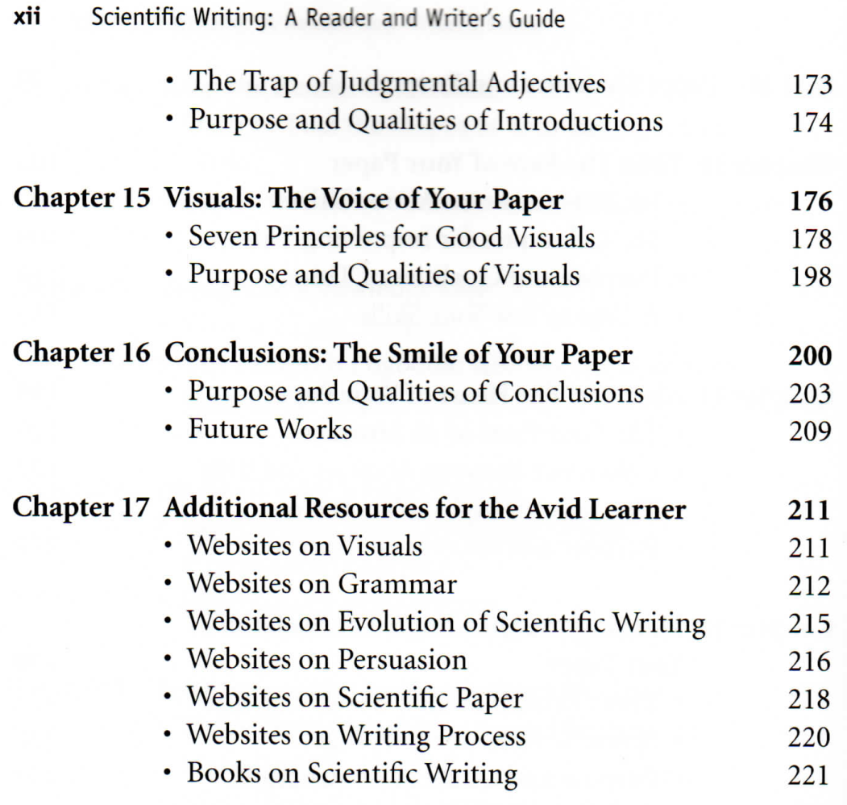

Slide 41
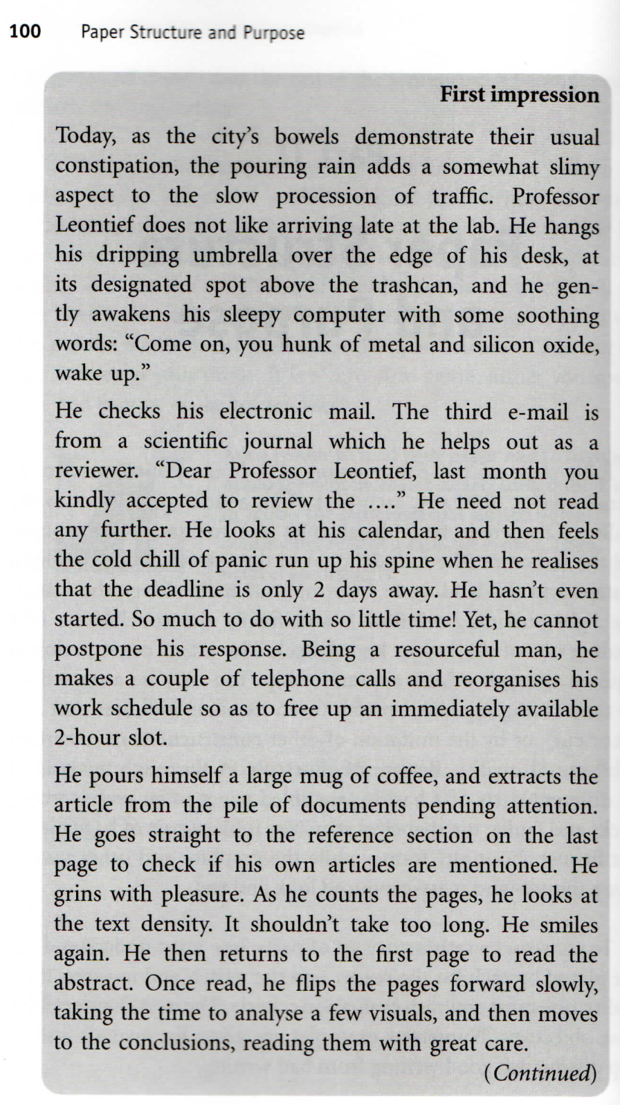
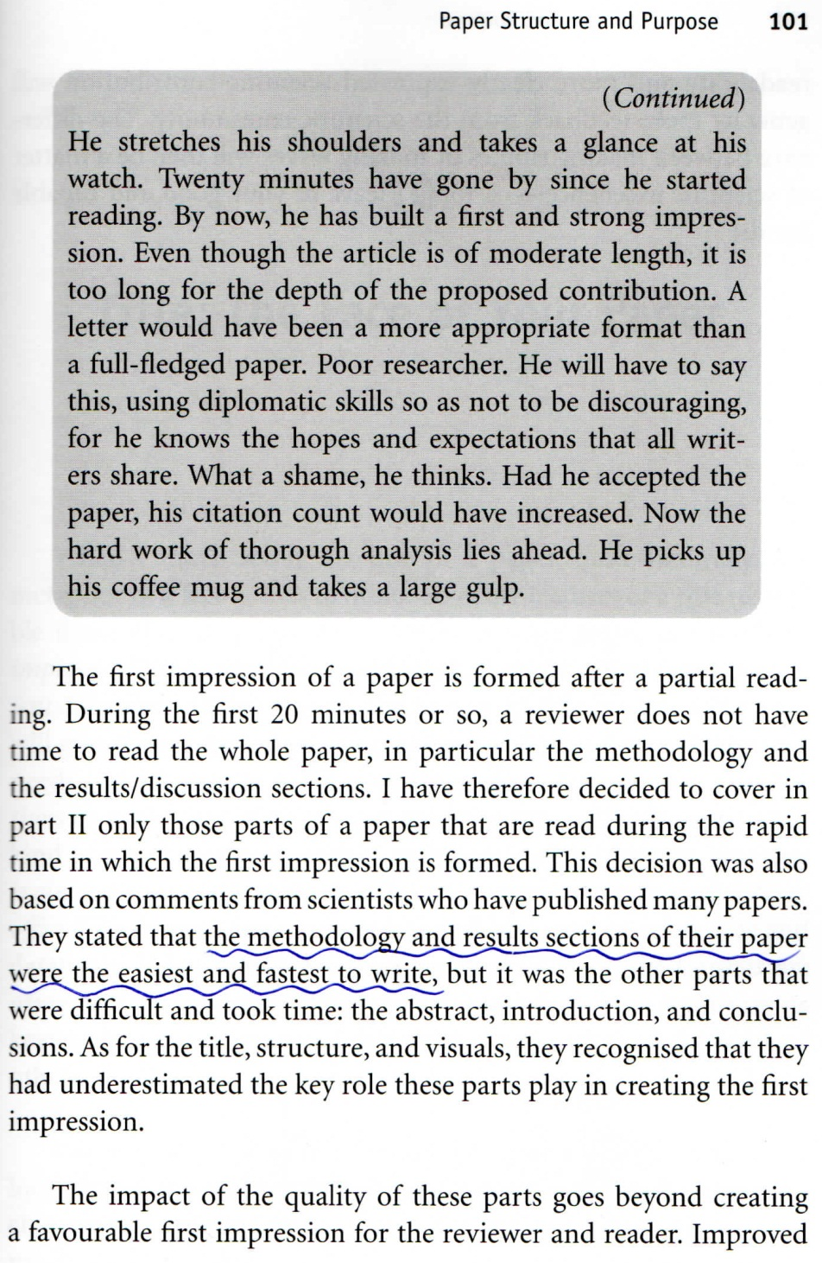

Slide 42
Title --- How to select one
Try alternative titles …
What are the differences
Pair elimination
The best one should be tempting and informative
Author’s contribution should come first

Slide 43
wenpchen@ms21.hinet.net

Slide 44
Title (cont.)
The title is not read; it is scanned, within 2 seconds at most
A long easily understood title is better than a short one with nouns to be unpacked, which in turn is better than an ambiguous one
An old or popular subject → a longer title in order to specify the contribution

Slide 45
Six Techniques to improve titles
Placement of Contribution First
  For a full sentence, the new information usually appears at the end and the old information at the beginning.
  In a verbless title, however, the situation is reversed.

Slide 46
2. Using Verbal Forms
  A verb gives energy. So use gerunds （動名詞）or infinitives （不定詞）to energize your title.
  For example:
  Deep Learning: Understanding Astronomical Data

Slide 47
3. Using Adjectives or Numbers to Stress contribution
  Fast, highly efficient, robust, but not new or novel
  The most specific, the better, e.g., 5 Hz sampling is better than fast sampling
4. Clear and Specific Keywords
Easier to locate by a search engine or database

Slide 48
5. Smart Choice of Keywords
  Pick your keywords from recent or often-cited titles close to your contribution
  → searches to retrieve those will also find yours
  If two keywords are equally good, choose one for the title and the other for the abstract.
6. Catchy Acronyms
  MACHO, TAOS

Slide 49
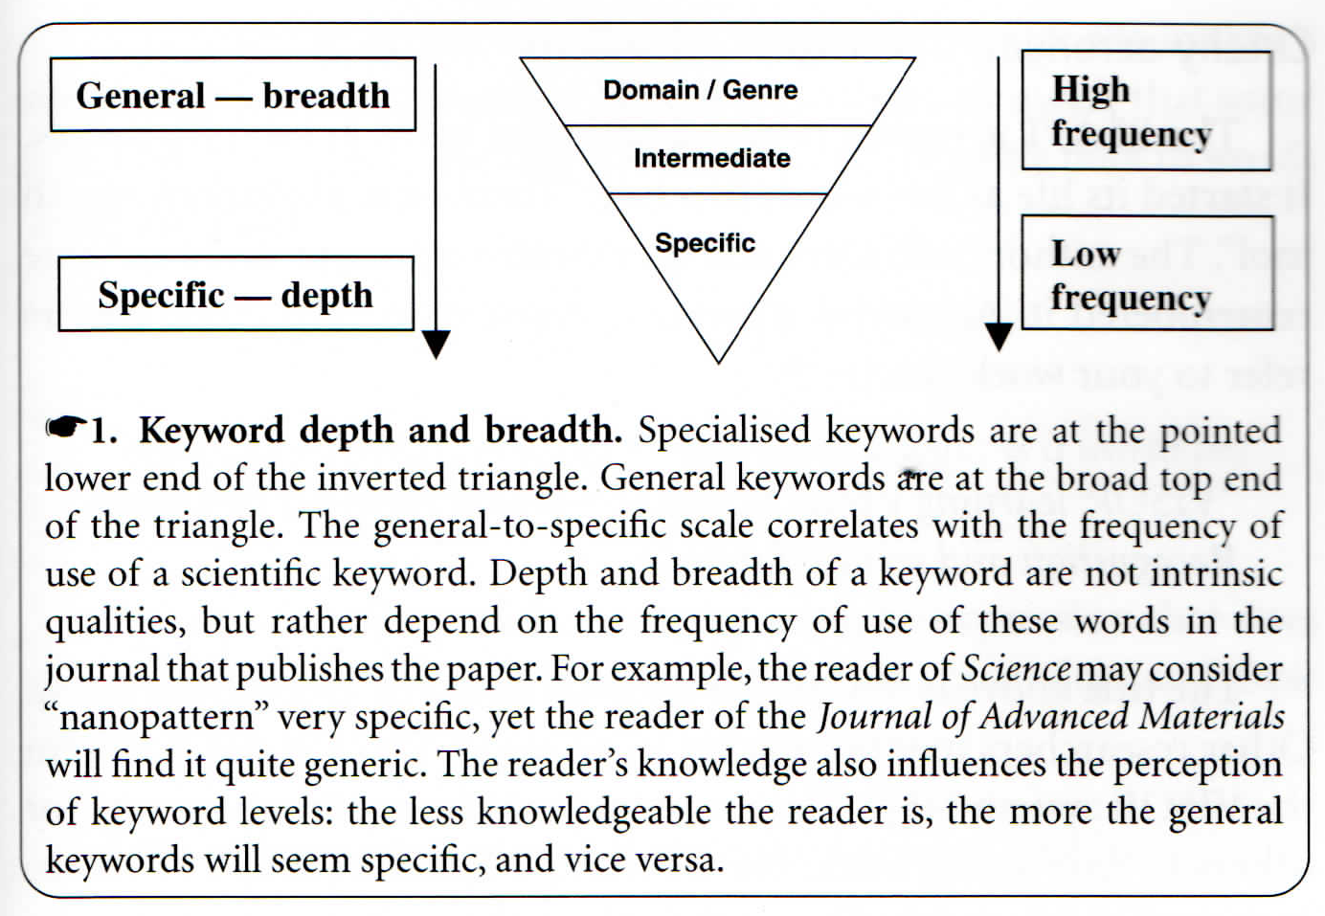

Slide 52
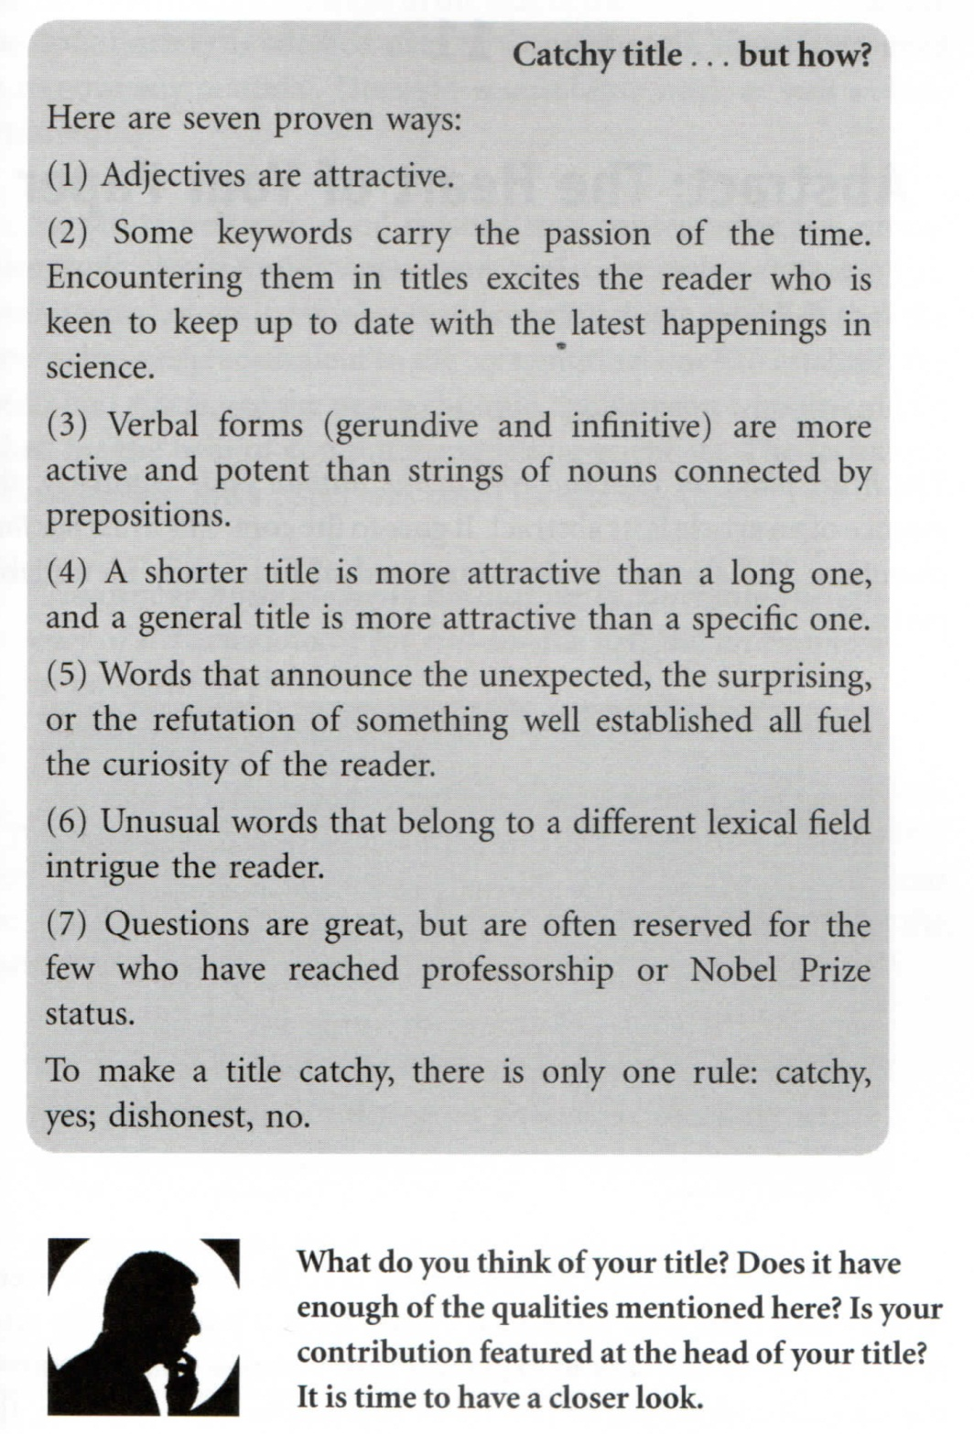
So a good title should be
  unique, lasting, concise, clear, easy to find, honest and representative, and (if possible) catchy
  A question for the title?

Slide 53
HW: Let us be critical …
  Select 10 titles from the latest ApJ issue.
  Do the same for 10 titles in RAA.
What is the title you have come up with for your thesis/paper? Or else describe the project you are currently working on.
Bring it to our discussion in class.

Slide 54
HW by
白建迎

Slide 58
Abstract --- the heart of your paper
Chapter 11 of Jean-Luc Lebrun
What does a reader expect to see in an abstract?
What do you expect to see as a reader?

Slide 59
Four parts of an abstract
What
  What is the problem? What is the topic of this paper? Why do the readers care?
How
  How is the problem solved (methodology)?
Results
  What are the specific results? How well is the problem solved? Visuals in abstracts?
Impact
  So what? How useful is this to science or to the reader?

Slide 60
Very often, the fourth part (impact) is missing, because
The maximum number of words allowed by the journal ran out too quickly with a long rambling start.
The author (mistakenly) considered that the results should speak for themselves.
The author was not able to assess the impact of the scientific contribution.
  “a result of the myopia caused by the atomization of research tasks among many researchers”
  見樹不見林

Slide 61
The parts with the most number of words
= contribution
Adjectives ok in the title, but precision in the abstract
Coherence between abstract and title
30%~80% (i.e., > 1/3) significant title words are in the first sentence of the abstract. There are exceptions, but usually at least there should be one word from the title. Otherwise, sentences 2 and 3 mention most of the other title words.
The first sentence should expand, not just repeat, the title.

Slide 62
All title words should be in the abstract. Otherwise, why does a word deserve a “title” status of your paper? One exception is using an alternative, interchangeable keyword in the field → to increase the chance of being found by search engines.
If a title word is not important, remove it.
If a title word is missing in the abstract and is important, put it in.
If the abstract contains a keyword that should be in the title, rewrite the title to incorporate that keyword.

Slide 63
The abstract needs to set the problem, but does not need to justify why it is important (the introduction does that.) The abstract, however, needs to justify the significance of the results.
The abstract should NOT (1) mention the work of other researchers (it is done in the introduction), unless the paper is an extension of a previous paper; (2) why the problem is important (also the role of the introduction). The abstract should concentrate on the importance of the results.

Slide 64
Use the present tense in the abstract is ok. Once the tense is chosen, keep it throughout the abstract.
Use the past tense in the conclusion.
The abstract should be stand-alone. It needs nothing else. It sets expectations for the reader.
It should not be longer than necessary.
It should tie to the title.

Slide 66
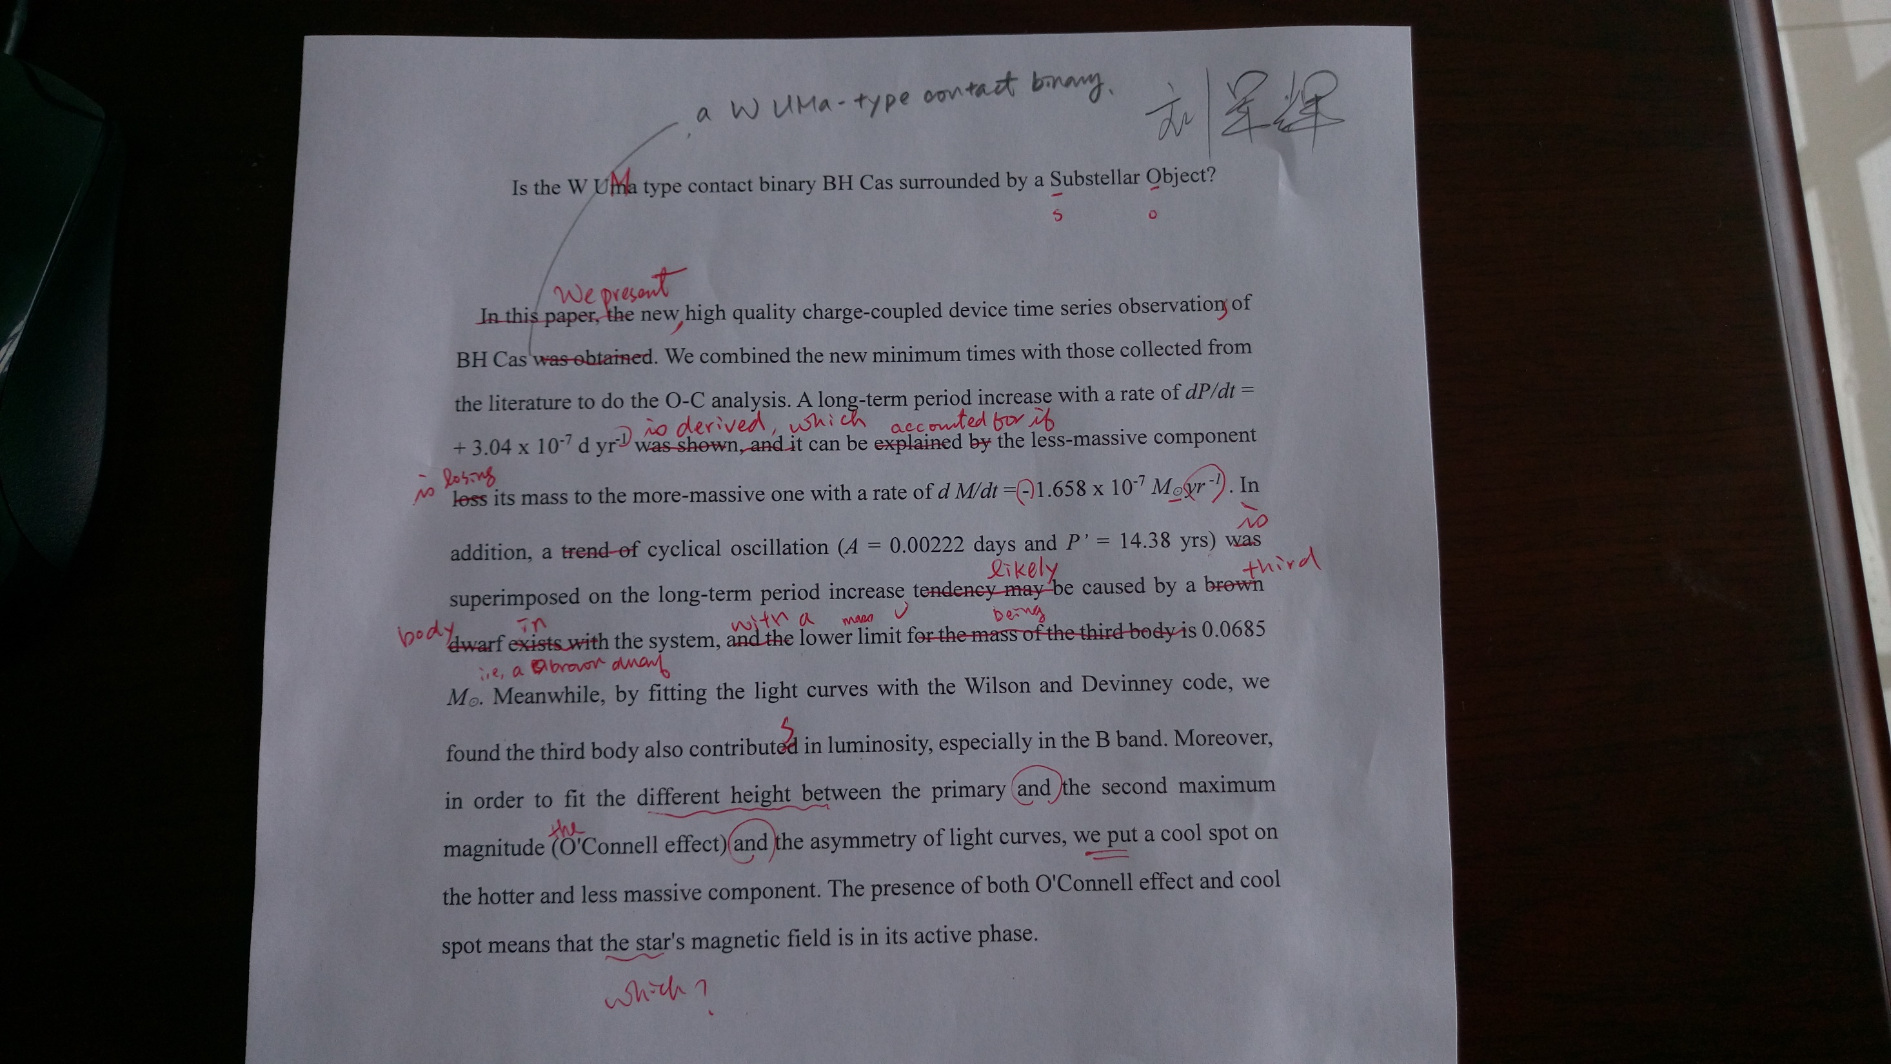

Slide 67
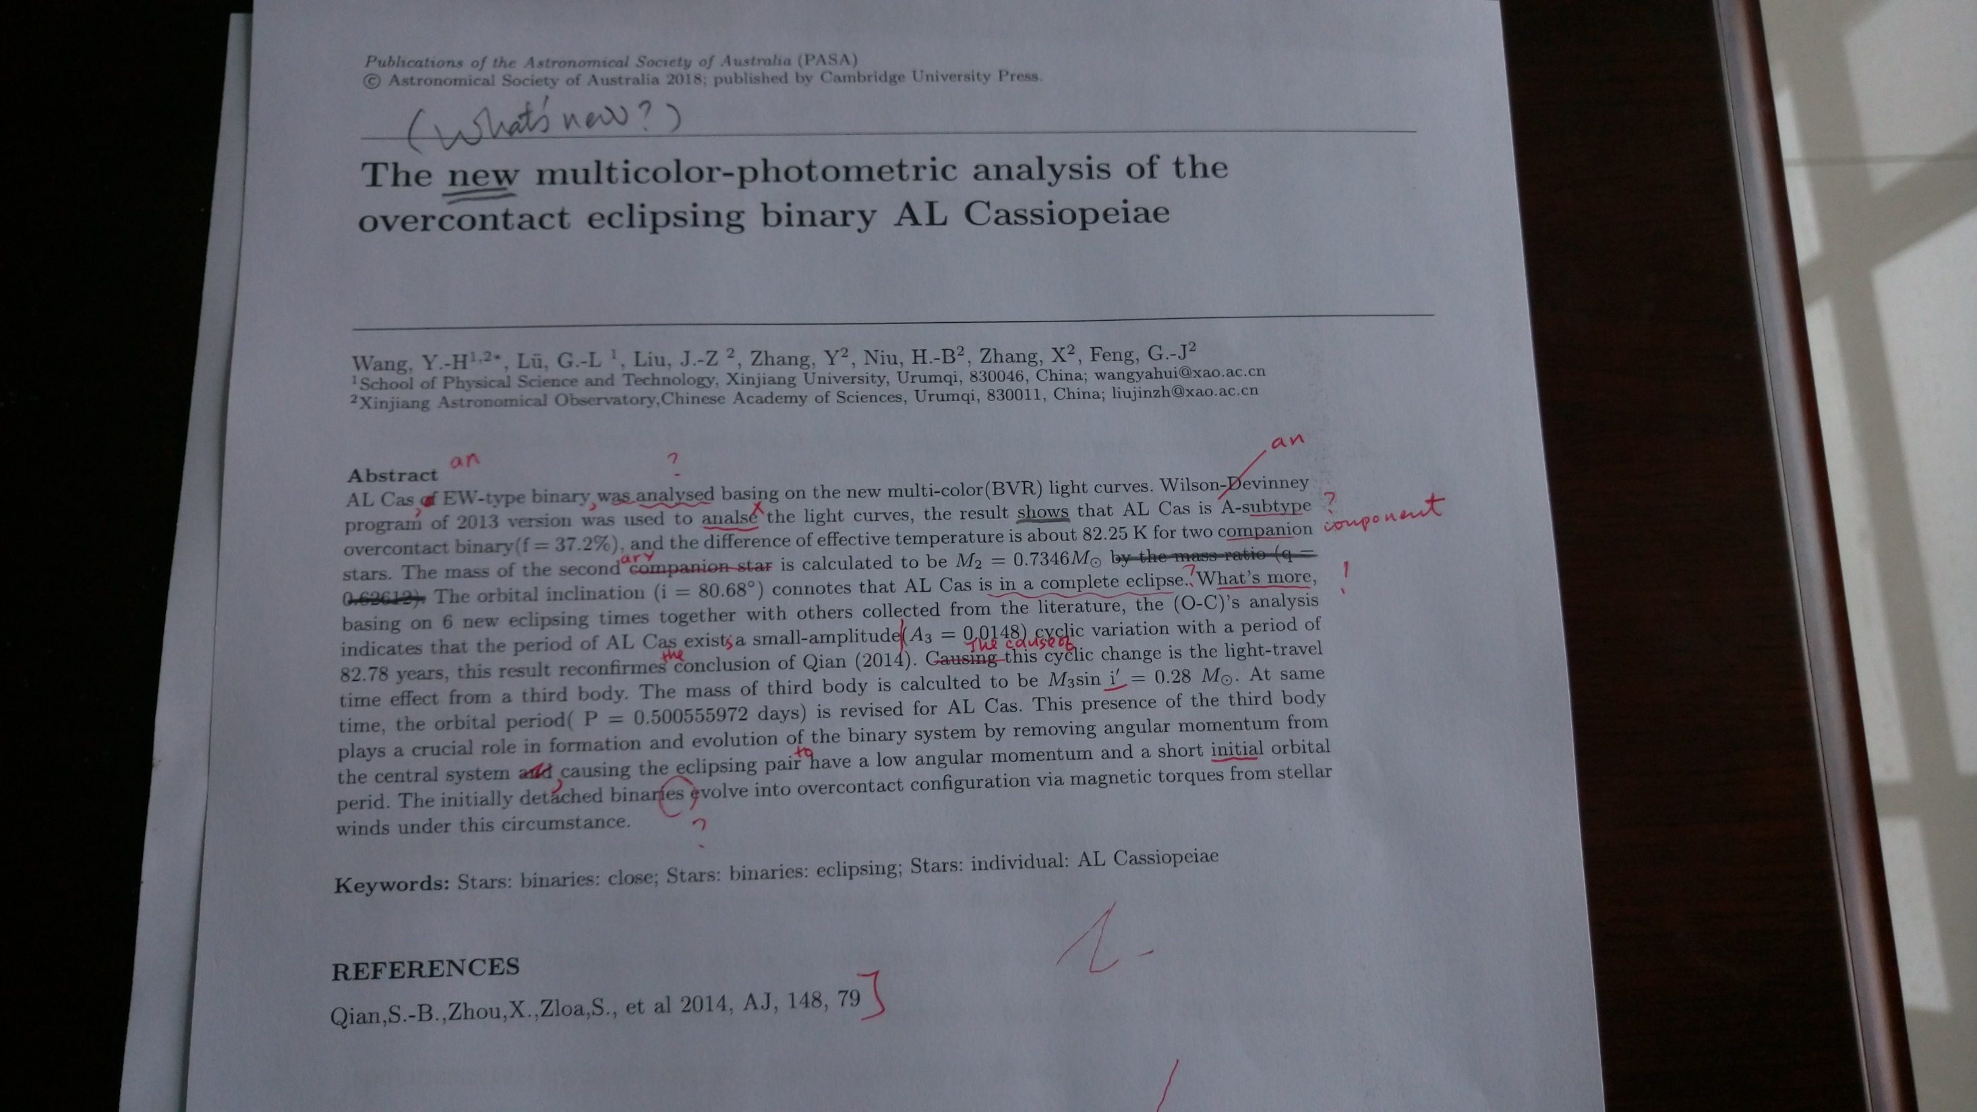

Slide 68
Headings and Subheadings
--- The Skeleton of Your Paper

Slide 69
The skeleton is standard, but it allows for variations in shape and size.
Bones are bones. But are they bird bones, or wolf bones?
Headings may be generic, i.e., the same from one article to the next (introduction, observations and data analysis, discussion, conclusions), but subheadings differ.
The most sophisticated parts are also the most detailed = the largest amount of contribution.

Slide 70
Three principles for a good structure
The contribution guides its shape.
Title words are repeated in its headings and subheadings. That is, headings and subheading should be connected to the title.
It tells a story clearly and completely in its broad lines.
Review papers may have exceptions.

Slide 71
A section with only one or two short paragraphs does not deserve its own subheadings; is should be merged with other sections.
Write more informative headings and subheadings.
Use the same syntactic rules for headings
  Introduction
  Data analysis
  Proposing a solution
  Simulation studies

Slide 72
It is a good practice to use structure as the framework for writing. After you come up with the title, write all the headings and subheadings in the order they appear in your paper, i.e., a table of contents. Identify words common in the structure and in the title. Do you see any discrepancy?
Then ask someone else to read your ToC. The less this person knows of your work, the better. Is the logic clear to that person? Ask the person to explain the story of the paper to you.

Slide 73
\title{A Kinematic and Photometric Study of the Galactic Young Star Cluster NGC\,7380 }
\section{INTRODUCTION}
\section{DATA AND ANALYSIS }
  \subsection{Photometric Data}
  \subsection{Archival Data}
  \subsection{Kinematic Data} % 2.3
    \subsubsection{Proper Motion Measurements}
    \subsubsection{Radial Velocity Measurements}
\section{Characterization of the Cluster} % Sec 3
  \subsection{Morphology and Size of the Cluster} % Sec 3.1
  \subsection{Interstellar extinction and Reddening } % Sec 3.2
  \subsection {Distance and age of the cluster} % Sec 3.3
  \subsection {Stellar Population of the Cluster and surrounding region} % Sec 3.4
  \subsection {Initial Mass Function and K-band luminosity function}
\section {Discussion} % Sec 4
\section{Summary}
Chen et al. AJ, 142, 71 (15 pp) (2011)

Slide 74
\title{
A Possible Detection of Occultation by a
Proto-planetary Clump in GM\,Cephei
}
Chen et al. ApJL, to be submitted (2011) < 4 pages
\section{Introduction}
\section{Light Curves and Color Variations }
\section{Discussions}

Slide 75
Introduction
--- The hands of your paper
Chapter 13-14 of Lebrun (2007)

Slide 76
Introduction is something more difficult to write than the methodology or results section.
It should bring the reader up to speed and reduce the initial knowledge gap. It poses the problem, the proposed solution, and the scope.
It answers the questions raised by the title and the abstract.

Slide 77
The introduction should be written, or at least in a preliminary form, right at the beginning of the writing, or even when the research project starts (when the observing proposal was written). It shows the skill of communication of the writer, in a personal way.
Much of the readership may be outside of your field. So many of your readers, sometime even the referee, will require an introduction of your paper.

Slide 78
Too often an introduction contains
(i) a short paragraph to describe the problem,
(ii) a paragraph to place the contribution in context
with densely packed references, and
(iii) a final “table of contents”.
Only a few experts in the field --- who are familiar with the material already anyway --- would appreciate this kind of an introduction. What purpose does it serve?
There is nothing wrong to write for experts, though.

Slide 79
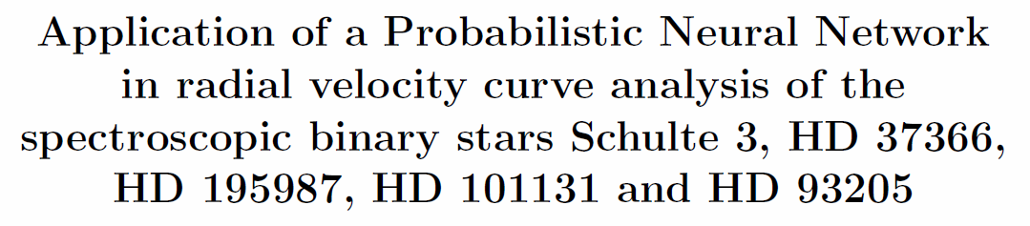
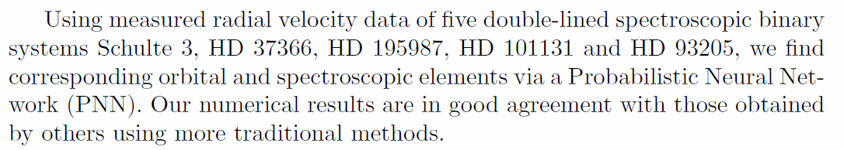
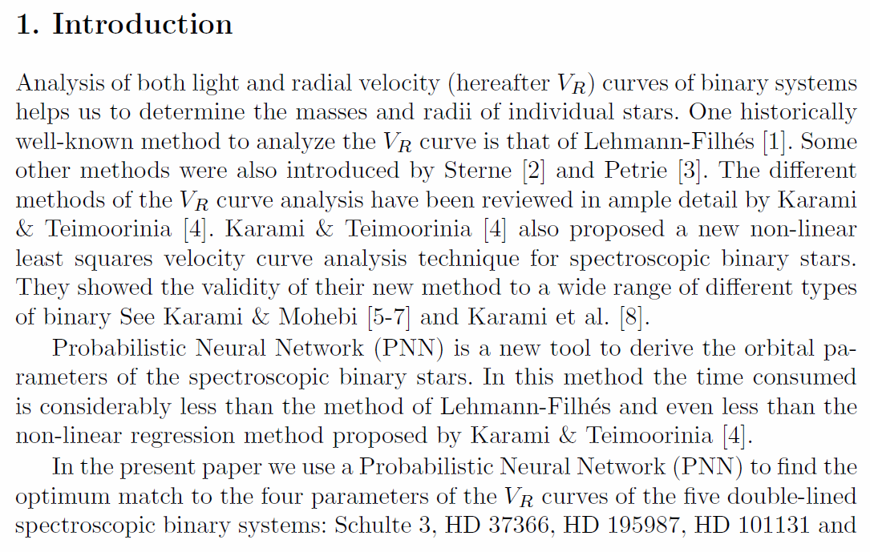
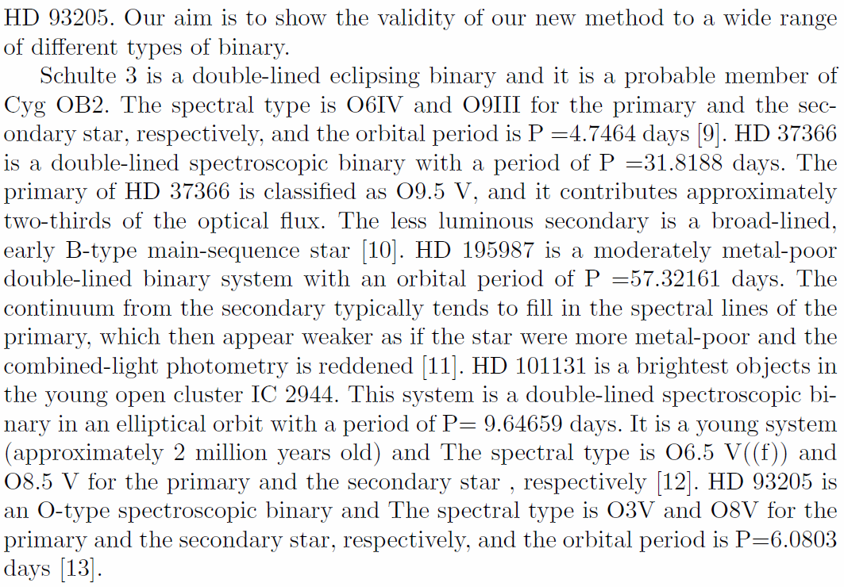
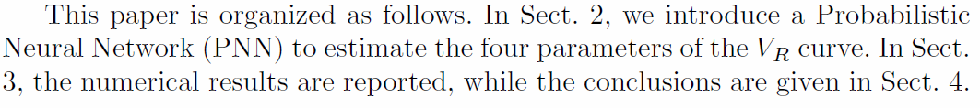

Slide 80
An introduction should
be clear of the objectives/motivations, and of what is new in the paper.
answer key questions. Identify the question that your title and abstract are supposed to answer. If you cannot phrase your contribution in a question form, you are not ready to write the paper. State the question as soon as possible in your introduction. Why now? Why this? Why this way? Why should the reader care? The readers rely on you to answer these questions.

Slide 81
set the foundation of your credibility. One should present both sides of an issue, i.e., “intellectual honesty”. What are the limitations of your work?
justify your choice of method to strengthen the credibility.
Our classification algorithm does not make any assumption
on the resolution of the images, nor does it make any
assumption on the shape of a galaxy.

Slide 82
An introduction should
give your own definition; frame your own scope of the of your contribution.
  An effective classification scheme should have the following desirable features …
be active and personal. You want to tell a story, your story, not a report. Use “we” or “our”.
  We were curious to see whether we could resolve the discrepancy between these models by using our new observations.

Slide 83
  Passive voice is acceptable in the rest of your paper. But in introduction, use active voice.

Slide 84
An introduction should
be engaging and motivating. The readers should want to read further. They should appreciate you as a writer, not just as a scientist.

Slide 85
  “I do not usually read introductions. Most of what’s in there is repeated verbatim elsewhere in the paper anyway. They are a water of time. They always say the same thing: the problem is important, everybody else but the author is doing it wrong, and they usually end up with a boring table of contents. So, I skip them.”
  --- quoted from “Kumar” in Lebrun’s book
Lebrun thinks some introductions are repetitive because they are written after the work is done, so the fun and excitement are gone! Write the introduction early, with the tantalizing hypothesis, supportive preliminary data, and fruitful methods.

Slide 86
An introduction should
avoid a vacuous false start
  In the age of all-sky surveys, we are confronted with a large amount of data … Significant progress in detector technology in general, and data analysis in particular, often prompts to enable …
  (Reader OS: ) Is there anything I do not know already?

Slide 87
An introduction should
avoid a considerable false start
  There has been a surge, in recent times, toward the increasing use of … There has been considerable interest in recent years in this technology, and, as trends indicate, it is expected to show continuing growth over the next decade …
  (Reader OS: ) Should I be excited by the sheer popularity of the problem (not the solution)?
avoid a dead table-of-contents ending

Slide 88
Do not cut and paste sentences from various parts of your paper into the introduction.
Check this example
  Abstract … The HBLRs and non-HBLRs identified in this data set had significantly different [NII]/Fe ratios, in accord with analysis of other AGN samples. These results demonstrate the emission to originate from different regions …
  Introduction … We demonstrate that the emission of HBLRs and non-HBLRs comes from different parts of the ….

Slide 89
The abstract is more precise than the introduction for key numerical results. The abstract is factual and passive “These results demonstrate …”; the introduction is personal and active “We demonstrate …”.

Slide 90
Popular Traps
The Trap of the Story Plot
A story (from Lebrun)
I’m so excited about telling you this great story. My father is on the front lawn cleaning the lawn mower. My sister is in the back kitchen making a cake. My mom has gone shopping, and I am playing my electric guitar in my bedroom.
Your readers are left ice cold. There is no plot, no relationship or connection between the elements of the story.
Identify your story plot in the introduction.

Slide 91
A better story --- with a thread
I’m so excited. I am going to tell you a great story. My father is on the front lawn cleaning the lawn mower. Do you know what this means? Trouble! He hates it. He wants everyone to help bring him this or that in order to feel less miserable. Whenever that happens, we all run away, not because we refuse to help him, but because he wants us to stand there and watch idly while he works. So, my sister is taking refuge in the back kitchen and is plunging her hand in flour to slowly making a cake. My mom has suddenly discovered that she is missing something, and has rushed out to shop, saying she would be gone for an hour or so. As for me, I am in my bedroom playing the electric guitar with my amplifier at maximum volume.

Slide 92
A terrible story
I’m so excited. I am going to tell you my second best story. A red Ferrari would take me to Vladimir Toldoff’s house in 5 hours. It is fast. However, it is very expensive. A red bicycle is much less expensive and is quite convenient for short trips. So, if Vladimir Toldoff came to live near my house, it would be quite cost effective. However, a bicycle that does not have a mudguard requires a bicycle clip so as not to dirty trousers. Since red athletic shoes do not require a bicycle clip, they are a better solution than a bicycle to travel short distances. However, their color is easily degraded by adverse weather conditions, particularly in the muddy rainy season. On the other hand, brownish open plastic sandals do not have any of the previous problems: they are cheap, convenient, require no bicycle clip, and do not show mud stains. Furthermore, they are easy to clean, and are fast to put on. However, contrary to the Ferrari, they reflect poorly on the status of their owners. Therefore, I am working on a framework to integrate self-awareness into the means of transportation, and will validate it through the popular Sims 2 simulation package.

Slide 93
The disconnect plot and however plot are frequently found because they are convenient:
They allow a list of loosely related references to be easily assembled.
The shallow analysis of related works is fast because it does not require extensive reading of other people’s works (abstracts or even titles are enough in most cases)
Usually a plot that works well in movies is also useful in scientific writing. It is all right if you show the readers how the story ends before it even starts. The readers have a full picture, so they can place your contribution in it. They know your limitations and expect that you will deal with them.

Slide 94
The Trap of Plagiarism
Plagiarism happens when someone else’s words are found in your paper without proper quotes or references.
For an academic position, plagiarism = end of career.
Changing a word here and there does not get rid of plagiarism → “patchwork plagiarism”
Changing every word except the keywords does not help.
Even quoting yourself can be dangerous. You might have coauthors. The copyright, after a paper is published, no longer belongs to you alone.
Free or open access does not imply free right of use.
Quoting is a good practice. You do not interpret; you cite.

Slide 95
When doing the electronic literature study, keep relevant documentation about the information source.
Completely rewrite without looking at the original, and express your point of view.
In apparent support of the cold dark matter cosmology, Chen (2012) provided observational evidence of …
With the skillful use of the word “apparent”, the author starts in the next paragraph with “However” to express disagreement.

Slide 96
The Trap of Imprecision
So your paper mentions 30 or more references. Did you read them all? Or did you just skim the abstracts?
Words like typical, generally, commonly, can/may, a number of, the majority of, substantial, probably, several, less, various, frequent, many, others, more, often, most, a few, the main…
Many people have been working on this problem [1,2,3,4,5,6,7,8,9,10], and others have recently improved on the method [11,12,13,14,15,16,17].
Very often, the rest of the paper does not contain as many references.
As a referee, how do you think of this paper?

Slide 97
If you read only the abstracts, or fill your paper with references of papers you have not read (or even do not have them), it will hurt you in the following ways:
Your paper will have superficial statements, so the referee will lower the value of your contribution.
Your research will be clearly positioned on the research landscape.
Your story will lack of details and, therefore, interest.
The reader will doubt your expertise. Why should they believe you otherwise?

Slide 98
The Trap of Judgmental Adjectives
When you refer to other’s work, some adjectives are dangerous (poor, good, fast, faster, not reliable, primitive, naïve, limited).
Every adjective is a claim, and in science, claims have to be substantiated. How do you justify “poor”?
Use those adjectives that you later justify with data or figures. Let adjectives be based on facts, or on quotes from other authors stating their own limitations of assumptions.

Slide 99
State that your work agrees (or disagrees) with another paper’s conclusions. State that your results are different or consistent.
Use facts and numbers.
Define your uniqueness.
Quote another paper that independently supports your views.

