Slide 1

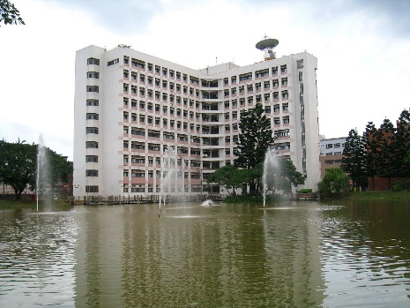
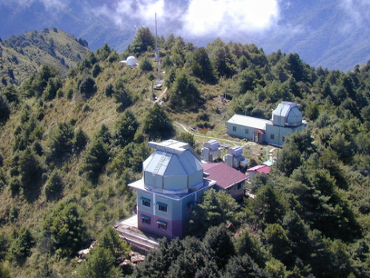
Formation and Dynamical Evolution of Star Clusters
Census of Galactic open clusters
Dynamical evolution of a star cluster
Star clusters as targets and as tools
Outstanding issues
Wen-Ping Chen
Graduate Institute of Astronomy
National Central University
2016 December 9 @NCKU/Physics

Slide 2
Study of Star Clusters
Historically, one of the oldest subjects in astronomy, next to stars and planets, e.g., the Messier objects …
Progress paused for a few decades because CCD sizes did not catch up.
Interest revived because of sky surveys and OIR wide-field imaging
Current census: 3000+ open clusters,
100+ globular clusters in the Milky Way
Latest interests mainly in massive star clusters, dissolving/dissolved (extended clusters, moving groups), and extragalactic systems

Slide 3
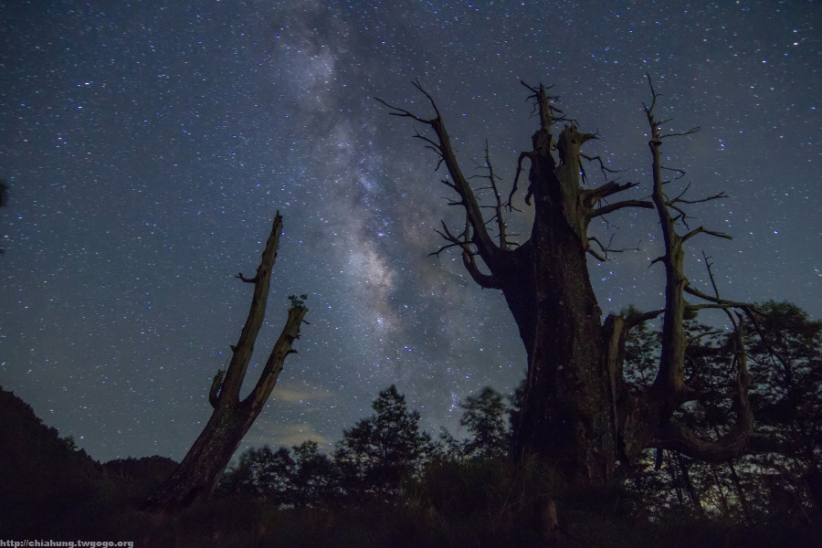

Slide 4
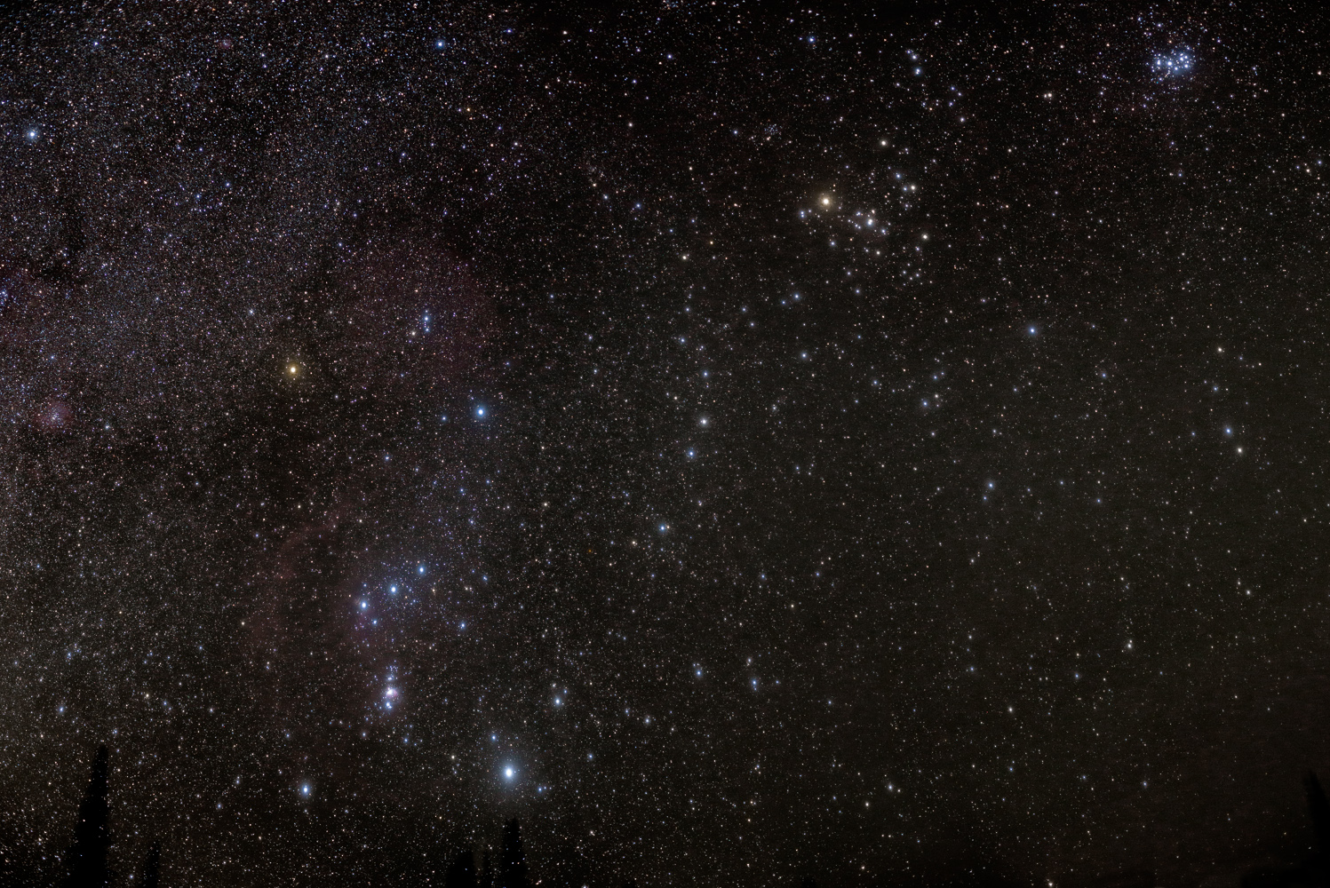

Hyades
d=47 pc (closest to Sun)
Θ= 330’
$$ℳ=400 M_{⊙}$$
τ = 625 Myr
Pleiades (=M45)
d=136 pc (most obvious)
Θ= 110’
τ = 75--150 Myr
http://frontrange.ca/blog/page/6/

Slide 5
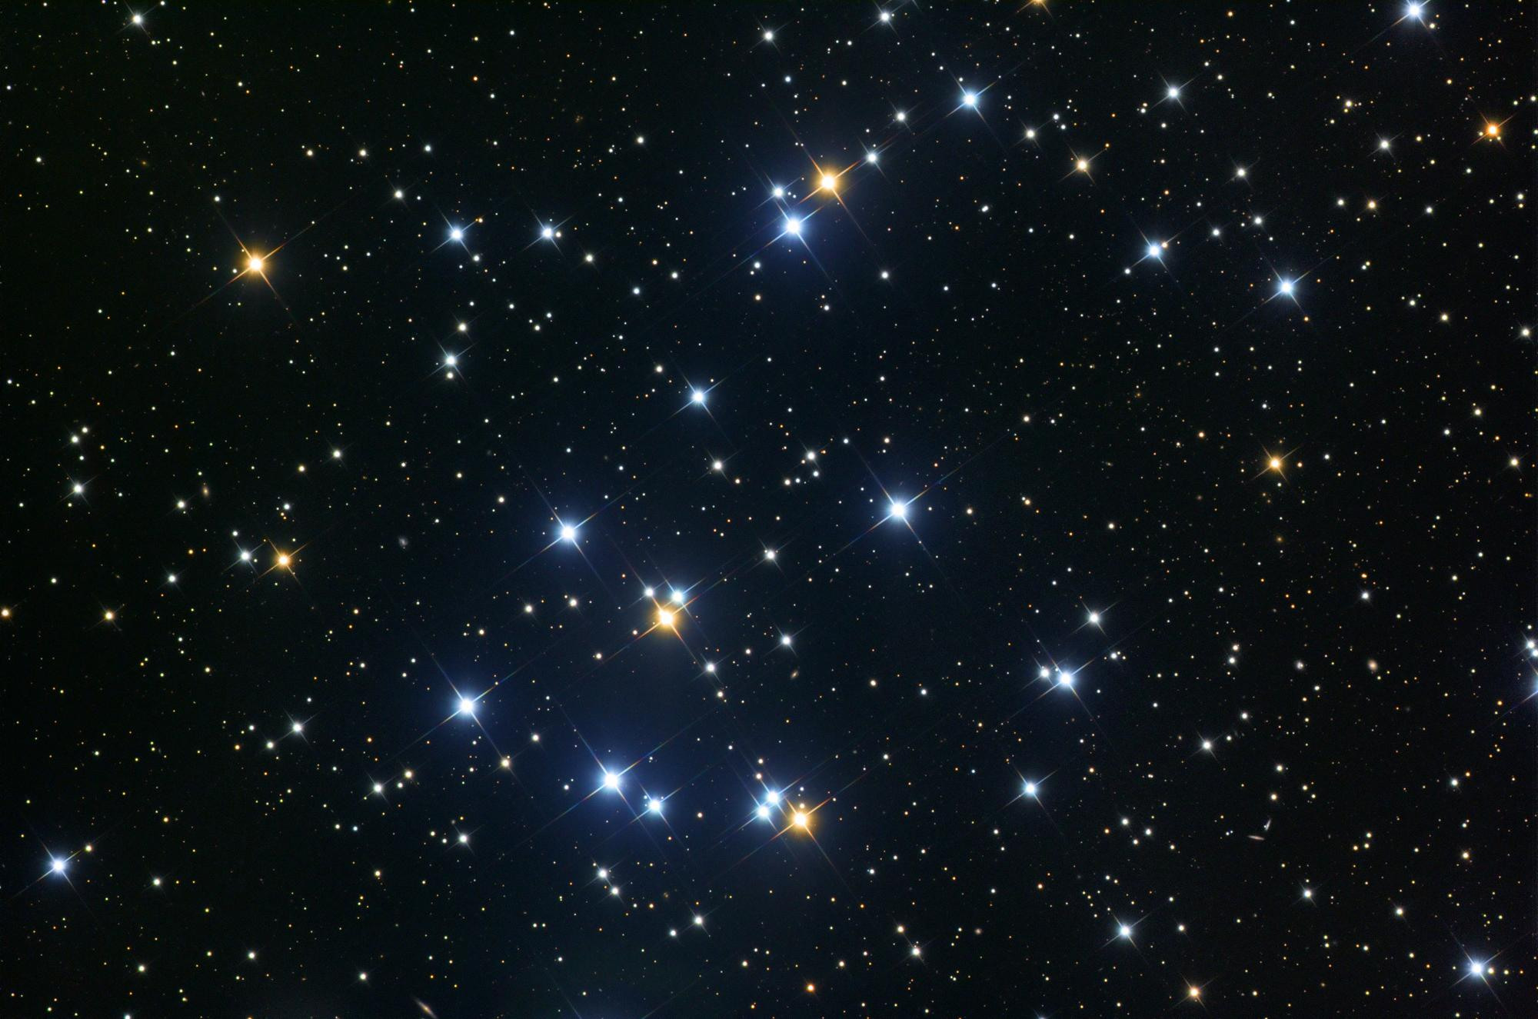
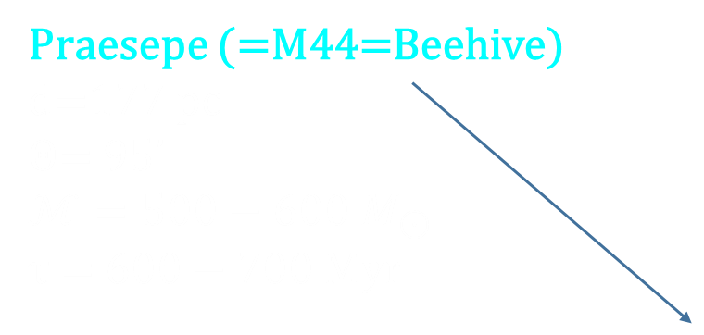
Praesepe (=M44=Beehive)
d=177 pc
Θ= 95’
$$ℳ=500−600 M_{⊙}$$
τ = 600 $−$ 700 Myr

Slide 6
Stellar Surface Temperature
Star clusters are of astrophysical interest because they
enable relatively precise determination of stellar ages and distances
are laboratories to study
stellar formation and evolution
Stellar Intrinsic Brightness
Castellani+01

Slide 7
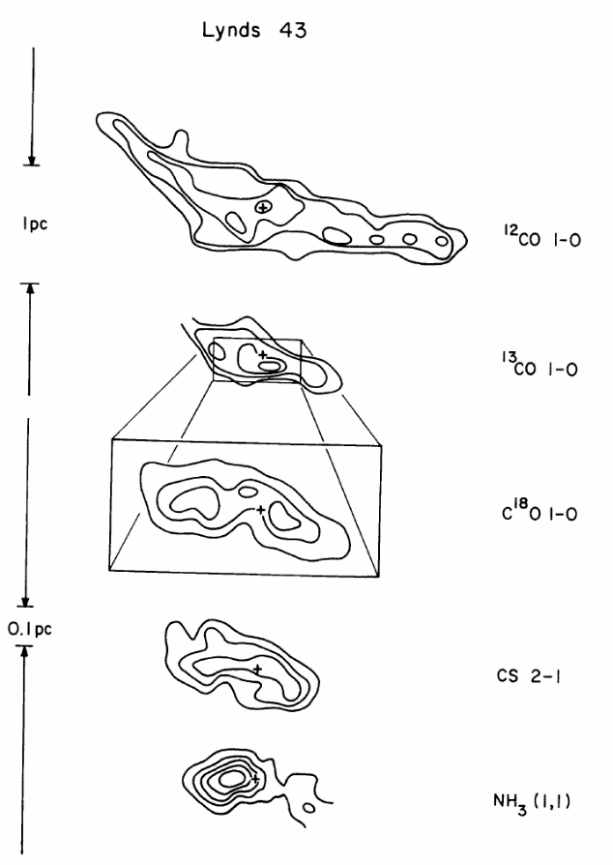
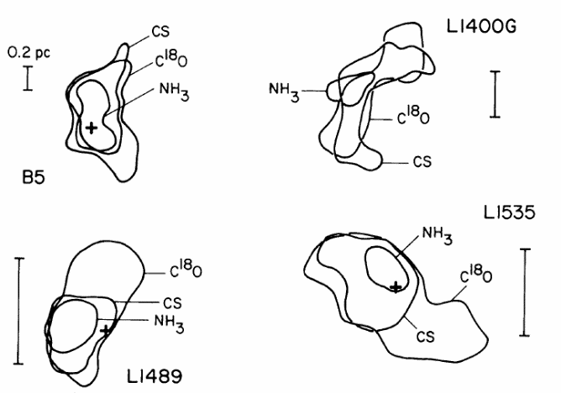
Star Formation = Cluster Formation
Stars are formed in groups out of dense molecular cloud cores, and planets are formed, at the same time as the stellar birth, in circumstellar disks.
Molecular clouds observed by different molecular tracers …

Slide 8
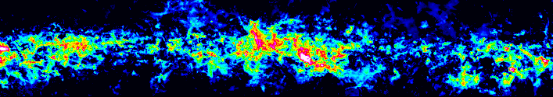
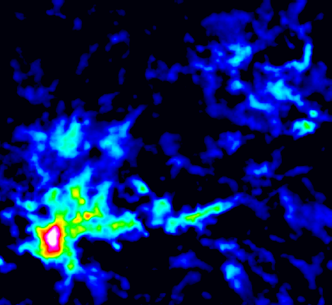
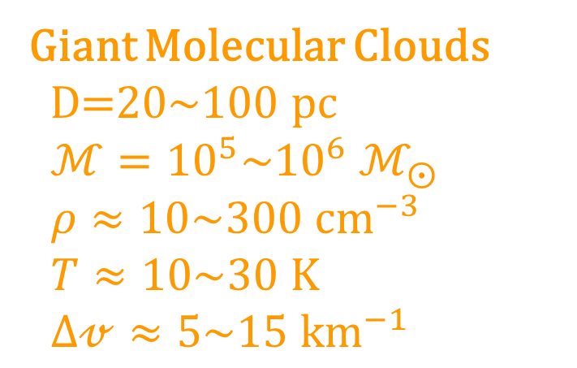
Filamentary Molecular Clouds
Giant Molecular Clouds
D=20~100 pc
$ℳ={10}^{5}\sim {10}^{6} ℳ_{⨀}$
$ρ≈10\sim 300 {cm}^{−3}$
$T≈10\sim 30 K$
$∆𝓋≈5\sim 15 {km}^{−1}$
Molecular clumps/ clouds/condensations
n ~ 10³ cm⁻³ , D ~ 5 pc,
M ~ 10³ M
Dense molecular cores
n ≥ 10⁴ cm⁻³ , D ~ 0.1 pc,
M ~ 1-2 M
http://www.bu.edu/galacticring/outgoing/PressRelease/

Slide 9
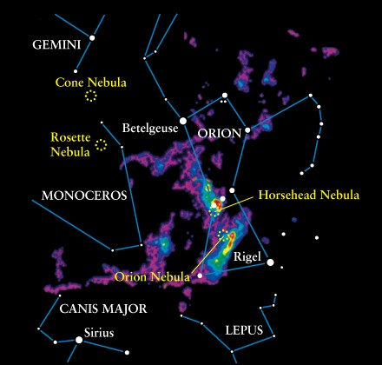
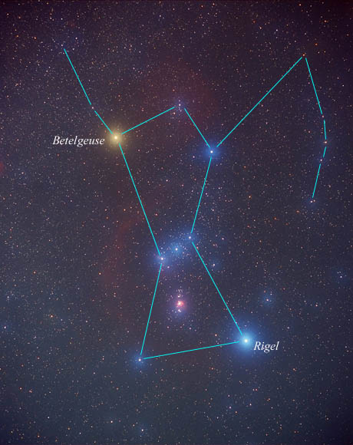
Orion in visible light
… and in CO

Slide 10
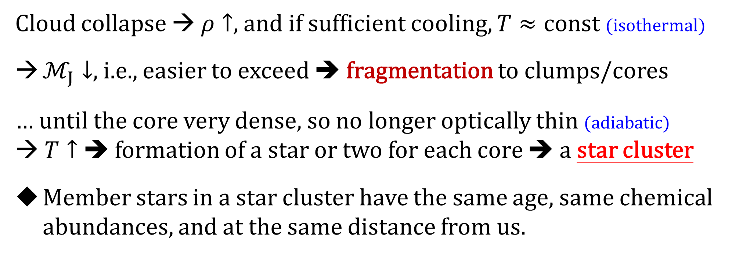
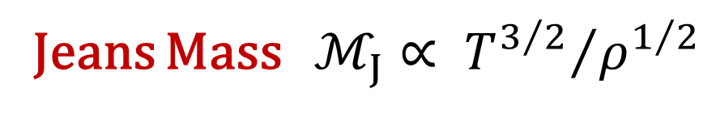
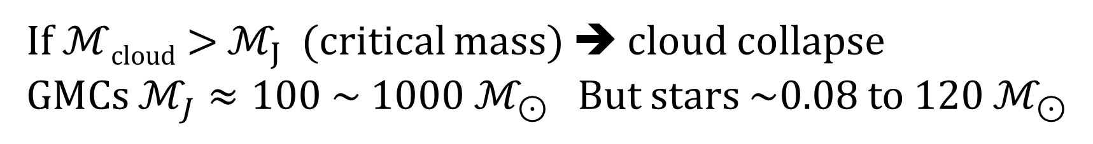
Jeans Mass $ℳ_{J}∝ {T^{3/2}}/{ρ^{1/2}}$
If $ℳ$_{cloud} > $ℳ_{J}$ (critical mass) ➔ cloud collapse
GMCs $ℳ_{J}≈100 \sim 1000 ℳ_{⊙}$ But stars ~0.08 to 120 $ℳ_{⊙}$
Cloud collapse → $ρ↑$, and if sufficient cooling, $T≈const$ (isothermal)
$ℳ_{J}↓$, i.e., easier to exceed ➔ fragmentation to clumps/cores
… until the core very dense, so no longer optically thin (adiabatic)
→ $T↑$ ➔ formation of a star or two for each core ➔ a star cluster
Member stars in a star cluster have the same age, same chemical abundances, and at the same distance from us.
denser → more collisions/excitations/line emission → IF photons escape → cooling
… well, almost

Slide 11
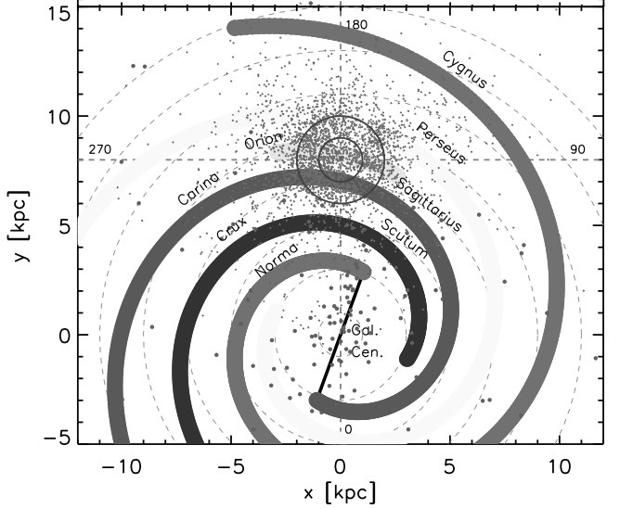
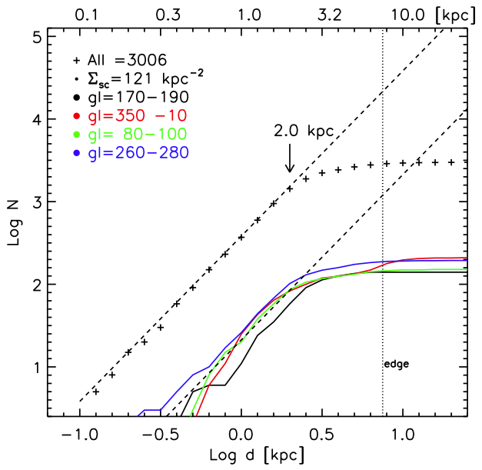





Census of Star Clusters
Known Milky Way globular clusters (~160), open clusters (6000+?)
The sample of Galactic OCs (e.g., Kharchenko +13) is highly incomplete, limited to within 1-2 kpc → $>{10}^{5}$ in the disk?
Lin+16 in prep

Slide 12
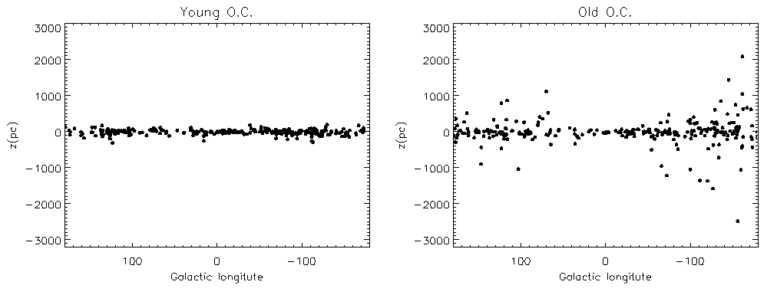
Young open clusters ( < 100 Myr) are located near the Galactic plane, whereas older systems are more scattered above and below the plane.

Slide 13
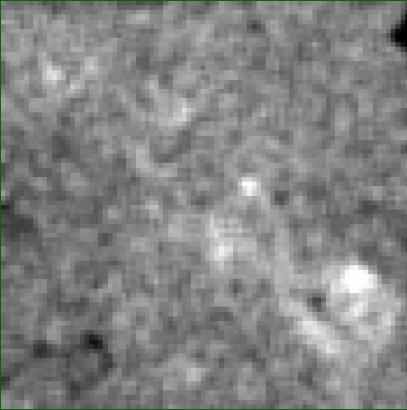
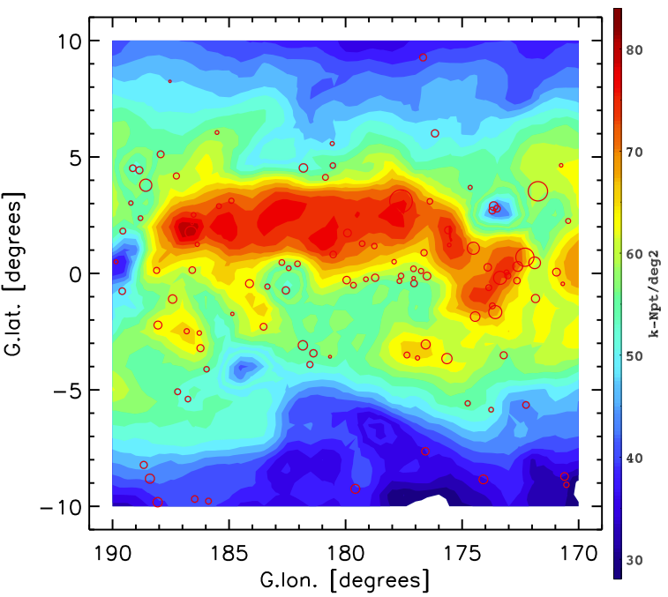
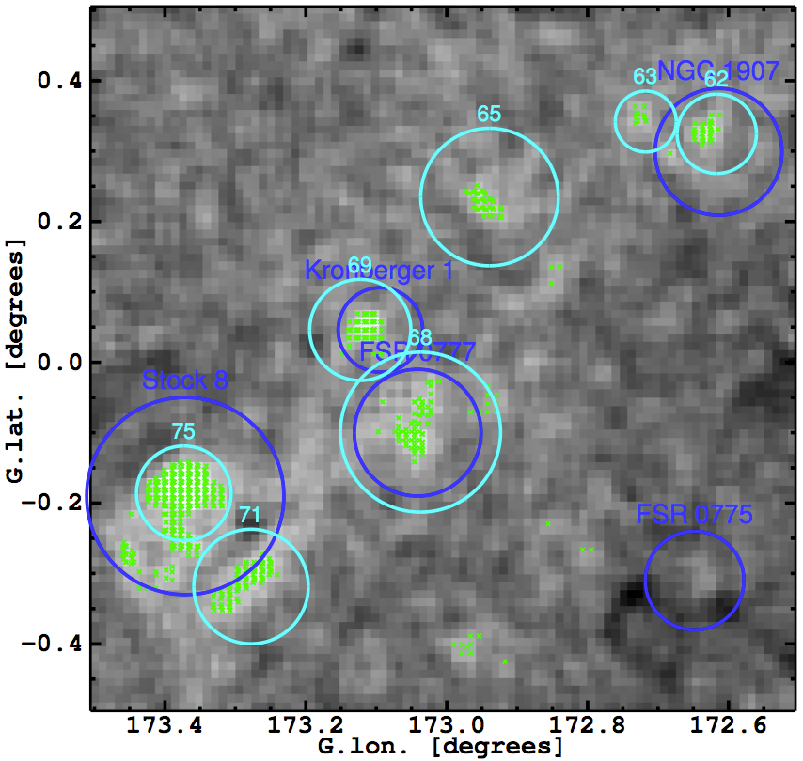
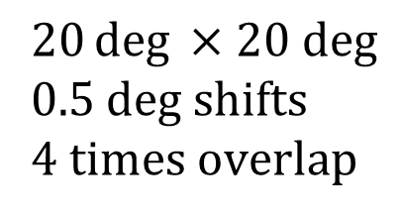
A pilot study to search for stellar density enhancements toward the Galactic anti-center as candidate OCs using Pan-STARRS data
Also rediscovered known OCs; some detected with substructures or tails
$$20\deg{ ×20 deg}$$
0.5 deg shifts
4 times overlap
Lin+16 in prep
Lin+ in prep

Slide 14
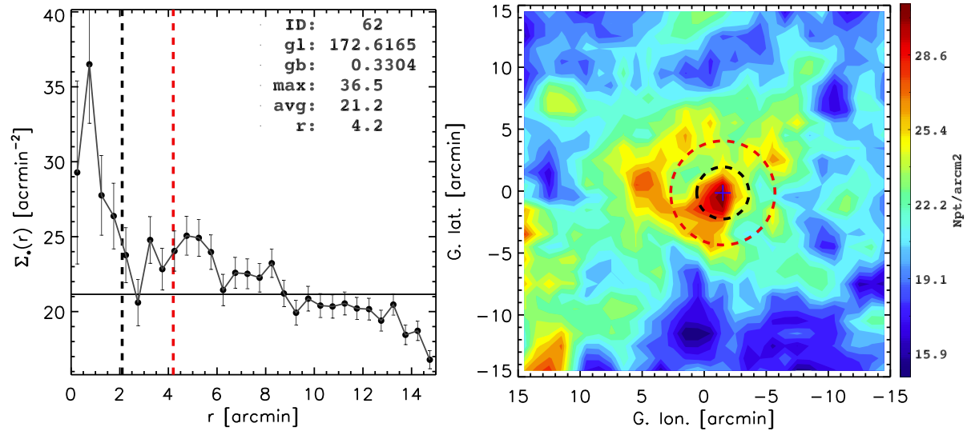
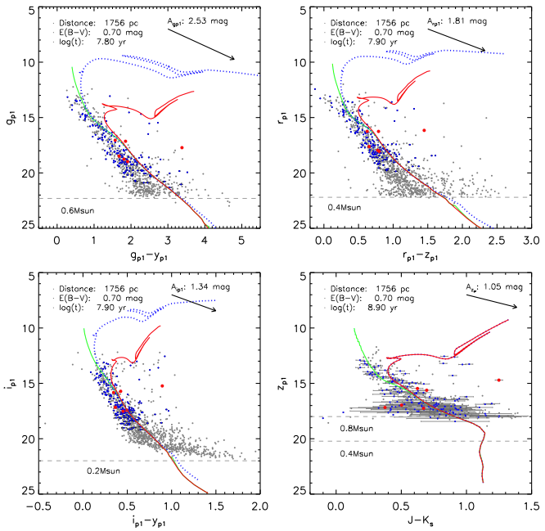
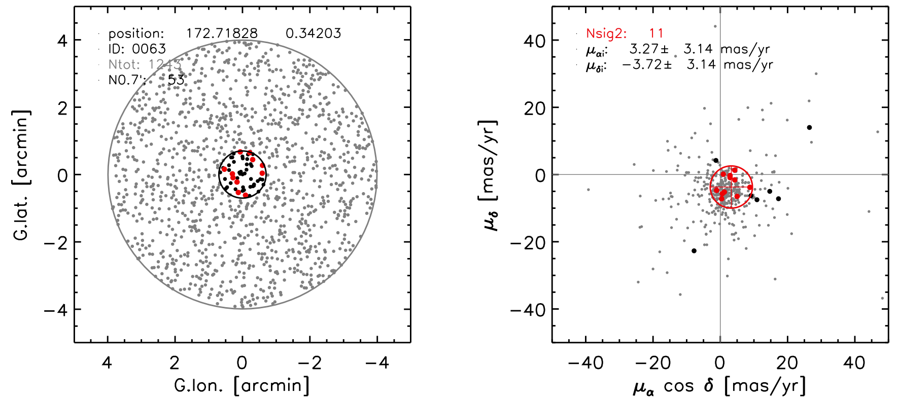
To characterize each candidate with coordinates, radius, reddening, distance, proper motion, (age), …

Slide 15
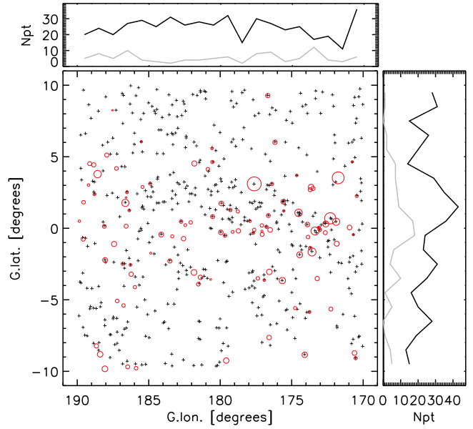
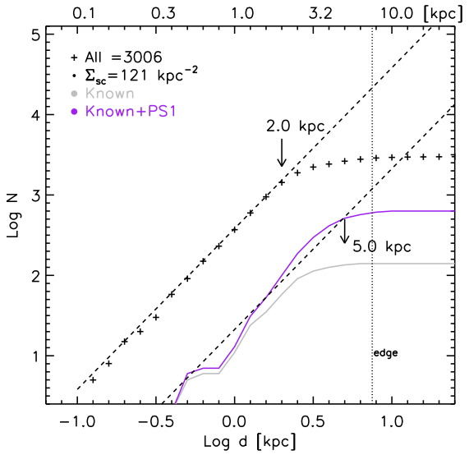
Some 500 OC candidates found; ~110 matched with known ones
Completeness 1-2 kpc → 5 kpc

Slide 16
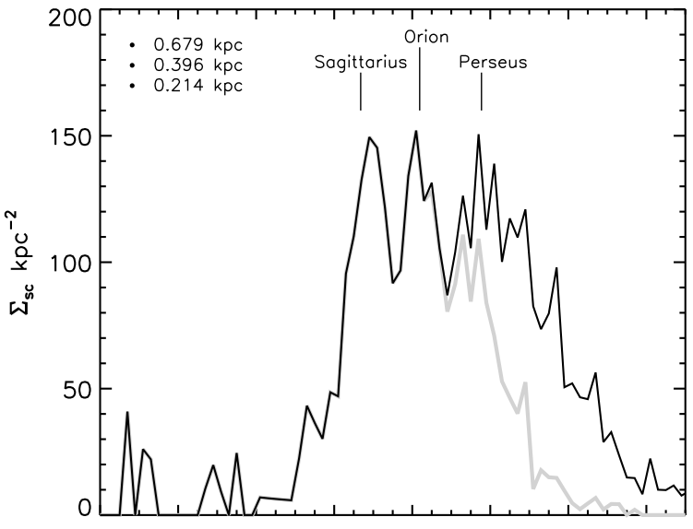
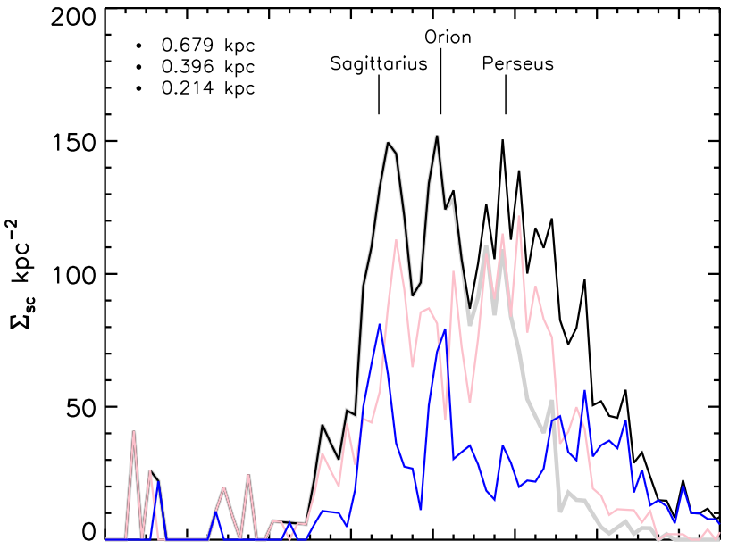
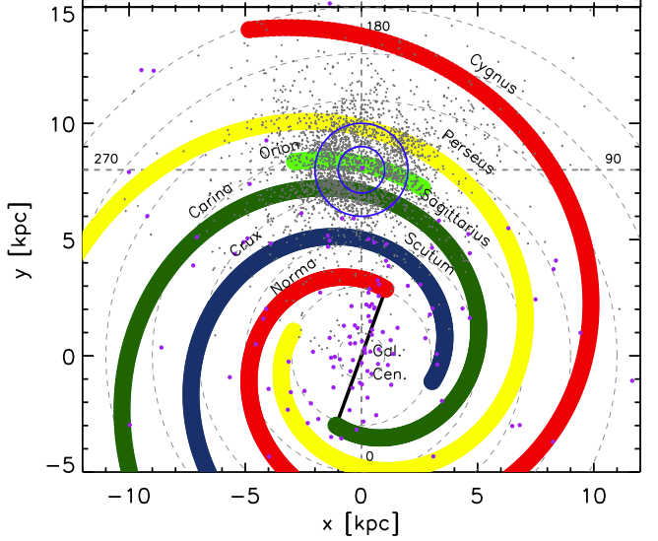

Spiral arms
Sagittarius:
450±50 pc
Orion:
400±50 pc
Perseus:
800±100 pc
log(t) > 8
3.2 kpc
log(t) < 8
PS1 SC
5 kpc
10
5
x[kpc]
-5
-10
Lin+16 in prep
-5 0 y [kpc] 10 15

Slide 17
Chen, Chen & Shu, 2004, AJ, 128, 2306
Chen & Chen, 2010, ApJ, 721, 1790
Evolution of Star Clusters
(Initial) Molecular clouds are clumpy and filamentary; so are the youngest star clusters.
(Internal) Gas dispersal (stellar winds, SN explosions) + Mutual gravitational interaction between members → spherical shape (relaxation), with more massive stars concentrating more toward the center (mass segregation). Lowest-mass members are vulnerable to ejection out from the system (stellar evaporation).
(External) Eventually Galactic perturbations (tidal forces, differential rotation) distort and rip apart the star clusters. Then-members supply the Galactic disk population.
A recently dissolved system in the solar neighborhood may be recognized as a moving (star) group.

Slide 18
Stellar Dynamics
(segregation, evaporation, tidal disruption)
Stars Formed in Groups
Star-Cloud Interplay
Cloud Dispersal
Disk Population
Molecular Cloud
Star Cluster & H II Region
Cluster at Birth
Cluster Evolved
Cluster Dissolved

Slide 19
Feedback of Massive Stars on Star/Cluster Formation
Active in SF
Quiescent
+ PMO 12CO, 13CO, and C18O data
Samal+16 in prep

Slide 20
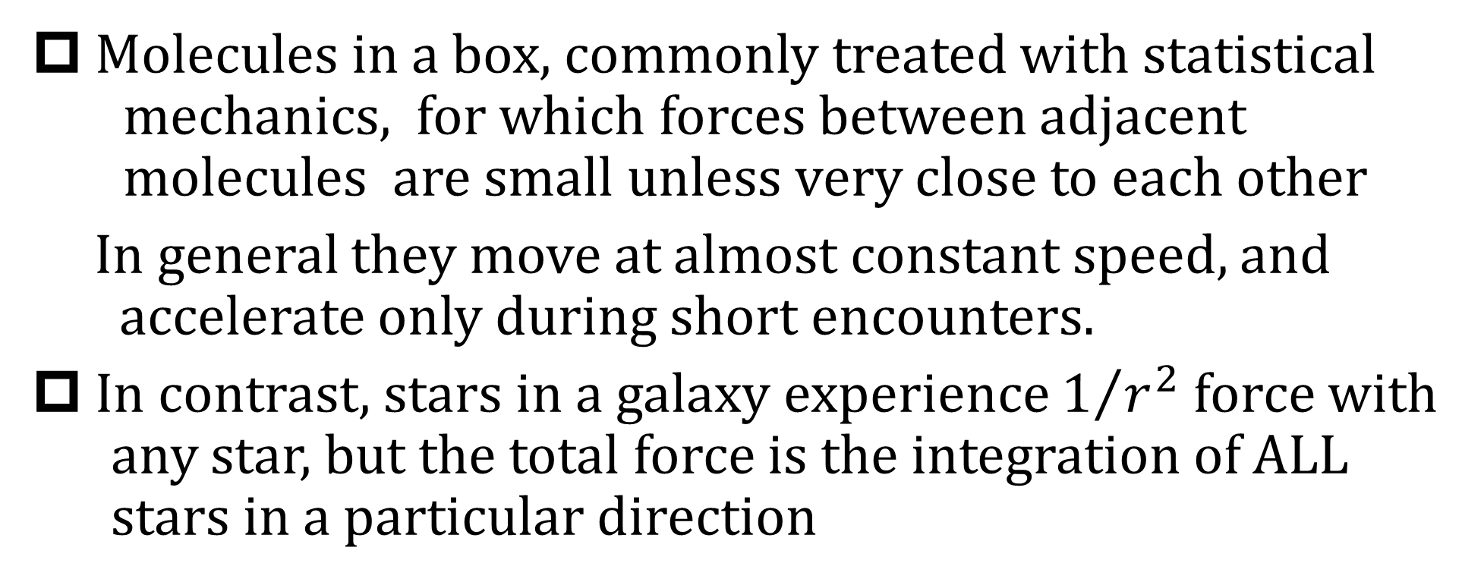
Equilibrium of a (Collisionless) Stellar System
Molecules in a box, commonly treated with statistical
mechanics, for which forces between adjacent
molecules are small unless very close to each other
In general they move at almost constant speed, and
accelerate only during short encounters.
In contrast, stars in a galaxy experience $1/{r^{2}}$ force with
any star, but the total force is the integration of ALL
stars in a particular direction
The Boltzmann equation $\frac{∂f}{∂t}+\overset{⃑}{v}∙\overset{⃑}{∇}f−$ $\overset{⃑}{∇}φ∙\frac{∂f}{∂\overset{⃑}{v}}$ = 0 (or $Γ[f]$)

Slide 21
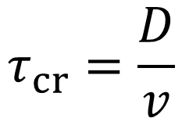
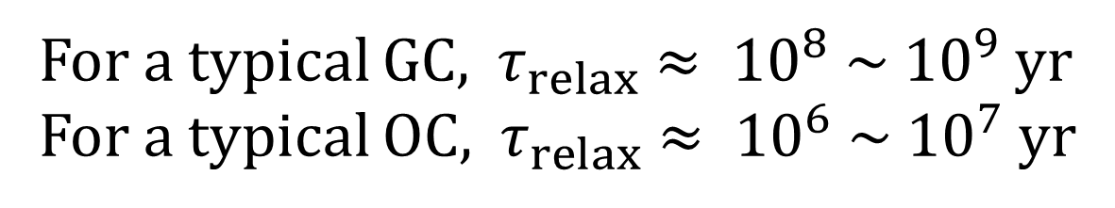
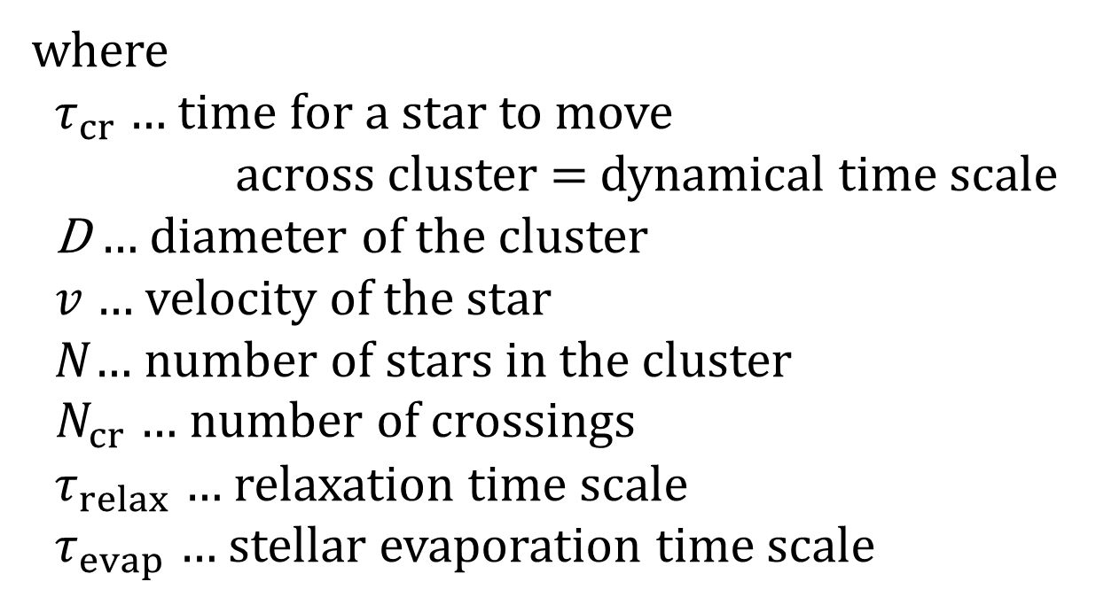
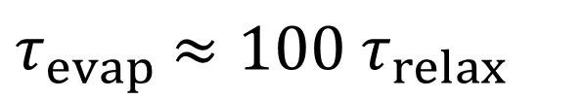

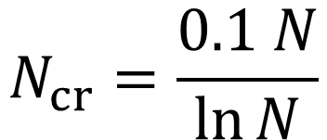
Dynamical Relaxation of a Stellar System
Spitzer (1988)
Shu (1984)
Binney & Tremaine (1987)
$$τ_{cr}=\frac{D}{v}$$
where
${ τ}_{cr}$ … time for a star to move
across cluster = dynamical time scale
D … diameter of the cluster
$v$ … velocity of the star
$N$… number of stars in the cluster
$N_{cr}$ … number of crossings
${ τ}_{relax}$ … relaxation time scale
${ τ}_{evap}$ … stellar evaporation time scale
$$N_{cr}=\frac{0.1 N}{\ln{N}}$$
$τ_{relax}=$ $τ_{cr}∙N_{cr}$
$τ_{evap}$ $≈100{ τ}_{relax}$
For a typical GC, ${ τ}_{relax} ≈ {10}^{8} \sim {10}^{9}$ yr
For a typical OC, ${ τ}_{relax} ≈ {10}^{6} \sim {10}^{7}$ yr
… most GCs have been relaxed.
… young OCs are being relaxed.

Slide 22
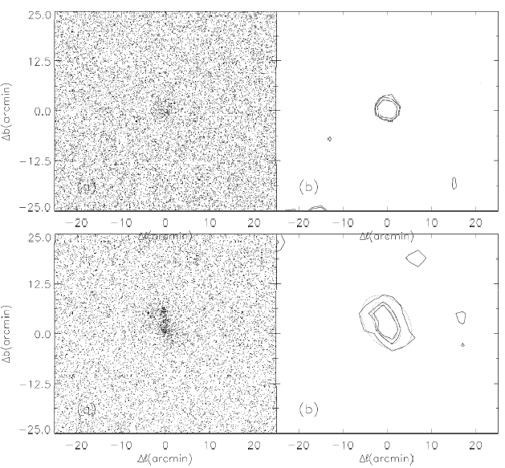
Shape Morphology
Probabilistic star counting --- weighting each star by the number of neighbors
OCs are in general flattened, even among the youngest ones of a few Myr. As an OC ages, its core becomes circularized by stellar encounters; the overall size expands and stellar density drops.
2MASS PSC
Ks < 15.6 mag
Isodensity contours
NGC 2414 Round
Core:
1/3 max density
Halo:
3 times field fluctuation
NGC 1893 Elongated
Chen+04

Slide 23
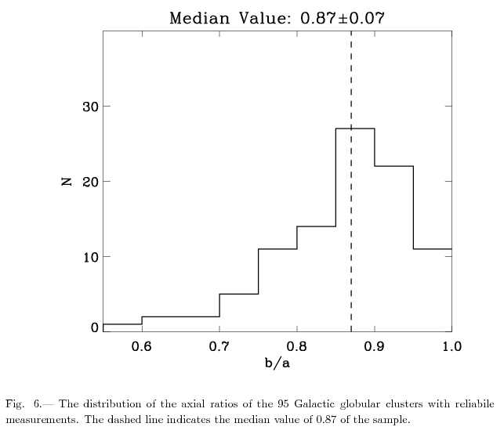
Globular Clusters not perfectly around
Rotation alone cannot account for the flattening.
Axial Ratios of 116 GCs
CW Chen & WP Chen (2010)

Slide 24
Tidal Distortion by Bulge
Ellipses as GCs projected on the sky (enlarged)
Bulge GCs in thick lines
Flatter than average with a line with length proportional to axial ratio
CW Chen & WP Chen (2010)

Slide 25
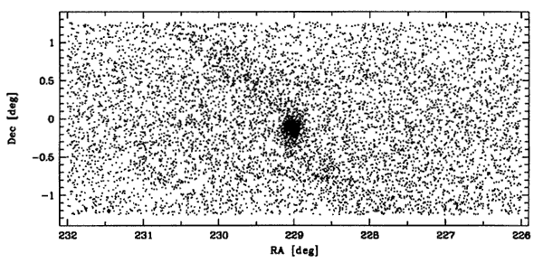
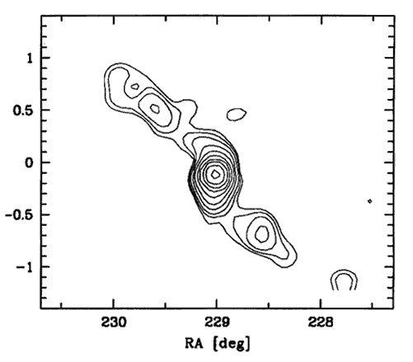
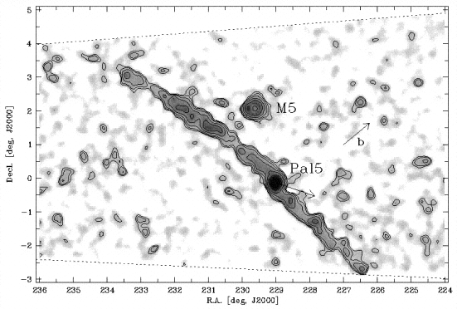
Tidal Tails
Palomar 5
Discovery with the SDSS equatorial strip data
Odenkirchen+01
… later with an extended view of 10 degree tails
Odenkirchen+03
http://www.astro.virginia.edu/class/majewski/2007/astr551/lectures/globular_clusters/life_cycle.html

Slide 26
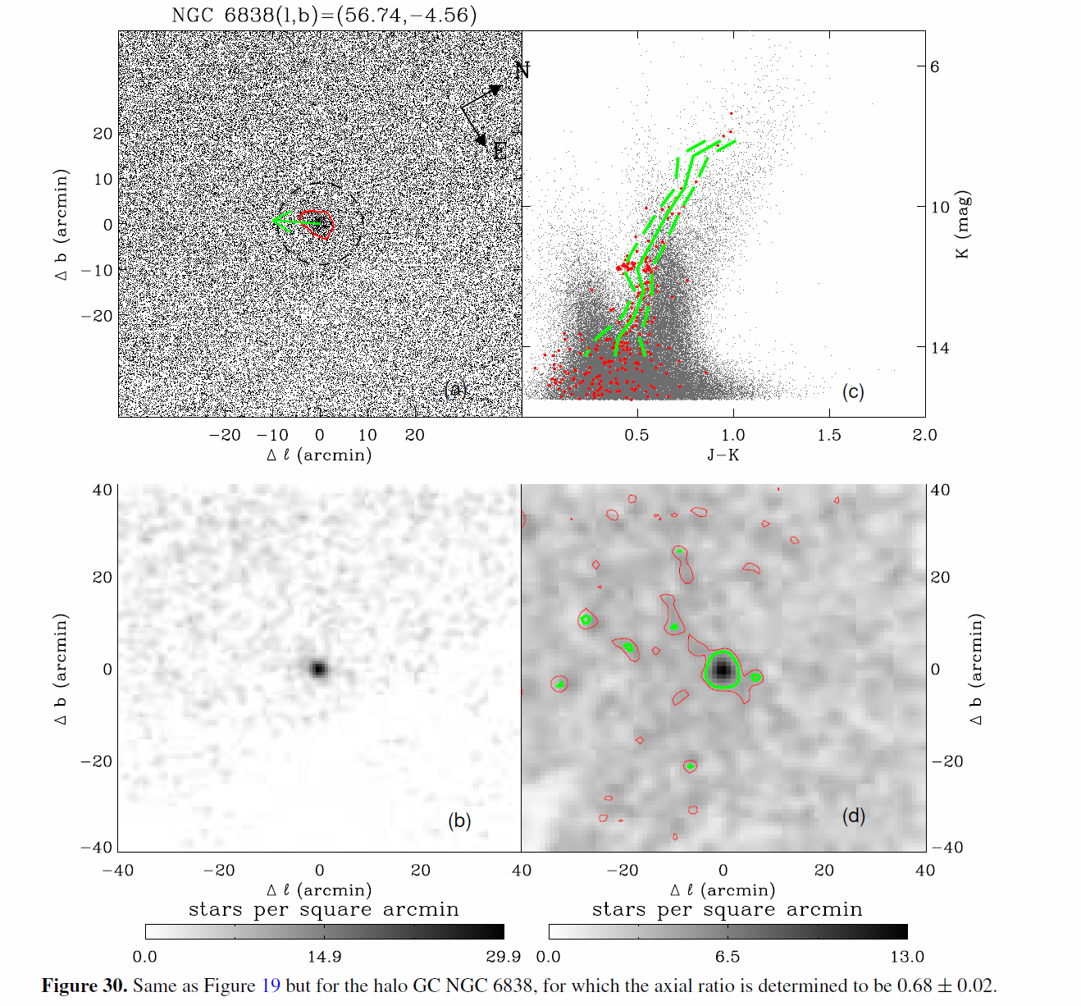
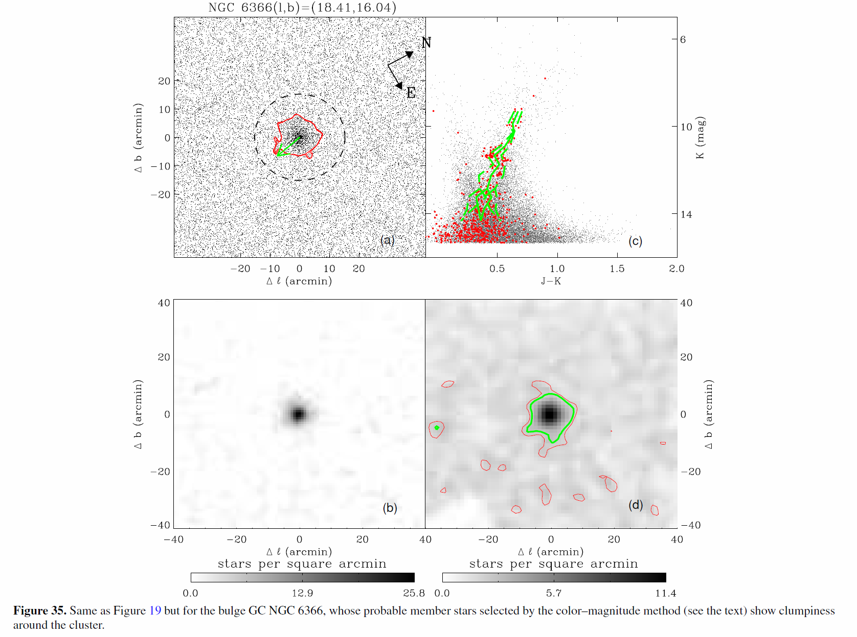
Tidal Tails and Stellar Debris
Many globular clusters are elongated, with stellar debris, pointing toward the Galactic bulge.
Chen, CW, et al. (2010)

Slide 27
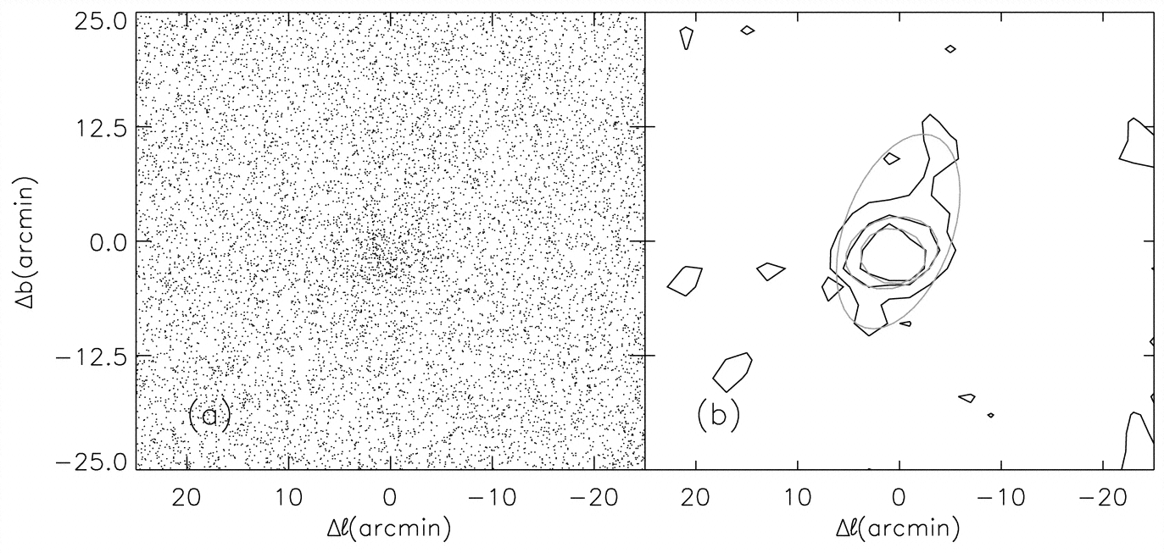
Tidal Structure of Open Clusters
Eventually tidal force and Galactic differential rotation tear a cluster apart.
Berkeley 17 by 2MASS
The old open cluster Berkeley 17 (l =176º, b=－4º)
Chen+04

Slide 28
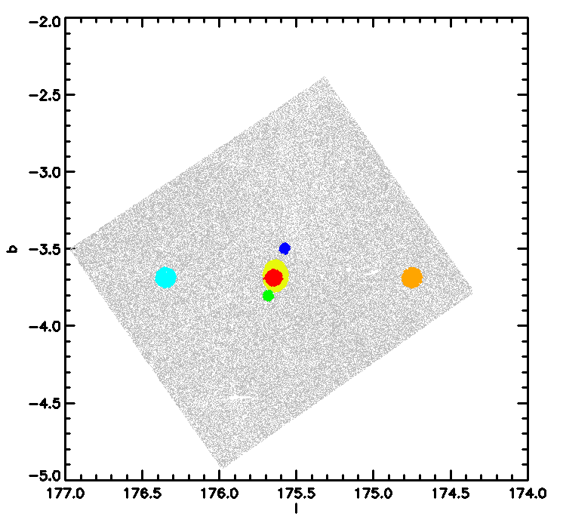
Tail A
Be 17 by PS1
Core
Tail B
Bhattacharya+ in prep

Slide 30
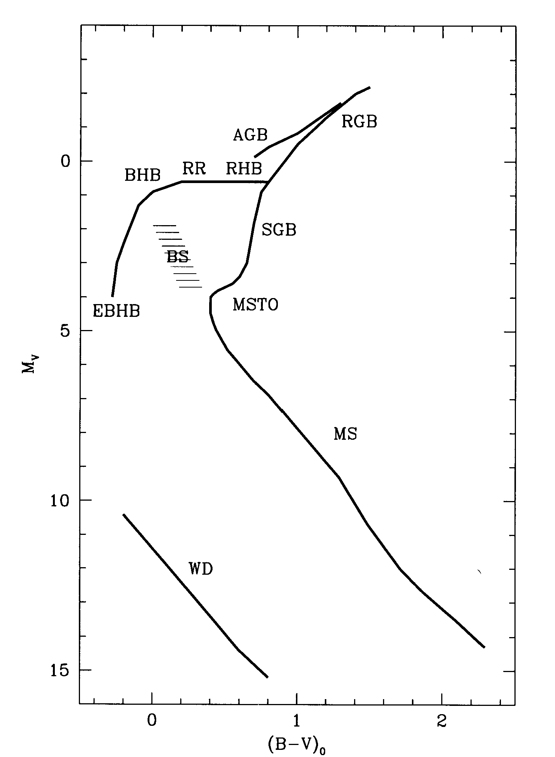
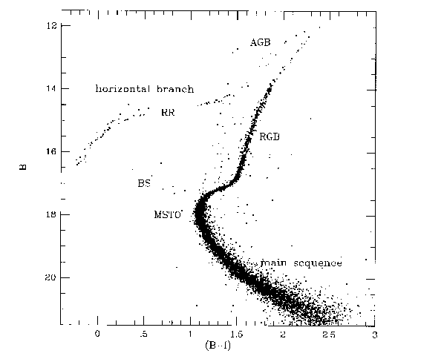
Blue Stragglers
Stars lying along the extension of the main sequence. Should have evolved off the turn-off given the age of the hosting cluster
Origin not clear; likely as a merger of two low-mass stars as consequence of collisional or binary merging
M5

Slide 31
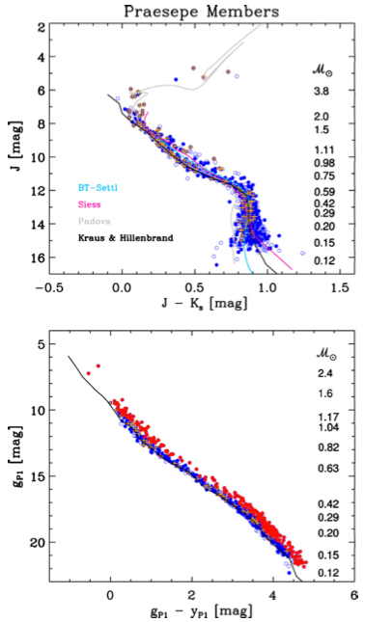
Dissolving Star Clusters
Praesepe
(M44, 750 Myr, 179 pc)
2MASS, PS1, PPMXL → 1040 member candidates
Put stellar evolutionary models to test, e.g., Padova/PARSEC Chen+14
20-40% binary rate with a preference of
similar-mass pairs
Wang+13

Slide 32

Trapezium
disk
Mass segregation with the lowest mass members (< 0.2 M⊙) being stripped
➔ The cluster is being dissolved.
Wang+13

Slide 33


Origin of Stellar Masses
A universal (initial) mass function, but why?
Trapezium
$α=−1.35$ for ${ℳ>0.6 ℳ}_{⨀}$
$α=−$0.2 for ${ℳ=0.1−0.6 ℳ}_{⨀}$
$α=+1.0$ for ${ℳ<0.1 ℳ}_{⨀}$
Jeffries 2012
Muench+02

Slide 34




NGC 7380
4 Myr
$α=−1.27±0.10$
for 1.0 to 16.4 $ℳ_{⨀}$
Be 59/S171
4 Myr
$α=−1.01±0.1$1
for 2.5 to 16 $ℳ_{⨀}$
Chen+11
Pandey+08
0.6 M  2 M  16 M
NGC 1893
4 Myr
Stock 8 (12 Myr)
± 0.12
Jose+08
Sharma+07

Slide 35
Dissolved Star Clusters
Recently dissolved star clusters recognizable if young and in the solar neighborhood → stellar moving groups
Then-members share the same space volume and motion, (and abundance, age, etc.)
So far 9 MGs known within 150 pc, with ages 10‒100 Myr

Slide 36




Known Moving Groups
$β Pic$ in BPMG
Lagrange et al. 2009
HR 8799 in Columba
Marois et al. 2010
Known nearby moving groups, adapted from Torres et al. (2008)
Name | D^{T} [pc] | Age^{M} [Myr] | U^{T} [kms⁻¹] | V^{T} [kms⁻¹] | W^{T} [kms⁻¹] | N^{T}
$β$ Pictoris (BP) | 40±18^{T,S} | 12-22 | -10.1±2.1 | -15.9±0.8 | -9.2±1.0 | 55^{T,S}
AB Doradus (AB Dor) | 51±29^{T,S} | 50-120 | -6.8±1.3 | -27.2±1.2 | -13.3±1.6 | 97^{T,S}
Tucana/Horologinm (Tuc-Hor) | 48±7 | 10-40 | -9.9±1.5 | -20.9±0.8 | -1.4±0.9 | 44
TW Hydrae (TWH) | 59±22^{D} | 8-20 | -10.5±0.9 | -18.0±1.5 | -4.9±0.9 | 31^{D}
Columba (Col) | 82±30 | 10-40 | -13.2±1.3 | -21.8±0.8 | -5.9±1.2 | 41
Carina (Car) | 85±35 | 10-40 | -10.2±0.4 | -23.0±0.8 | -4.4±1.5 | 23
Argus (Arg) | 106±51 | 30-50 | -22.0±0.3 | -14.4±1.3 | -5.0±1.3 | 64
$ϵ$ Chamaeleontis ($ϵ$ Cha) | 108±9 | ~6^{T} | -11.0±1.2 | -19.9±1.2 | -10.4±1.6 | 30^{M2}
Octans (Oct) | 141±34 | ~20^{T} | -14.5±0.9 | -3.6±1.6 | -11.2±1.4 | 15
D: Ducourant et al. 2014, M: Malo et al. 2013 , M2: S: Schlieder et al. 2012, T: Torres et al. 2008, M2: Murphy et al. 2013
Chen, CY (2016)
Notes:
Young nearby association are can be used to study the transition phase of disk dispersal and planet formation.
How stellar association dissolve!
Because of the youth and close to us, nearby young moving groups are the good targets to study the properties of dust and the planetary formation.
This table shows ten nearby young moving group.
Now I am studying the beta pic moving group, the age is about 10 Myr.
there might be the circustellar disk around the members of the moving groups!

Slide 37



Locations of known members of the BPMG
Origin: Sun
Blue: Torres et al. 2008
Orange: Schlieder et al. 2012
Green: Geometric center
Pink: Line of sight toward the Kepler field.
Locations in Galactic Coordinates of known members of the BPMG with respect to the Sun

Slide 38




AB Doradus MG
Origin: Sun, Blue: Torres et al. 2008 (AB Dor), Ducourant et al. 2014 (TWH), Orange: Schlieder et al. 2012, Pink: the Kepler field
TW Hydrae MG

Slide 39



$ε$ Cha MG = false positives

Slide 40

Expected Kinematics of the BPMG members

Slide 41


Radial Velocities --- LAMOST
Proper Motions --- UCAC4
The fourth U.S. Naval Observatory CCD Astrograph Catalog
A compiled, all-sky star catalog covering mainly 8 to 16 mag in a single bandpass between V and R; > 113 Mn objects, > 105 Mn with PMs
Bright stars supplemented with Hipparcos/ Tycho-2 stars. Positional errors 15 to 20 mas for stars in the 10 to 14 mag. PM errors peak at 4 mas/yr
Large Sky Area Multi-Object Fiber Spectroscopic Telescope
(郭守敬望遠鏡)
Clear aperture 4 m
Field of view 5°
Focal plane 1.75 m
Focal length 20 m
Spectral ranges 370-900 nm
Spectral resolution power R=500, 1000, 1800
Spectral resolution 1/0.25 nm
Observable sky ‒10° to +90° Declination
Average error of RVs 5 km/s
DR2 (blue): 67,241 RVs from 2012 to 2014
DR3 (orange): 31,395 RVs from Sep.2014 to May 2015
Notes:
Ma:5.72m×4.4m
Mb: 6.67m×6.05m
A special quasi-meridian reflecting Schmidt telescope located in Xinglong Station.
LAMOST promise a very high spectrum acquiring rate of several ten-thousands of spectra per night.
The available large focal surface accommodates up to 4000 fibers, by which the collected light of distant and faint celestial objects down to 20.5 magnitudes is fed into the spectrographs, promising a very high spectrum acquiring rate of several ten-thousands of spectra per night.
The light of individual objects is fed into the front ends of optical fibers accurately positioned on the focal surface, and then transferred into the spectrographs fixed in the room underneath, to be dispersed into spectra and recorded on the CCD detectors, respectively and simultaneously.

Slide 42
We have developed the pipeline to identify member candidates of MGs (PM + dist + RV/LAMOST dr2/dr3)
In a pilot study toward the Kepler field, found for the BP/ABDor/TWH MGs
  103 probable kinematic candidates (23 with multiple LAMOST RVs, 5 with flares). Most are field stars with coincident UVW.
  Some 30 X-ray (i.e., active or young) sources without RVs
Among 75 debris-disk sources (Liu+14) by Hipparcos and AKARI, rediscovered 16 known members; found 1 new candidate each in Columba, AB Dorados, and TW Hydrae
Spectroscopic confirmation being undertaken

Slide 43

Expected PMs at 40 pc with membership tangential velocities in gray
The 75 disk sources with consistent tangential velocities (PMs + Hipparcos parallaxes) marked in red or otherwise in black

Slide 44


Substellar Members in Star Clusters
Stars | $ℳ/{M_{⨀}}>0.08$, core H fusion Spectral types O, B, A, F, G, K, M
Brown Dwarfs | $0.065 >ℳ/{M_{⨀}}>$ $0.013$, core D fusion $0.080 >ℳ/{M_{⨀}}>$ $0.065$, core Li fusion Spectral types M6.5–9, L, T, Y Electron degenerate core $10 g{ cm}^{−3}< ρ_{c}< {10}^{3 }g{ cm}^{−3}$ $T_{c}<3×{10}^{6}$ K
Planets | $ℳ/{M_{⨀}}<0.013$, no fusion ever
Star
Brown dwarf
Planet
Burrows+01

Slide 45
Most known brown dwarfs and planet-mass objects are in the field, so have aged ↔ exoplanets
To study their formation and early evolution → a young sample
They are brighter when younger.
But even the nearest SFRs are a far cry.
Strategy:
  Wide-field IR to surveys for candidates, e.g., CFHT/WIRCam
  for molecular “line imaging” (methane or water on-off),
  and cool atmospheres in CMDs
  Large mirrors for spectroscopic confirmation, e.g.,
  Gemini/VLT/Subaru

Slide 46
Gemini/Hcon
Gemini/[FeII]
IRAC1
IRAC2
WISE/W1
WISE/W2
Gemini/Hcon
CFHT/H
T4
CFHT/CH4OFF
CHFT/CH4ON
Methane imaging

Slide 47

Calibration with known field Ls and Ts
Known L and T dwarfs observed with CH4 imaging
Gray: computed from the SpeX library
$${mag}_{H} − {mag}_{CH4ON}$$
Chiang+15a

Slide 48
Finding T dwarfs in Rho Oph/L1688
Chiang+15a
All WIRCam/c2d (N=23,974)
Methane selected (441)
Temp selected (268)
+ known M/L in Rho Oph
A total of 28 T dwarf candidates found (1) with methane features, (2) with cool atmospheres, (3) not detected by Spitzer MIPS, (4) with consistent PMs.
Half may be false positives.
1 Myr isochrones:
COND (solid); DUSTY (dashed),
BT-Settl (dot-dashed)

Slide 49
Gemini South/FLAMINGOS-2 spectra
T0/T1
T3/T4 in H
L8/T1 in K
Chiang+15b

Slide 50


The W Team CFHT/WIRCam (+ W filter)
$$Q=\left(J−W\right)+c (H−W)$$
$H_{2}O$-band imaging photometry
Beth Biller (ROE, UK), Deacon Niall (Hertfordshire U, UK), Loic Albert, Etienne Artigau, Rene Doyon (U Montreal, Canada), Gregory Herczeg, Jessy Jose (KIAA, China), Mickael Bonnefoy, Philippe Delorme (UJF, France), Katelyn Allers (Bucknell U, USA), Mike Liu (IfA, USA), Poshih Chiang, Wen-Ping Chen (NCU, Taiwan)

Slide 51



$$1 Myr$$
A W-band survey of nearby SRFs; started with Taurus
L1495
2012 (JHK) + 2015 (W)
J (21), H/W (19.5), K (18.5)
Candidates:
  ABS(Q) > 3 Qerr
  $Q< −0.6$
  K > 15 mag
→ 9 candidates
$$13 M_{J}$$
Chiang+16 in prep

Slide 52




Star Clusters in LMC
NGC2107 (e_{k89}=0.88)
NGC1751 (e_{k89}=0.85)
Globular Clusters in the Fornax Dwarf Galaxy
Where are the old stars?

Slide 53


Star Formation in Globular Clusters
None at present
Still poorly understood
Formed at one single epoch (where?) or in multiple generations?
Different from one cluster to another?
If so, why? If not, why?
Most MW GCs have similar metallicities → single stellar population
But some (here NGC 288) → two populations (age diff 1.5 Gyr) (Roh +11).

Slide 54

Extragalactic Globular Clusters
Number of GCs $⇔$ galaxy luminosity
$$S_{N}=N_{GC}× {10}^{0.4 (M_{V}+15)}$$
The specific frequency (richness),
$S_{N}\sim 1.2$ for M31
$S_{N}\sim$14.4 for M87 ($N_{GC}$~10,000)
Higher in massive ellipticals than in spirals
Brodie & Strader (2006) ARAA; data from S. Larsen

Slide 55

Super Star Clusters
Open clusters rich in massive stars; precursor of globular clusters?
Examples:
Westerlund 1, NGC 3603 (MW);
R136 (LMC);
A1 and A2 (NGC 1569)
Proto-Super Clusters
NGC 4038/4039 (Antennae) by ALMA
The Arches cluster near the Galactic center

Slide 56

visible
X-ray
magnetar
The hot OB supergiants in Wd1 primarily emit blue light – however they appear as red stars in the visible light image on the left, as all the blue light from the stars has been absorbed due to the large interstellar reddening.

Slide 57

Survival Star Clusters
α = 17^{h} 45^{m} 50.5^{s}
δ = 28° 49′ 28″
d =8500 pc
Optically obscured
100 ly from the GC
τ = 2~4 Myr
Many young, massive stars
Stars > 150 M☉ ?
ESO/VLT JHK
Arches Cluster toward the Galactic center

Slide 58
Extended Globular Clusters
A new kind of star clusters in addition to open clusters and globular cluster …
similar to globular clusters in number of members and
metallicity
but with much larger sizes
so not as dense as globular clusters.
For example, in M31:
M31WFS C1, M31WFS C2, and M31WFS C3

Slide 59
Conclusions
To expand significantly the OC sample
(To estimate the IMFs of OCs in various environments)
To characterize the stellar populations in tidal tails
To complete census to lowest-mass members
… to compare the spatial, kinematic and other
properties with stellar counterparts
To find young brown dwarfs and free-floating planets,
(and exoplanets by YETI)
Stay tuned …

