Slide 1
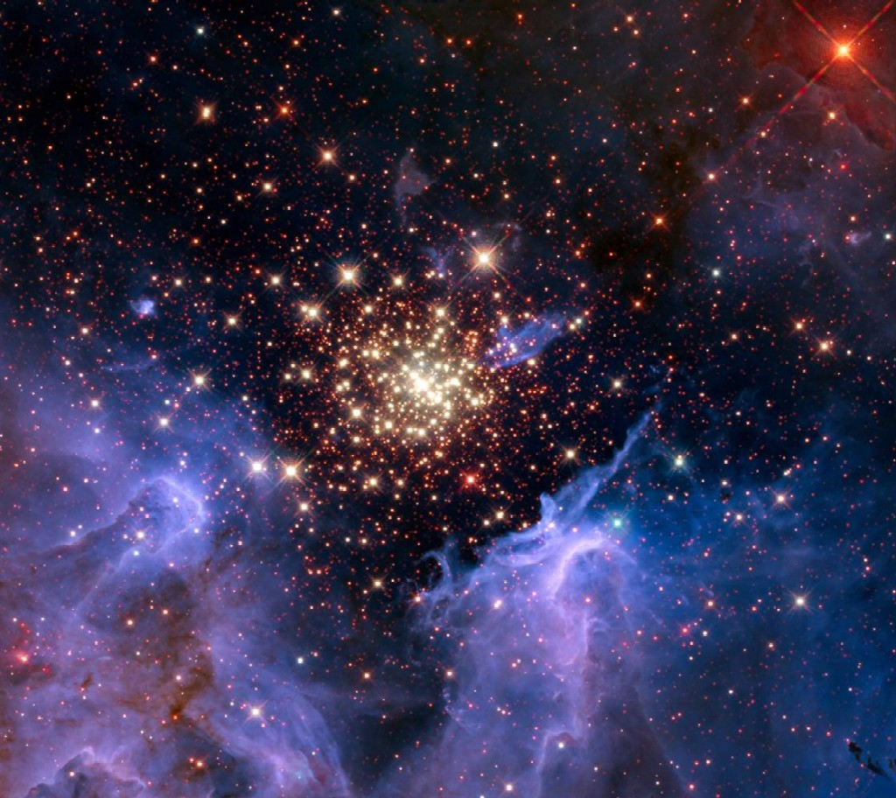
Understanding Star Clusters in the Era of Multi-dimensional Diagnostics
* November 8 (Tuesday) to 10, 2016 *
* National Central University *
Workshop Topics
Theoretical Paradigms of Formation and Evolution of Star Clusters
Survey Projects Relevant to Star Clusters
Stellar Populations
Metallicity, Angular Momentum, and Dynamical Diagnoses
Outstanding Problems in Star Cluster Research ---
the Milky Way and Beyond
Hands-on Sessions on Photometric, Spectroscopic, and Polarimetric Data Analysis (LAMOST, Pan-STARRS, PTF, etc.)
For information, please refer to
www.astro

